Slide 1
Washington DC
Metroplex
March 5, 2015 Implementation

Slide 2
Agenda
Washington DC Metroplex overview
Procedure details
Flight planning considerations
Flight crew expectations
Implementation day details
Questions and discussion

Slide 3
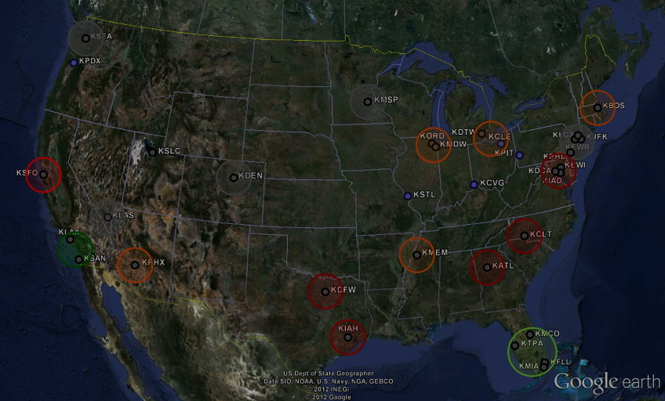
What is Metroplex?
Takes a systems approach to PBN initiatives and airspace design
Provides a geographic focus to problem solving
Delivers an expedited process for integrated airspace and procedures efforts
Uses collaborative teams
Uses an educated prioritization process
Enables predictable and repeatable flight paths
Reduces task complexity while maximizing safety and efficiency
3

Slide 4
DC Metroplex Overview
Design efforts include:
57 procedural designs
50 are RNAV STAR and SID designs
7 ATS routes and 13 airspace alterations
HITL and Flight Simulator Tested
Many of these procedures have been examined collaboratively through Human in the Loop (HITL) testing to verify ATC capabilities
The procedures were flown in industry flight simulators to determine speeds, descent profiles, and altitude restrictions
Simulations included headwind and tailwind data and varying temperatures to imitate the majority of flight conditions in this region
To date, 26 procedures have been implemented

Slide 5
March 5 Implementation
Part of a series of implementations to optimize airspace and procedures in the Washington DC Metroplex
DCA RNAV STARs: CAPSS1, DEALE1
IAD RNAV STARs: CAVLR1
BWI RNAV STARs: MIIDY1, RAVNN4
BWI STAR: RIPKN1
BWI RNAV SID: TERPZ4
ADW RNAV STARs: VUDOO1, SPISY1
Satellite RNAV STAR: TRSTN1
Airspace
BILIT, OJAAY, and BARIN STARs will be N/A

Slide 6
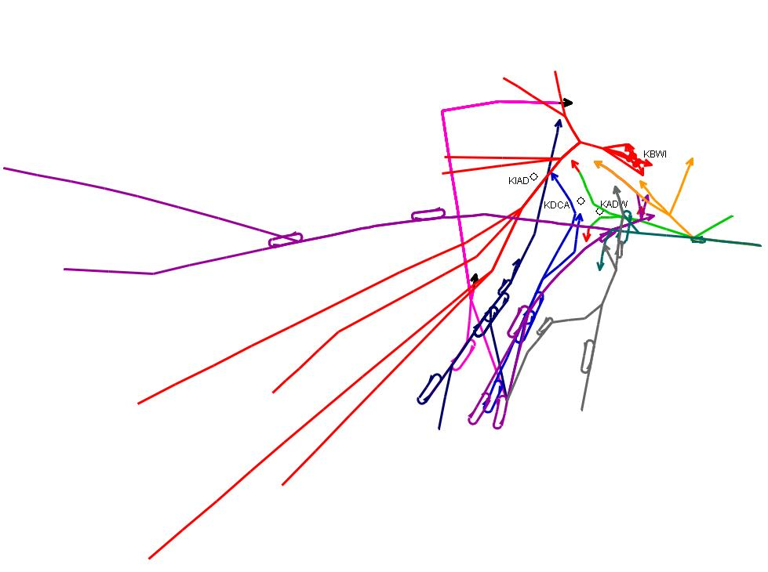
March 5 Procedures
TRSTN1 RNAV STAR
MIIDY1 RNAV STAR
SPISY1 RNAV STAR
DEALE1 RNAV STAR
VUDOO1 RNAV STAR
CAVLR1 RNAV STAR
TERPZ4 RNAV SID
RAVNN4 RNAV STAR
CAPSS1 RNAV STAR

Slide 7
Flight Planning Considerations and Flight Crew Expectations
DESCEND VIA RNAV STARS
CAPPS (DCA), CAVLR (IAD), RAVNN (BWI) RNAV STARs: Washington ARTCC (ZDC) will issue the descend via clearance and runway transition via a landing direction, Potomac TRACON (PCT) will issue the landing runway
ZDC: “Descend via the CAPSS ONE Arrival, landing south”
PCT: After initial contact, “Runway one nine”
DEALE, MIIDY, RNAV STARs: PCT will issue both the descend via clearance and runway transition
“Descend via the DEALE ONE Arrival, Runway 19”
RNAV STARS (not descend via)
VUDOO (ADW), SPISY (ADW), TRSTN (Satellite) RNAV STARS
RNAV SID
TERPZ4 (BWI)

Slide 8
DCA CAPSS1 RNAV STAR

Slide 9
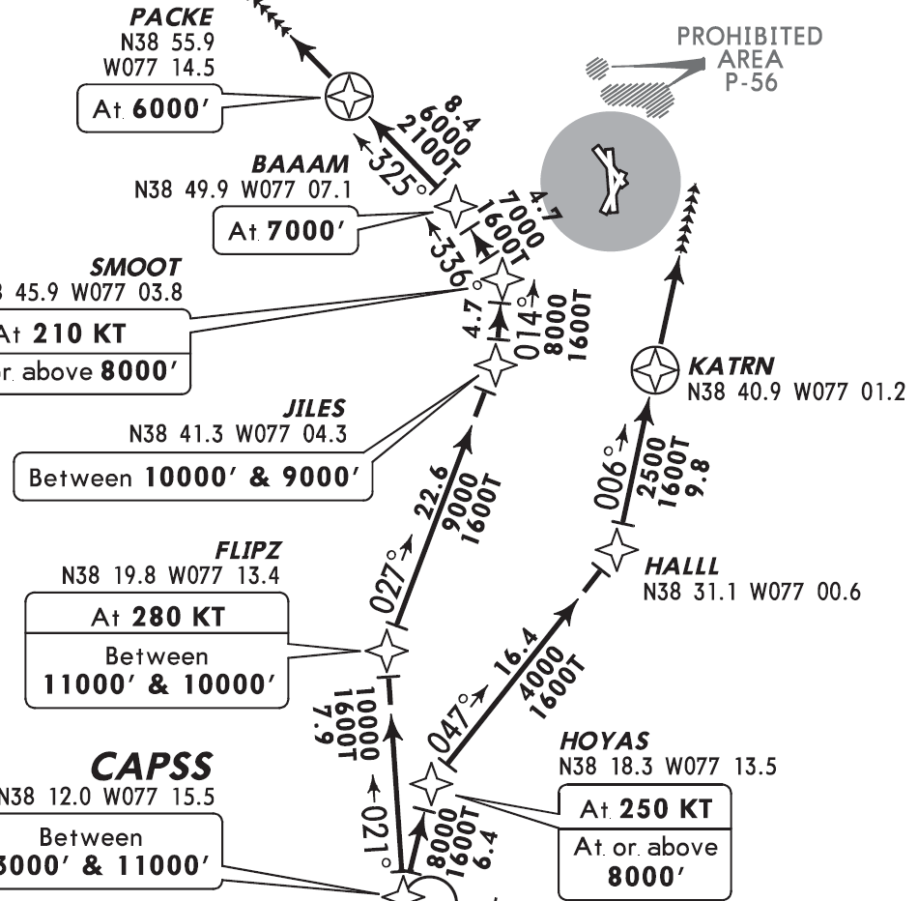
Landing Direction and Bottom Altitude
Bottom Altitude Landing South - 6000
Bottom Altitude Landing North - 8000

Slide 10
DCA DEALE1 RNAV STAR

Slide 11
IAD CAVLR1 RNAV STAR

Slide 12
BWI MIIDY1 RNAV STAR

Slide 13
BWI RAVNN4 RNAV STAR

Slide 14
BWI RIPKN1 STAR

Slide 15
BWI TERPZ4 RNAV SID

Slide 16
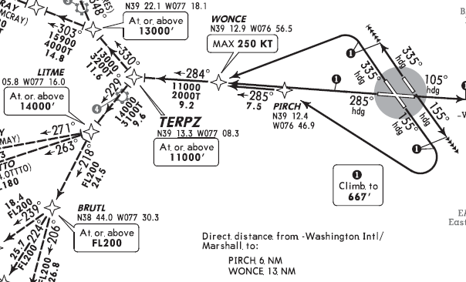
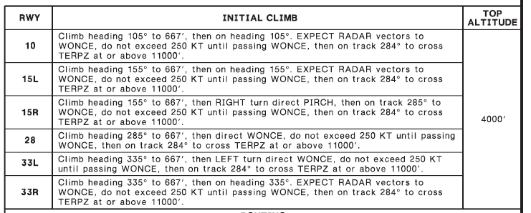
BWI TERPZ4 – Climb Via confusion
The Top Altitude is
4000, but there are
Higher published altitudes.
DO NOT climb higher
than 4000 until cleared
to do so!

Slide 17
ADW VUDOO1 RNAV STAR

Slide 18
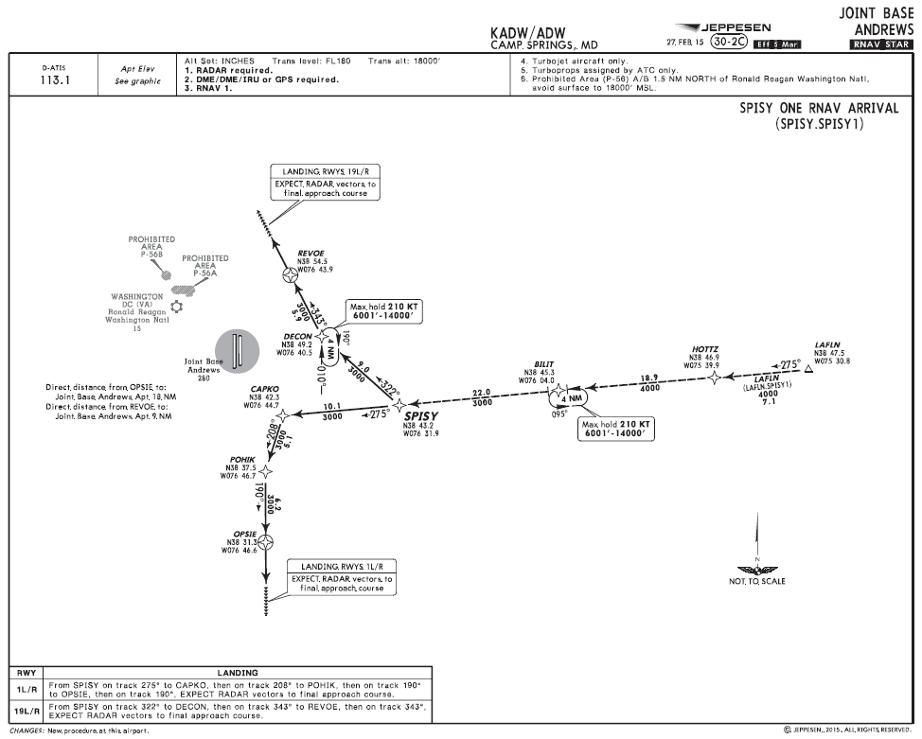
ADW SPISY1 RNAV STAR

Slide 19
TRSTN1 RNAV STAR

Slide 20
Traffic Management Initiatives (TMIs)
Traffic Management Initiatives (TMIs) are expected to be initiated on March 5th daily from 1200Z – 0300Z for up to 14 days after the procedures are implemented
TMIs will be planned and coordinated between ZDC and PCT and initiated dynamically, utilizing known demand volumes and initiatives for DCA, IAD, and BWI
Additional attention and emphasis will be placed on newness of Optimized Profile Descents (OPDs) for both Industry and ATC in an area not previously familiar with OPDs
Additional consideration will be given to fleet mix and relation to stacked OPDs into BWI and DCA from the south ZDC flow into PCT as well as new offset arrival to IAD and new offset arrival to ADW
Expanded TMIs are not anticipated for new MIIDY (BWI) and DEALE (DCA) east arrival RNAV procedures, nor are they anticipated for the BWI TERPZ departure procedure

Slide 21
Pilot Emphasis Items
Descend Via
If ATC previously assigned a speed to maintain, then later issues a descend via clearance, the previous speed restriction is cancelled and all published speeds are mandatory
Bottom Altitude
A descend via clearance is to the last “published” altitude on the “STAR” and is not a clearance to fly any altitudes on an instrument approach procedure until cleared for the approach, or visual approach
Initial Climb Via SID clearance
Do not climb above the published Top Altitude, even if there are higher altitude constraints, until receiving an ATC clearance to do so

Slide 22
Pilot Emphasis Items
Correct Phraseology
Correct phraseology is imperative
Read back a descend via clearance verbatim
Abbreviated or clipped phraseology is not acceptable
On initial contact with ATC on a descend via clearance, state
Aircraft/flight Identification
Current altitude
Descending Via
Name and number of STAR
Runway transition, if issued (Landing North/South, Runway 01/19)
ATIS

Slide 23
Flight Planning Considerations
Contingency plans are in place for aircraft that are unable to accept the new procedures
CAPSS1 – IRONS5 conventional arrival
DEALE1 – ATR.V308.BILIT.DCA
CAVLR1 – COATT4 conventional arrival
MIIDY1 – ATR.V308.BILIT.BWI
RAVNN4 – OTT6 conventional arrival
RIPKN1 – OTT6 conventional arrival
TERPZ4 – Radar vectors, PCT will coordinate heading with ZDC
VUDOO1 – V33.COLIN.ADW
SPISY1 – ATR.V308.BILIT.ADW
TRSTN1 – ROOKY @ 130 Radar Vectors

Slide 24
Implementation Day Details
Go Teams will be established at PCT and ZDC to address any implementation issues
Implementation telcons will be scheduled daily at 1000L and 1600L
Go Teams will remain in effect as needed; estimate is 4 days
Final Go Team members briefing will be held on March 3 to discuss roles and responsibilities
Teams will consist of Metroplex team members, subject matter experts, and industry
Industry reps – please coordinate with Tommy Nicholson (tnicholson@mitre.org) for inclusion on the Go Team

