Slide 1
Careers in
Business Aviation
Presenter name

Slide 2
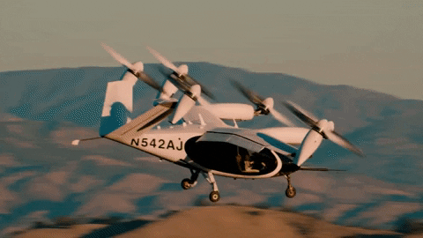
What is Business Aviation?
Business aviation is the use of any “general aviation” aircraft for a business purpose.
It is a business tool that:
Offers a competitive advantage to businesses all around the world
Involves many different types of aircraft
Is supported by a variety of people and jobs
Often considered “aviation’s best kept secret”
Notes:
If time allows, let students answer this question. If not, just jump into the definition.
Give students the opportunity to answer what they think Business Aviation is.
Transition into a definition of Business Aviation
Give some examples of companies
Have this be a mix of aviation specific companies and companies with aviation

Slide 3
Who is Business Aviation?
Companies that use business aviation are both large and small,
public and private.
Aviation can be the main focus of the company
Aviation can be a function of the company
Or a company can be somewhere in between
Notes:
Make sure to point out examples of both types and offer companies where pilot isn’t the main job (i.e. FBO or fuel sales)

Slide 4
Who is Business Aviation?
Types Business Aviation Operations - 14 CFR Federal Aviation Regulations
Part 91
Owner Operated Aircraft
Corporate Flight Departments
Example: Walmart, Nike, Lowes, etc.
Part 125
Corporate Shuttles
Large aircraft
20+ Passengers or payload of 6,000lbs+
Example: Sports Teams
Part 135
Private Charter
On demand commercial flights
Certificated by the FAA

Slide 5
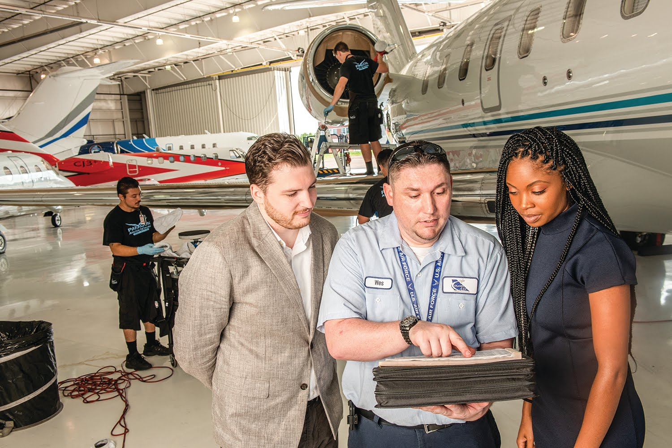
Why Business Aviation?
Wide variety of roles and organization types
Career Advancement Opportunities
Incredible Community
Growing Industry
Work-Life Balance
Notes:
Career Advancement - Focus on Professional Development in many companies to make you better

Slide 6
Why Business Aviation?
Cutting Edge Technology
AAM - eVTOL
Travel Opportunities
Flexible Schedules
Unique Operations
Competitive Pay

Slide 7
Careers in Business Aviation
Competitive Compensation
Captain: $177,000-$181,000
Copilot: $109,000-$129,000
Flight Attendant: $116,000 - $128,000
A&P Maintenance Technician: $92,000 -108,000
Flight Coordinator/Scheduler: $78,000 - $85,000
Line Service Personnel: $48,000 - $57,000
*Stats based on Average Total Compensation under 5 years in position from 2023 NBAA Compensation Survey

Slide 8
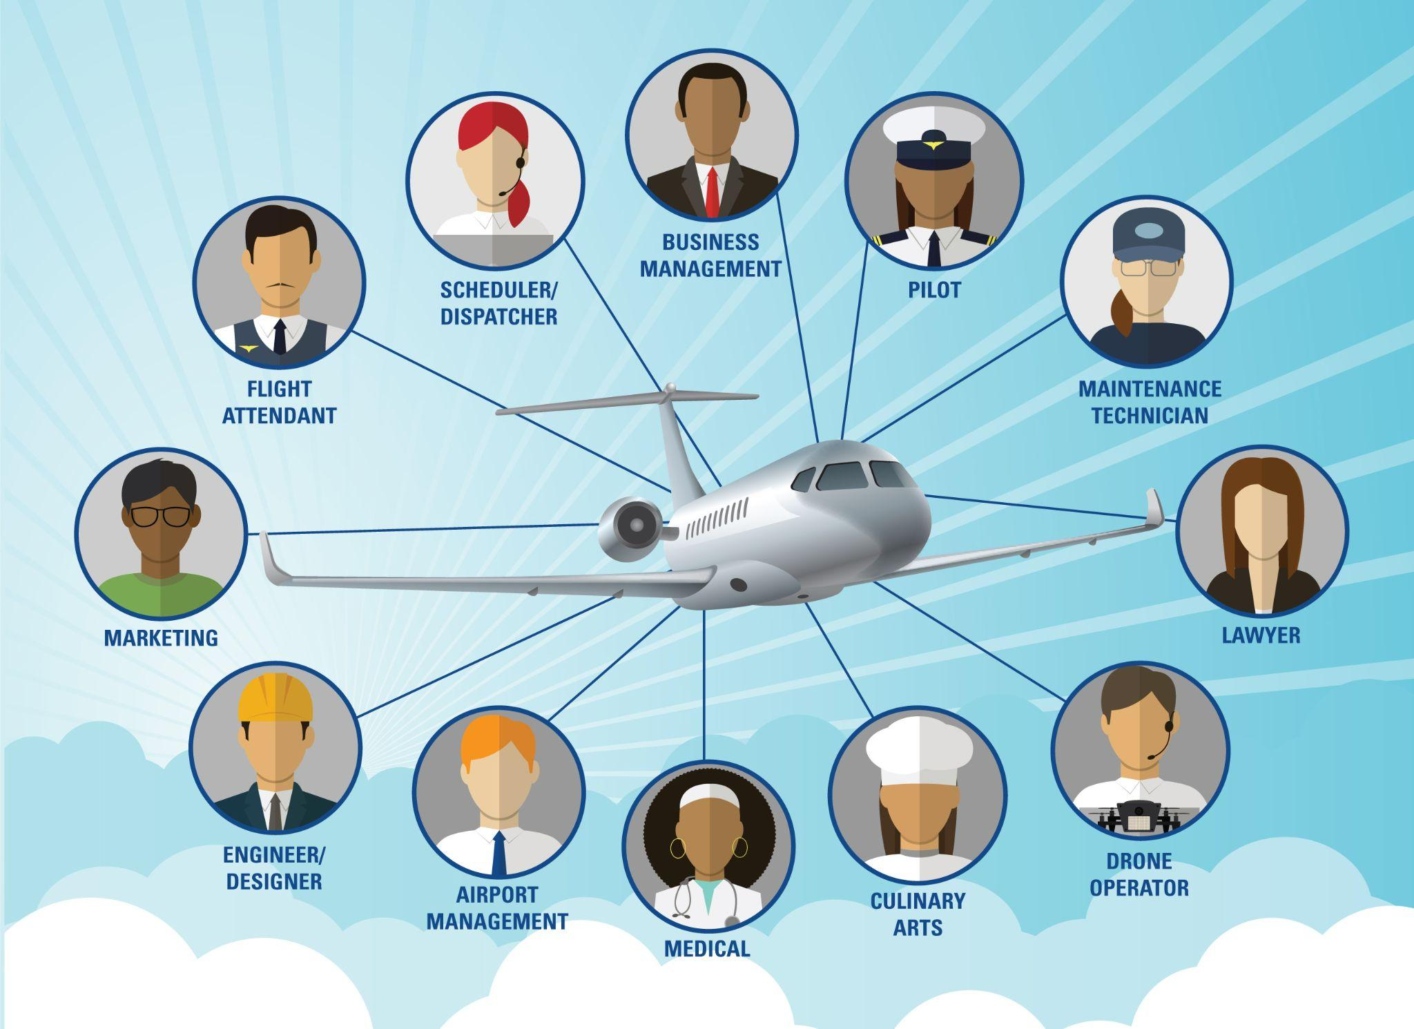
Careers in Business Aviation
Something for Everyone
BizAv employs more than 1.2 million people in the US.
Opportunities Everywhere
Business Aviation reaches 10x the number of US airports compared to airlines

Slide 9
Careers in Business Aviation
Common Careers
Pilots
Aircraft Mechanics
Schedulers
Dispatchers
Airport Operations
FBO Management
Flight Attendants
Aircraft Sales/Broker
Air Traffic Control
Aviation Lawyer
Charter Sales
Aircraft Management
Flight Department Management
Customer Service
Marketing
Business Development
Accountants
Nurses
Engineers
Culinary
Drone Pilot
Government Affairs
Education
Administration
Graphic Design
Interior Design
Journalist/Media
Notes:
ATC

Slide 10
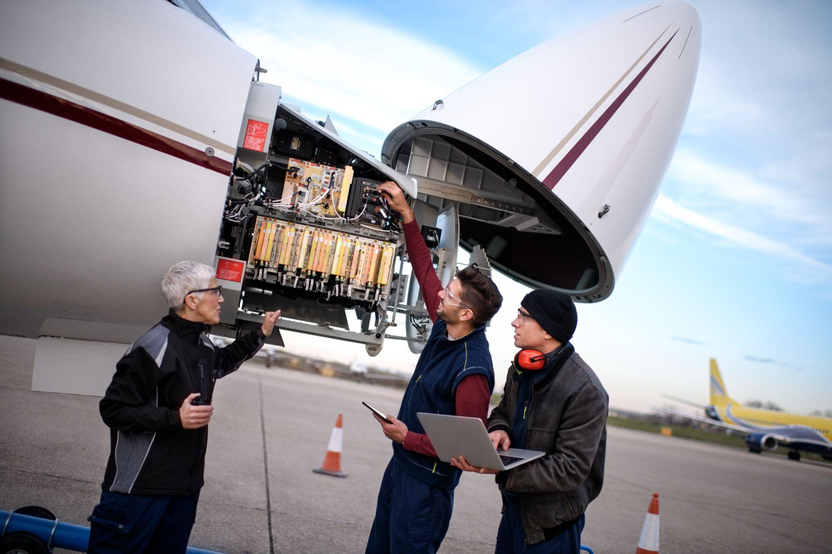
Education/Training Requirements
Look into what type of job you might want and see what common requirements are.
2-year degree? 4-year college? Trade school? High school diploma?
Do you need specific training/certifications?
Common for pilots, flight attendants, dispatchers and mechanics
Do your research
Talk to someone in your field
Find somebody that knows something that you don’t

Slide 11
Careers in Business Aviation
Community Connections
Business Aviation is a tight-knit community
Humanitarian Efforts
Helpy Day at events
Network receptions
Happy hours
Committee and Council opportunities
Friends!
Notes:
Idk if this is necessary.

Slide 12
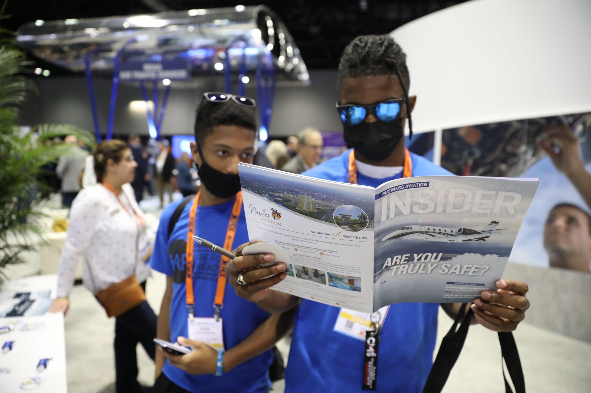
Get Involved: NBAA Student Memberships
Access to Resources: NBAA.org/students
NBAA Scholarships
NBAA Member Directory
NBAA Job Board
NBAA YoPros & YoProGo
Mentorship Network
Regional Groups
Notes:
If you are short on time, use this slide to cover all benefits. If you have more time, use this slide to introduce ways to get involved in Business Aviation through NBAA Student Memberships

Slide 13
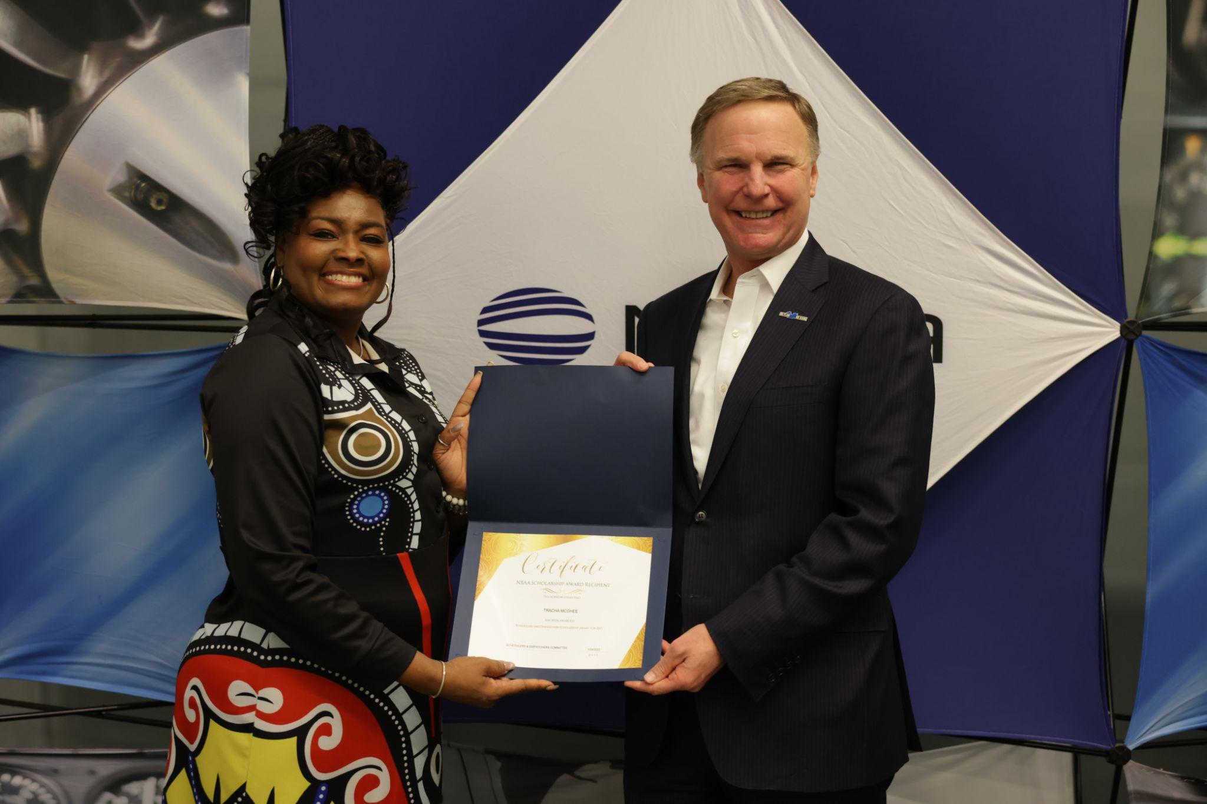
Get Involved: Scholarships
NBAA offers nearly $100,000 annually in tuition reimbursement for enrolled students
NBAA.org/scholarships
UAA offers scholarships year round.
https://www.uaa.aero
Notes:
Currently Open: Steve Brown Leadership Scholarship
More opening in the summer.

Slide 14
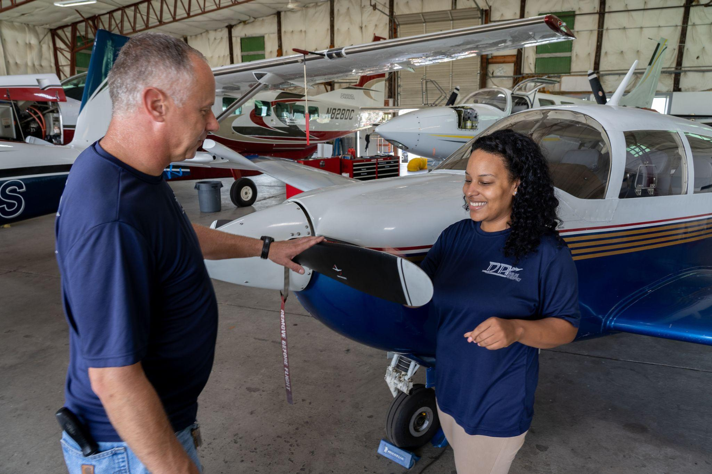
Get Involved: Internships
Internships
NBAA
Charter Companies
Manufacturers
Airport Operations
and more.
NBAA Job Board
NBAA Member Directory
Notes:
Gain Experience, Get a foot in the door, Explore a new sector of aviation
NBAA Job Board is a great place to find internships
Use the NBAA Member Directory to search for contacts at companies that you might want to work for or intern with

Slide 15
Get Involved: NBAA YoPros
Young Professionals (YoPros)
Top 40u40
Networking events
Virtual Happy Hours
Conference Happy Hours
YoProGo
Notes:
YoPro Go
Meetings every other month
Connect with Young Professionals all over the world
Help out with events in your area

Slide 16
Get Involved: NBAA Mentoring Network
Network of professionals who want to help develop, support, and grow the industry.
Find someone who does what you want to do or something you are interested in learning more about.
Open enrollment, anytime at NBAA.org/Mentor
Notes:
Student Member Benefits
Subscription to Business Aviation Insider
Access to the NBAA Member Directory
Great place to search for companies to look for
Access to the NBAA Mentorship Network
Look for local companies that offer internship or apprenticeship opportunities. Try to have a few different options of types of internships/apprenticeships
Also if there are any local Regional groups with opportunities for students, this is great time to mention those.

Slide 17
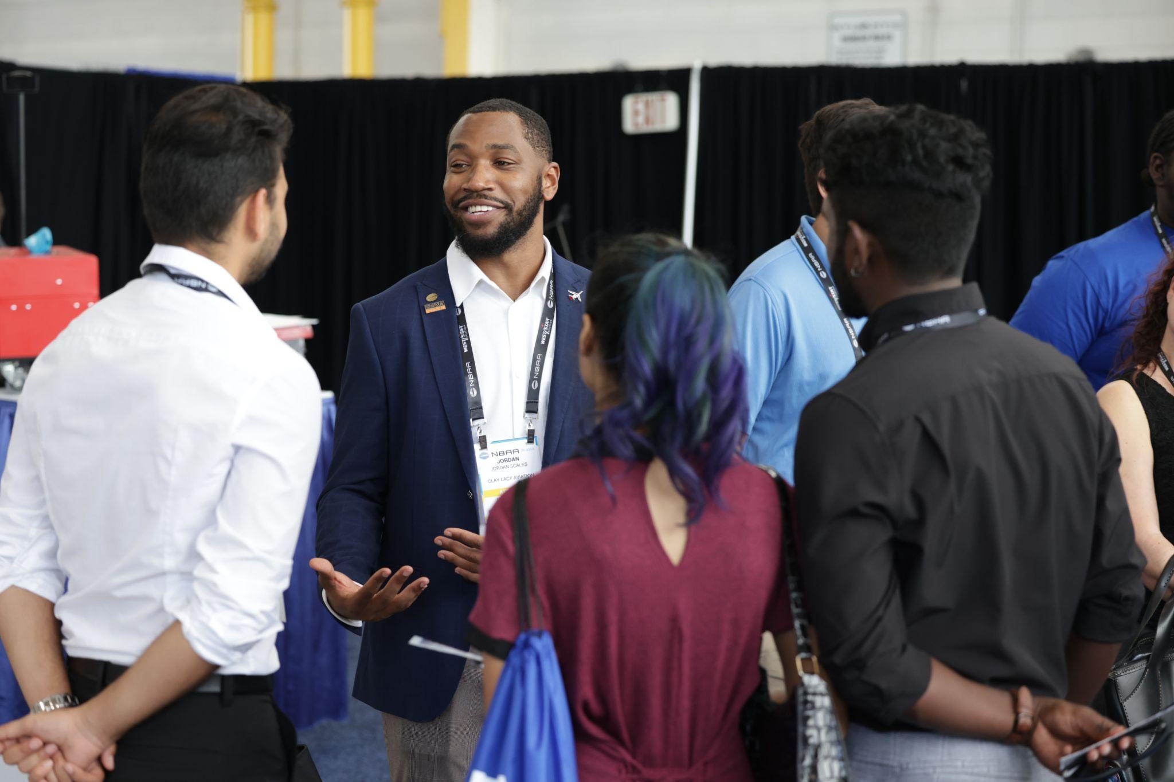
NBAA-BACE (Business Aviation Convention & Exhibition)
October 17-19 | Las Vegas, NV
Thursday (Oct. 19) is Collegiate Connect, which is free for students!
Get Involved: Near Future Networking Opportunities
Notes:
Fill in the blank for upcoming events. If there are any events by local/regional groups coming up, list those as well!
2023 Events
NBAA Schedulers & Dispatchers Conference
January 24-26 | Nashville, TN
Miami-Opa Locka Regional Forum
February 8 | Opa-locka, FL
International Operators Conference
February 13-15 | Austin, TX
Leadership Conference
February 27-March 1 | Charlotte, NC
Maintenance Conference
May 2-4 | Hartford, CT
White Plains Regional Forum
June 14 | White Plains, NY
NBAA-BACE (Collegiate Connect is free for students!)
October 17-19 | Las Vegas, NV

Slide 18
Get Involved: Regional Groups
[Optional Slide - if you have an active regional group add the info here]
Notes:
If you have an active regional group this would be a great place to include. Additionally, information about regional directors and how they can help.

Slide 19
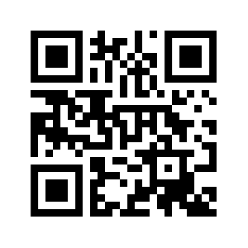
Questions?
Resources:
Presenter
Contact Information
Regional Representative
Contact Information
Visit NBAA.org/Students or scan QR code for more resources and to get involved!
Notes:
NBAA.org/Students (QR code)
Contact Info of presenter
Regional Rep Contact Information

