Slide 1
Northeast Corridor Atlantic Coast Routes (NEC ACR) July 16, 2020 J-Route Deletions and Amendments

Slide 2
Meeting Purpose and Overview
Purpose
To Provide Details on the NEC ACR J-Route Deletions and Amendments on 7/16/2020
Overview
18 J-Routes to be cancelled or amended effective 7/16/2020
10 J-Routes to be amended (shortened)
8 J-Routes to be entirely cancelled
Preferred IFR Routes, Coded Departure Routes, and Playbooks will be updated on 7/16/2020 to reflect these cancellations/amendments
Advance copy of routes to be provided mid-June
J75 and J575 NOTAM’d NA (Not Authorized) will auto-cancel on 7/16/2020, concurrent with deletions

Slide 3
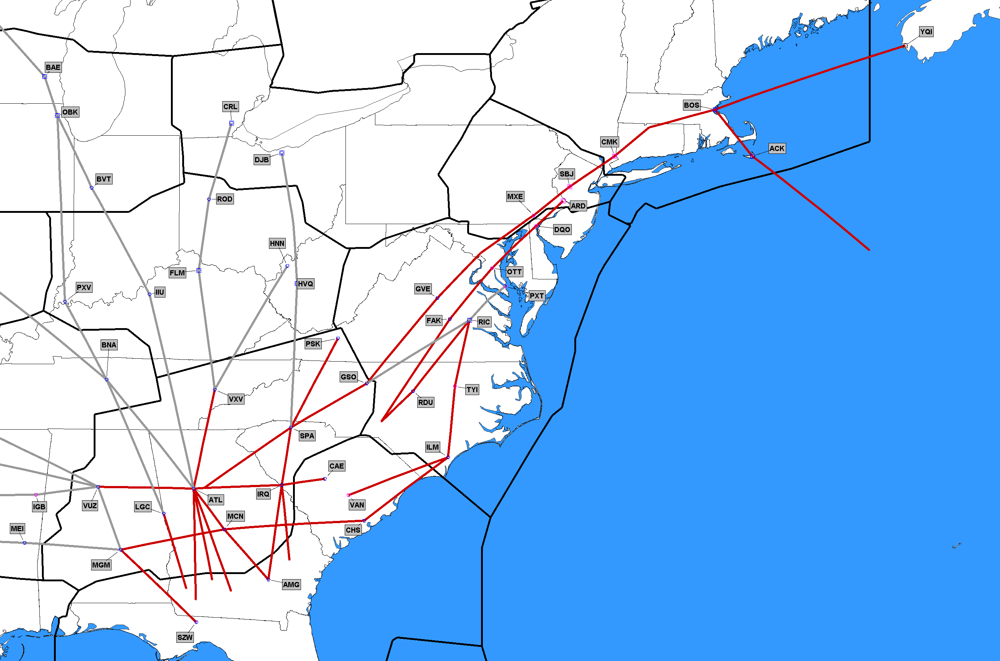
7/16/2020 NEXT STEP - Delete/Amend 18 J-Routes
Amend 10 J-Routes
J14, J20, J41, J43, J45, J52, J73, J85, J89, J91
Delete 8 J-Routes
J40, J51, J53, J75,
J81, J97, J210, J575
5 ARTCCs
ZJX
ZTL
ZDC
ZNY
ZBW
Red Routes/Segments Being Deleted

Slide 4
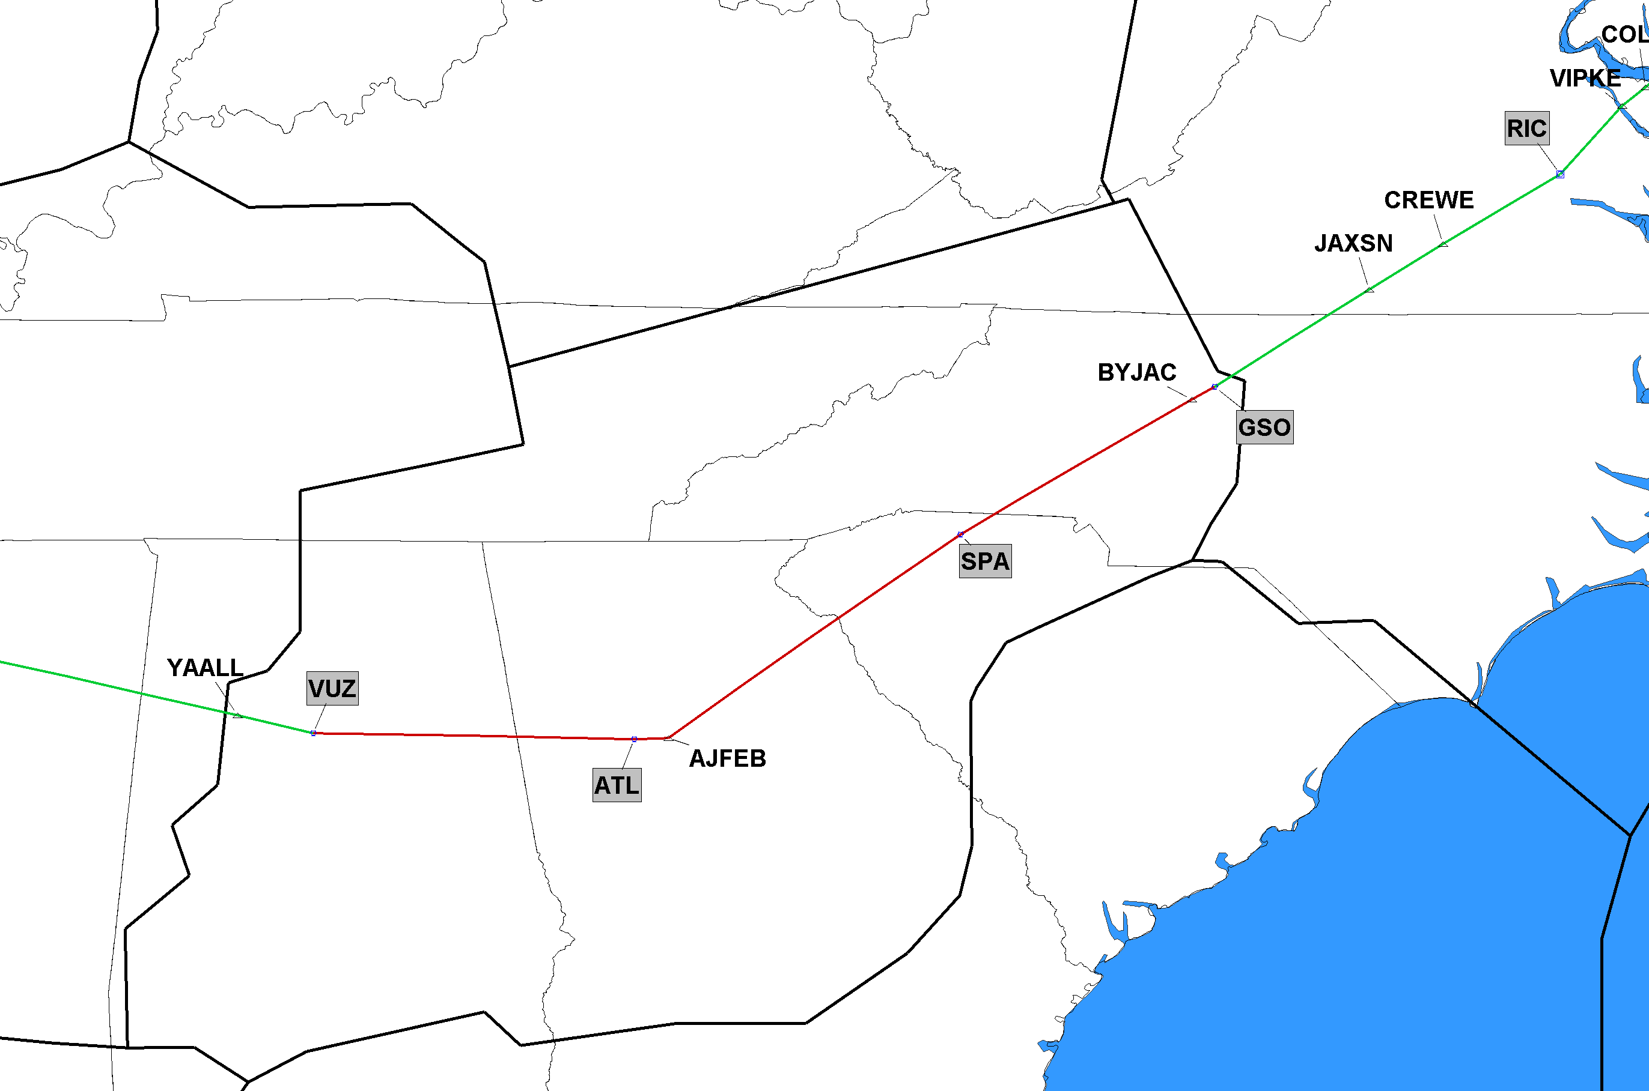
7/16/2020 J14 Cancel Segment J14 Vulcan (VUZ), AL to Greensboro (GSO), NC
SAMPLE DETAILED SLIDE
ADDITIONAL SLIDES AT THE END OF THIS PRESENTATION
ZTL
Red Segment Being Deleted
Click to Return to Index

Slide 5
What You Can Do
Transition to updated Preferred IFR Routes on 7/16/2020
Use published preferred IFR (“green book”) routes to the extent possible
Share this briefing with others
Share inside your organization, with subsidiaries & Express carriers
Provide feedback and suggestions
Help identify issues/mitigations
Utilize the Virtual Go-Team on Thursday 7/16/2020
Open conference bridge staffed by subject matter experts available to address any ATC or operator issues
Open conference bridge (0600-1600 EDT)
888-924-3230 (direct 609-916-1975); Passcode: 817568

Slide 6
What We Are Doing, Why, When
NEC ACR is one of the biggest changes to the National Airspace System (NAS) in decades
What: 39 new/amended Q Routes and Y Routes will replace the north-south high-altitude route structure along the east coast of the United States
Why: Transition to a PBN-Centric NAS thus decreasing reliance on ground-based NAVAIDs
When: Changes being implemented on 10 separate chart dates over a 15-month timeframe 10/10/2019-12/31/2020
Main implementation to occur 11/5/2020

Slide 7
Implementation Milestones
10/10/2019 Publish/Implement 1 New Y-Route and 8 Waypoints
11/7/2019 Implement ZDC Low Altitude Sector Changes
12/5/2019 NOTAM NA 33 J-Routes/Q-Routes (FL Metroplex) for 56 days
1/30/2020 Delete/Amend 33 J-Routes/Q-Route (FL Metroplex), Cancel N/A NOTAM
1/30/2020 Delete 5 CHS STARs
3/26/2020 Delete/Amend 6 SIDs (BWI/IAD/DCA/HEF/ADW)
5/21/2020 Amend 2 Q-Routes: Q75, Q475
5/21/2020 Amend 1 SID (DOV)
7/16/2020 Delete/Amend 18 J-Routes
9/10/2020 Publish/Amend 32 Q-Routes, 4 Y-Routes, NOTAM N/A for 56 days
9/10/2020 Amend 1 SID (ATL)
10/8/2020 Implement ZDC Ultra High Sector 30 and 3 minor airspace changes
11/5/2020 Implement 32 Q-Routes, 4 Y-Routes, Cancel N/A NOTAM
11/5/2020 Publish/Delete/Amend 14 STARs (PHL/EWR/TEB/LGA/DOV/WRI)
11/5/2020 Publish/Delete/Amend 29 SIDs/STARs/SIAPs (CHS/JZI/RDU)
11/5/2020 Delete/Amend 31 J-Routes, 1 Q-Route, Cancel N/A NOTAM
12/31/2020 Delete 2 STARs (LGA/EWR)

Slide 8
FAA Points of Contact
Paul Withers, FAA Management Co-Lead
paul.m.withers@faa.gov
904-710-5939
Joey Tinsley, NATCA Co-Lead
joseph.b.tinsley@faa.gov
770-363-1718
More information to be provided in future briefings

Slide 9
Detailed Slides

Slide 10
7/16/2020 J14 Cancel Segment J14 Vulcan (VUZ), AL to Greensboro (GSO), NC
ZTL
Red Segment Being Deleted
Click to Return to Index

Slide 11
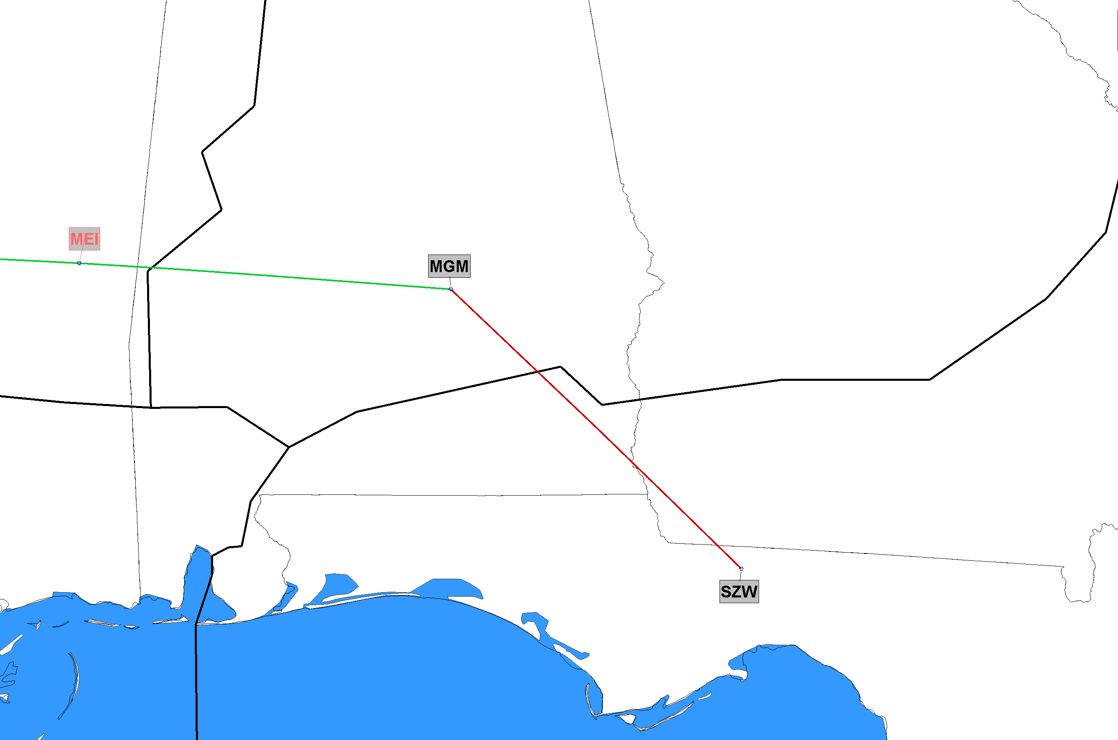
7/16/2020 J20 Cancel Segment J20 Montgomery (MGM), AL to Seminole (SZW), FL
ZTL
ZJX
Red Segment Being Deleted
Click to Return to Index

Slide 12
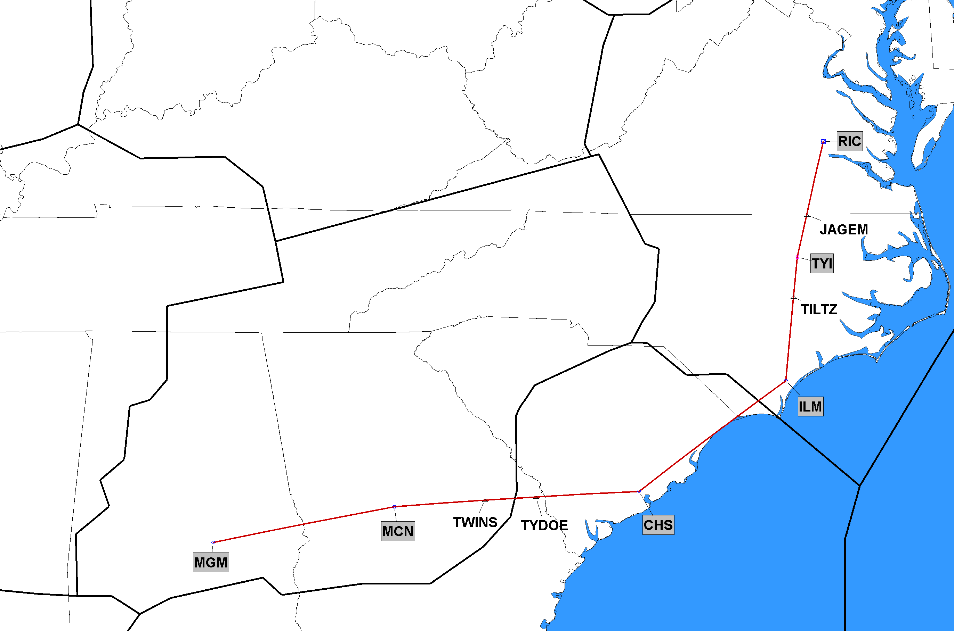
7/16/2020 J40 Completely Deleted J40 Montgomery (MGM), AL to Richmond (RIC), VA
ZDC
ZTL
ZJX
J-Route Deleted in its Entirety
Click to Return to Index

Slide 13
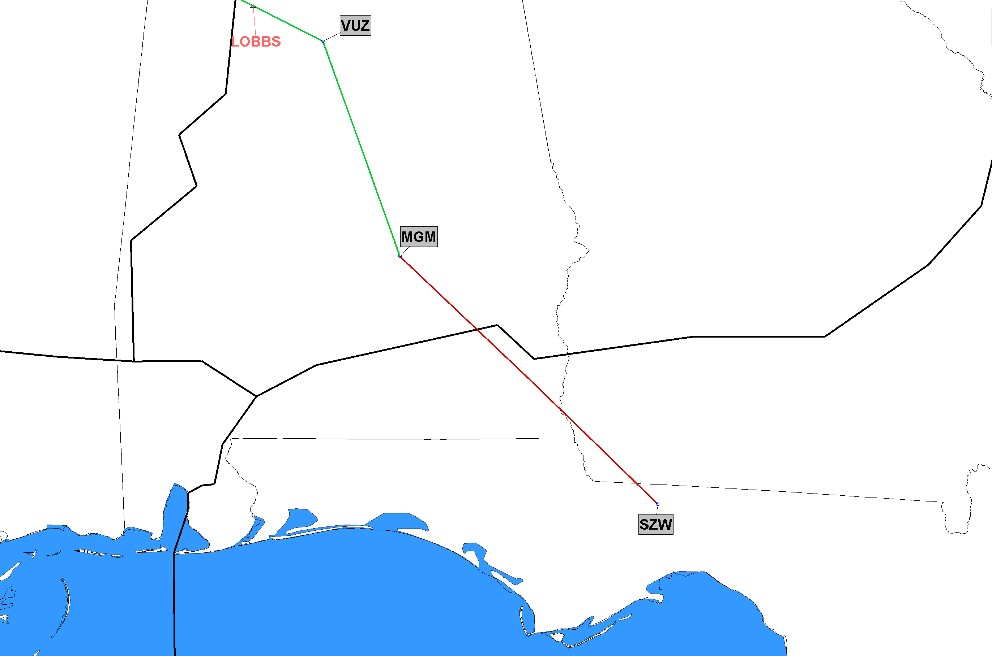
7/16/2020 J41 Cancel Segment J41 Montgomery (MGM), AL to Seminole (SZW), FL
ZTL
ZJX
Red Segment Being Deleted
Click to Return to Index

Slide 14
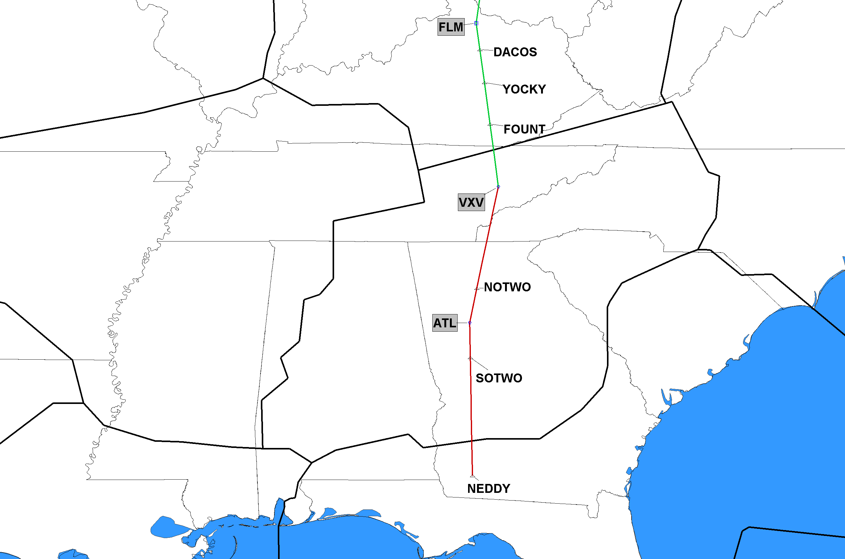
7/16/2020 J43 Cancel Segment J43 NEDDY, FL to Volunteer (VXV), TN
ZTL
ZJX
Red Segment Being Deleted
Click to Return to Index

Slide 15
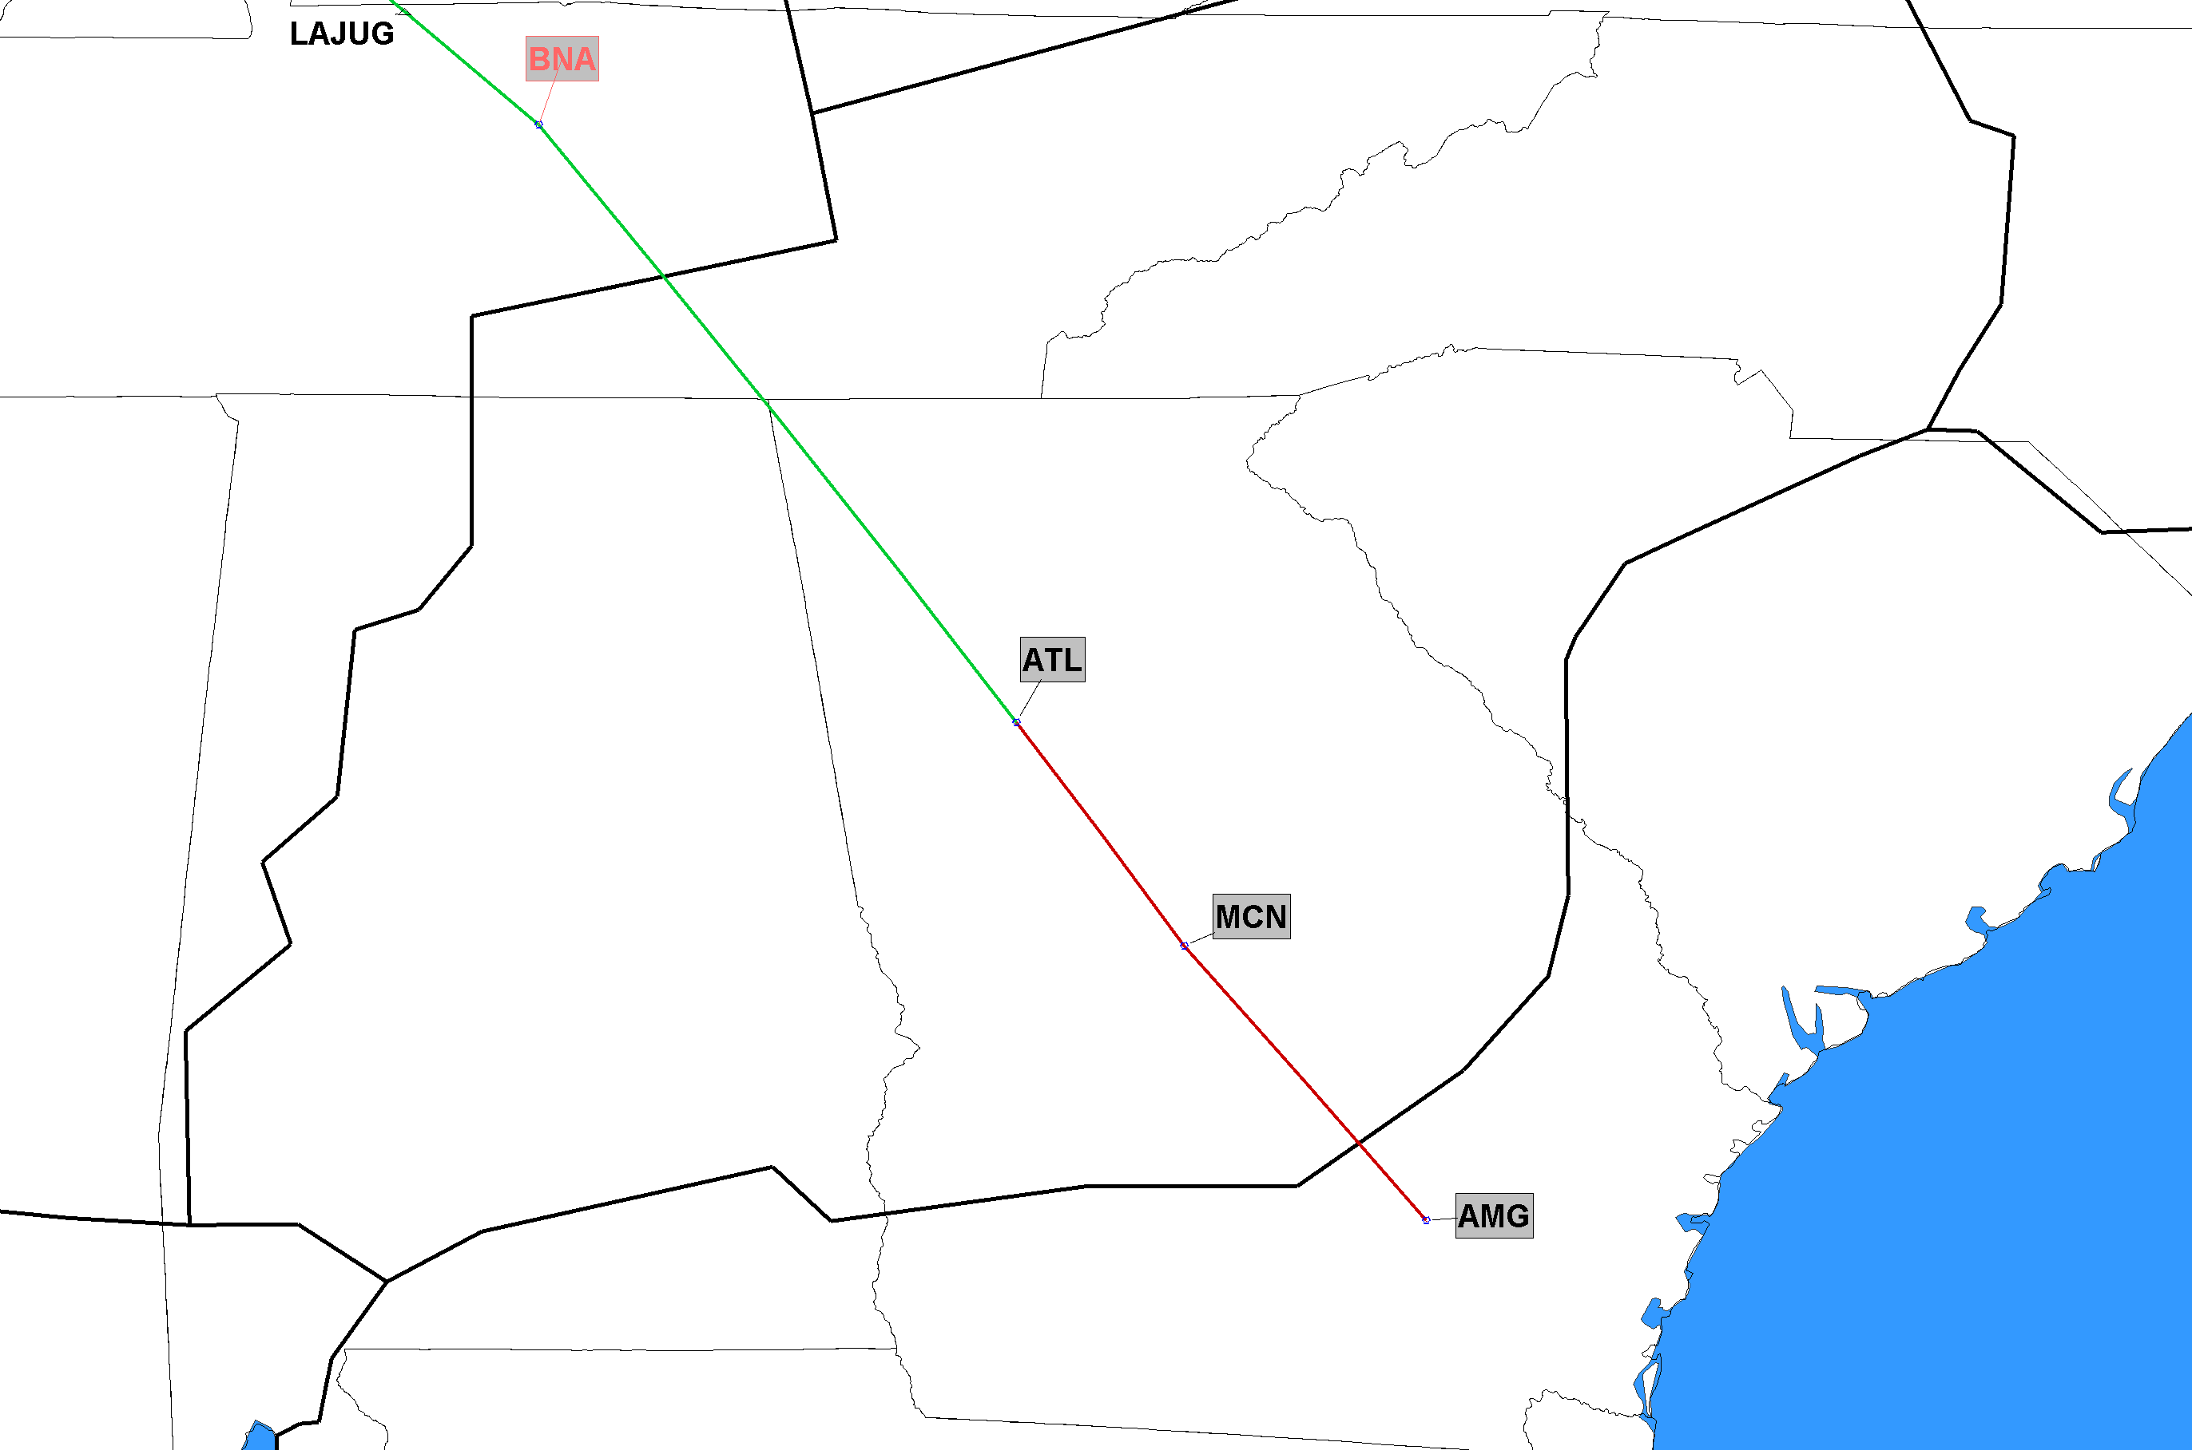
7/16/2020 J45 Cancel Segment J45 Alma (AMG), GA to Atlanta (ATL), GA
ZTL
ZJX
Red Segment Being Deleted
Click to Return to Index

Slide 16
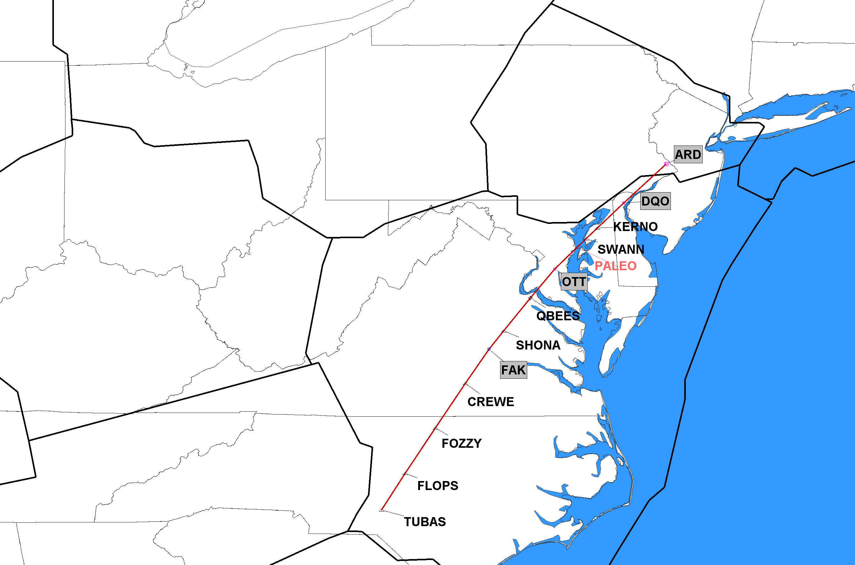
7/16/2020 J51 Completely Deleted J51 TUBAS, NC to Yardley (ARD), NJ
ZNY
ZDC
J-Route Deleted in its Entirety
Click to Return to Index

Slide 17
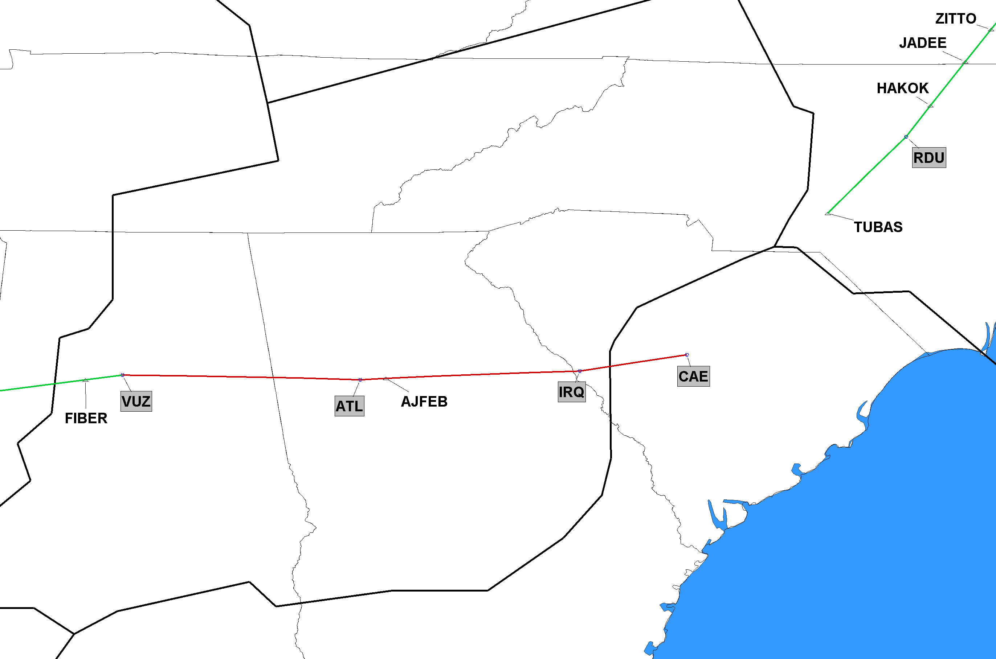
7/16/2020 J52 Cancel Segment J52 Vulcan (VUZ), AL to Columbia (CAE), SC
ZTL
ZJX
Red Segment Being Deleted
Click to Return to Index

Slide 18
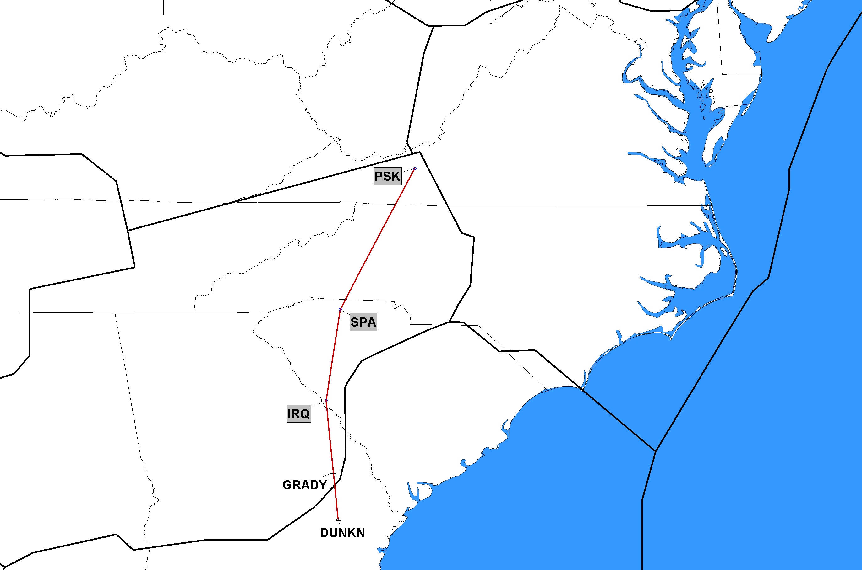
7/16/2020 J53 Completely Deleted J53 DUNKN, GA to Pulaski (PSK), VA
ZTL
ZJX
J-Route Deleted in its Entirety
Click to Return to Index

Slide 19
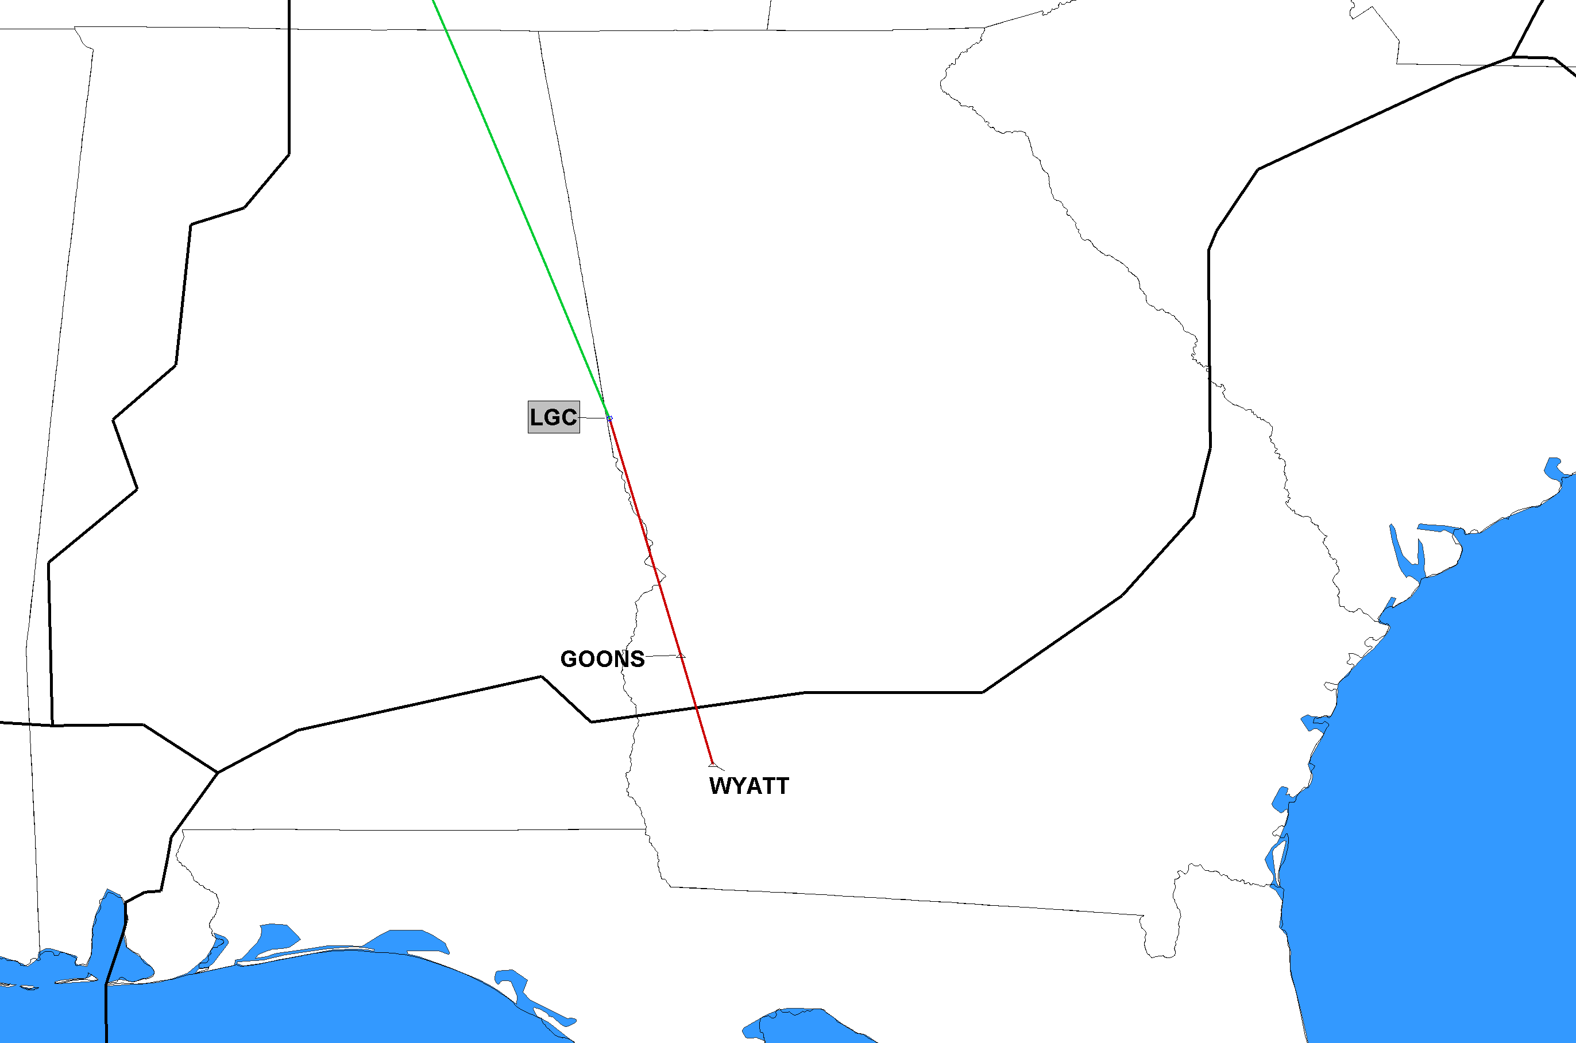
7/16/2020 J73 Cancel Segment J73 WYATT, GA to La Grange (LGC), GA
ZTL
ZJX
Red Segment Being Deleted
Click to Return to Index

Slide 20
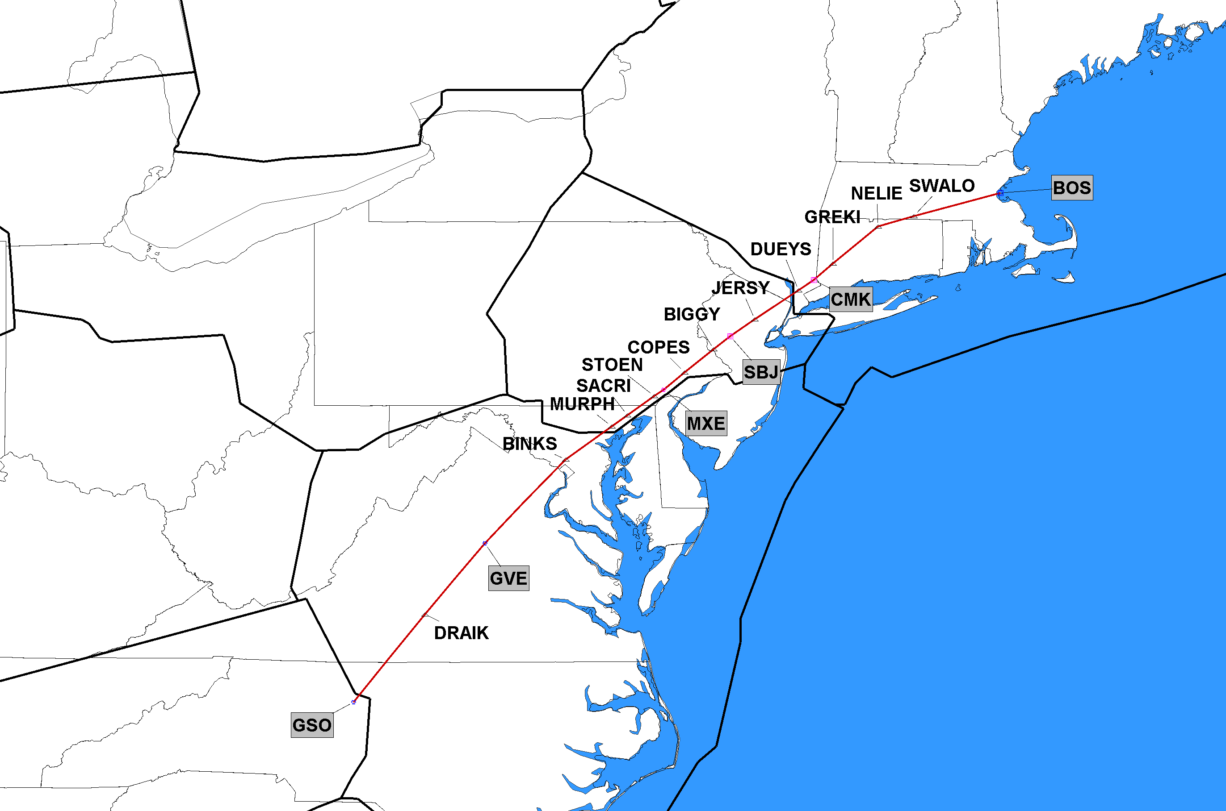
7/16/2020 J75 Completely Deleted J75 Greensboro (GSO), NC to Boston (BOS), MA
ZBW
ZNY
ZTL
ZDC
J-Route Deleted in its Entirety
Click to Return to Index

Slide 21
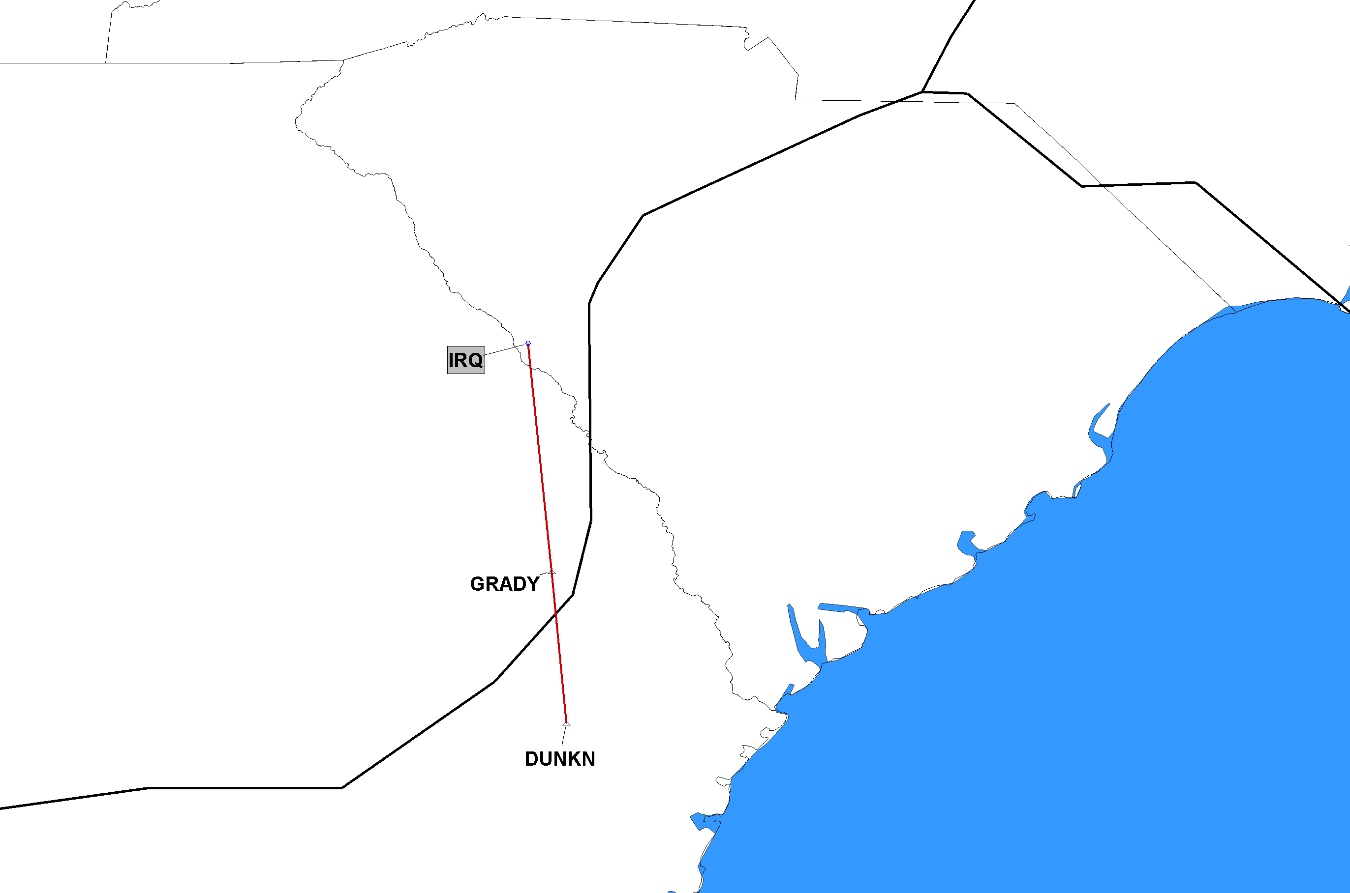
7/16/2020 J81 Completely Deleted J81 DUNKN, GA to Colliers (IRQ), SC
ZTL
ZJX
J-Route Deleted in its Entirety
Click to Return to Index

Slide 22
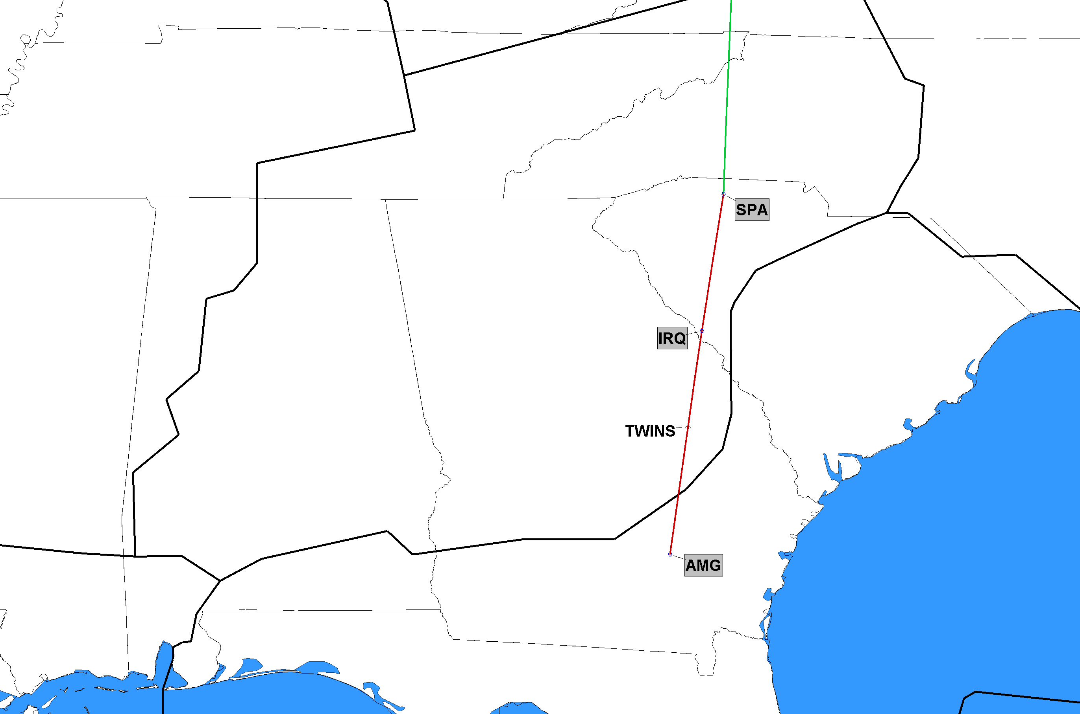
7/16/2020 J85 Cancel Segment J85 Alma (AMG), GA to Spartanburg (SPA), SC
ZTL
ZJX
Red Segment Being Deleted
Click to Return to Index

Slide 23
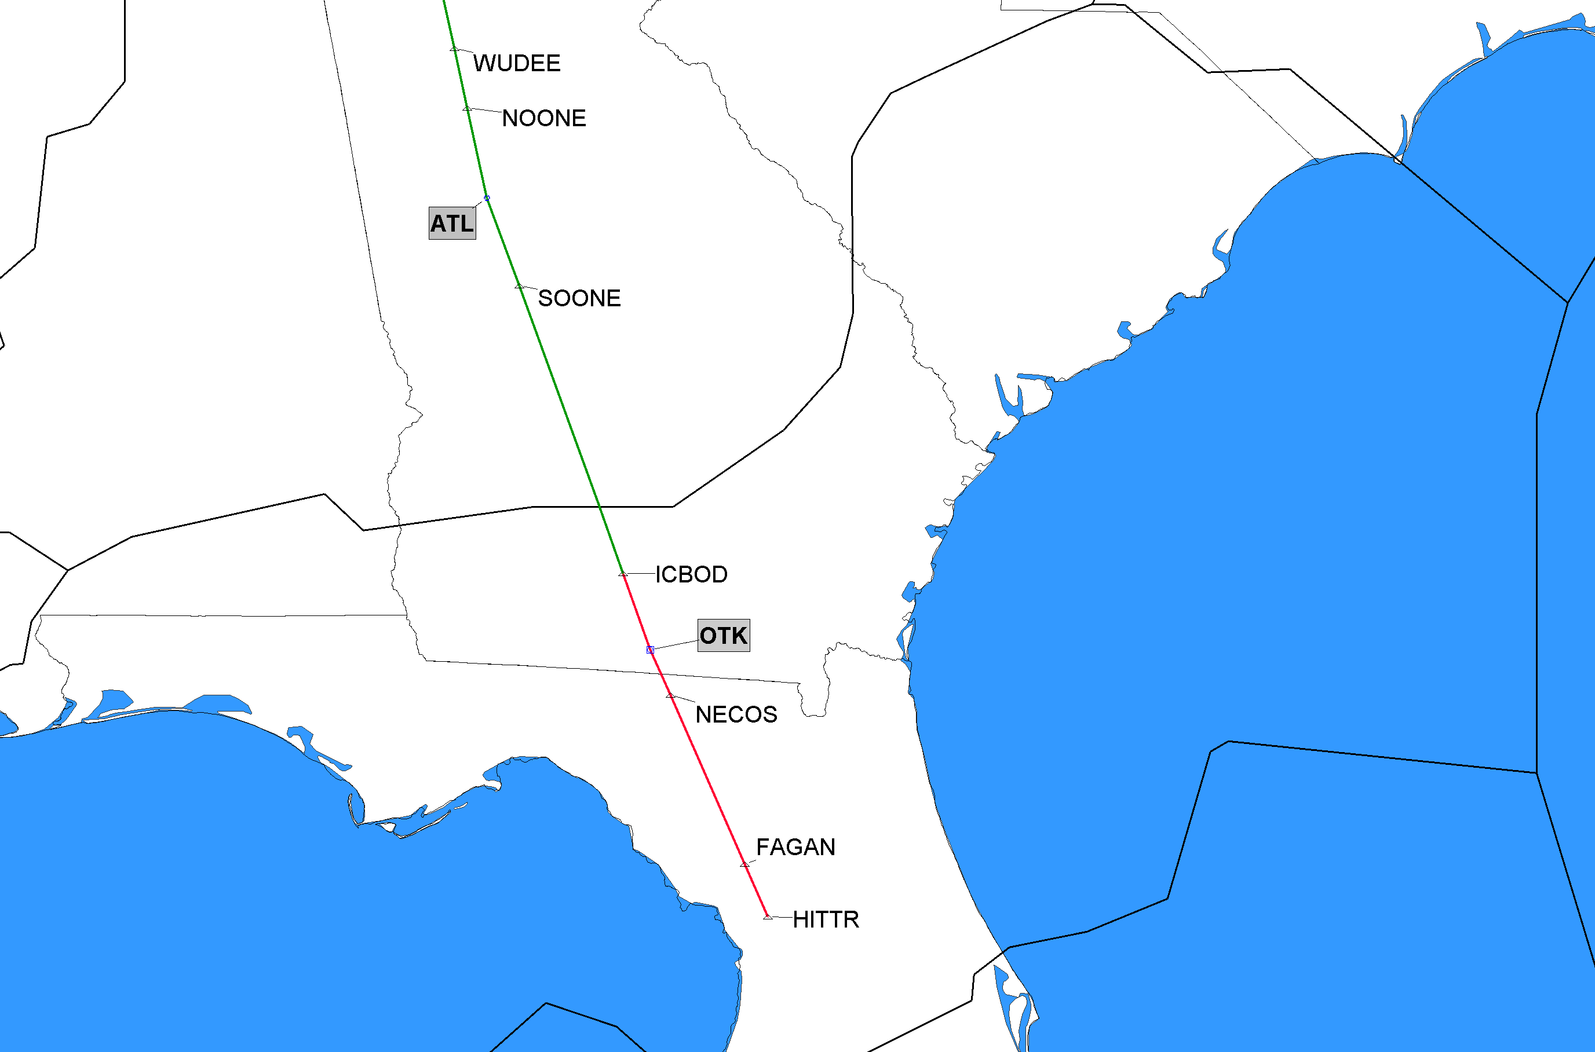
7/16/2020 J89 Cancel Segment J89 ICBOD, GA to Atlanta (ATL), GA
ZTL
ZJX
Red Segment Being Deleted
Click to Return to Index

Slide 24
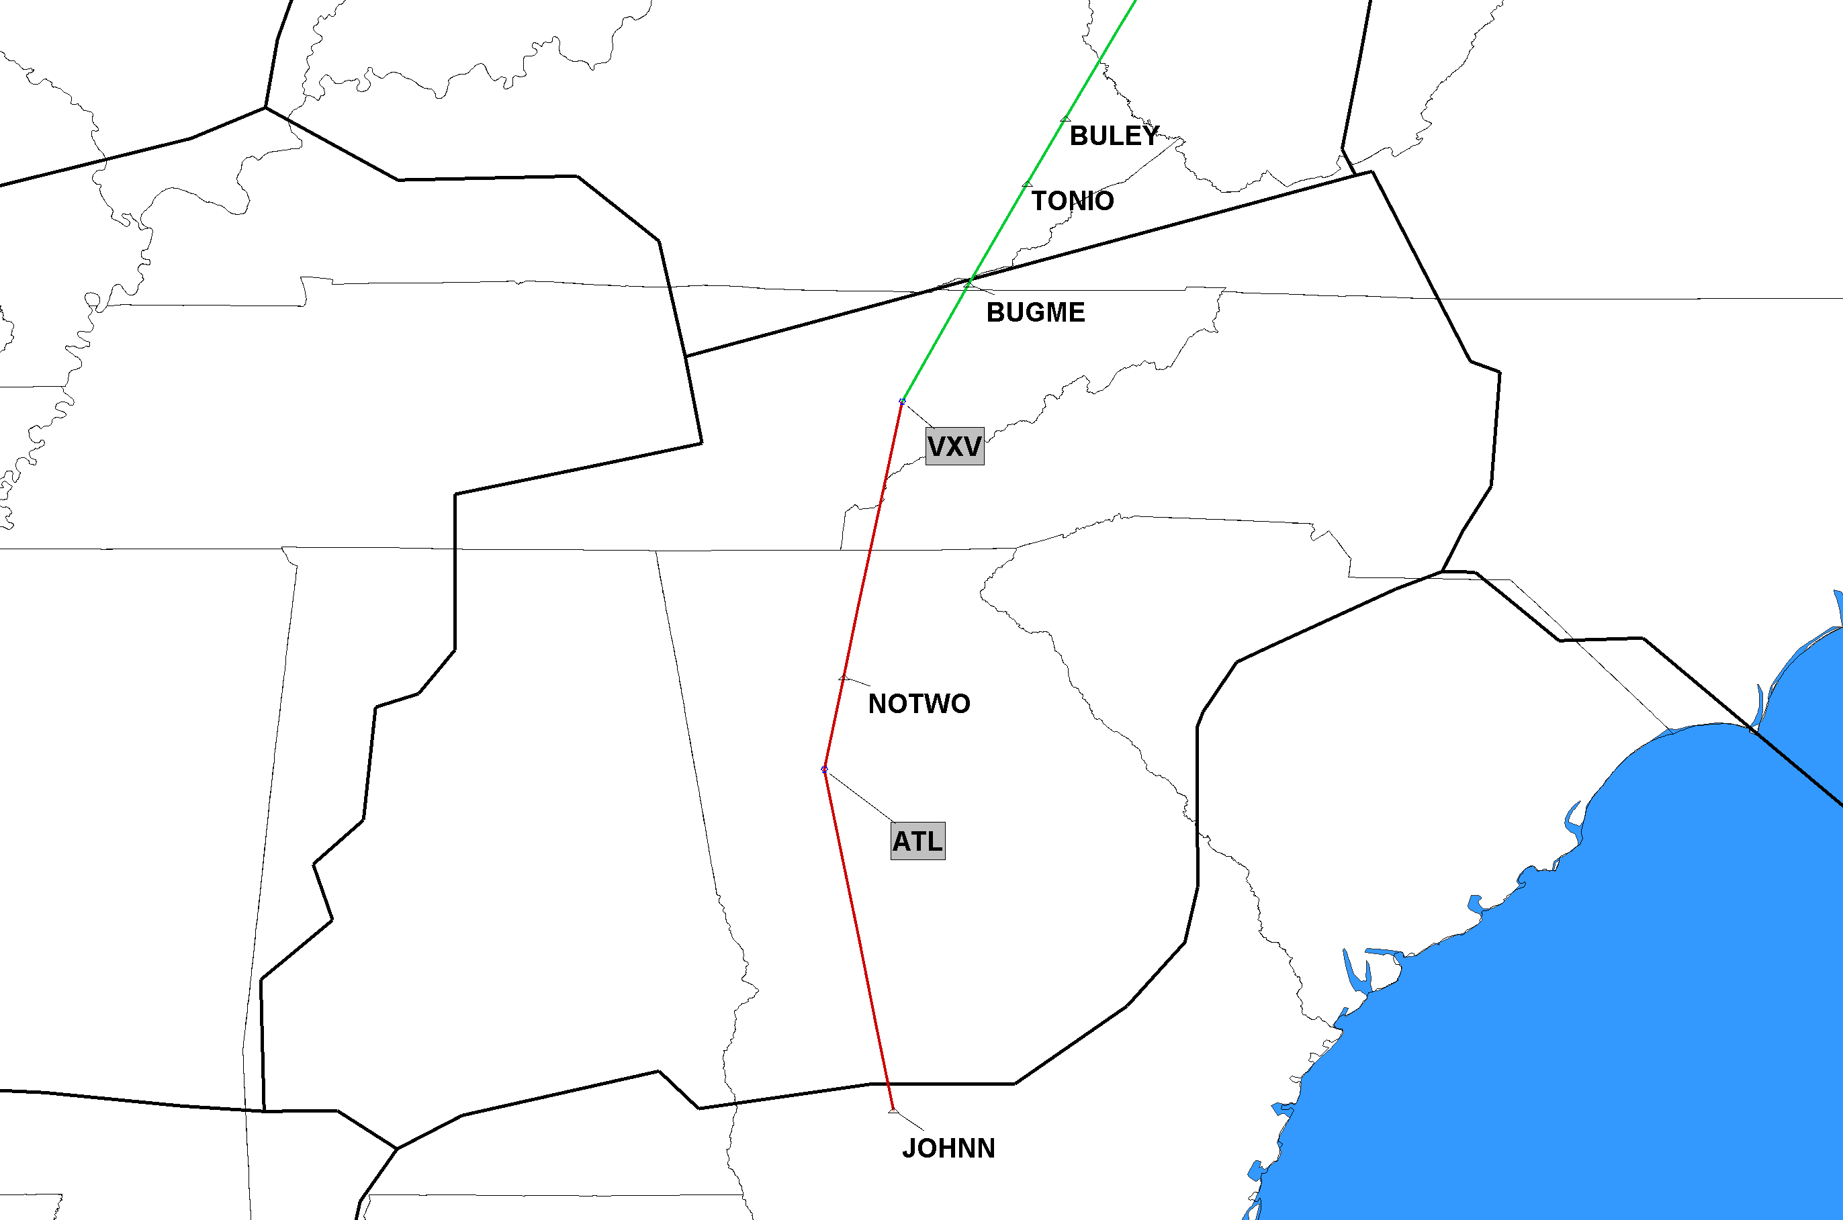
7/16/2020 J91 Cancel Segment J91 JOHNN, GA to Volunteer (VXV), TN
ZTL
ZJX
Red Segment Being Deleted
Click to Return to Index

Slide 25
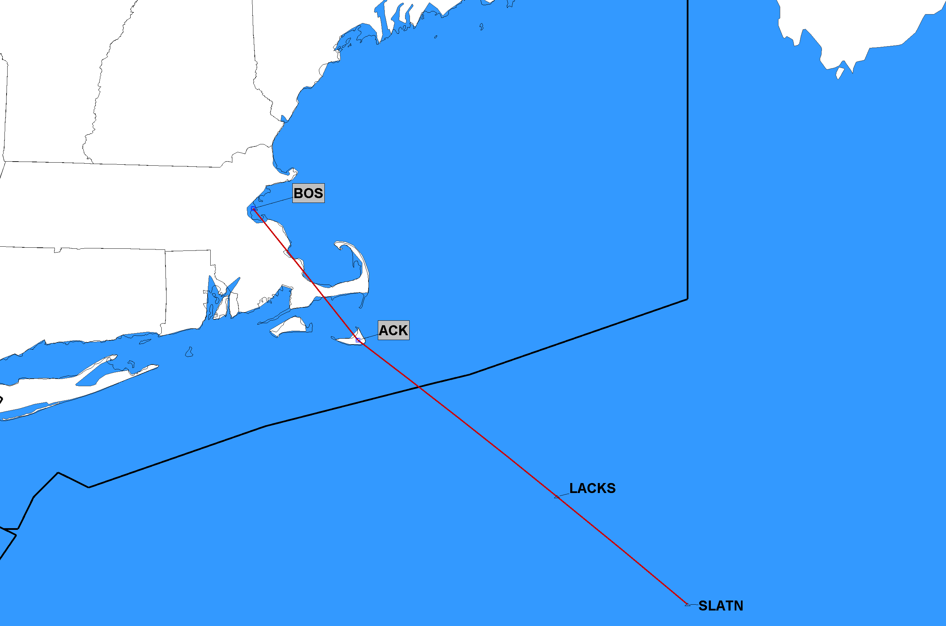
7/16/2020 J97 Completely Deleted J97 SLATN to Boston (BOS), MA
ZBW
ZNY
J-Route Deleted in its Entirety
Click to Return to Index

Slide 26
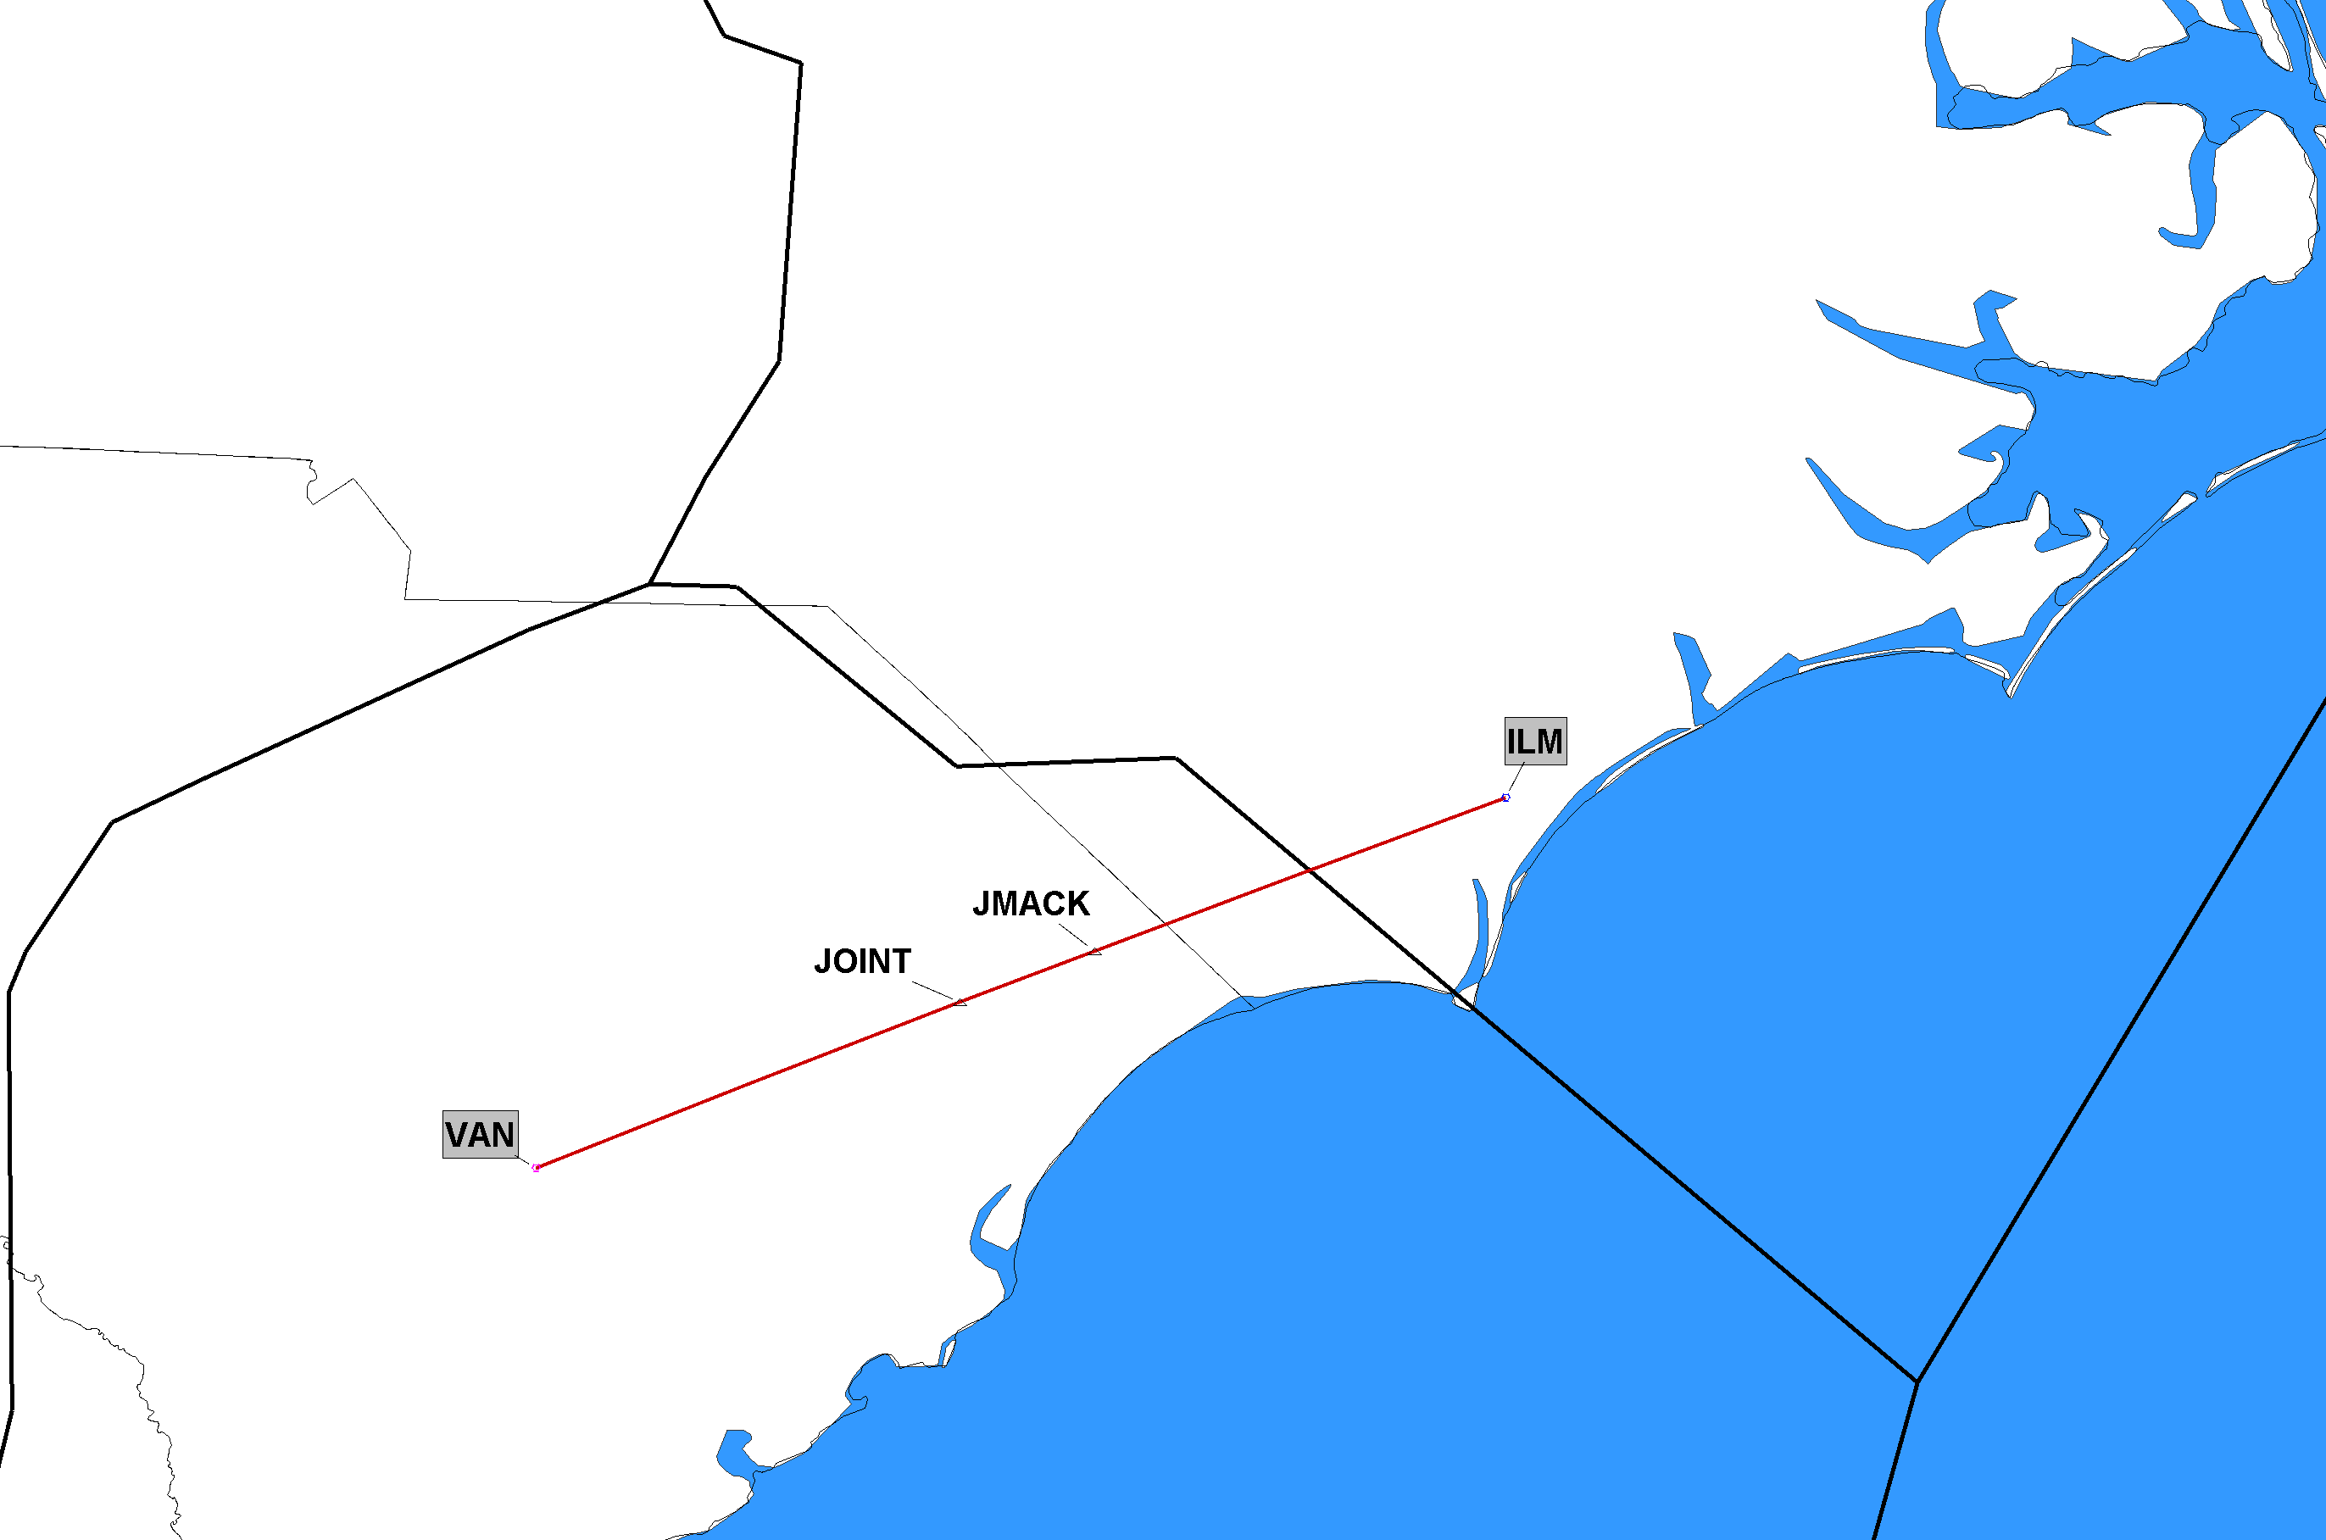
7/16/2020 J210 Completely Deleted J210 Vance (VAN), SC to Wilmington (ILM), NC
ZDC
ZJX
J-Route Deleted in its Entirety
Click to Return to Index

Slide 27
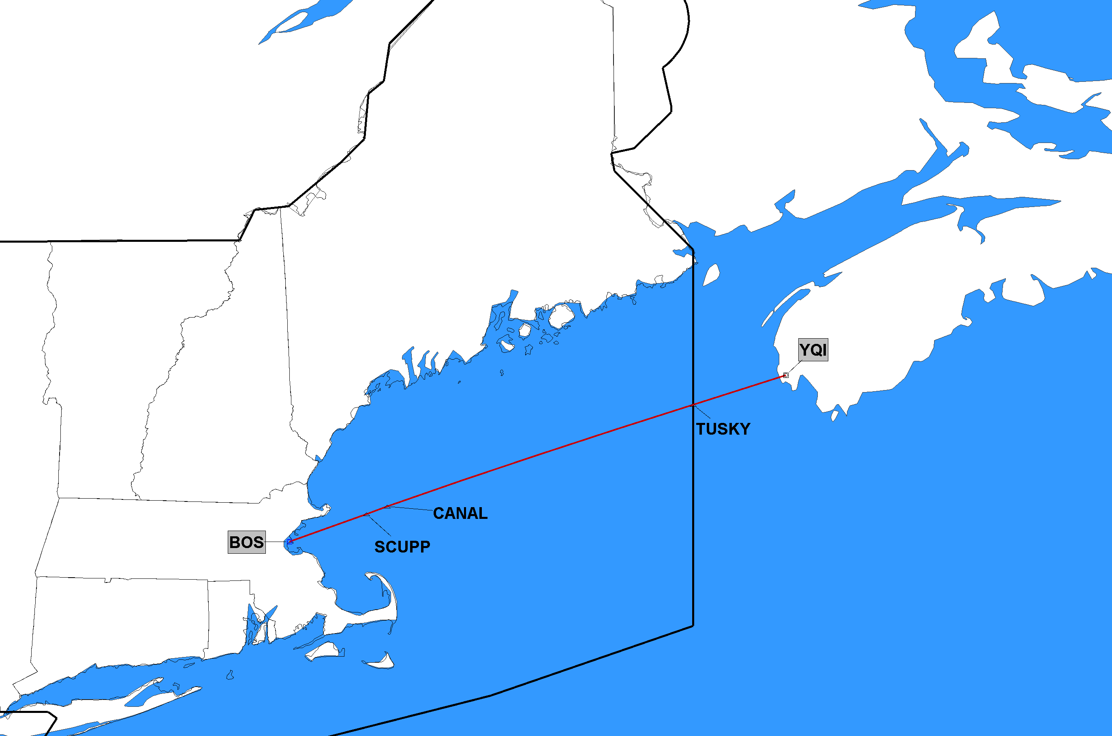
7/16/2020 J575 Completely Deleted J575 Boston (BOS), MA to Yarmouth (YQI), NS
NavCanada
ZBW
J-Route Deleted in its Entirety
Click to Return to Index

