Slide 1
Northeast Corridor Atlantic Coast Routes (NEC ACR) 9/10/2020 Publications 11/5/2020 Implementation

Slide 2
What We Are Doing, Why, When
NEC ACR is one of the biggest changes to the National Airspace System (NAS) in decades
What: 39 new/amended Q Routes and Y Routes will replace the north-south high-altitude route structure along the east coast of the United States
Why: Transition to a PBN-Centric NAS thus decreasing reliance on ground-based NAVAIDs
When: Changes being implemented on 13 separate chart dates 10/10/2019 through 1/27/2022

Slide 3
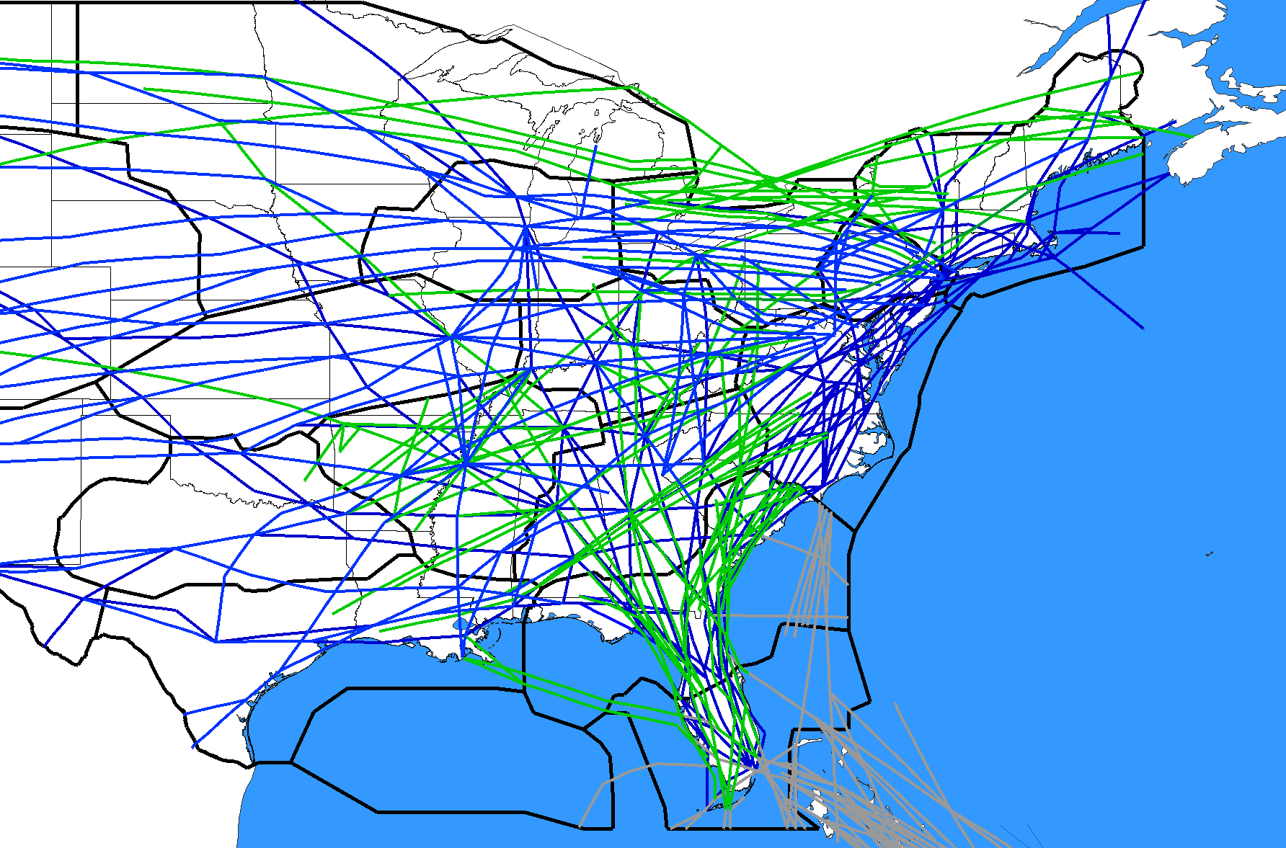
BEFORE
Not all central and western U.S. Routes are depicted
Q-Routes depicted in green
Y-Routes depicted in gray
J-Routes depicted in blue

Slide 4
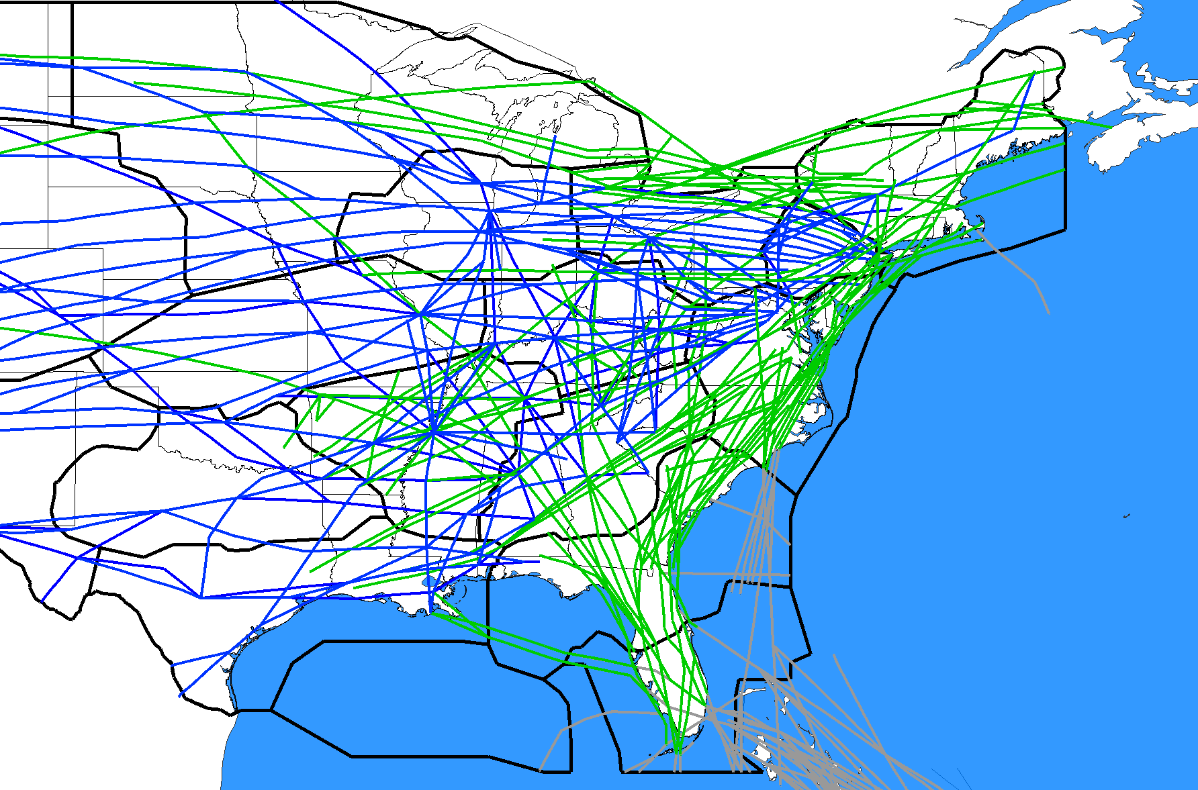
FUTURE STATE 12/2/2021
Not all central and western U.S. Routes are depicted
Q-Routes depicted in green
Y-Routes depicted in gray
J-Routes depicted in blue

Slide 5
Implementation Milestones
10/10/2019 Publish/Implement 1 New Y-Route and 8 Waypoints
11/7/2019 Implement ZDC Low Altitude Sector Changes
12/5/2019 NOTAM NA 33 J-Routes/Q-Routes (FL Metroplex) for 56 days
1/30/2020 Delete/Amend 33 J-Routes/Q-Route (FL Metroplex), Cancel N/A NOTAM
1/30/2020 Delete 5 CHS STARs
3/26/2020 Delete/Amend 6 SIDs (BWI/IAD/DCA/HEF/ADW)
5/21/2020 Amend 2 Q-Routes: Q75, Q475
5/21/2020 Amend 1 SID (DOV)
7/16/2020 Delete/Amend 18 J-Routes
9/10/2020 Publish/Amend 32 Q-Routes, 4 Y-Routes, NOTAM N/A for 56 days
9/10/2020 Amend 1 SID (ATL)
10/8/2020 Implement ZDC Ultra High Sector 30 and 3 minor airspace changes
11/5/2020 Implement 32 Q-Routes, 4 Y-Routes, Cancel N/A NOTAM
11/5/2020 Publish/Delete/Amend 14 STARs (PHL/EWR/TEB/LGA/DOV/WRI)
11/5/2020 Publish/Delete/Amend 29 SIDs/STARs/SIAPs (CHS/JZI/RDU)
11/5/2020 Delete/Amend 31 J-Routes, 1 Q-Route, Cancel N/A NOTAM
12/31/2020 Delete 2 STARs (LGA/EWR)
RE-PLANNED
DUE TO COVID-19

Slide 6
NEC ACR Changes - 2020
9/10/2020 (8) Q-Route Additions/Amendments
Publish New Q119, Q127, Q129, Q220, Q430, Q439, Q450 per original 18-AEA-16
Amend Q480 per original 18-AEA-16
IMPORTANT: All of the above routes EXCEPT Q480 will be NOTAM’d NA on 9/10/2020 for one chart cycle.
11/5/2020 (11) J-Route/Q-Route Deletions/Amendments
Delete J62, J109, J230, J570, Q108 per original 19-ASO-27
Amend J2 (del TAY-DEFUN), J39 (del CEW-MGM), J61 (del EDDYS-EMI) per original 19-ASO-27
Amend (with changes) J37 (del ALB-MSS), J55 (del CHS-TUBAS), J121 (del BRIGS-ENE)
11/5/2020 (18) SIDs/STARs/SIAPs
Amend TEB MAZIE3 STAR
Publish STARs: LGA (APPLE1), EWR (BRAND1), DOV (ARLFT1), WRI (WAALK1)
Delete STARs: LGA (GATBY1), EWR (RUUTH1), DOV (SMYRNA3), WRI (SEA ISLE4)
Amend CHS SIDs (PLMTO3, LGRHD3, JZI-KIAWAH2)
Amend CHS STARs: (AMYLU3, OSPRI7)
Amend CHS RNAV (GPS) Y APCHs (RWYS 03, 21, 15, 33)

Slide 7
Q-Route NA NOTAMs Effective 9/10/2020-11/5/2020
ROUTE ZDC ZNY. Q119 SCOOB, VA TO WESTMINSTER (EMI) VORTAC, MD NA.
ROUTE ZDC. Q127 GORDONSVILLE (GVE) VORTAC, VA TO SMYRNA (ENO) VORTAC, DE NA.
ROUTE ZDC. Q129 GARIC, NC TO PYTON, MD NA.
ROUTE ZBW. Q220 RIFLE, NY TO LARIE, MA NA.
ROUTE ZNY ZBW ZOB. Q430 ZANDR, OH TO NANTUCKET (ACK) VOR/DME, MA NA.
ROUTE ZDC ZBW. Q439 BRIGS, NJ TO PRESQUE ISLE (PQI) VOR/DME, ME NA.
ROUTE ZNY. Q450 HNNAH, NJ TO DEER PARK (DPK) VOR/DME, NY NA.

Slide 8
How Operators Can Help
Share this briefing with others
Share inside the organization
Utilize briefing(s) for route planners & dispatchers
Provide feedback and suggestions
Help identify issues/mitigations not yet identified
Direct questions/comments to NEC ACR
Watch for additional information
Flight Planners Telcon, NCF briefings, NBAA, CNS Taskforce, etc.
Plan resources for route planning & programming
Especially after the 9/10/2020 publications
Be ready to utilize the new routes
Beginning on 11/5/2020 flight plan the new routes

Slide 9
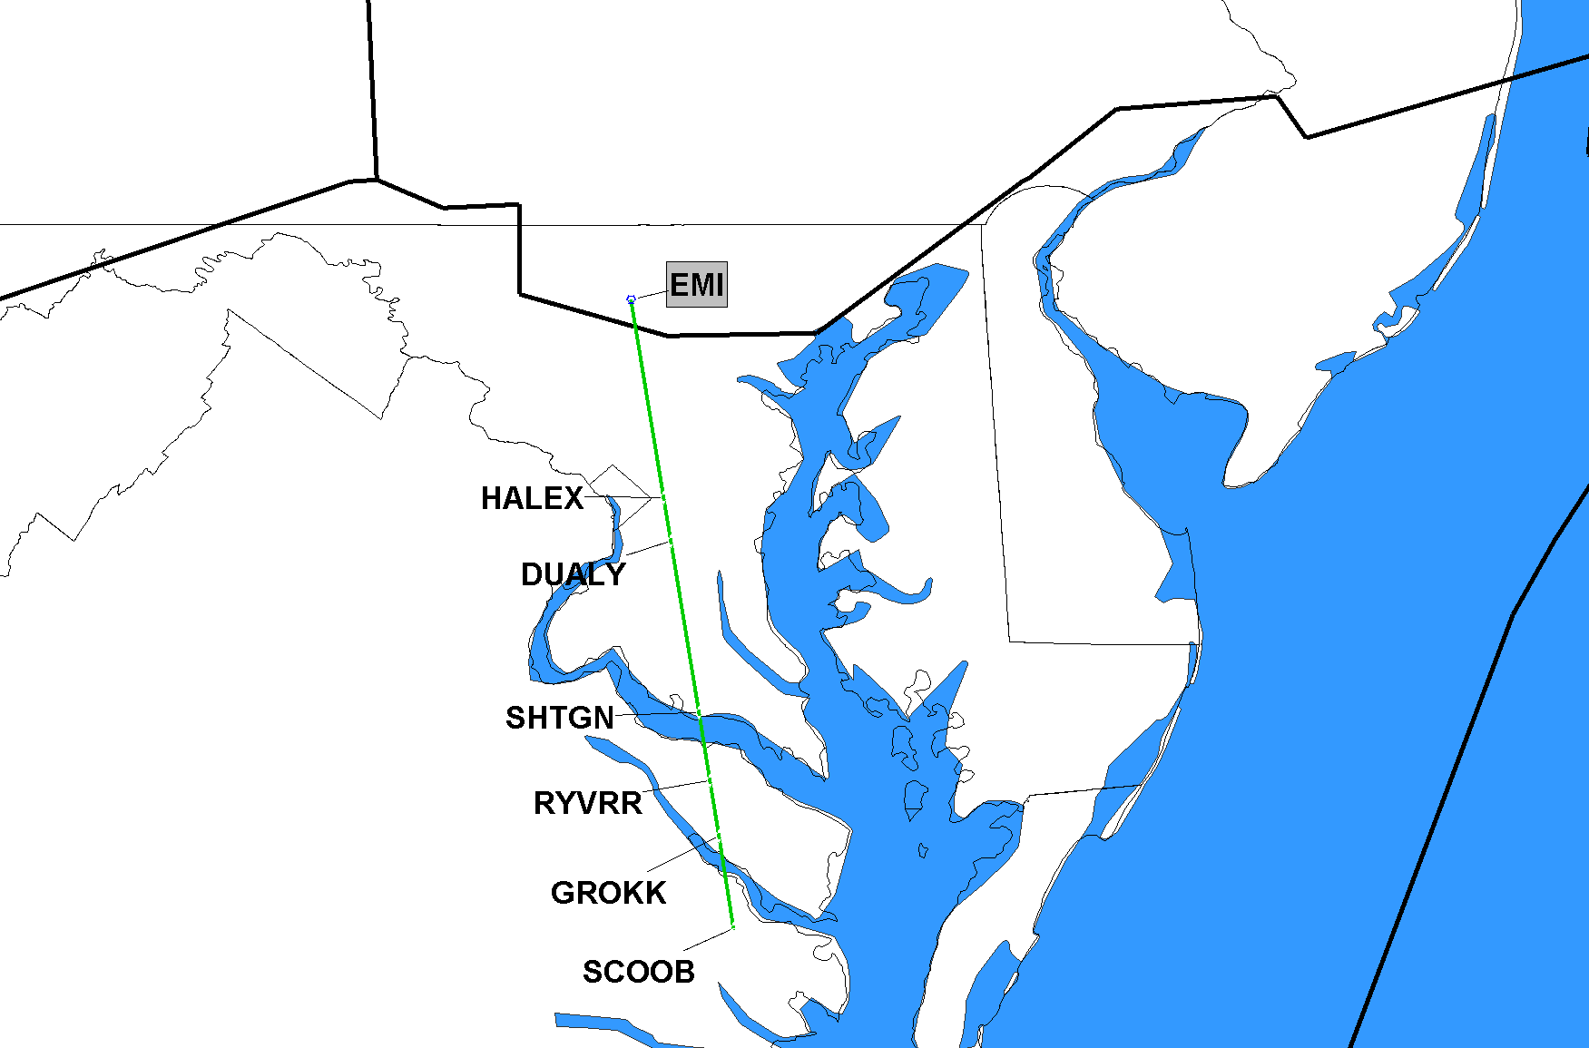
9/10/2020 Q119 Publish Q119 SCOOB, VA TO WESTMINSTER, MD (EMI) VORTAC
ZNY
SAMPLE DETAILED SLIDE
ADDITIONAL SLIDES AT THE END OF THIS PRESENTATION
ZDC
Implement on 11/5/2020

Slide 10
Q-Route/Y-Route NOTAMs
Q-Routes: Existing “ATC ASSIGNED ONLY” NOTAMs for the following Florida Q-Routes will be cancelled and reissued on 9/10/2020 and will be effective through 12/2/2021:
Q85, Q87, Q97, Q109, Q113, Q135, Q409
Y-Routes: Existing “ATC ASSIGNED ONLY” NOTAMs for the following Florida Y-Routes will be cancelled and reissued on 9/10/2020 and will be effective through 12/2/2021:
Y289, Y291, Y299, Y307, Y309, Y319, Y323

Slide 11
Q-Route NA NOTAMs Effective through 12/2/2021
!FDC X/XXXX ZJX SC..NC..ROUTE ZJX. Q85 IGARY, SC TO SMPRR, NC. ATC ASSIGNED ONLY.
!FDC X/XXXX ZJX SC..ROUTE ZJX. Q87 JROSS, SC TO LCAPE, SC. ATC ASSIGNED ONLY.
!FDC X/XXXX ZJX SC..NC..ROUTE ZJX. Q97 CAKET, SC TO ELLDE, NC. ATC ASSIGNED ONLY.
!FDC X/XXXX ZJX SC..ROUTE ZJX. Q109 PANDY, SC TO LAANA, NC. ATC ASSIGNED ONLY.
!FDC X/XXXX ZJX SC..ROUTE ZJX. Q113 RAYVO, SC TO SARKY, SC. ATC ASSIGNED ONLY.
!FDC X/XXXX ZJX SC..NC..ROUTE ZJX. Q135 JROSS, SC TO RAPZZ, NC. ATC ASSIGNED ONLY.
!FDC X/XXXX ZJX SC..ROUTE ZJX. Q409 JROSS, SC TO MRPIT, NC. ATC ASSIGNED ONLY.

Slide 12
Y-Route NA NOTAMs Effective through 12/2/2021
!FDC X/XXXX ZJX SC..GA..FL..ROUTE ZJX. Y289 DULEE, OA TO ZILLS, OA. ATC ASSIGNED ONLY.
!FDC X/XXXX ZJX SC..GA..FL..ROUTE ZJX. Y291 HOAGG, OA TO SAGGY ,OA. ATC ASSIGNED ONLY.
FDC X/XXXX 1 ZJX SC..GA..FL..ROUTE ZJX. Y299 GRUBR, OA TO JRDAN, OA. ATC ASSIGNED ONLY.
FDC X/XXXX ZJX SC..GA..FL..ROUTE ZJX. Y307 CARPX, OA TO GARIC, OA. ATC ASSIGNED ONLY.
FDC X/XXXX ZJX SC..GA..FL..ROUTE ZJX. Y309 PELCN, OA TO IDOLS, OA. ATC ASSIGNED ONLY.
!FDC X/XXXX ZJX SC..GA..FL..ROUTE ZJX. Y319 OHLAA, OA TO IDOLS, OA. ATC ASSIGNED ONLY.
FDC X/XXXX ZJX SC..GA..FL..ROUTE ZJX. Y323 CARPX, OA TO IDOLS, OA. ATC ASSIGNED ONLY.

Slide 13
NEC ACR Changes - 2021
2/25/2021 (20) SIDs/STARs
Amend RDU SIDs: (HOOKZ4, HURIC4, LWOOD4, OXFRD4, ROZBO4, BEXGO4, SHPRD4)
Amend RDU STARs: (ALDAN3 RNAV, BLOGS3 RNAV, MALNR5 RNAV, BUZZY9 [conv])
Delete RDU STARs (KAROO2 RNAV, ARGAL6 [conv], SOUTH BOSTON6[conv])
Publish RDU TAQLE1 STAR
Delete RDU SIDs (TAR HEEL1, FAYETTVILLE4, BLUE DEVIL6)
Amend RDU SIDs: (RDU RALEIGH1, PACKK9)
10/7/2021 (28) Q-Route/Y-Route Additions/Amendments
Publish New Q101, Q107, Q111, Q115, Q117, Q131, Q167, Q419, Q445, Q481
Publish New Q133, Q437 (with changes from 18-AEA-16)
Amend Q22, Q54, Q60, Q64, Q85, Q87, Q97, Q99, Q109, Q113, Q135, Q409
Amend Y291, Y309, Y319, Y323
12/2/2021 (24) J-Route Deletions/Amendments
Delete J55 (del TUBAS-PQI), J79, J121 (del CHS-BRIGS), J150, J165, J174, J191, J193, J207, J209, J222, J225, J506, J561, J563, J573, J582, J585
Amend J14, J24, J37 (del LYH-ALB), J42, J52, J68
10/7/2021 (1) SID
Amend ATL PHIIL3 SID
12/2/2021 (5) STARs
Amend STARs: PHL (JIIMS4, PAATS4), EWR (PHLBO4), TEB (JAIKE4)
Publish LGA PROUD1 STAR
All 2021 Dates Subject to Change Due to COVID-19

Slide 14
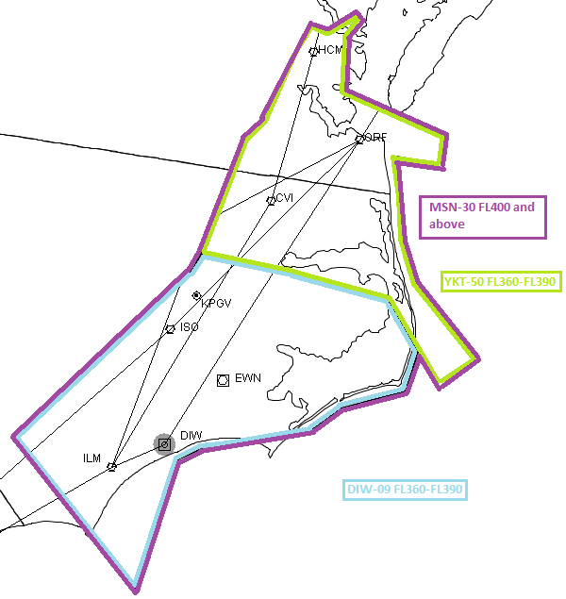
ZDC High Altitude Sector Changes
Stratify Sectors 09 & 50 to create new Sector 30
Resulting 3 Sectors
09 DIW Ultra High
FL360-390
50 YKT Ultra High
FL360-390
30 MSN Super High
FL400-ABV
To help reduce sector workload/complexity and improve sector throughput
TENTATIVE 4/22/2021
50
09

Slide 15
FAA Points of Contact
Paul Withers, FAA Management Co-Lead
paul.m.withers@faa.gov
904-710-5939
Joey Tinsley, NATCA Co-Lead
joseph.b.tinsley@faa.gov
770-363-1718

Slide 16
Q-Routes – Detailed Slides
9/10/2020 (8) Q-Route Additions/Amendments
Publish New Q119, Q127, Q129, Q220, Q430, Q439, Q450 per original 18-AEA-16
Amend Q480 per original 18-AEA-16
NOTAM NA (Not Authorized for one chart cycle)
Implement on 11/5/2020

Slide 17
9/10/2020 Q119 Publish Q119 SCOOB, VA TO WESTMINSTER, MD (EMI) VORTAC
ZNY
ZDC
Implement on 11/5/2020

Slide 18
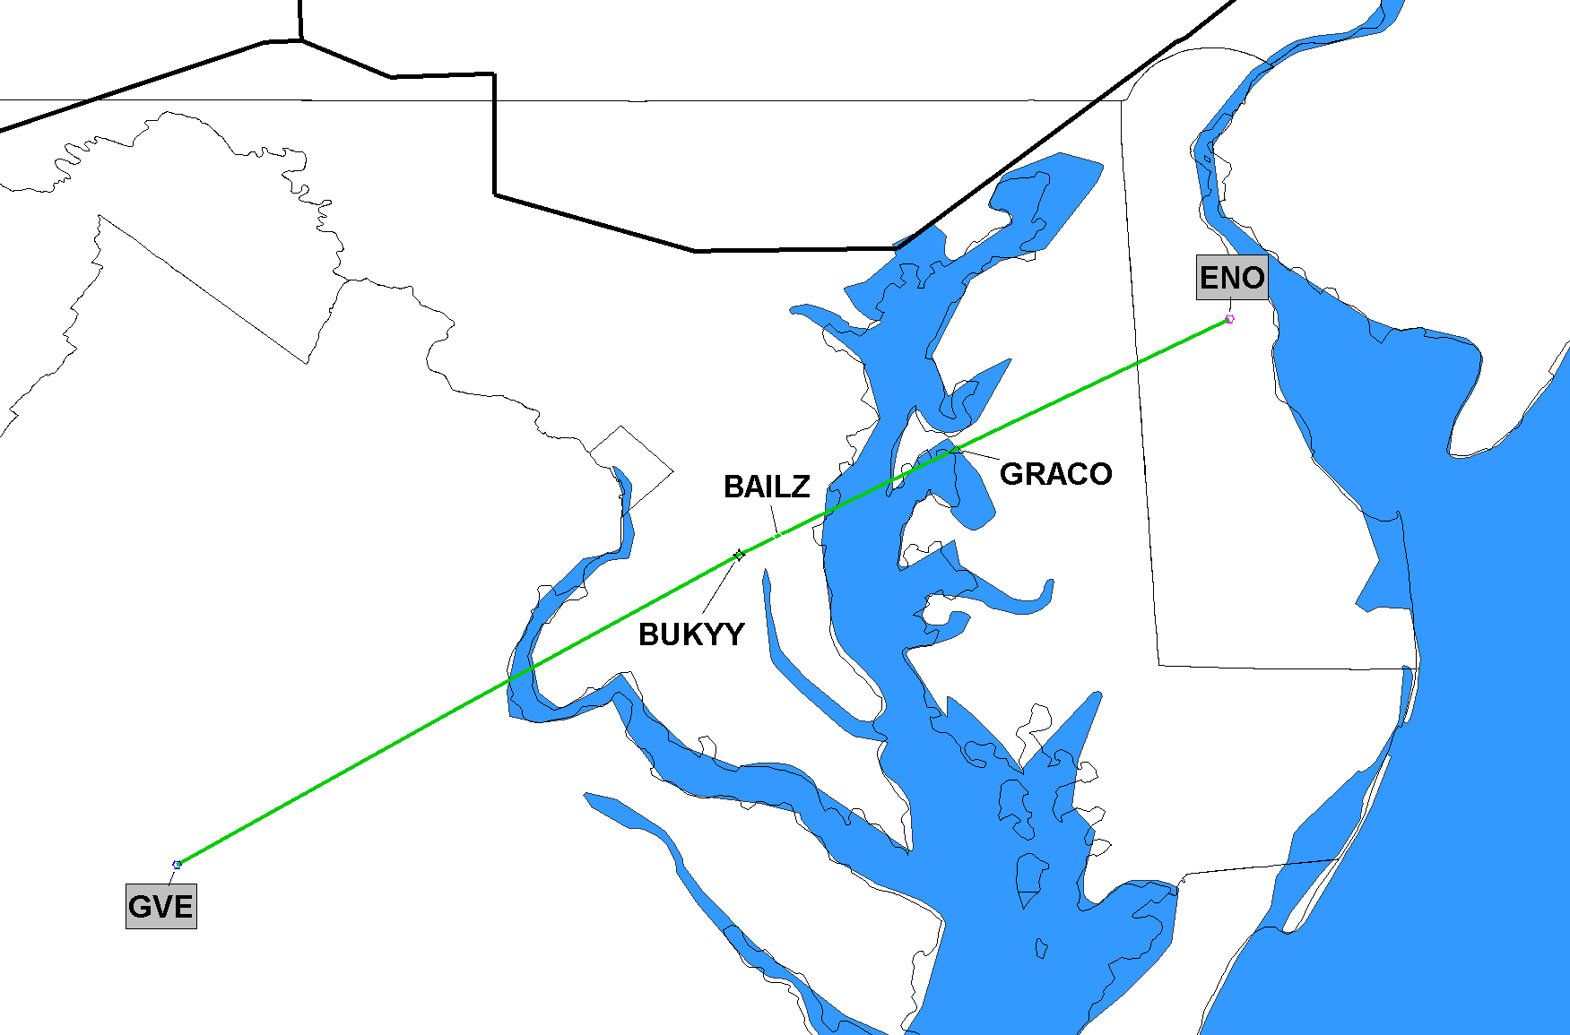
9/10/2020 Q127 Publish Q127 GORDONSVILLE, VA (GVE) VORTAC TO SMYRNA, DE (ENO) VORTAC
ZDC
Implement on 11/5/2020

Slide 19
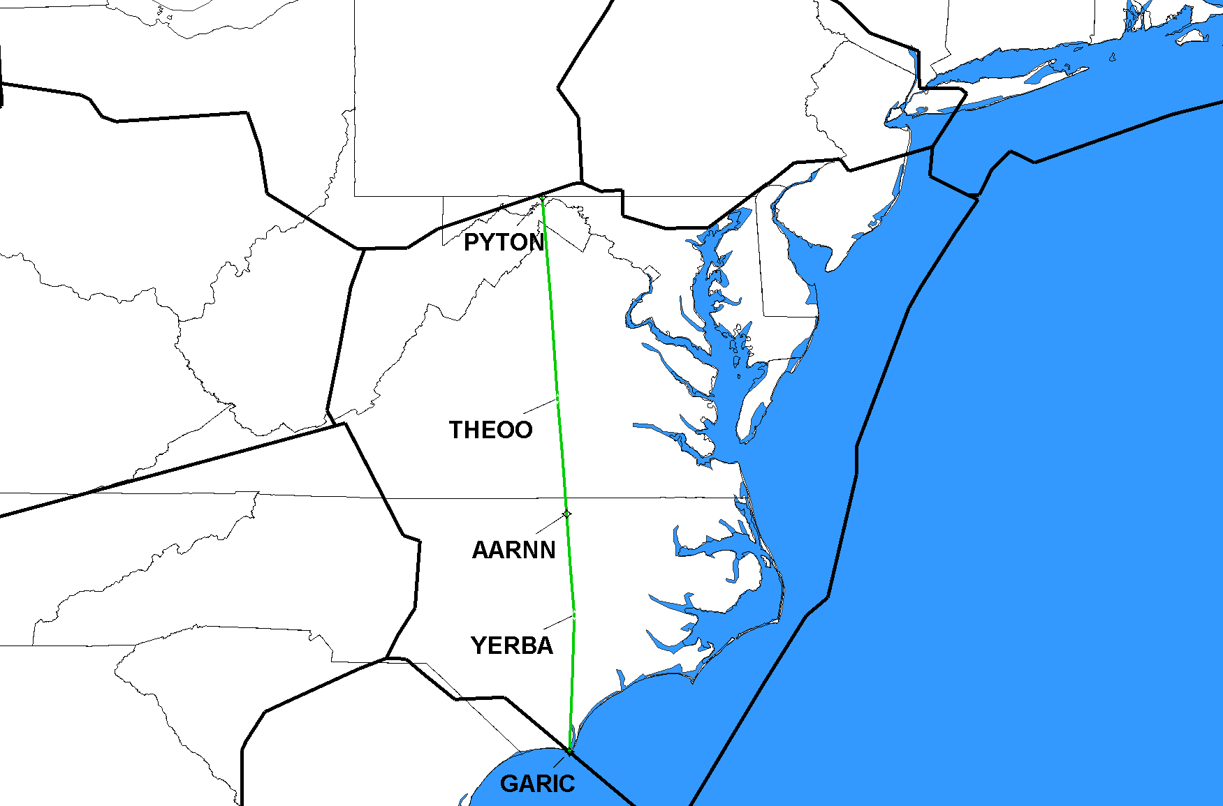
9/10/2020 Q129 Publish Q129 GARIC, NC TO PYTON, MD
ZOB
ZDC
ZJX
Implement on 11/5/2020

Slide 20
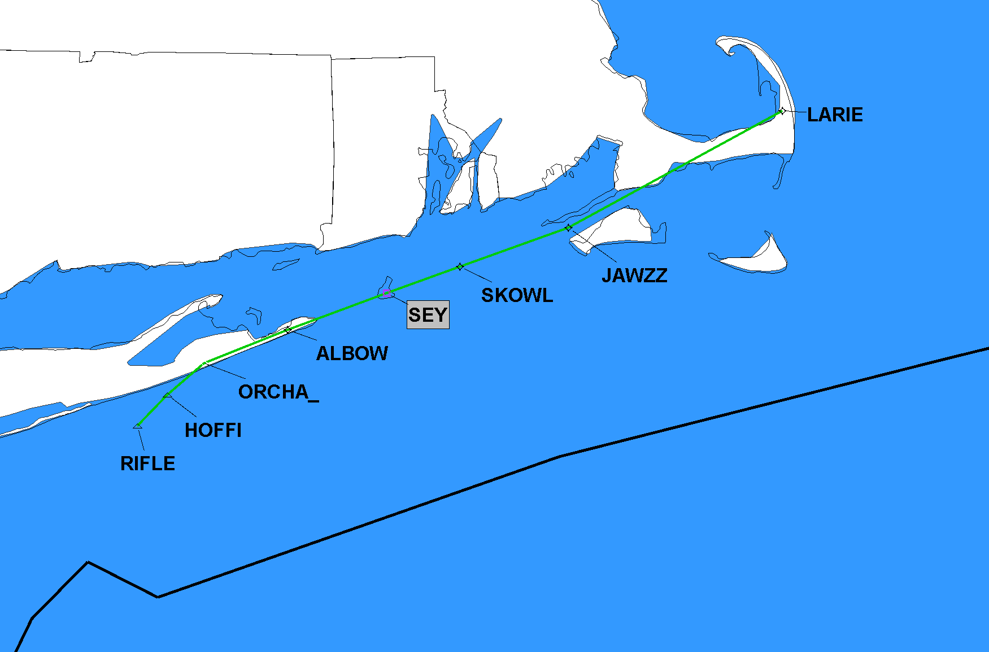
9/10/2020 Q220 Publish Q220 RIFLE, NY TO LARIE, MA
ZBW
Implement on 11/5/2020

Slide 21
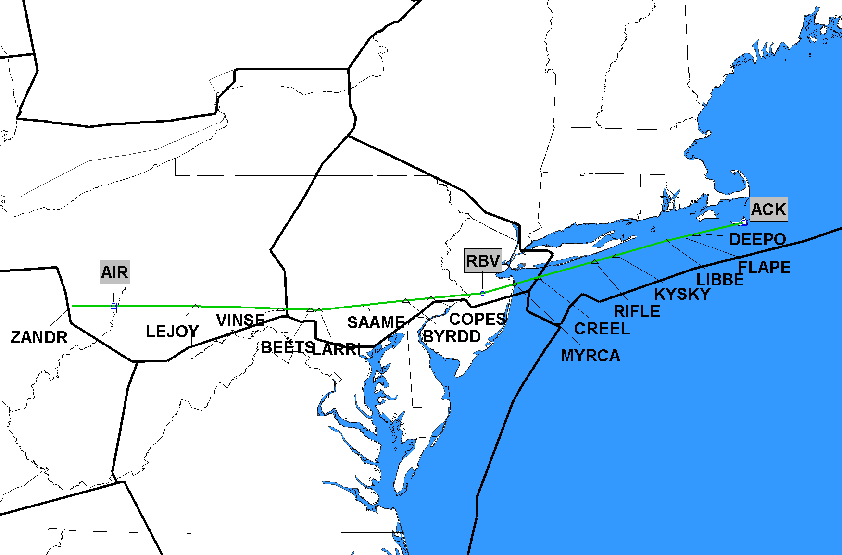
9/10/2020 Q430 Publish Q430 ZANDR, OH TO NANTUCKET, MA (ACK) VOR/DME
ZBW
ZNY
ZOB
Implement on 11/5/2020

Slide 22
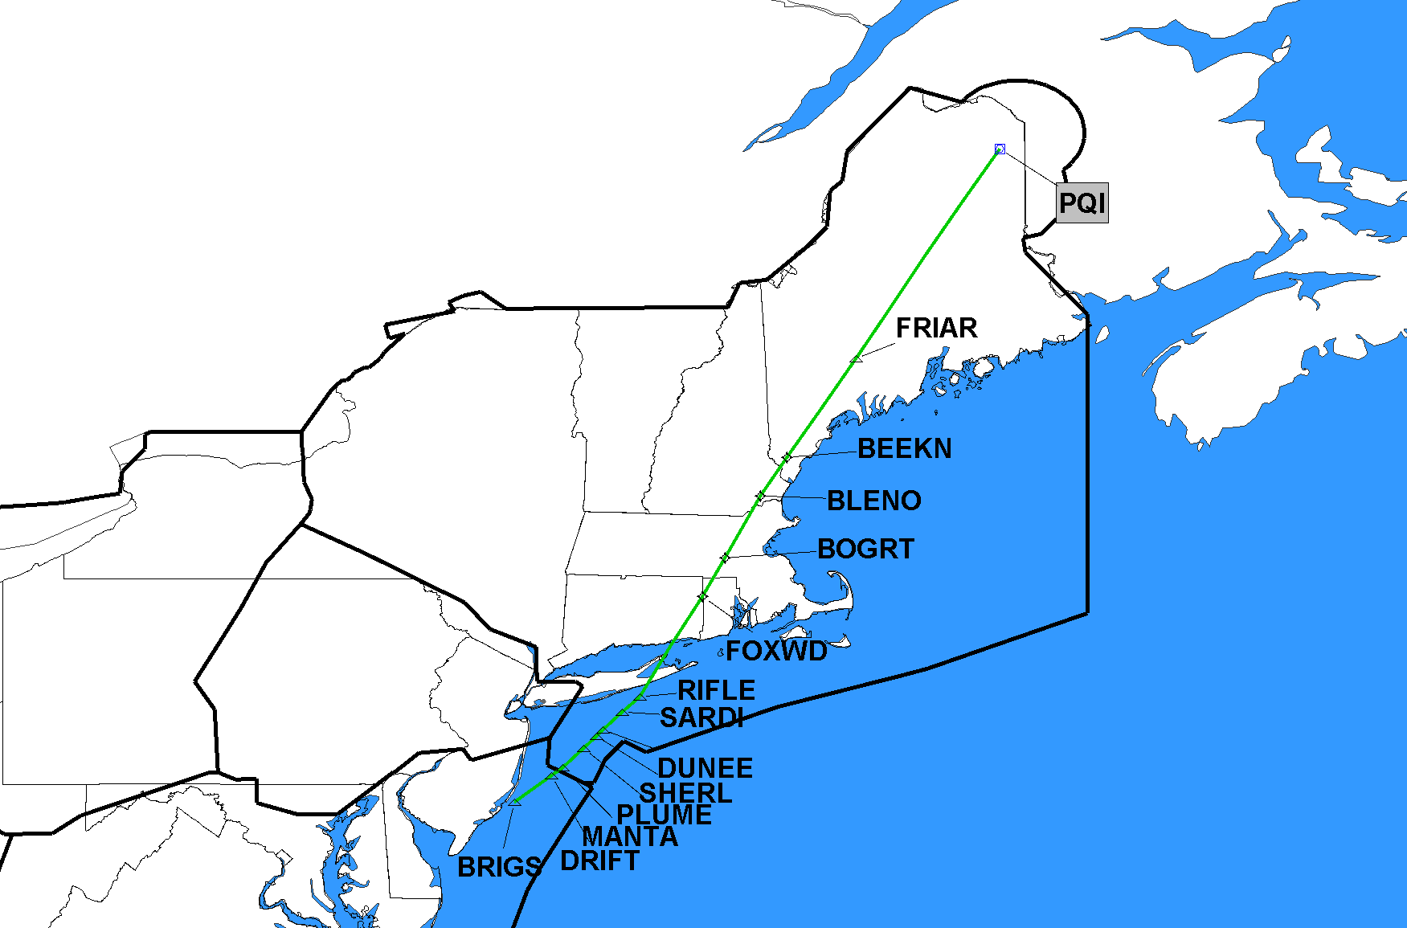
9/10/2020 Q439 Publish Q439 BRIGS, NJ TO PRESQUE ISLE, ME (PQI) VOR/DME
ZBW
ZDC
Implement on 11/5/2020

Slide 23
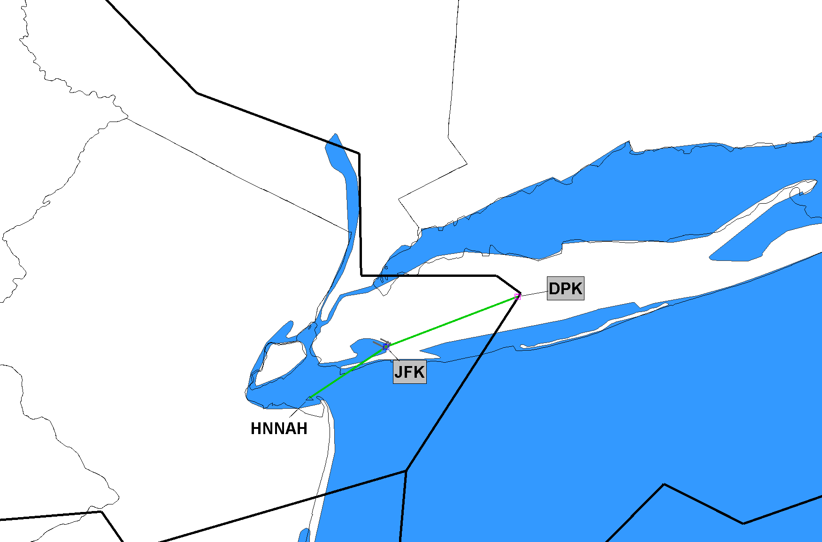
9/10/2020 Q450 Publish Q450 HNNAH, NJ TO DEER PARK, NY (DPK) VOR/DME
ZBW
ZNY
Implement on 11/5/2020

Slide 24
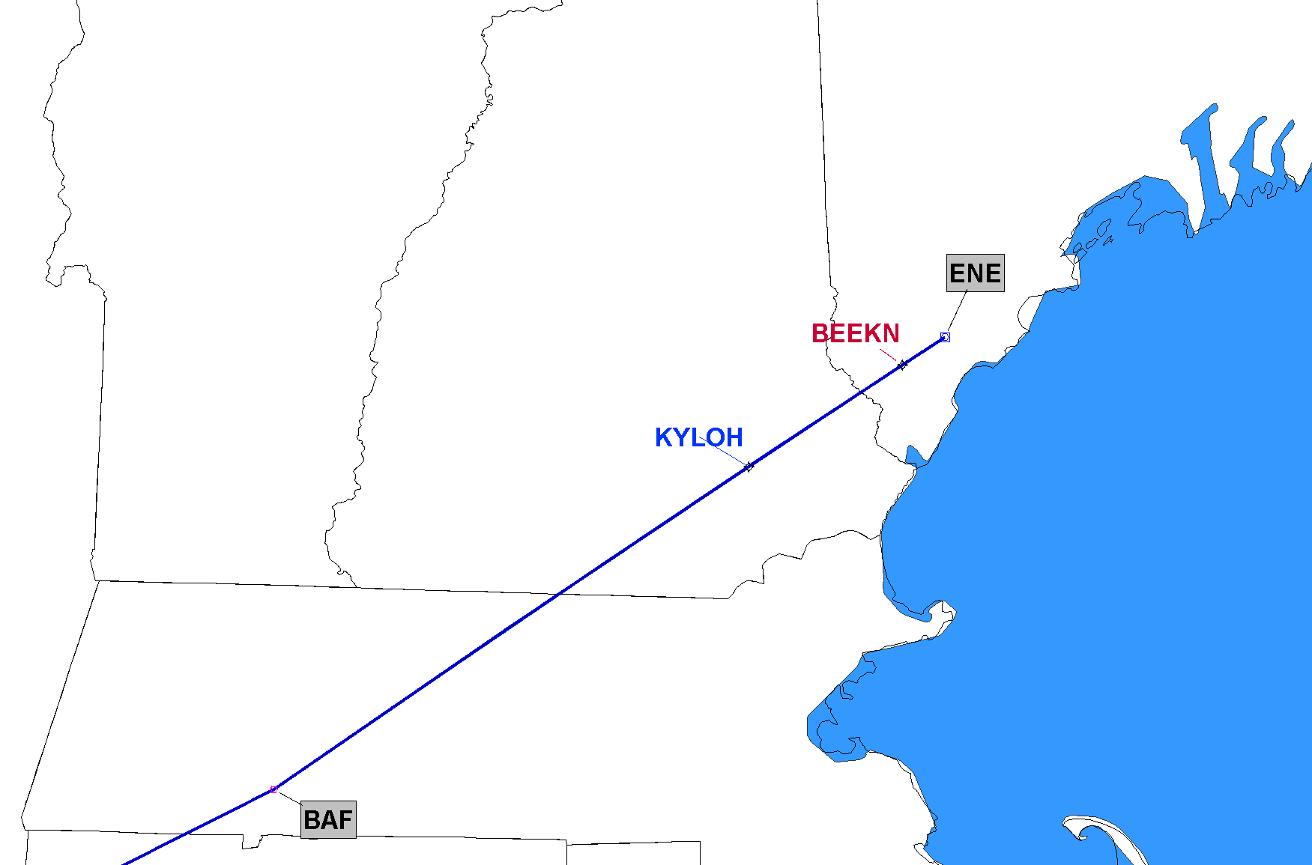
9/10/2020 Q480 Amend Q480 Add KYLOH & BEEKN
ZBW
Implement on 11/5/2020

Slide 25
J-Routes – Detailed Slides
11/5/2020 (11) J-Route/Q-Route Deletions/Amendments
Delete J62, J109, J230, J570, Q108 per original 19-ASO-27
Amend J2 (del TAY-DEFUN), J39 (del CEW-MGM), J61 (del EDDYS-EMI) per original 19-ASO-27
Amend (with changes) J37 (del ALB-MSS), J55 (del CHS-TUBAS), J121 (del BRIGS-ENE)
The above (J37/J55/J121) is a change to 19-ASO-27 and the procedure work currently in progress at AIS/AJV-A

Slide 26
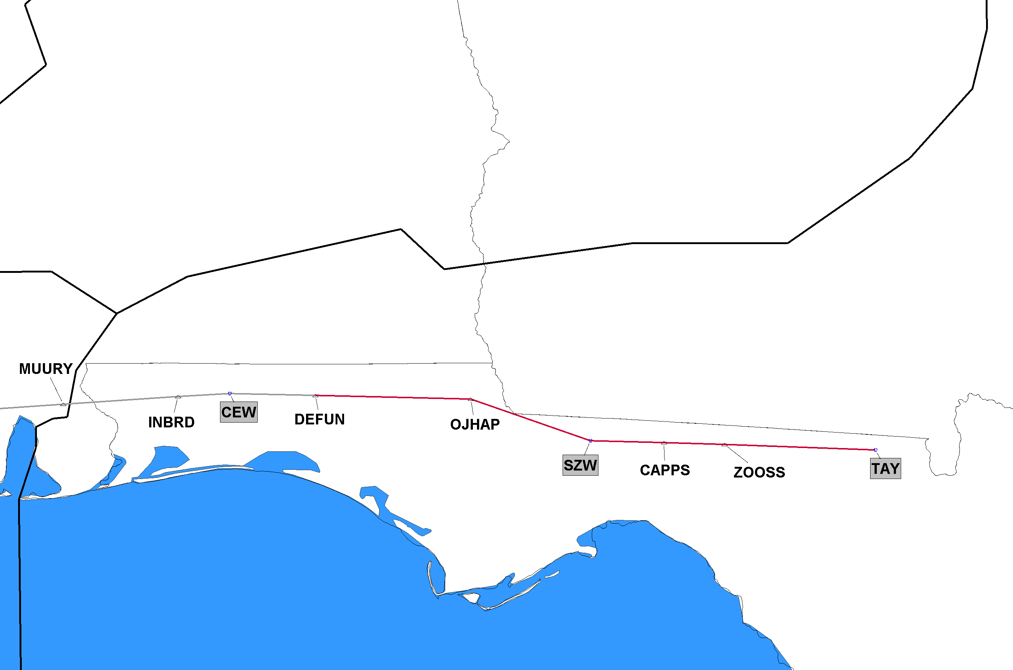
11/5/2020 J2 Cancel Segment J2 DEFUN, FL to Taylor (TAY), FL
ZJX
Red Segment Being Deleted
Click to Return to Index

Slide 27
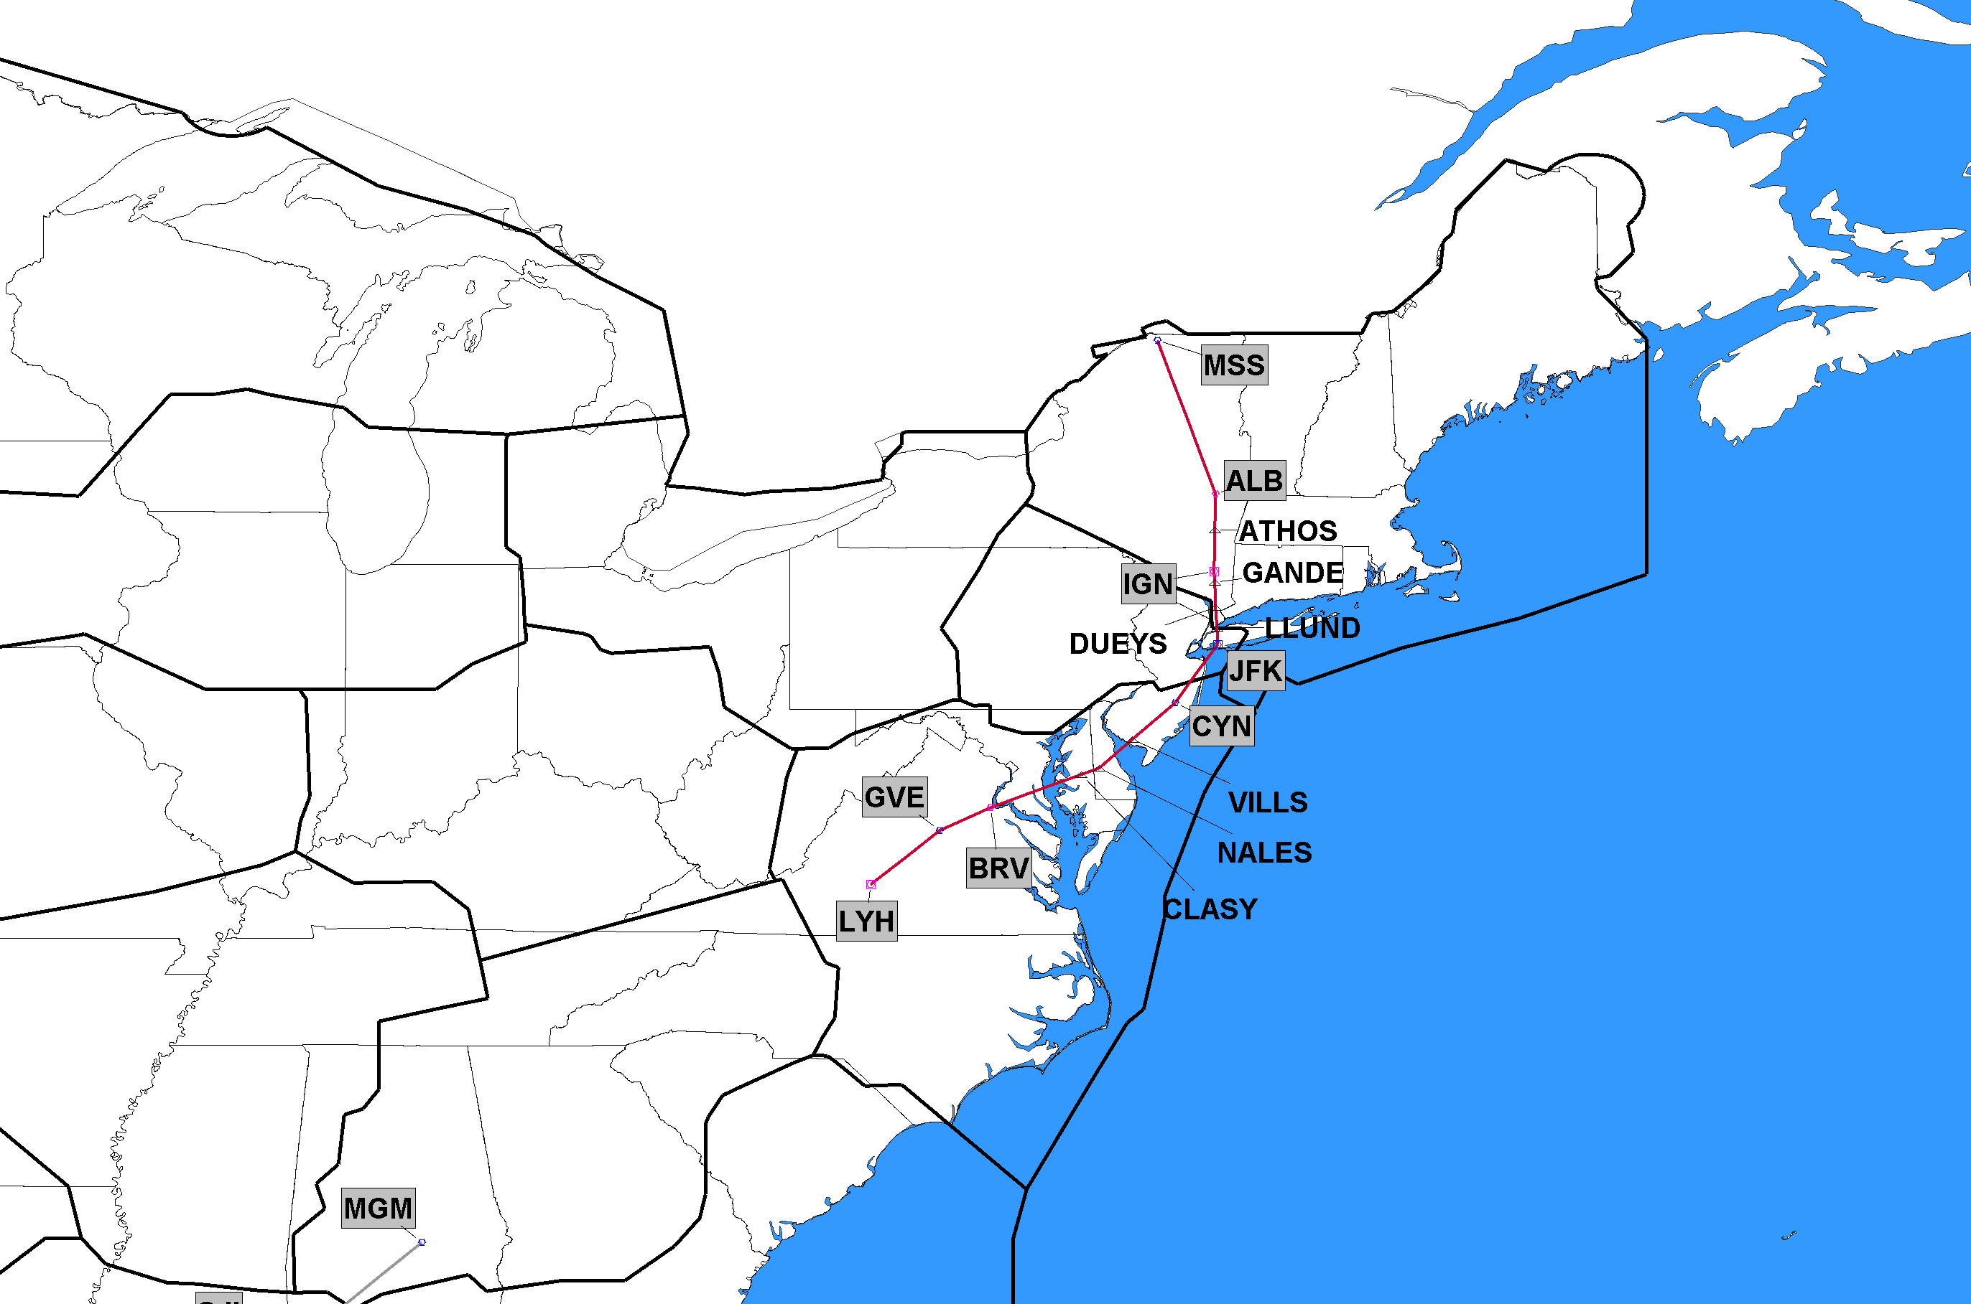
11/5/2020 J37 Cancel Segment J37 Albany (ALB), NY; to Massena (MSS), NY
ZBW
ZNY
ZDC
Delete ALB-MSS only 11/5/2020
Additional changes on 12/2/2021
Red Segment Being Deleted
Click to Return to Index

Slide 28
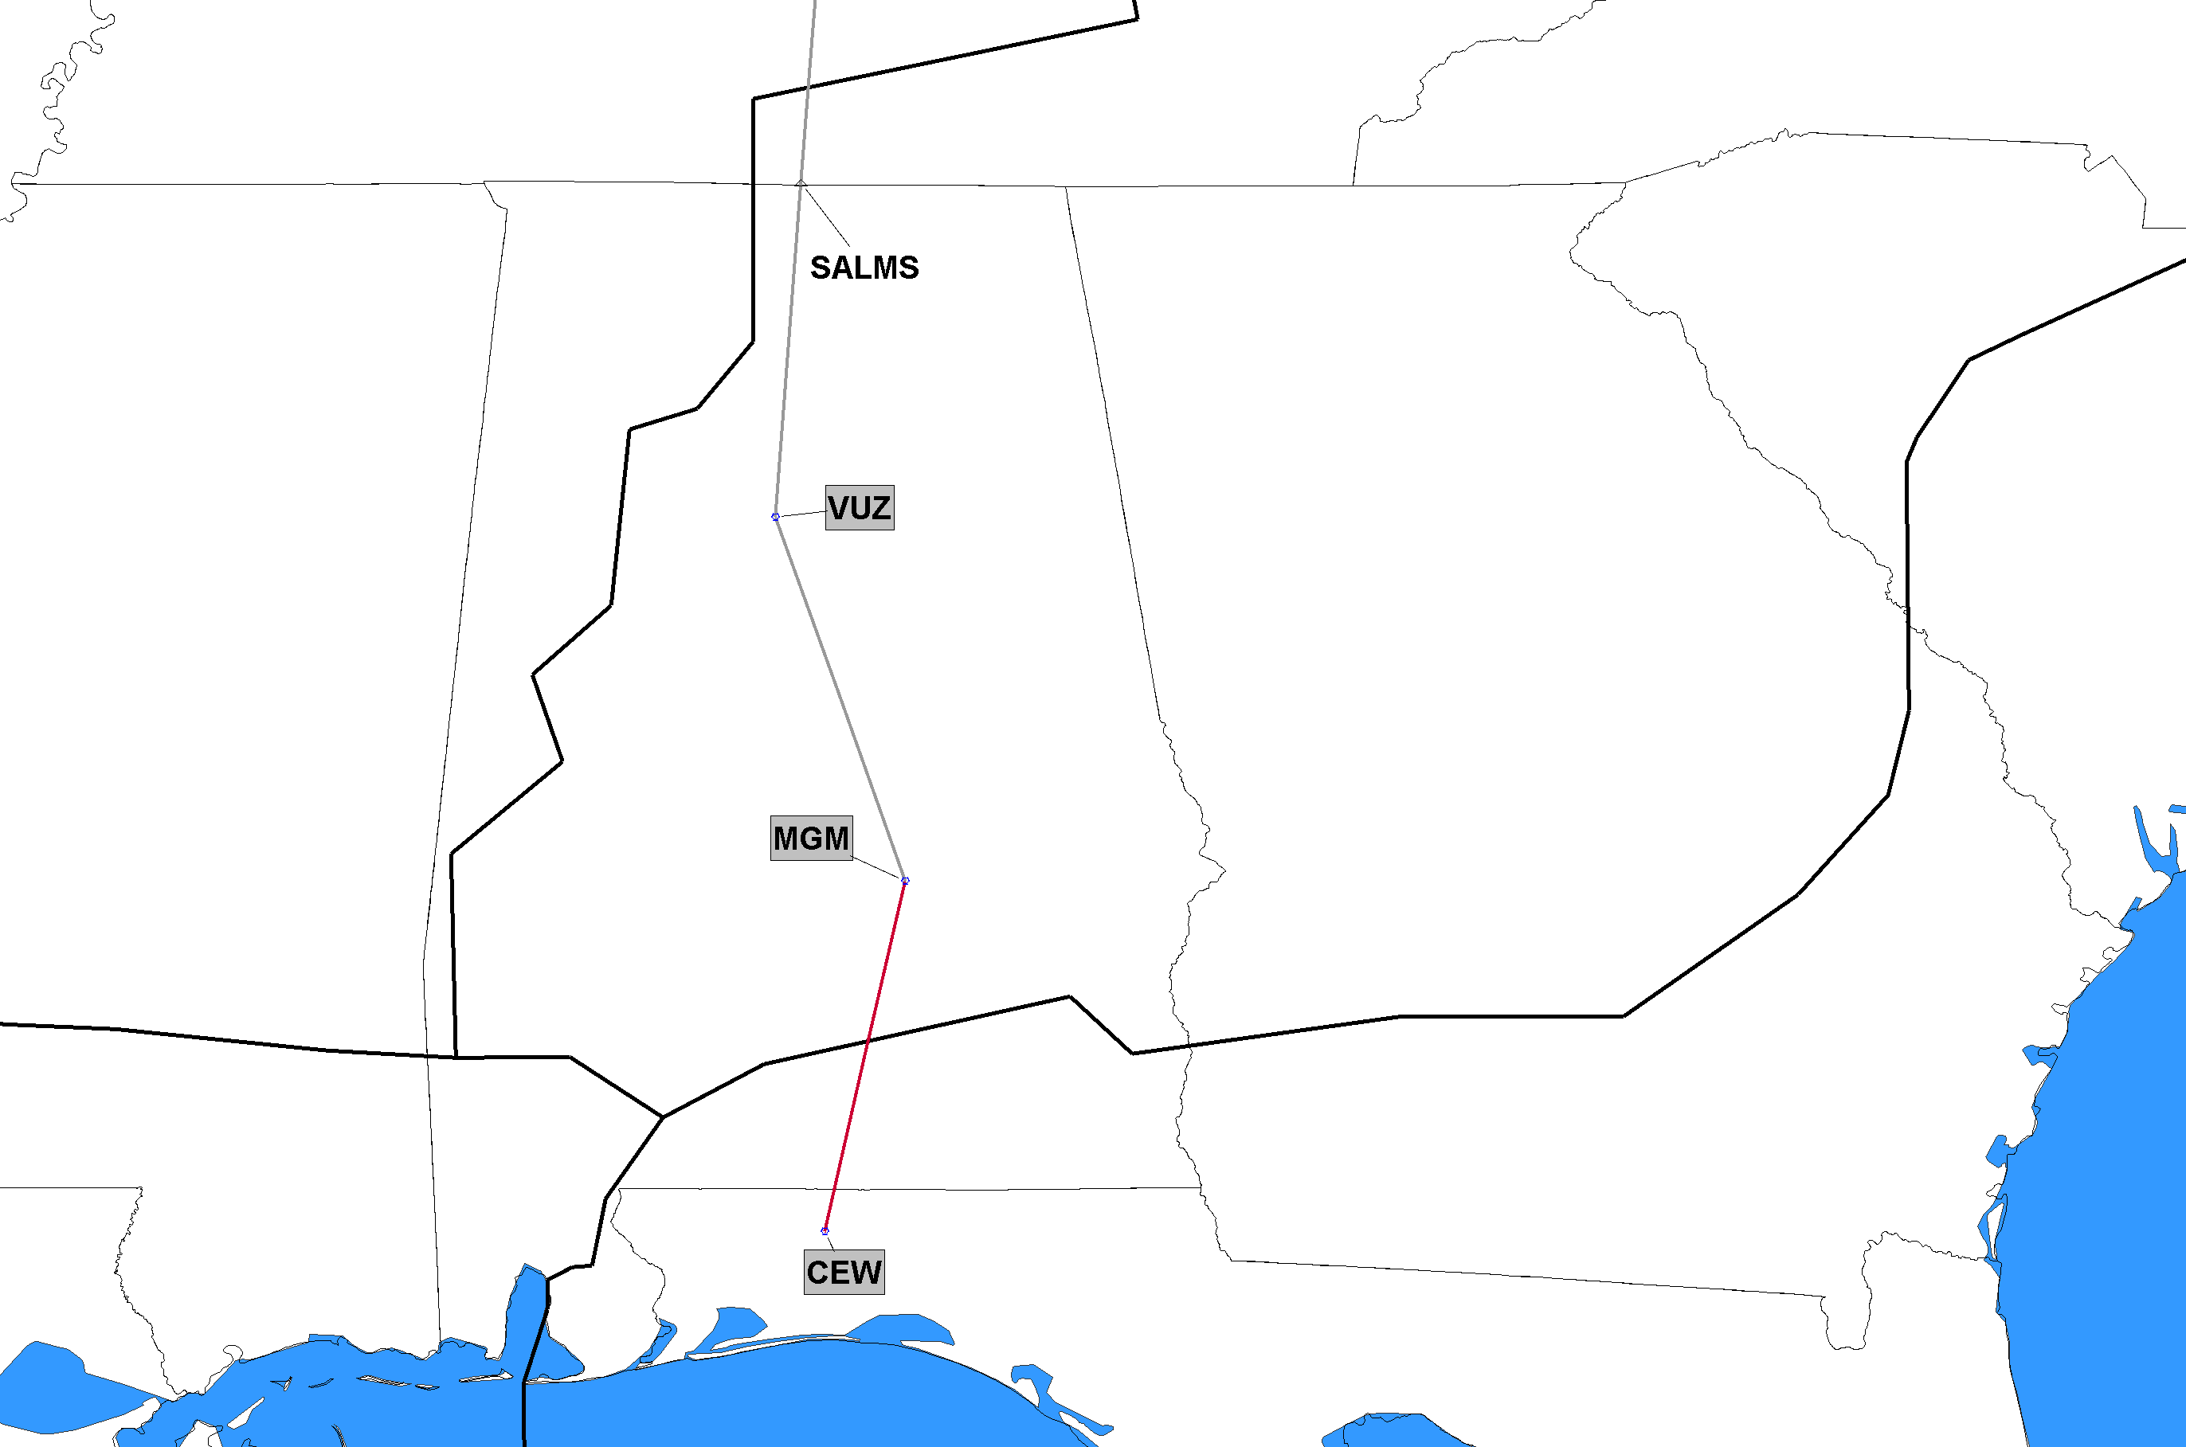
11/5/2020 J39 Cancel Segment J39 Crestview (CEW), FL to Montgomery (MGM), AL
ZTL
ZJX
Red Segment Being Deleted
Click to Return to Index

Slide 29
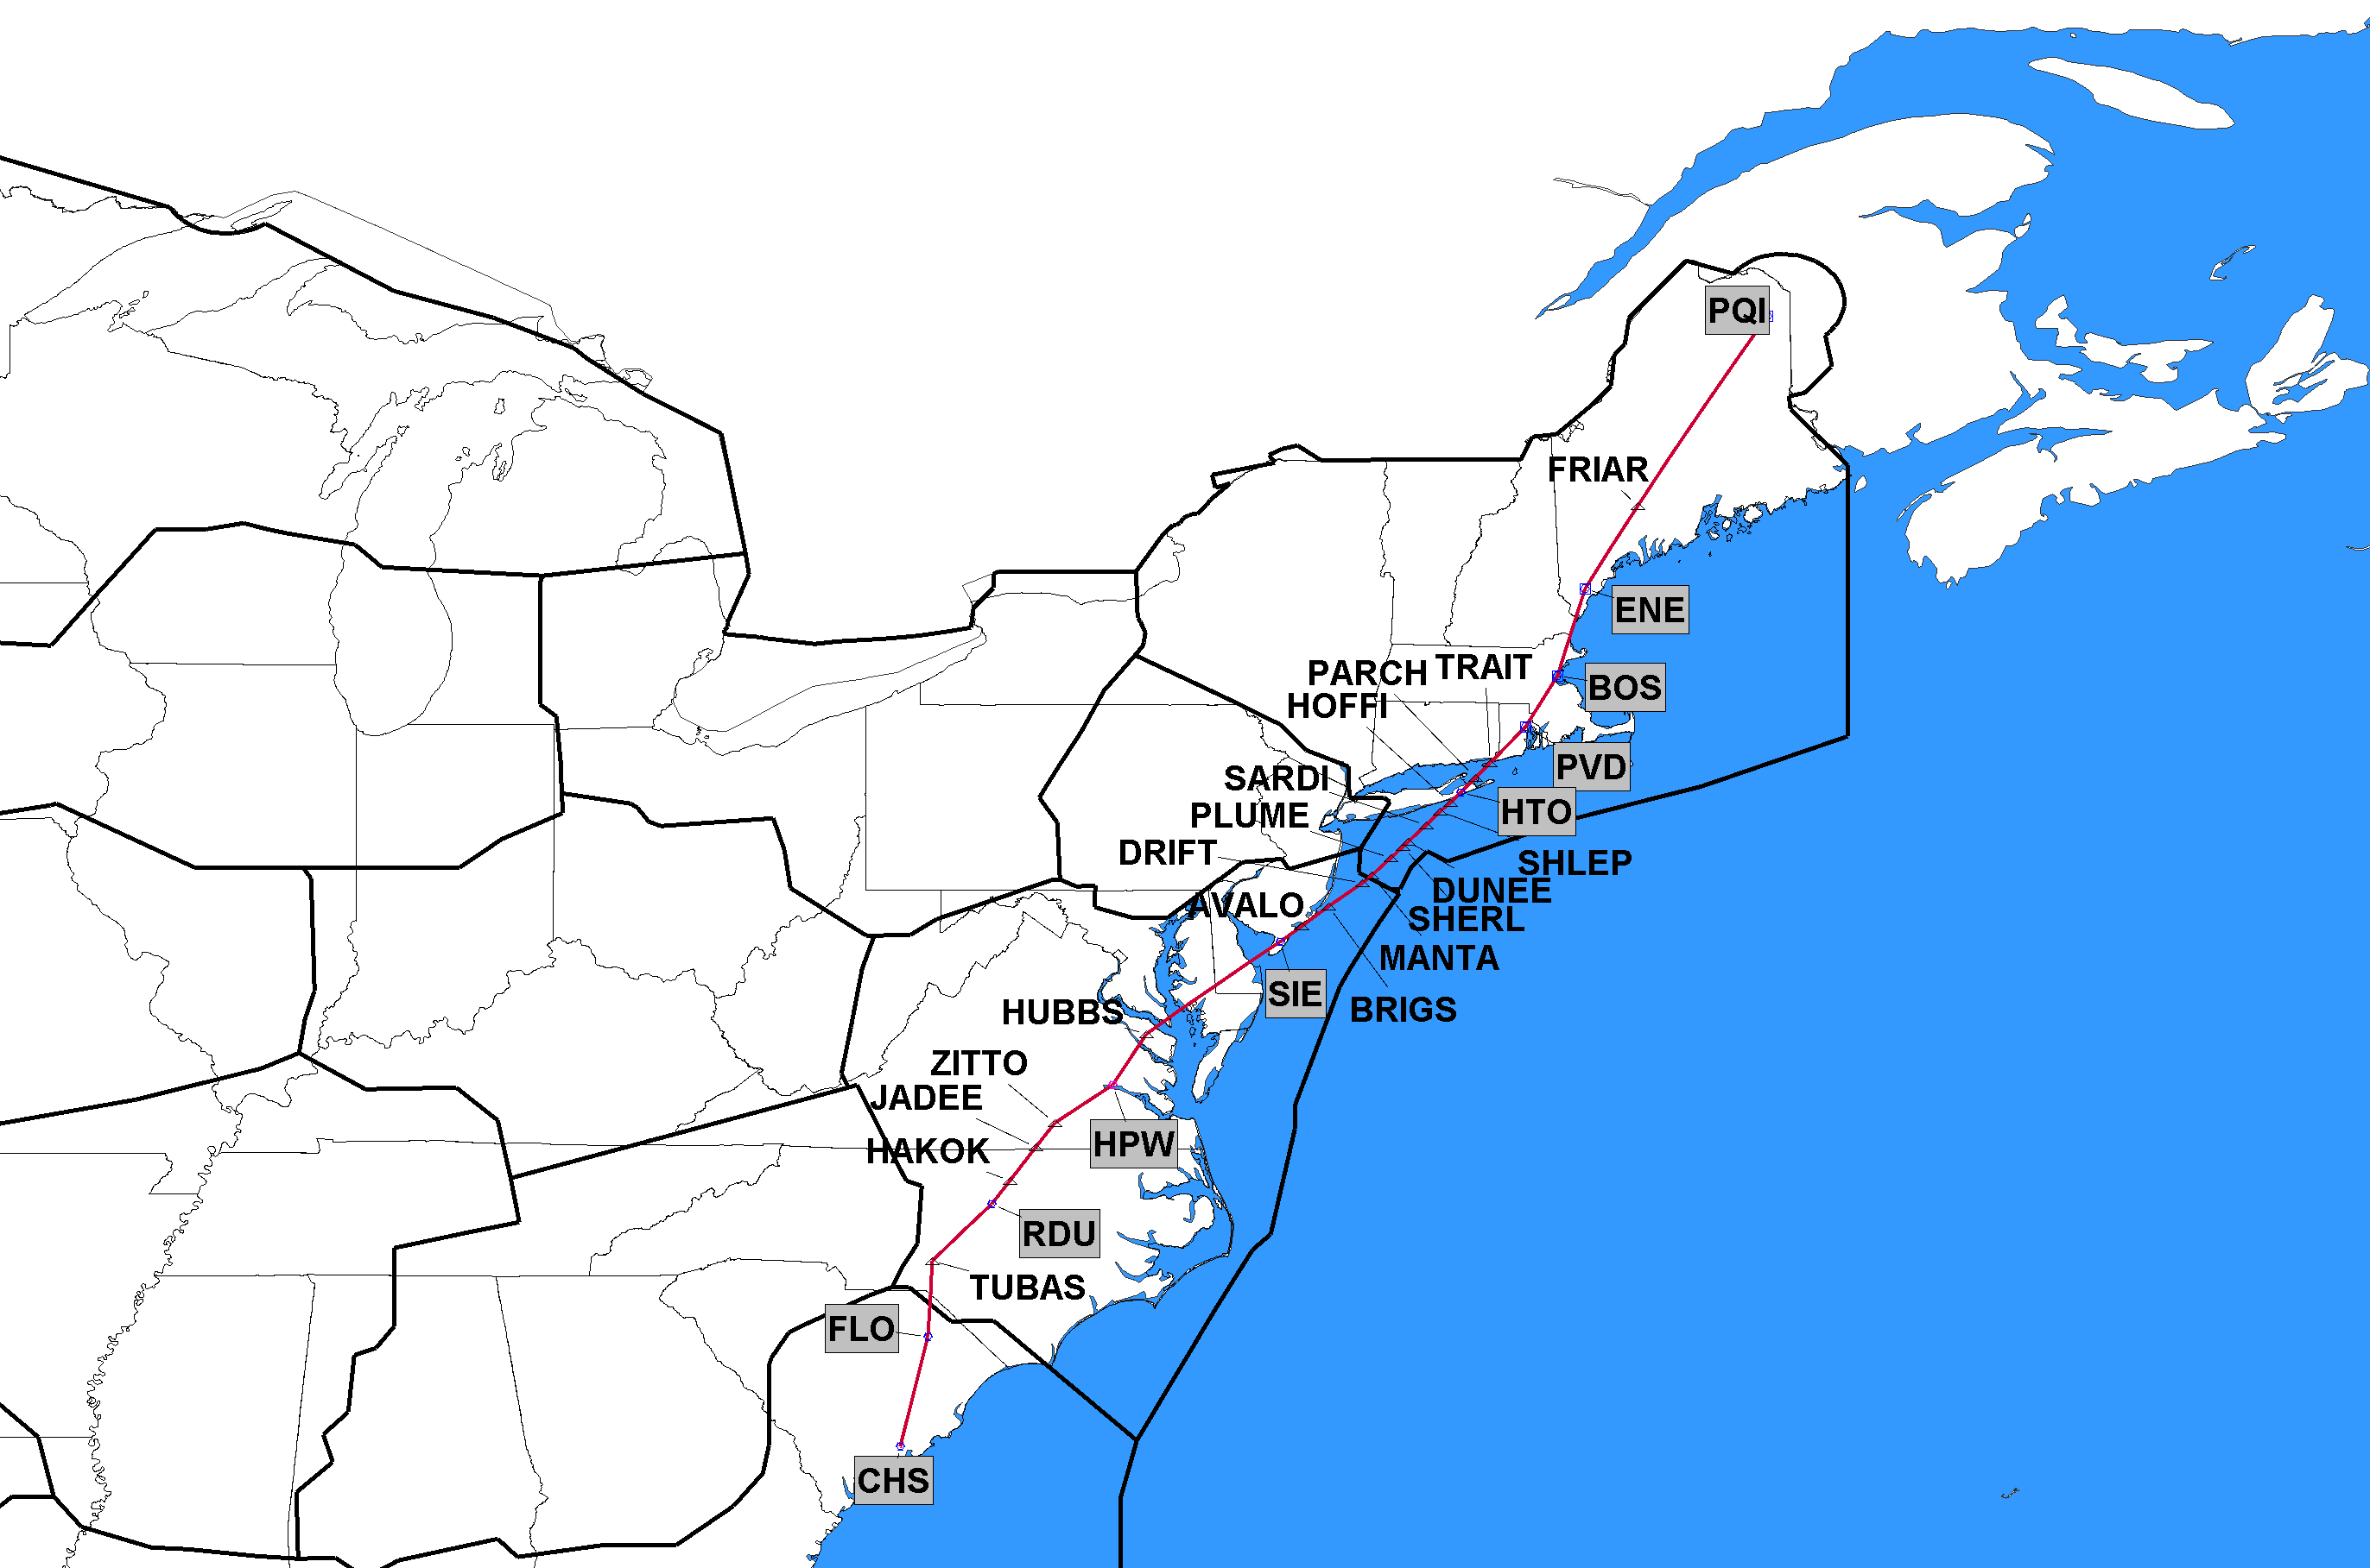
11/5/2020 J55 Cancel Segment J55 Charleston (CHS), SC to TUBAS, NC
ZBW
ZDC
Delete CHS-TUBAS only 11/5/2020
Additional changes on 12/2/2021
ZJX
J-Route Deleted in its Entirety
Click to Return to Index

Slide 30
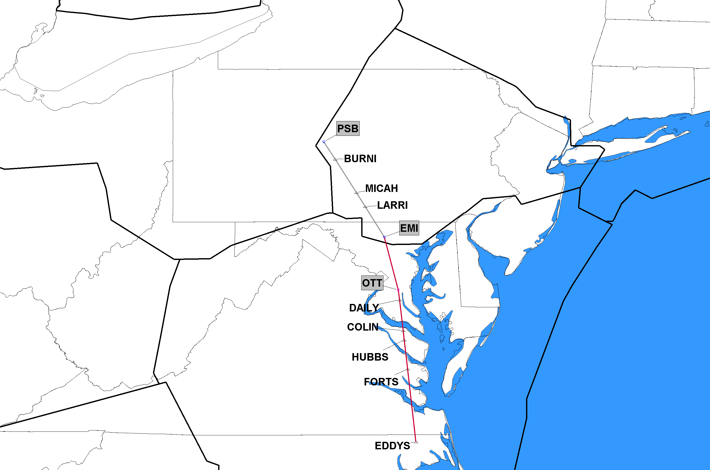
11/5/2020 J61 Cancel Segment J61 EDDYS, NC to Westminster (EMI), MD
ZNY
ZDC
Red Segment Being Deleted
Click to Return to Index

Slide 31
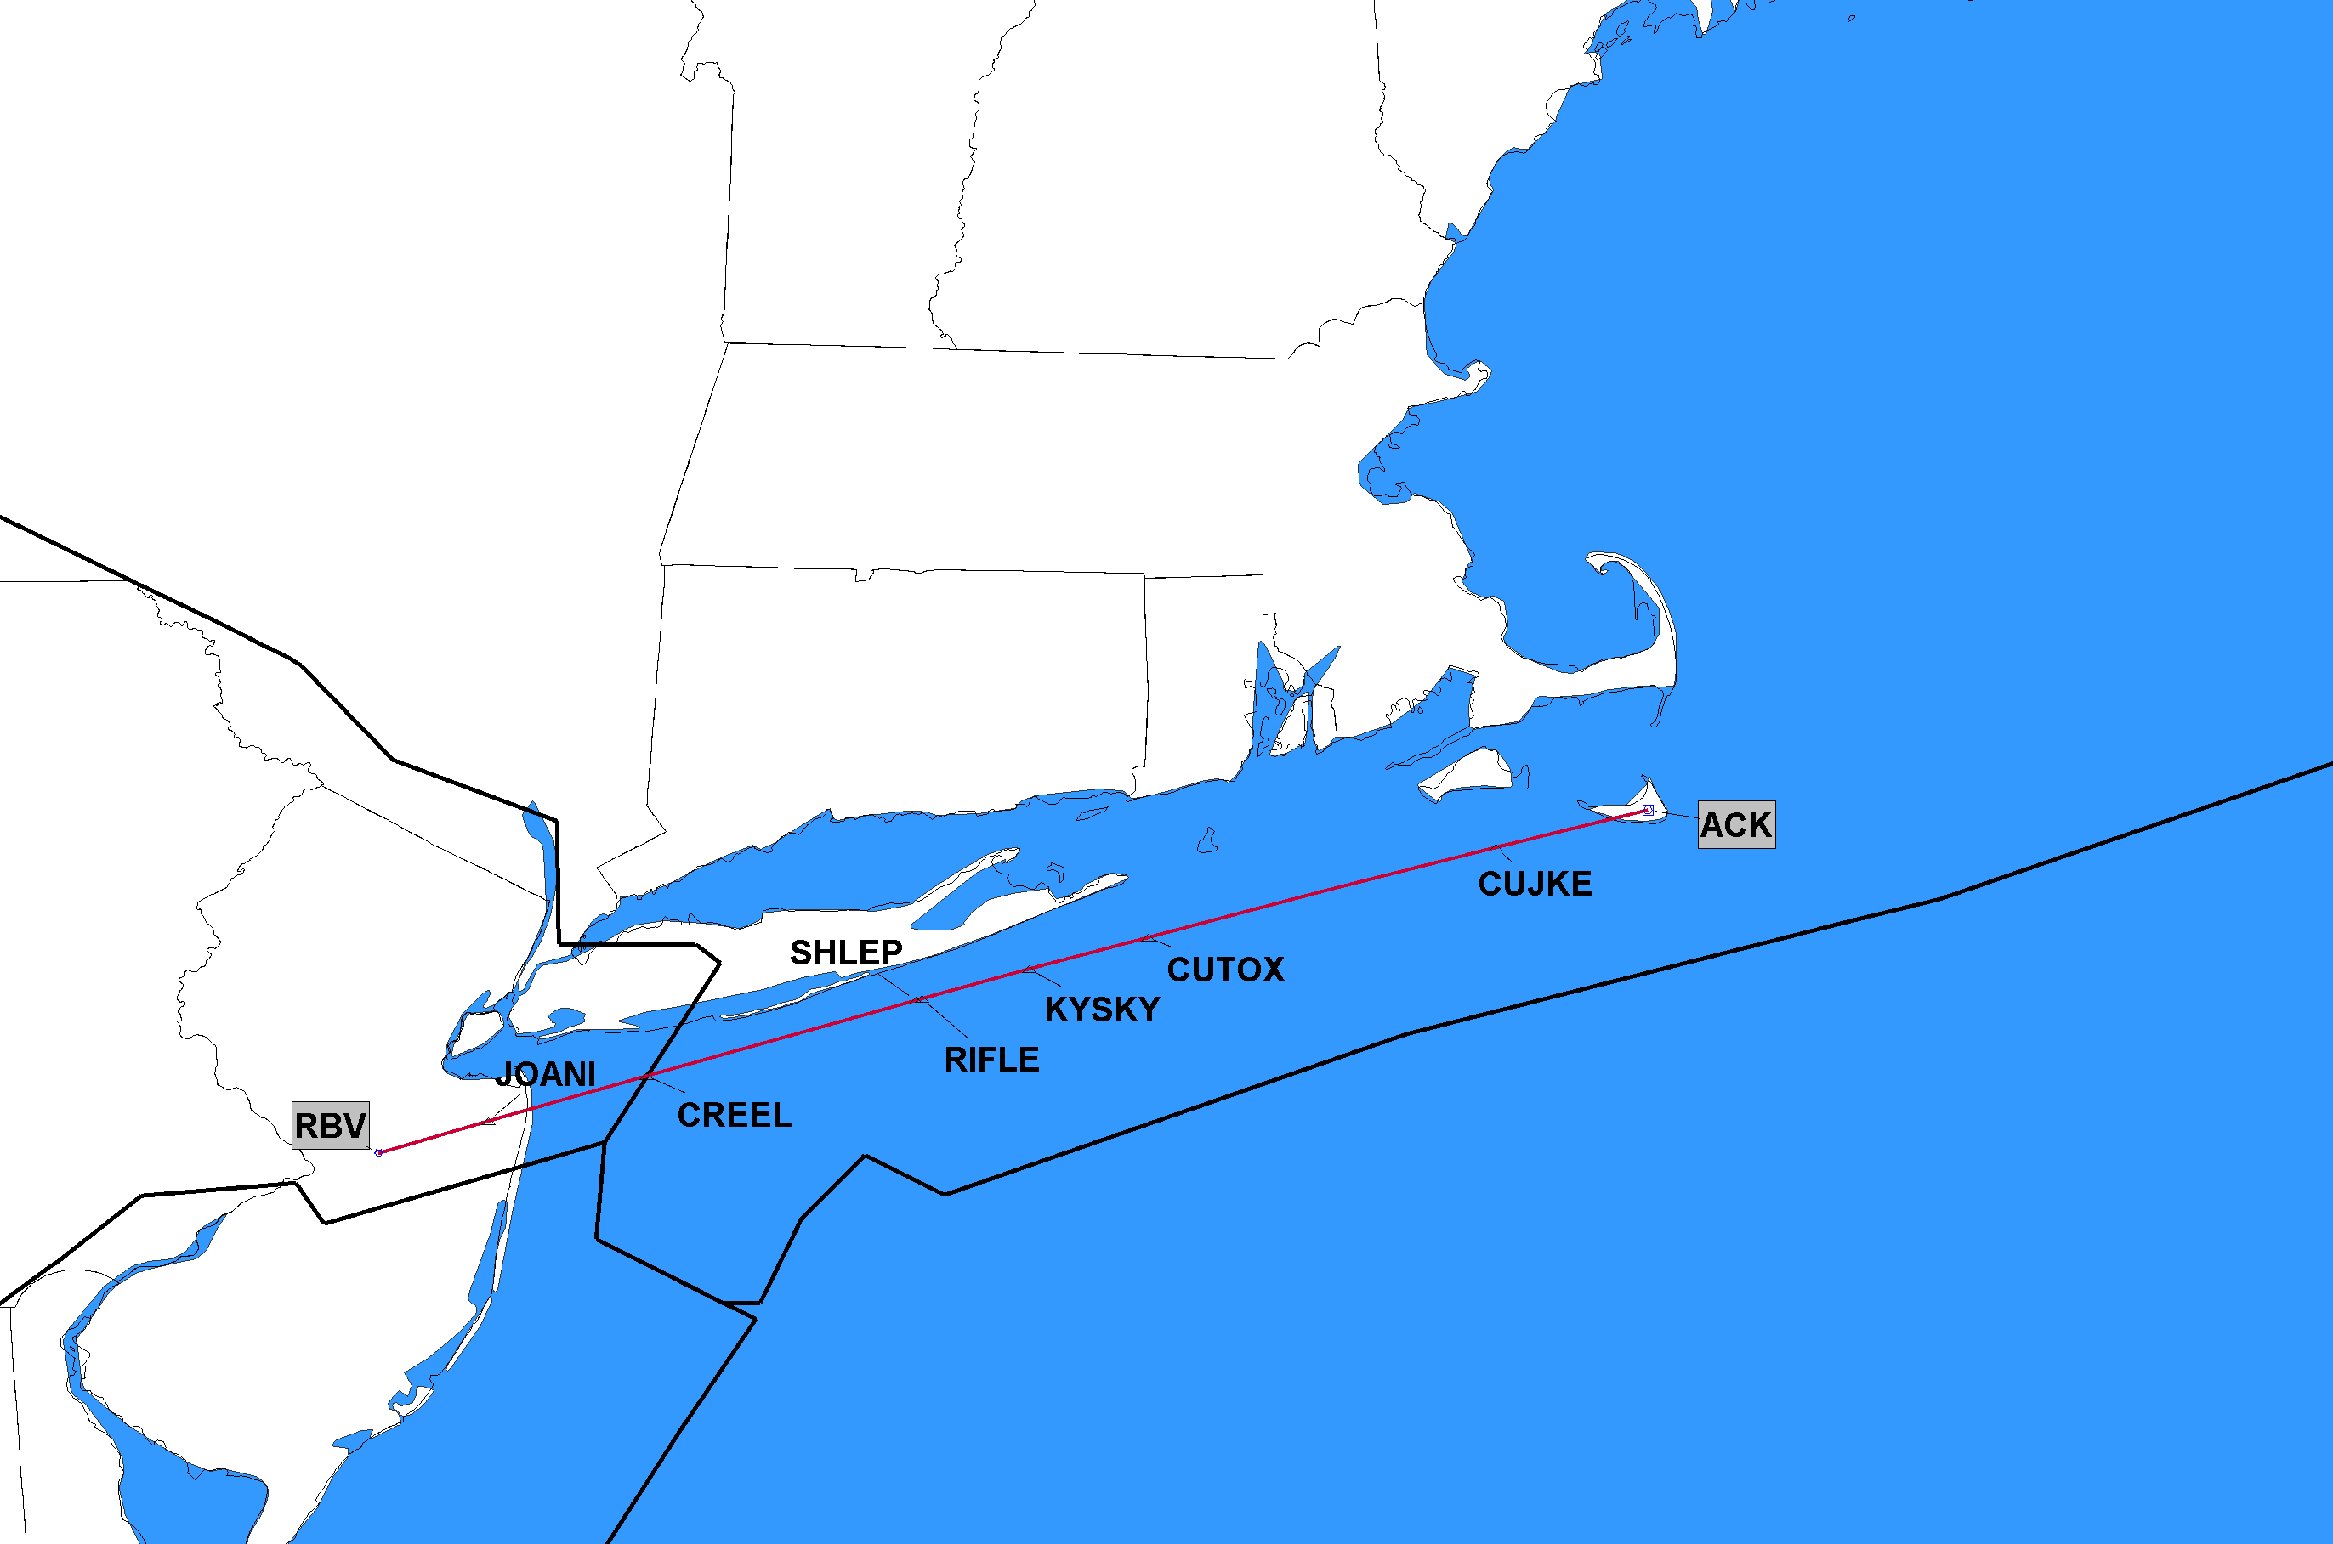
11/5/2020 J62 Completely Deleted J62 Robbinsville (RBV), NJ; to Nantucket (ACK), MA
ZBW
ZNY
J-Route Deleted in its Entirety
Click to Return to Index

Slide 32
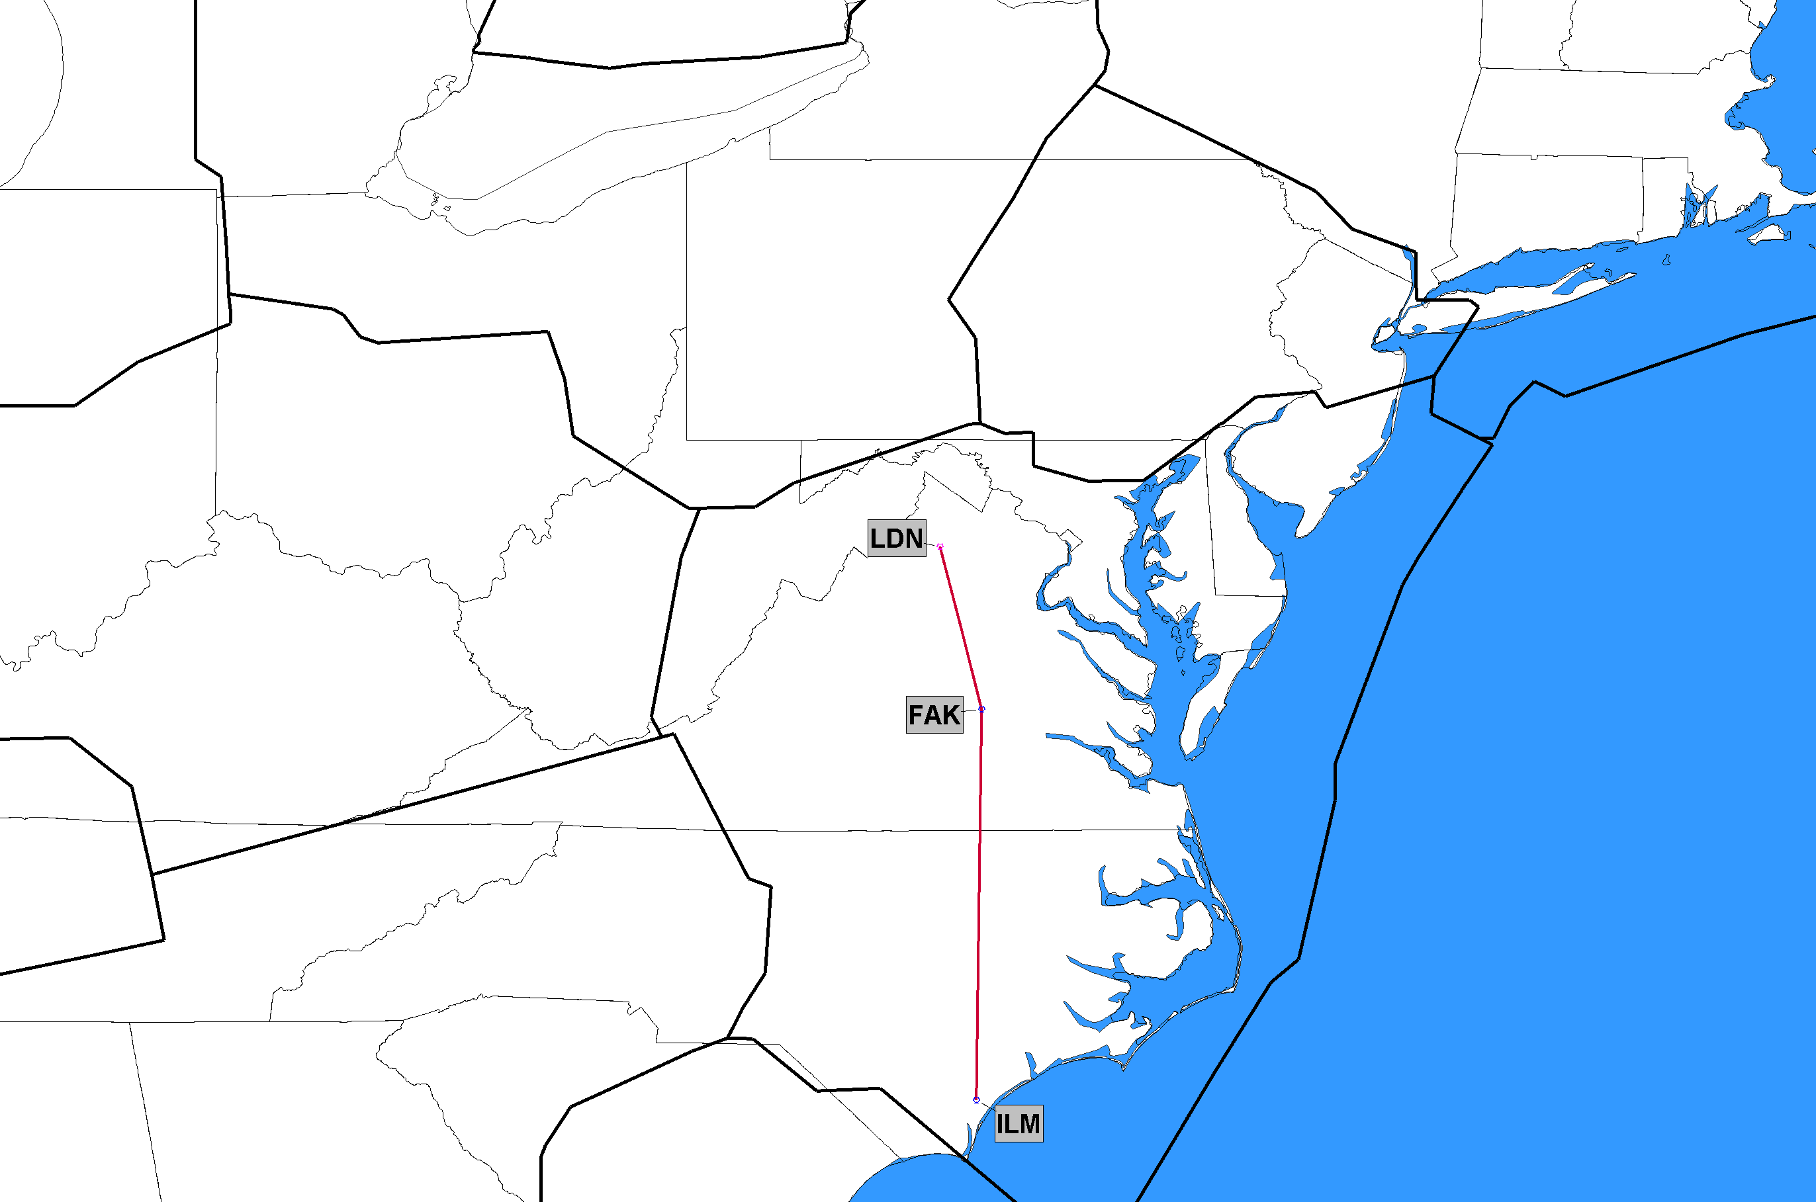
11/5/2020 J109 Completely Deleted J109 Wilmington (ILM), NC to Linden (LDN), VA
ZDC
J-Route Deleted in its Entirety
Click to Return to Index

Slide 33
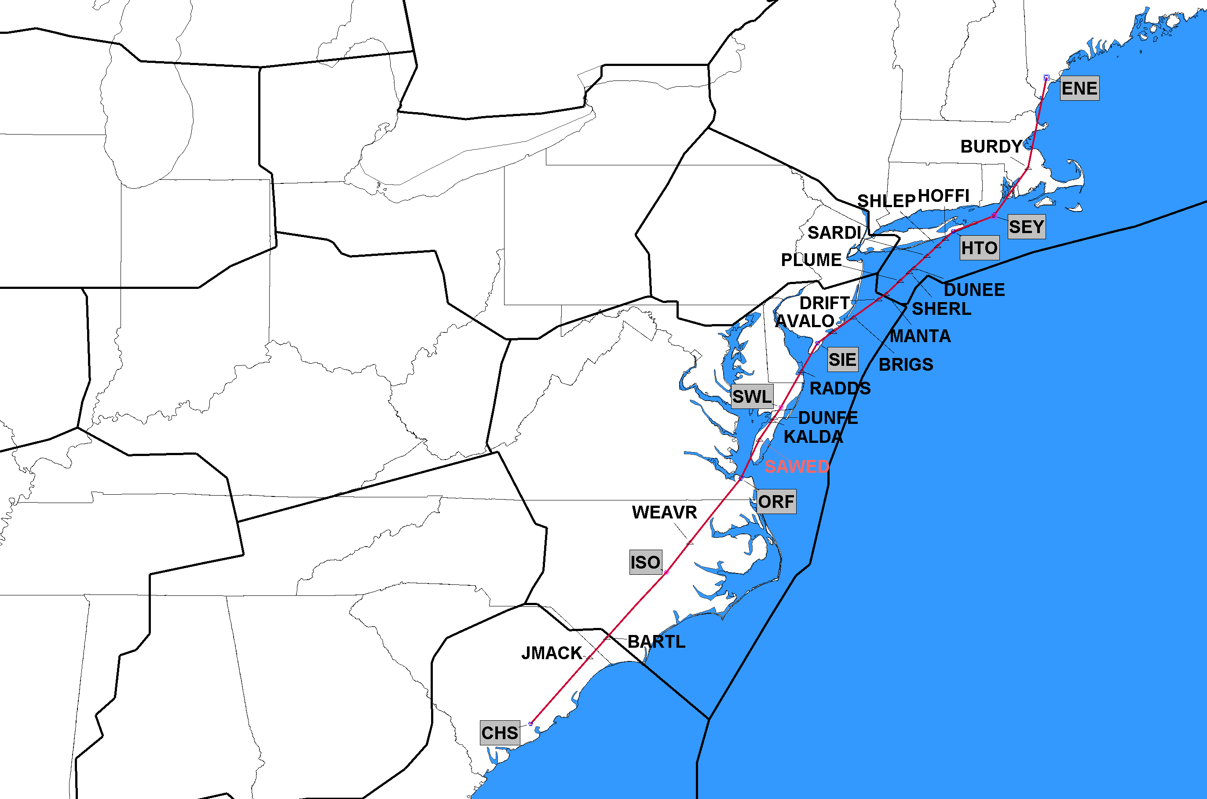
11/5/2020 J121 Cancel Segment J121 BRIGS, NJ to Kennebunk (ENE), ME
ZBW
ZDC
Delete BRIGS-ENE only 11/5/2020
Additional changes on 12/2/2021
ZJX
J-Route Deleted in its Entirety
Click to Return to Index

Slide 34
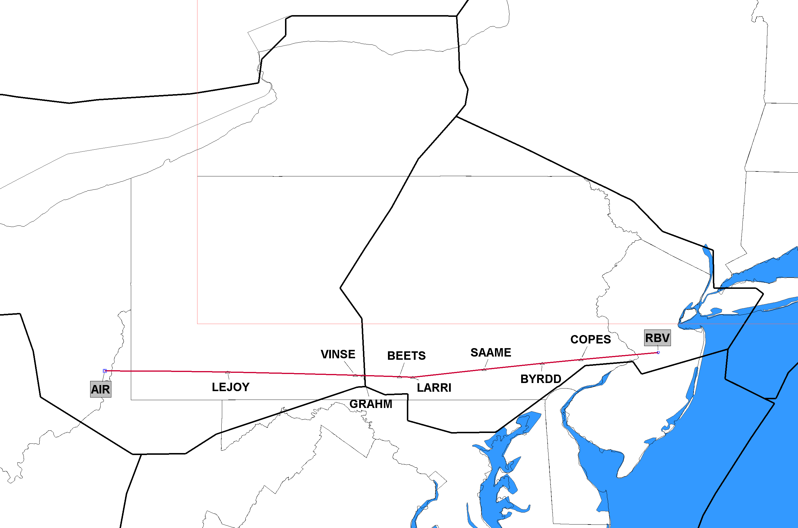
11/5/2020 J230 Completely Deleted J230 Robbinsville (RBV), NJ to Bellaire (AIR), OH
ZNY
ZOB
J-Route Deleted in its Entirety
Click to Return to Index

Slide 35
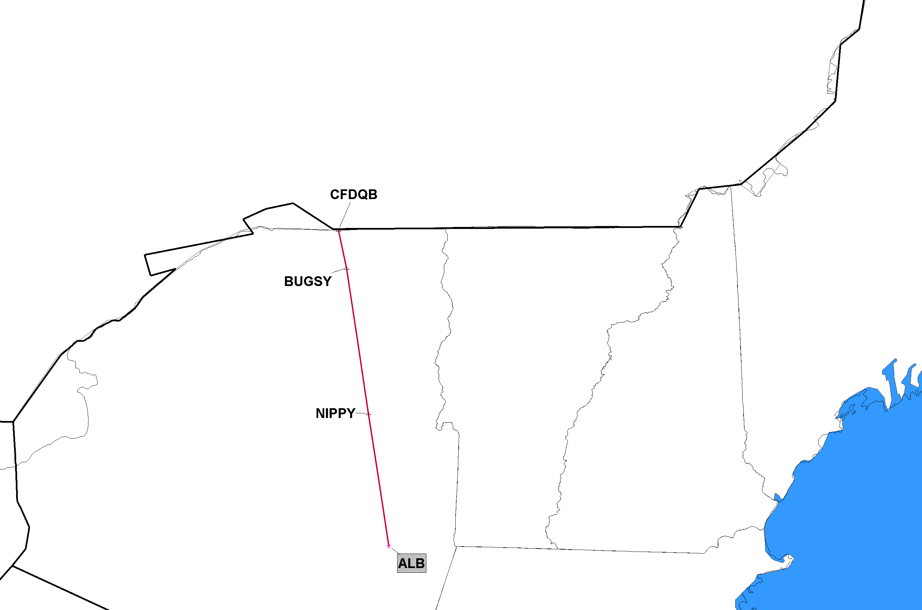
11/5/2020 J570 Completely Deleted J570 Albany (ALB), NY to Mirabel (YMX), PQ, Canada
NavCanada
Segment(s) in Canada not depicted
ZBW
J-Route Deleted in its Entirety
Click to Return to Index

Slide 36
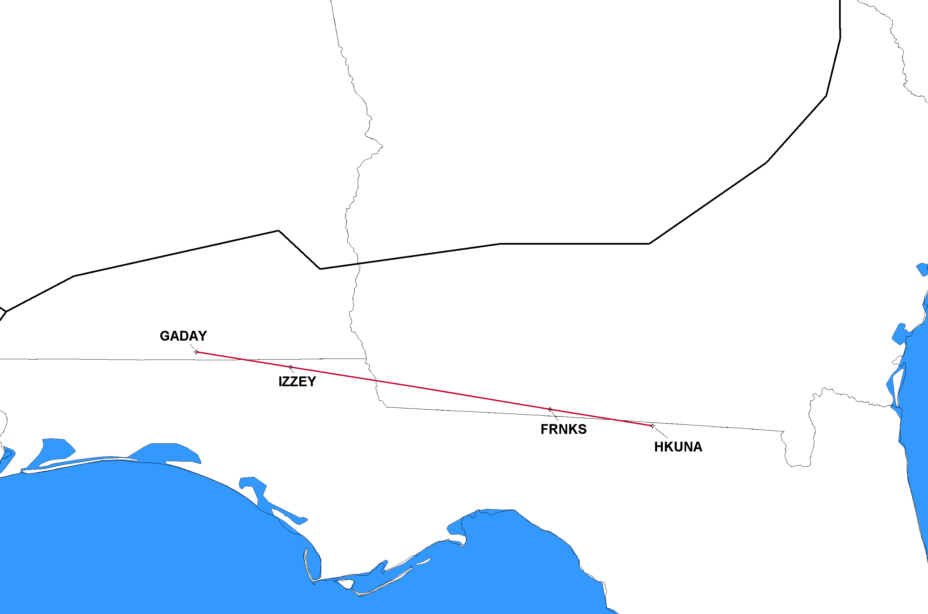
11/5/2020 Q108 Completely Deleted Q108 GADAY, AL to HKUNA, FL
ZJX
J-Route Deleted in its Entirety
Click to Return to Index

