Slide 1
KTPA KNOST RNAV DP N/A
ALTERNATE ROUTE TO FILE WHEN KTPA IS ON A NORTH OPERATION

Slide 2
BACKGROUND
The KNOST RNAV DP was commissioned as part of the Florida Metroplex project. Since that start date, we have found the procedure causes more issues than it solves. A joint decision was made to NOTAM the procedure N/A and use alternate routing.

Slide 3
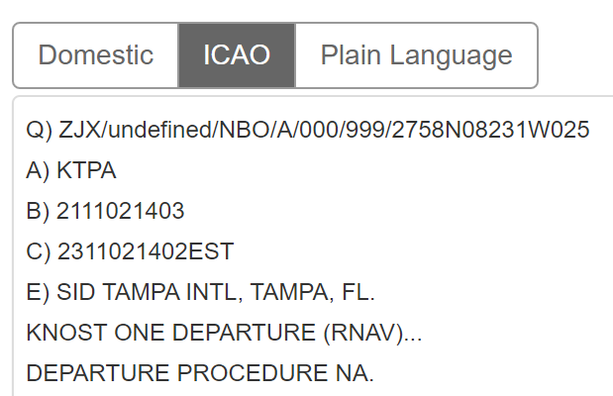
NOTAM (DOMESTIC & ICAO)

Slide 4
ALTERNATE ROUTING FOR WESTBOUND (GULF OF MEXICO) DEPARTURES FROM KTPA
When KTPA is on a NORTH OPERATION ONLY (RWYS 1L/R), please file the following route to go west over the Gulf:
KTPA DORMR PSTOL REMIS Q/Y/M Route
KTPA DORMR PSTOL CIGAR Q/Y/M Route
Flight crews will receive the LGTNG3 SID.

Slide 5
YOUR ATTENTION PLEASE
NOTE
Please do not file for the DORMR RNAV SID when KTPA is on a North Op.
The DORMR SID is for KTPA RWY 19L/R only. File the routing on that last slide and your crews will get a "Cleard As Filed" versus "...except change route to read..."

Slide 6
AND FINALLY...
The DORMR RNAV DP is scheduled to be updated to include KTPA RWYs 1L/R on the May 19, 2022 56-day update.

