Slide 1
Northeast Corridor Atlantic Coast Routes (NEC ACR) Project Status Update

Slide 2
What We Are Doing, Why, When
NEC ACR is one of the biggest changes to the National Airspace System (NAS) in decades
What: New/amended Q Routes and Y Routes will replace the north-south high-altitude route structure along the east coast of the United States
Why: Transition to a PBN-Centric NAS thus decreasing reliance on ground-based NAVAIDs
When: Changes being implemented from 10/10/2019 through 11/3/2022
Due to COVID-19, the implementation of the majority of the remaining routes and procedures were delayed due to inability to conduct controller training

Slide 3
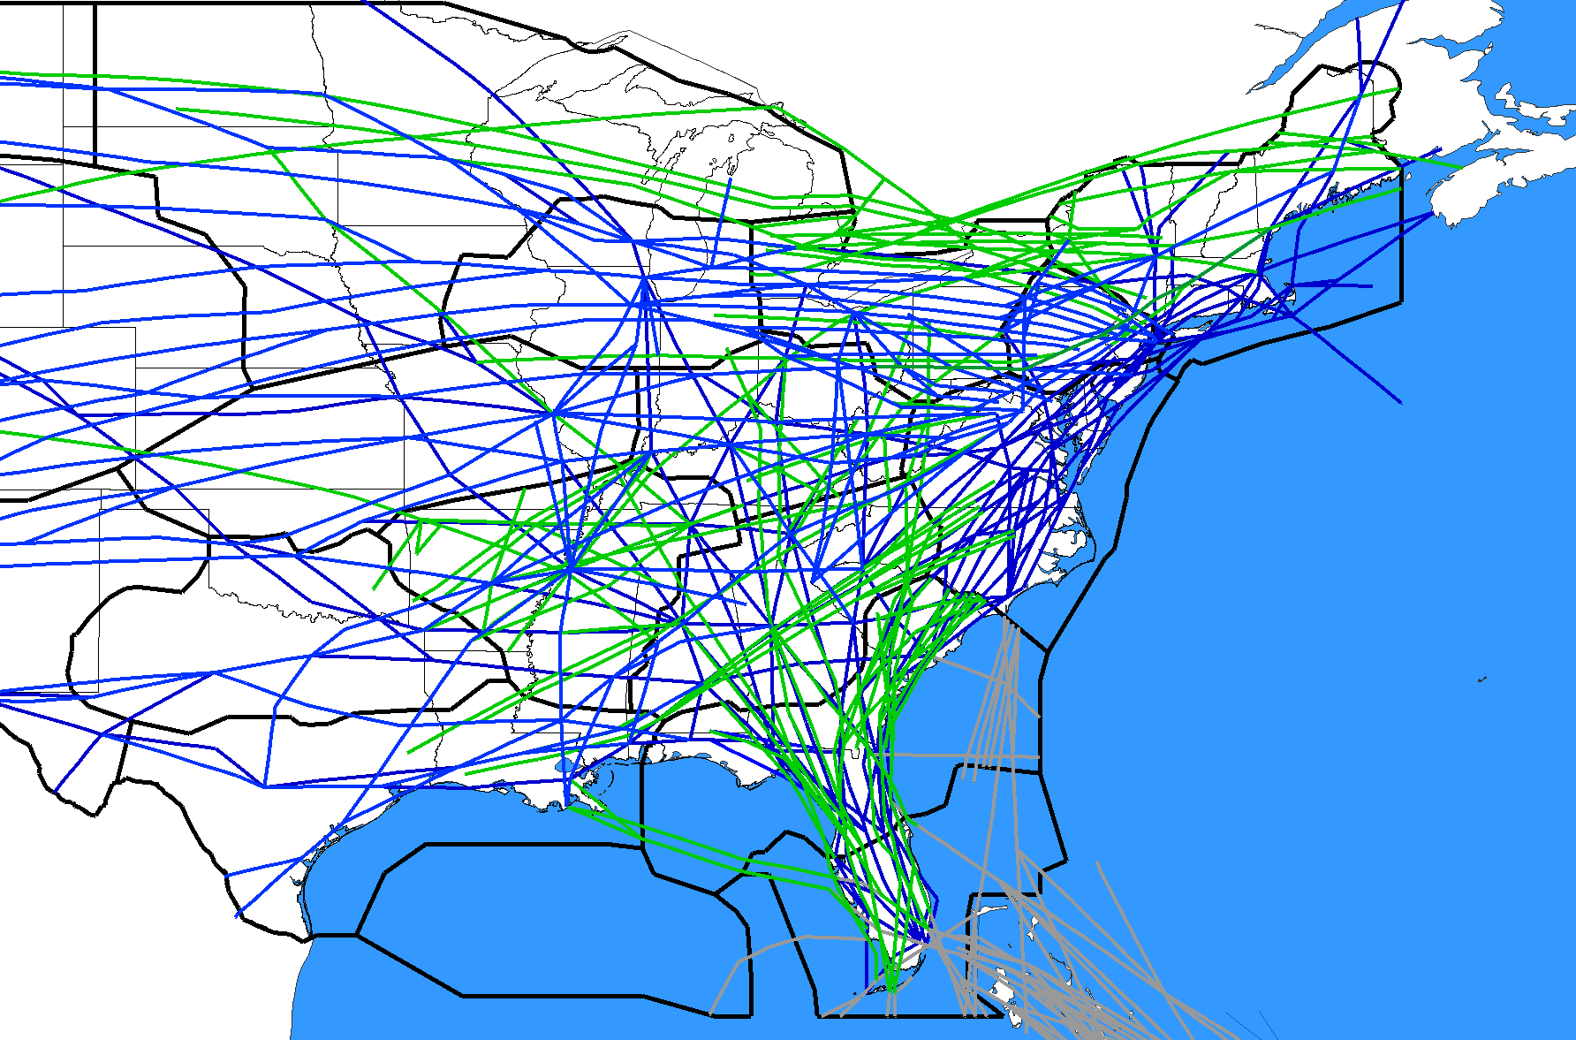
BEFORE
Not all central and western U.S. Routes are depicted
Q-Routes depicted in green
Y-Routes depicted in gray
J-Routes depicted in blue

Slide 4
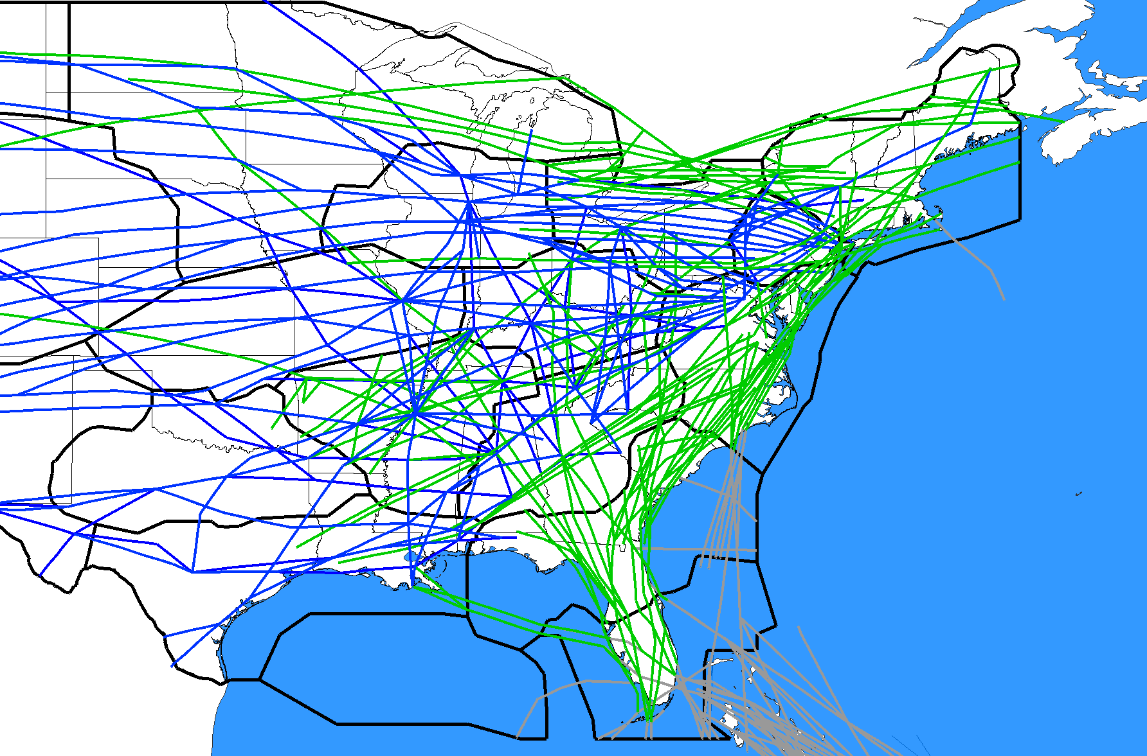
FUTURE STATE 11/3/2022
Not all central and western U.S. Routes are depicted
Q-Routes depicted in green
Y-Routes depicted in gray
J-Routes depicted in blue

Slide 5
Implementation Milestones
10/10/2019 Publish/Implement 1 New Y-Route and 8 Waypoints
11/7/2019 Implement ZDC Low Altitude Sector Changes
1/30/2020 Delete/Amend 33 J-Routes/Q-Route (FL Metroplex)
1/30/2020 Delete 5 CHS STARs
3/26/2020 Delete/Amend 6 SIDs (BWI/IAD/DCA/HEF/ADW)
5/21/2020 Amend 2 Q-Routes: Q75, Q475
5/21/2020 Amend 1 SID (DOV)
7/16/2020 Delete/Amend 18 J-Routes
9/10/2020 Publish/Amend 8 Q-Routes
11/5/2020 Publish/Delete/Amend 9 STARs (PHL/EWR/TEB/LGA/DOV/WRI)
11/5/2020 Publish/Delete/Amend 9 SIDs/STARs/SIAPs (CHS/JZI)
11/5/2020 Delete/Amend 10 J-Routes, 1 Q-Route
2/25/2021 Publish/Delete/Amend 20 RDU SIDs/STARs/SIAPs
10/7/2021 Publish/Delete/Amend 28 Q-Routes/Y-Routes/AR-Routes
10/7/2021 Amended 1 SID (ATL), 1 STAR (WRI)
COVID-19
66 Routes Published, Amended, Deleted in 2020-2021 as of 10/7/2021

Slide 6
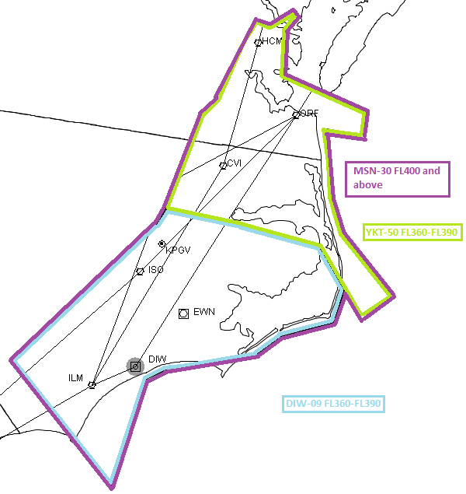
ZDC High Altitude Sector Changes
Stratify Sectors 09 & 50 to create new Sector 30
Resulting 3 Sectors
09 DIW Ultra High
FL360-390
50 YKT Ultra High
FL360-390
30 MSN Super High
FL400-ABV
To help reduce sector workload/complexity and improve sector throughput
11/4/2021
50
09

Slide 7
NEC ACR Changes - 2021
10/7/2021 (7) Q-Route Additions/Amendments
Publish (2) New Q419, Q437
Amend (5) Q22, Q29*, Q34, Q54*, Q64
NOTAM NA Q-Routes
10/7/2021-12/2/2021 NOTAM NA Q22, Q34, Q419, Q437
10/7/2021-11/3/2022 NOTAM NA Q64 TYI./.SAWED
10/7/2021 (20) Y-Route/AR-Route Deletions/Amendments
Amend (9) Y289, Y291 ,Y299, Y307*, Y309, Y323, Y436*, Y438*, Y494*
Amend* (9) AR3, AR5, AR12, AR15, AR16, AR17, AR18, AR21, AR23
Delete* (2) AR7, AR25
NOTAM NA Y-Routes
10/7/2021-9/8/2022 NOTAM NA Y291, Y309, Y319, Y323
10/7/2021-11/3/2022 NOTAM NA Y289, Y299
10/7/2021 (1) SID
Amend ATL PHIIL3 SID
11/4/2021 ZDC High Altitude Sector Changes (Sector 30)
12/2/2021 Cancel Q-Route NA NOTAMs: Implement Q419, Q22, Q437, Q34
12/2/2021 (6) J-Route Deletions/Amendments
Delete (4) J150, J193, J222, J225
Amend (2) J42, J191 (Delete HPW-RBV Only)
*Note: All changes to Q29, Q54, Y307, Y436, Y438, Y494, and the AR-Routes were implemented when published on 10/7/2021.
All 2021 Dates Subject to Change Due to COVID-19

Slide 8
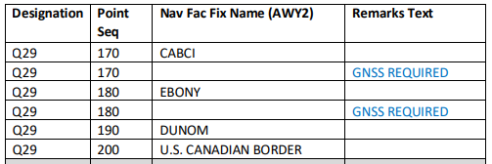
Safety Alerts and Charting NOTAMs
Safety Alert: NASR 21-15 SA
Q29 should have “GNSS REQUIRED” in the last two segments:
CABCI..EBONY and EBONY..DUNOM
NOTAMs (details on next 2 pages):
Enroute High Chart H-08
Enroute High Chart H-09

Slide 9
NOTAM: H-08, FDC 1/7555
1/7555 for H8
!FDC 1/7555 FDC CHART CORRECT U.S. GOVERNMENT IFR
ENROUTE HIGH ALTITUDE
CHART H-8, J, EFFECTIVE 04 NOV 2021...
EFFECTIVE 07 OCT 2021
Y350 MISSING ROUTE SEGMENT BETWEEN WAYPOINT CILEX (BEARING148),
WAYPOINT KNSLY (BEARING 330 ) DISTANCE 224, MAA-60000, WHICH OFF
THIS CHART AND SHOULD BE DEPICTED AS EDGE TYPE.
EFFECTIVE 07 OCT 2021
Y353 MISSING ROUTE SEGMENT BETWEEN WAYPOINT KNSLY (BEARING 333) TO
WAYPOINT SUMAC (BEARING 150) MAA-60000 DISTANCE 329 TO, WHICH OFF
THIS CHART AND SHOULD BE DEPICTED AS EDGE TYPE
EFFECTIVE 07 OCT 2021
Y398 MISSING ROUTE BETWEEN WAYPOINT JAGOR (BEARING 142) TO WAYPOINT
KNSLY (BEARING 325), DISTANCE 316, MAA-60000 TO, WHICH IS OFF THIS
CHART.. 2110041451-PERM

Slide 10
NOTAM: H-09, FDC 1/7568
1/7885 for H-9
!FDC 1/7885 FDC CHART CORRECT U.S. GOVERNMENT IFR
ENROUTE HIGH ALTITUDE
CHART H-9, PANEL C, EFFECTIVE 09 SEP 2021...
EFFECTIVE 07 OCT
Y438 IS MISSING FROM BAHAA (BEARING 100) TO SNABS (BEARING 279)
WITH A DISTANCE OF 25 AND MAA-60000
Y438 IS MISSING FROM SNABS (BEARING 099) TO OZENA (BEARING 279)
WITH A DISTANCE OF 9 AND MAA-60000
Y438 IS MISSING FROM OZENA (BEARING 100) TO OHLAA (BEARING 280)
WITH A DISTANCE OF 13 AND MAA-60000
Y438 IS MISSING FROM OHLAA (BEARING 100) TO CARPX (BEARING 280)
WITH A DISTANCE OF 18 AND MAA-60000
Y438 IS MISSING FROM CARPX (BEARING 101) TO TROUT (BEARING 282)
WITH A DISTANCE OF 39 AND MAA-60000. 2110042056-PERM

Slide 11
Q-Route NA NOTAMs Effective 10/7/2021-12/2/2021
Effective 10/7/2021-12/2/2021
Q22, BEARI, VA TO FOXWD, CT NA
Q34, SWAAP, TN TO ROBBINSVILLE, NJ (RBV) VORTAC NA
Q419, BROSS, MD TO DEER PARK, NY (DPK) VOR/DME NA
Q437, VILLS, NJ TO SLANG, VT NA
Effective 10/7/2021-11/3/2022
Q64, TAR RIVER, NC (TYI) VORTAC TO SAWED, VA NA

Slide 12
ZJX Q-Route/Y-Route NOTAMs
Y-Routes: Existing “ATC ASSIGNED ONLY” NOTAMs for the following Florida Y-Routes will be cancelled on 10/7/2021 and reissued to be effective through 11/3/2022:
Y289, Y299
Q/Y-Routes: Existing “ATC ASSIGNED ONLY” NOTAMs for the following Florida Q/Y-Routes will be cancelled on 10/7/2021 and reissued to be effective through 9/8/2022:
Q85, Q87, Q97, Q109, Q113, Q135, Q409
Y291, Y309, Y319, Y323
Q/Y-Routes: Existing “ATC ASSIGNED ONLY” NOTAMs for the following Florida Q/Y-Routes will be cancelled on 9/8/2022 and reissued to be effective through 11/3/2022:
Q85, Q87, Q97, Q109, Q113, Q135, Q409
Y291, Y309, Y319, Y323

Slide 13
Preferred IFR Routes Effective 10/7/2021
The following changes will be implemented on 10/7/2021:
ATL PHIIL 3 RNAV SID: HRTWL transition replaces GRD transition
Q54, HRTWL waypoint replaces GRD VORTAC
ASHEL waypoint added between RAYNE and NUTZE
Q64, HRTWL waypoint replaces GRD VORTAC
DADDS and MARCL waypoints added between IDDAA and TYI
Q29, MEMFS waypoint replaces MEM VORTAC
DUNOM waypoint moved 1.26 NM east to the US/Canadian border
Q34, MEMFS waypoint replaces MEM VORTAC
LOOSE waypoint added between TXK and WASKO
Existing Route | New Route
PHIIL (RNAV)-DP GRD | PHIIL (RNAV)-DP HRTWL
Q54 GRD | Q54 HRTWL
GRD Q54 | HRTWL Q54
Q64 GRD | Q64 HRTWL
GRD Q64 | HRTWL Q64
Q29 MEM | Q29 MEMFS
MEM Q29 | MEMFS Q29
Q34 MEM | Q34 MEMFS
MEM Q34 | MEMFS Q34
Origin | Destination | Route Type | Route Number | Revised Route String
ATL | JFK | H | 1 | PHIIL (RNAV)-DP HRTWL Q64 TYI ORF J121 SIE CAMRN-STAR
ATL | ORF | H | 1 | PHIIL (RNAV)-DP HRTWL Q54 NUTZE DRONE DRONE-STAR
ATL | PHF | H | 1 | PHIIL (RNAV)-DP HRTWL Q54 NUTZE DRONE DRONE-STAR
DFW | BDL | H | 1 | TRYTN (RNAV)-DP LOOSE MEMFS Q29 JHW Q82 MEMMS WILET STELA-STAR
DFW | JFK | H | 1 | FORCK (RNAV)-DP FORCK ELD SQS Q30 VUZ ATL HRTWL Q64 TYI ORF J121 SIE CAMRN-STAR
HOU | ORF | H | 1 | ELOCO (RNAV)-DP LLA HRV SJI J37 CATLN Q64 HRTWL Q54 NUTZE DRONE DRONE-STAR
IAH | ORF | H | 1 | GUMBY (RNAV)-DP GUSTI Q22 CATLN Q64 HRTWL Q54 NUTZE DRONE DRONE-STAR
IAH | ORF | H | 2 | MMUGS (RNAV)-DP GUSTI Q22 CATLN Q64 HRTWL Q54 NUTZE DRONE DRONE-STAR
MEM | SDF | H | 2 | MEMFS Q29 SIDAE CHERI CHERI-STAR
Additional changes publishing on 10/7/2021 for Q22, Q34, Q419, and Q437 will be reflected in the 12/2/2021 Preferred IFR Route amendments, concurrent with the cancellation of NA NOTAMs.

Slide 14
Preferred IFR Routes Effective 2DEC2021
Will distribute as soon as possible
Provided for advance planning purposes only
Please do not file the new routes until 12/2/2021
National Playbook Routes and Coded Departure Routes are also being updated

Slide 15
How Operators Can Help
Share this briefing with others
Share with route planners, dispatchers, & management/staff
Provide feedback and suggestions
Help identify issues/mitigations not yet identified
Direct questions/comments to NEC ACR
Watch for additional information
Flight Planners Telcon, NCF briefings, NBAA, IATA, etc.
Plan resources for route planning & programming
Updated Preferred IFR Routes to be distributed ASAP
Do not file the new Q-Routes before 12/2/2021
Be ready to utilize the new routes
File the new Q-Routes beginning on 12/2/2021

Slide 16
Implementation TMIs
Utilized up to 2 weeks during the implementation period
To provide controllers and aircrews the opportunity to become accustomed to the new routes and changes to the airspace while ensuring a safe operation
Intended to reduce complexity and redistribute volume across all available airspace
TMIs being considered to reduce the need for AFPs
Reroutes to the west of ZDC i.e.J6, altitude capping or tunneling
Voluntary actions to reduce need for TMIs
Use of overwater routes, filing at/above FL400, filing lower altitudes on shorter routes, filing routes west or north of ZDC
TMIs to be re-evaluated on a daily basis

Slide 17
NEC ACR Go Team
Utilize the Virtual Go-Team 12/2-12/4/2021
Open conference bridge staffed by subject matter experts available to address any ATC or operator issues
ZoomGov meeting; Password for all options is 252302
Click to Join: https://faavideo.zoomgov.com/j/16197088093
Call 1-888-924-3239 or 1-571-302-4908; Meeting ID: 16197088093
Download the ‘Zoom Cloud Meetings’ App; Select ‘Join a Meeting’ and enter Meeting ID: 16197088093
Dates/Hours/Status Reports
Thursday, Friday, Saturday(if needed) 12/2-4, 0600-1600
Status Reports @ 0600, 1000, and1400 EDT
The NEC ACR Q-Route/Y-Route NA NOTAMs will be cancelled on 12/2/2021 at 0900 GMT
Please do not file the new Q-Routes until 12/2/2021

Slide 18
FAA Points of Contact
Paul Withers, FAA Management Co-Lead
paul.m.withers@faa.gov
904-710-5939
Joey Tinsley, NATCA Co-Lead
joseph.b.tinsley@faa.gov
770-363-1718

Slide 19
Request from Boston ARTCC Flight Plans to PHL
Please refrain from using J55 in flight plans to PHL or Philadelphia satellite airports
Instead, utilize Q439 to the maximum extent possible
Preferred IFR Routes are available at:
NFDC Preferred Routes Database (faa.gov)
If departing an airport without a published route, please improvise and try to use one of the following arrival routes
RIFLE Q439 BRIGS JIIMS3 PHL
MANTA Q439 BRIGS JIIMS3 PHL

Slide 20
Preferred IFR Routes to PHL
Orig | Dest | Route String
ACK | PHL | ACK MVY JAWZZ Q220 RIFLE Q439 BRIGS JIIMS3 PHL
ACK | PHL | ACK MVY JAWZZ Q220 RIFLE Q439 BRIGS JIIMS3 PHL
BDL | PHL | BDL CSTL9 CCC MANTA Q439 BRIGS JIIMS3 PHL
BED | PHL | BED PUT CCC MANTA Q439 BRIGS JIIMS3 PHL
BGR | PHL | BGR BEEKN Q439 BRIGS JIIMS3 PHL
BOS | PHL | BOS SSOXS5 SSOXS BUZRD SEY ORCHA RIFLE Q439 BRIGS JIIMS3 PHL
MHT | PHL | MHT PPORT3 CCC MANTA Q439 BRIGS JIIMS3 PHL
PVD | PHL | PVD JUMPR RIFLE Q439 BRIGS JIIMS3 PHL
PWM | PHL | PWM NUBLE4 CCC MANTA Q439 BRIGS JIIMS3 PHL
ALLEX | PHL | ALLEX LARIE Q220 RIFLE Q439 BRIGS JIIMS3 PHL
BRADD | PHL | BRADD LARIE Q220 RIFLE Q439 BRIGS JIIMS3 PHL
DOVEY | PHL | DOVEY ACK JAWZZ Q220 RIFLE Q439 BRIGS JIIMS3 PHL
EBONY | PHL | EBONY BEEKN Q439 BRIGS JIIMS3 PHL
KANNI | PHL | KANNI LARIE Q220 RIFLE Q439 BRIGS JIIMS3 PHL
QUBIS | PHL | QUBIS PQI Q439 BRIGS JIIMS3 PHL
SAILE | PHL | SAILE ACK JAWZZ Q220 RIFLE Q439 BRIGS JIIMS3 PHL
TAFFY | PHL | TAFFY PQI Q439 BRIGS JIIMS3 PHL
TOPPS | PHL | TOPPS BEEKN Q439 BRIGS JIIMS3 PHL
TUSKY | PHL | TUSKY LARIE Q220 RIFLE Q439 BRIGS JIIMS3 PHL
VITOL | PHL | VITOL ACK JAWZZ Q220 RIFLE Q439 BRIGS JIIMS3 PHL
WHALE | PHL | WHALE LARIE Q220 RIFLE Q439 BRIGS JIIMS3 PHL

Slide 21
NEC ACR Changes – 2022
9/8/2022 (19) Q-Route Additions/Amendments
Publish (9) New Q101, Q107, Q111, Q117, Q131, Q133, Q167, Q445, Q481
Amend (10) Q22, Q60, Q85, Q87, Q97, Q99, Q109, Q113, Q135, Q409
9/8/2022 Amend ATL PLMMR3 SID
9/8/2022 (4) Y-Route Additions/Amendments
Amend (4) Y291, Y309, Y319, Y323
9/8/2022 NOTAM NA the above Q-Routes/Y-Routes (except Q22)
11/3/2022 Cancel NA NOTAMs and Implement Q/Y-Routes
Includes cancellation of NA NOTAMs for Y289, Y299
11/3/2022 (19) J-Route Deletions/Amendments
Delete (15) J37, J55, J79, J121, J165, J174, J191, J207, J209, J506, J561, J563, J573, J582, J585
Amend (4) J14, J24, J52, J68
11/3/2022 (9) AR-Route Additions/Amendments
Amend (9) AR15, AR16, AR17, AR18, AR19, AR21, AR22, AR23, AR24
11/3/2022 (5) STARs
Amend (4) STARs: PHL (JIIMS4, PAATS4), EWR (PHLBO4), TEB (JAIKE4)
Publish New LGA PROUD1 STAR
12/29/2022 (2) STARs
Delete (2) STARs: LGA (KORRY4), EWR (DYLIN4)
All 2022 Dates Subject to Change Due to COVID-19

Slide 22
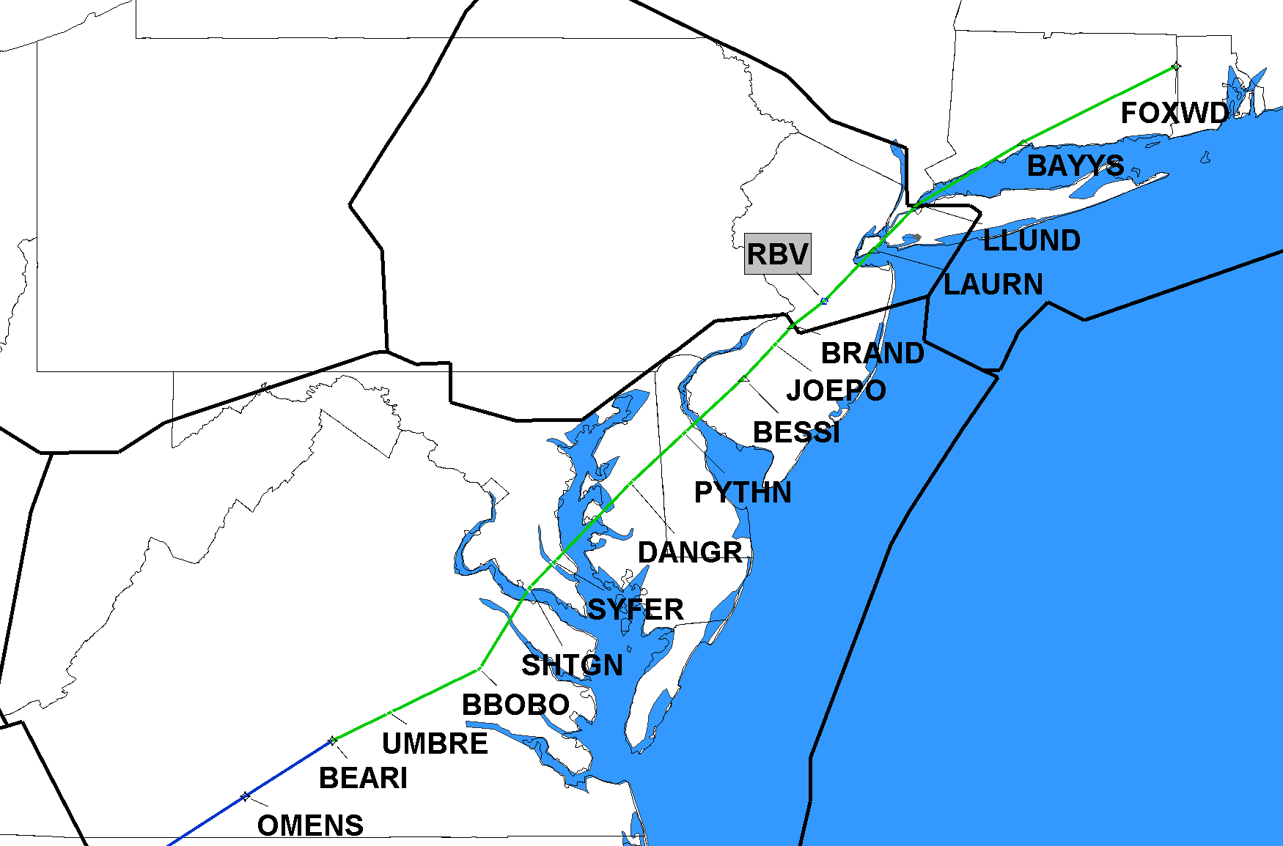
10/7/2021 Q22 Amend BEARI, VA TO FOXWD, CT
ZBW
ZNY
NEW SEGMENT(S) to be NOTAM’d NA for 56 days 10/7/2021-12/2/2021
ZDC
Implement on 12/2/2021

Slide 23
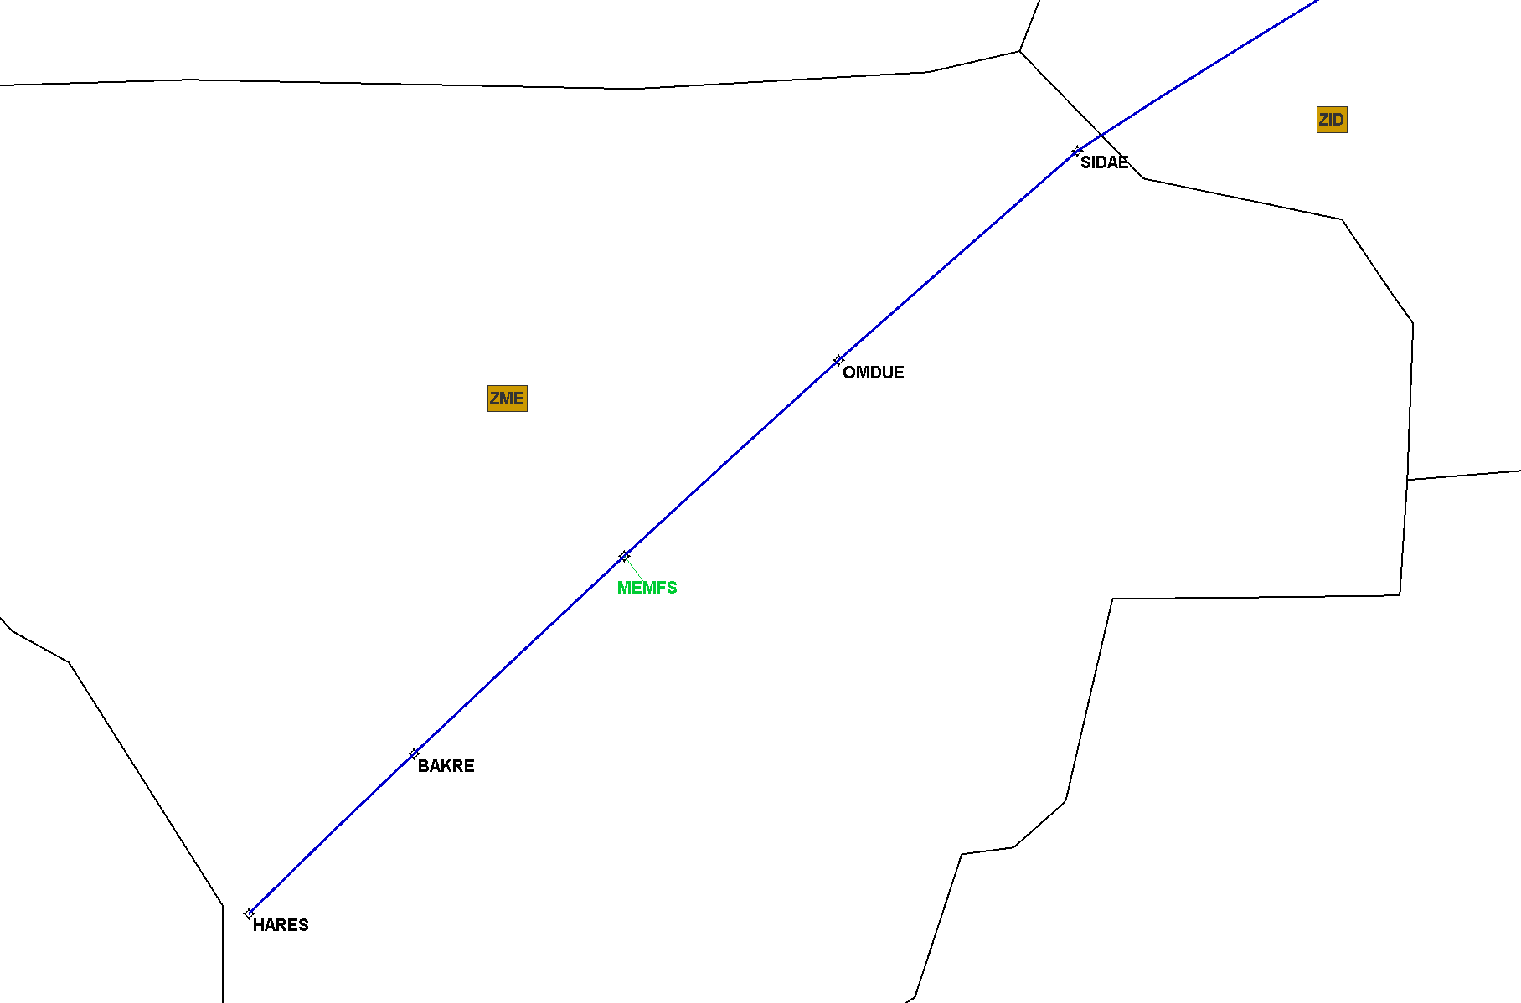
10/7/2021 Q29 Amend MEMFS, TN and DUNOM, ME
Implement on 10/7/2021

Slide 24
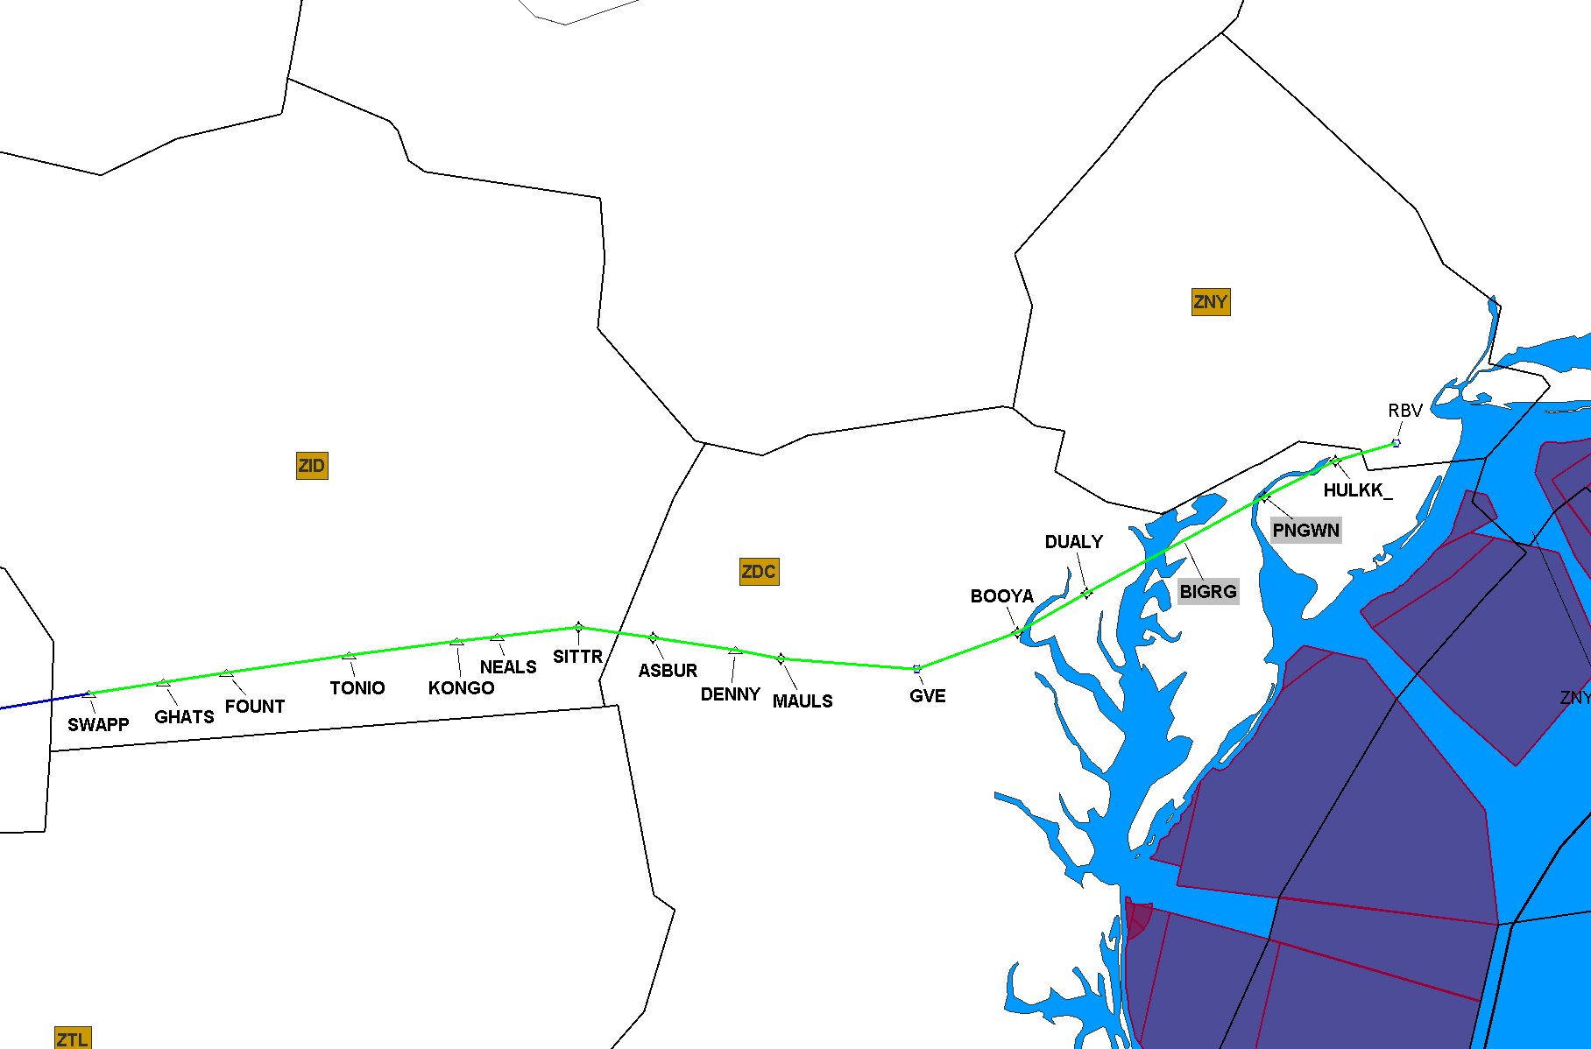
10/7/2021 Q34 Amend SWAAP, TN TO ROBBINSVILLE, NJ (RBV) VORTAC MEMFS, TN and LOOSE, AR
NEW SEGMENT(S) to be NOTAM’d NA for 56 days 10/7/2021-12/2/2021
Implement on 12/2/2021

Slide 25
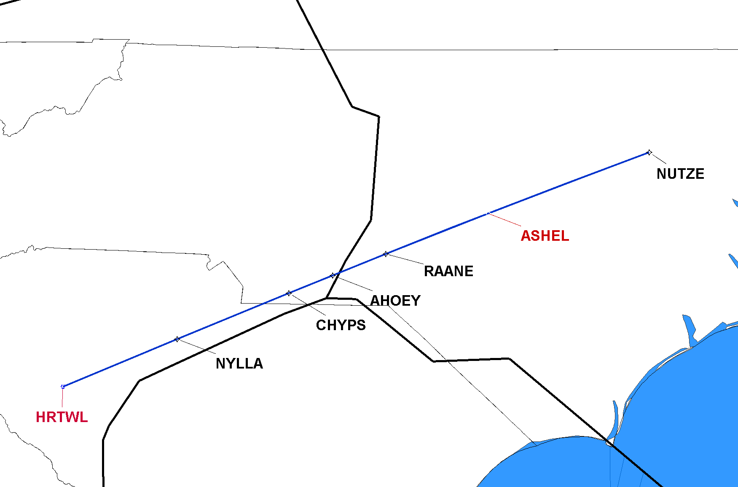
10/7/2021 Q54 Amend HRTWL, SC & ASHEL, NC
ZDC
ZTL
ZJX
Implement on 10/7/2021

Slide 26
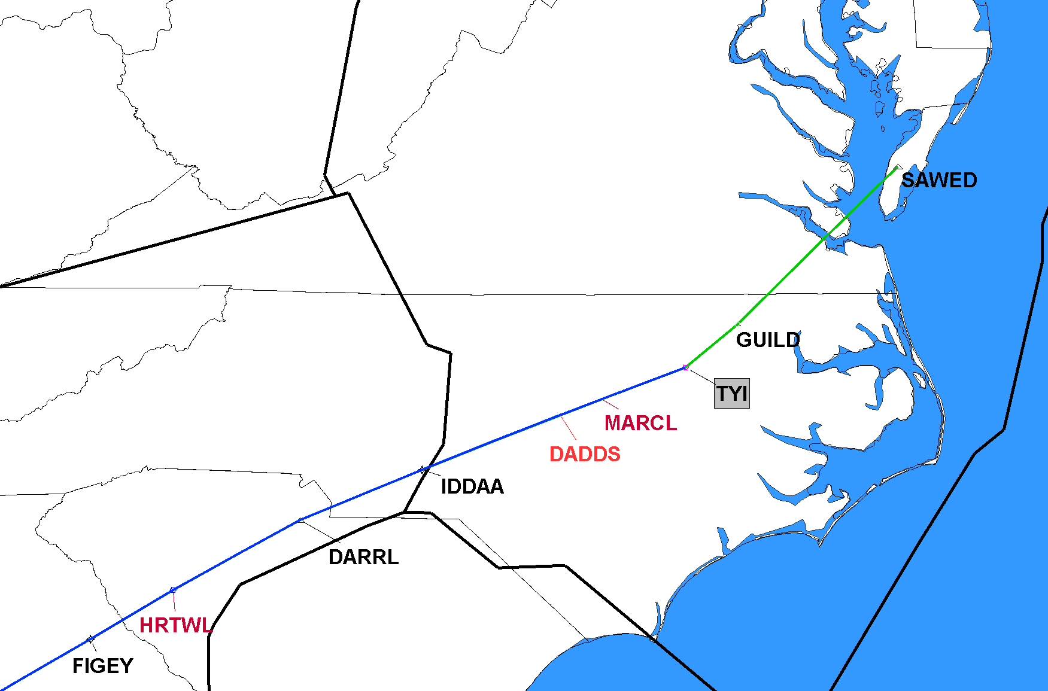
10/7/2021 Q64 Amend TAR RIVER, NC (TYI) VORTAC TO SAWED, VA HRTWL, SC, DADDS, NC and MARCL, NC
NEW SEGMENT(S) to be NOTAM’d NA from 10/7/2021-11/3/2022
ZDC
ZTL
Implement TYI-SAWED on 11/3/2022

Slide 27
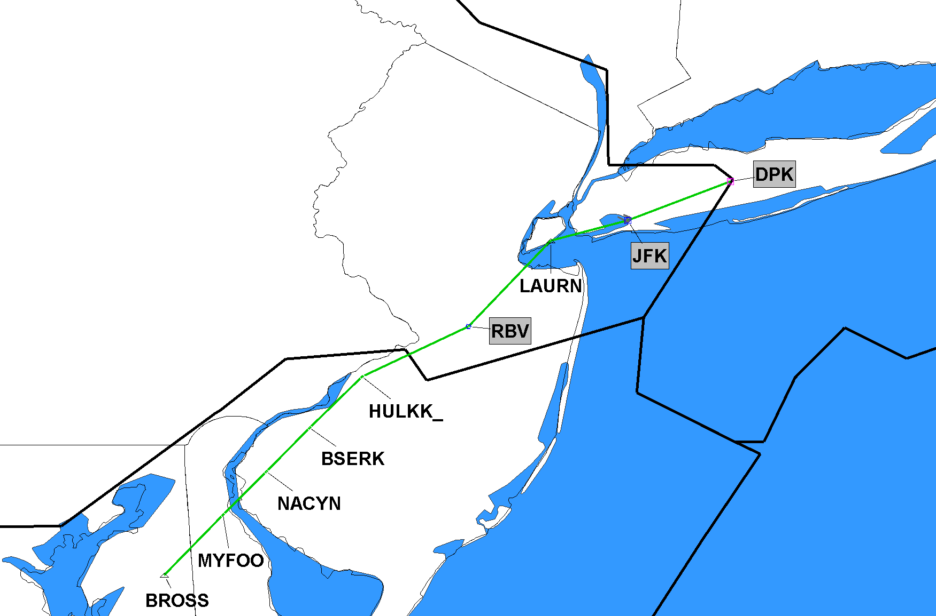
10/7/2021 Q419 Publish BROSS, MD TO DEER PARK, NY (DPK) VOR/DME
ZNY
NEW Q-Route to be NOTAM’d NA for 56 days 10/7/2021-12/2/2021
ZBW
ZDC
Implement on 12/2/2021

Slide 28
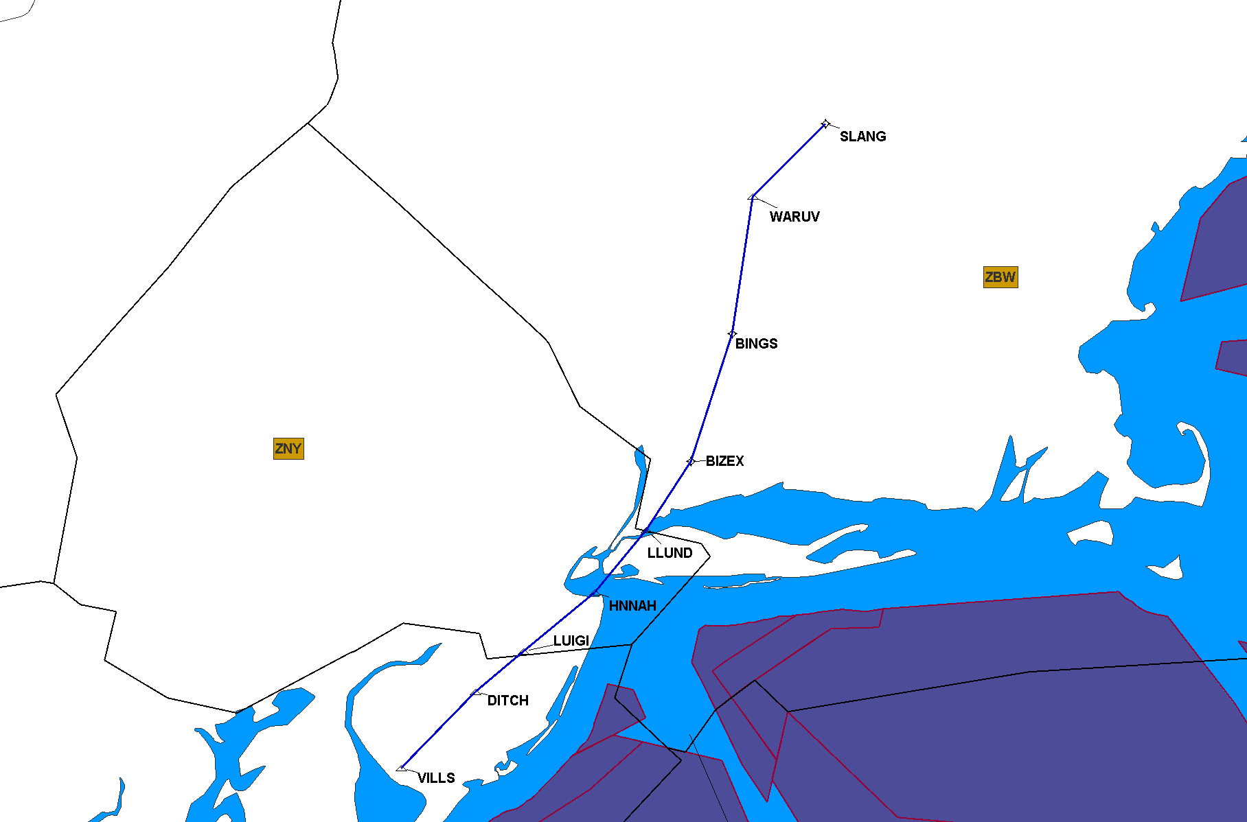
10/7/2021 Q437 Publish VILLS, NJ TO SLANG, VT
Changes made per ZBW:
New Docket#: 20-AEA-19
NEW Q-Route to be NOTAM’d NA for 56 days 10/7/2021-12/2/2021
Implement on 12/2/2021

Slide 29
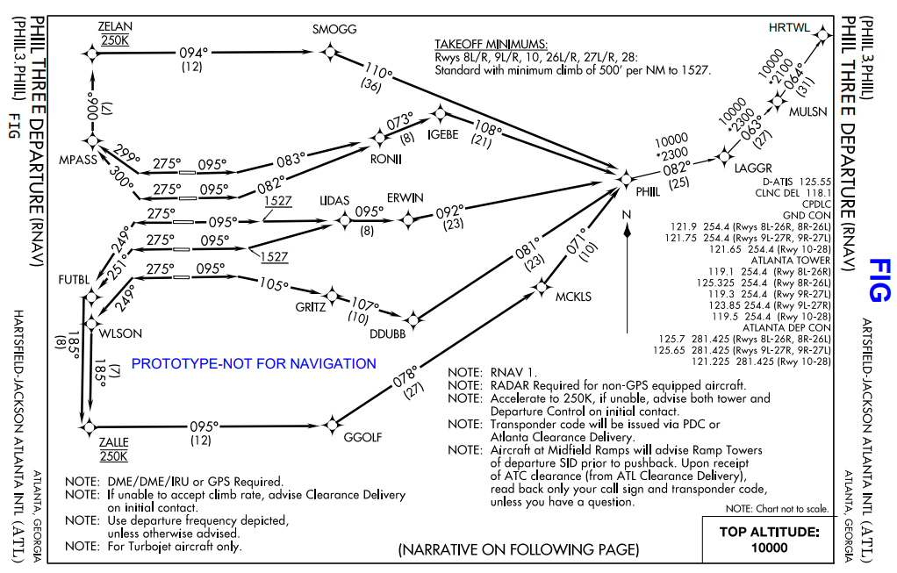
10/7/2021 ATL PHIIL 3 SID REPLACE GRD with HTRWL waypoint
Implement on 10/7/021

Slide 30
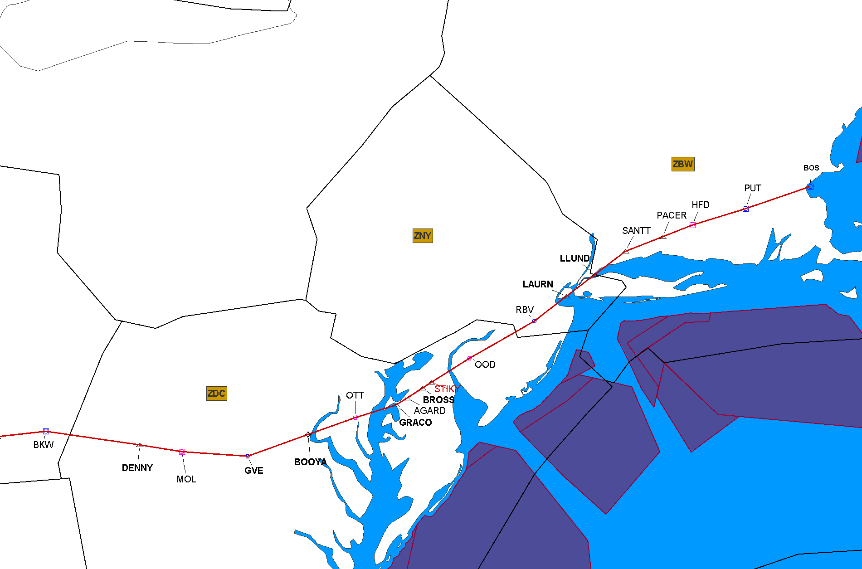
12/2/2021 J42 Cancel Segment Texarkana (TXK), AR to Boston (BOS), MA
Red Segment Being Deleted
Click to Return to Index

Slide 31
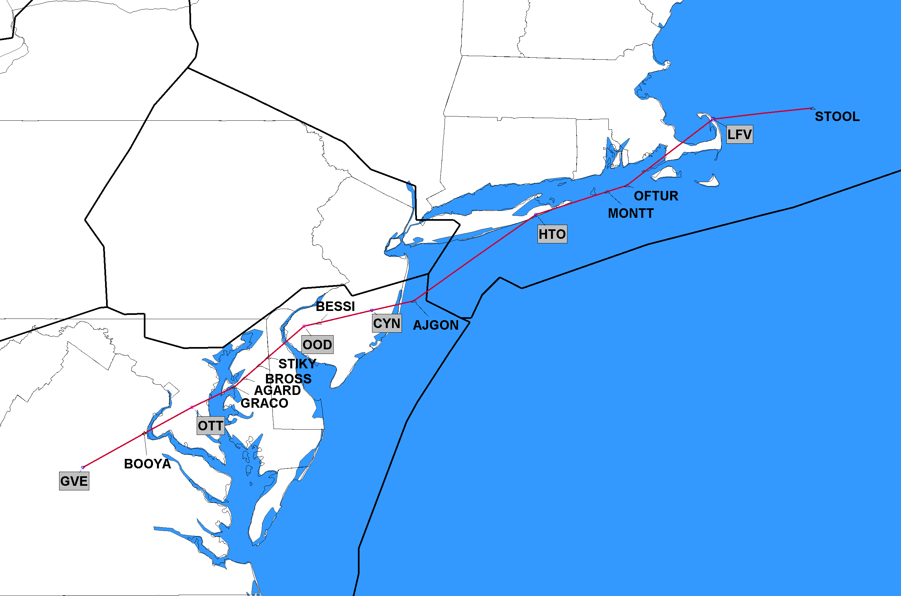
12/2/2021 J150 Completely Deleted Gordonsville (GVE), VA to STOOL, OA
ZBW
ZDC
J-Route Deleted in its Entirety
Click to Return to Index

Slide 32
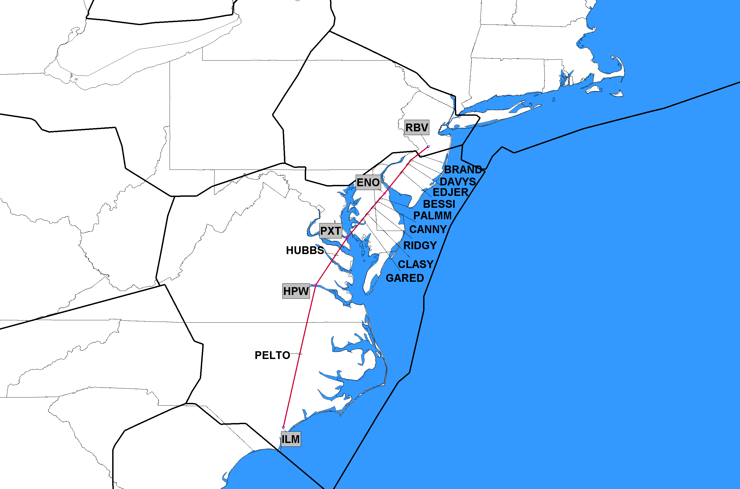
12/2/2021 J191 Completely Deleted Robbinsville (RBV), NJ to Hopewell (HPW), VA
ZNY
ZDC
NOTE: Cancellation of Segments from
Hopewell (HPW), VA to Wilmington (ILM) NC postponed until 11/3/2022
J-Route Deleted in its Entirety
Click to Return to Index

Slide 33
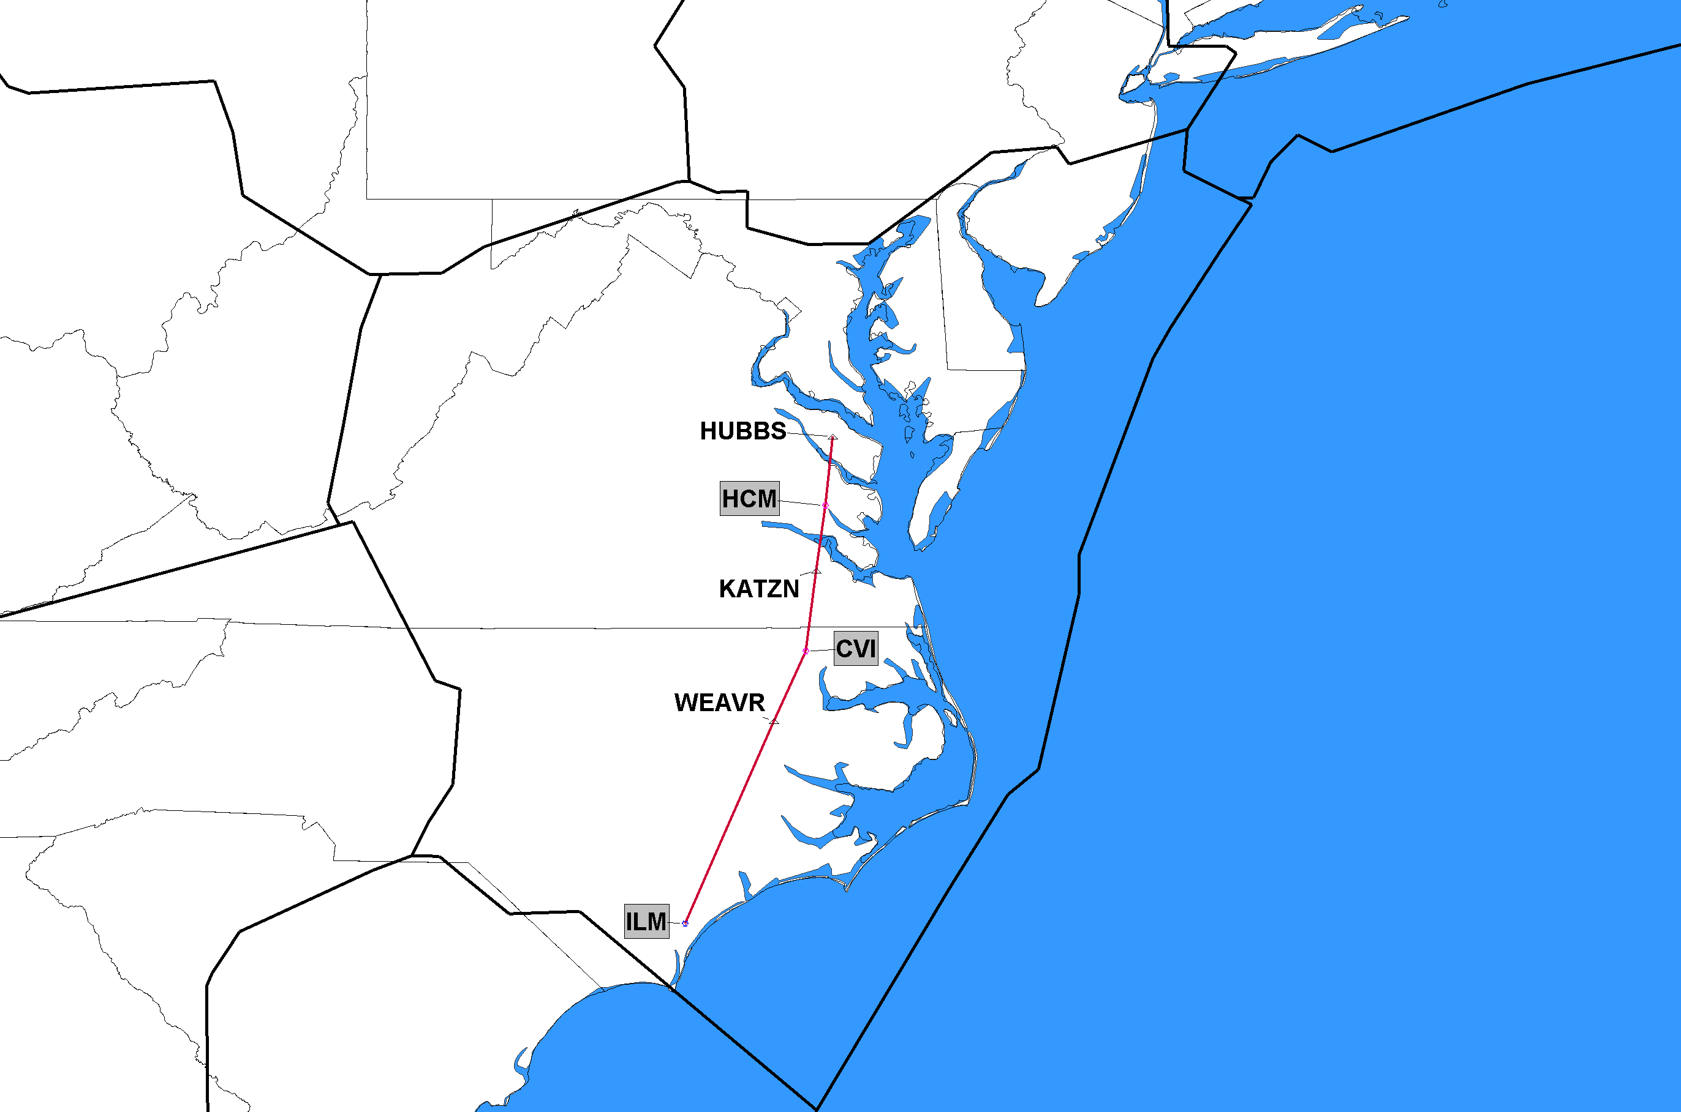
12/2/2021 J193 Completely Deleted Wilmington (ILM), NC to HUBBS, VA
ZDC
J-Route Deleted in its Entirety
Click to Return to Index

Slide 34
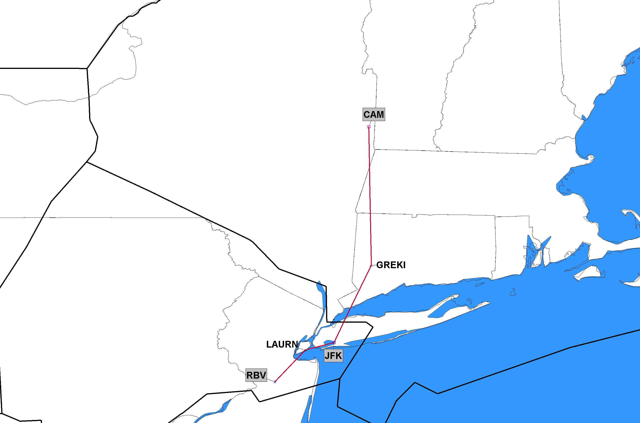
12/2/2021 J222 Completely Deleted Robbinsville (RBV), NJ to Cambridge (CAM), NY
ZBW
ZNY
J-Route Deleted in its Entirety
Click to Return to Index

Slide 35
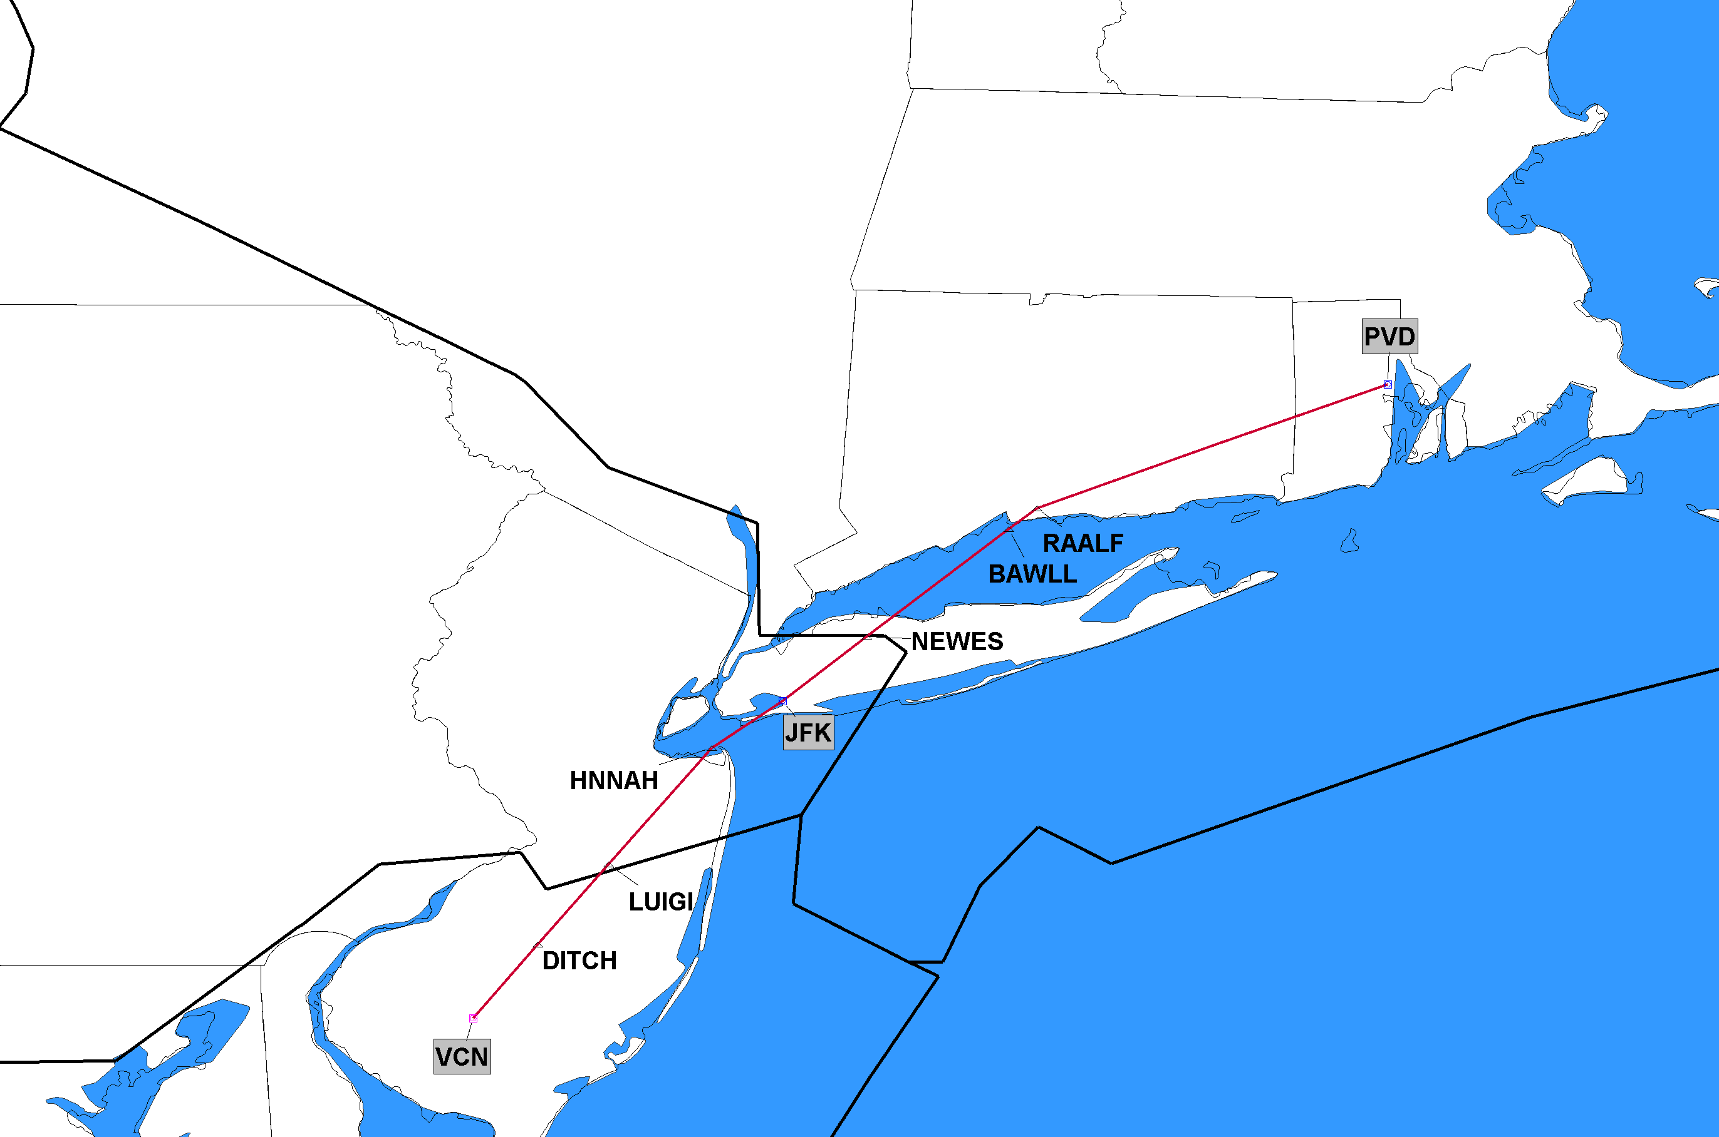
12/2/2021 J225 Completely Deleted Cedar Lake (VCN), NJ to Providence (PVD), RI
ZNY
ZBW
ZDC
J-Route Deleted in its Entirety
Click to Return to Index

