Slide 1
Northeast Corridor Atlantic Coast Routes (NEC ACR) Project Status Update Implementation 4/20/2023
Presented to: Flight Plan Filers
By: Reggie Davis, FAA Co-Lead (Management)
Joey Tinsley, FAA Co-Lead (NATCA)
Date: April 5, 2023

Slide 2
What We Are Doing, Why, When
NEC ACR is one of the biggest changes to the National Airspace System (NAS) in decades
What: New/amended Q Routes and Y Routes will replace the north-south high-altitude route structure along the east coast of the United States
Why: Transition to a PBN-Centric NAS thus decreasing reliance on ground-based NAVAIDs
When: Changes being implemented from 10/10/2019 through 4/20/2023
Due to COVID-19, the implementation of the majority of the remaining routes and procedures was delayed due to inability to conduct controller training

Slide 3
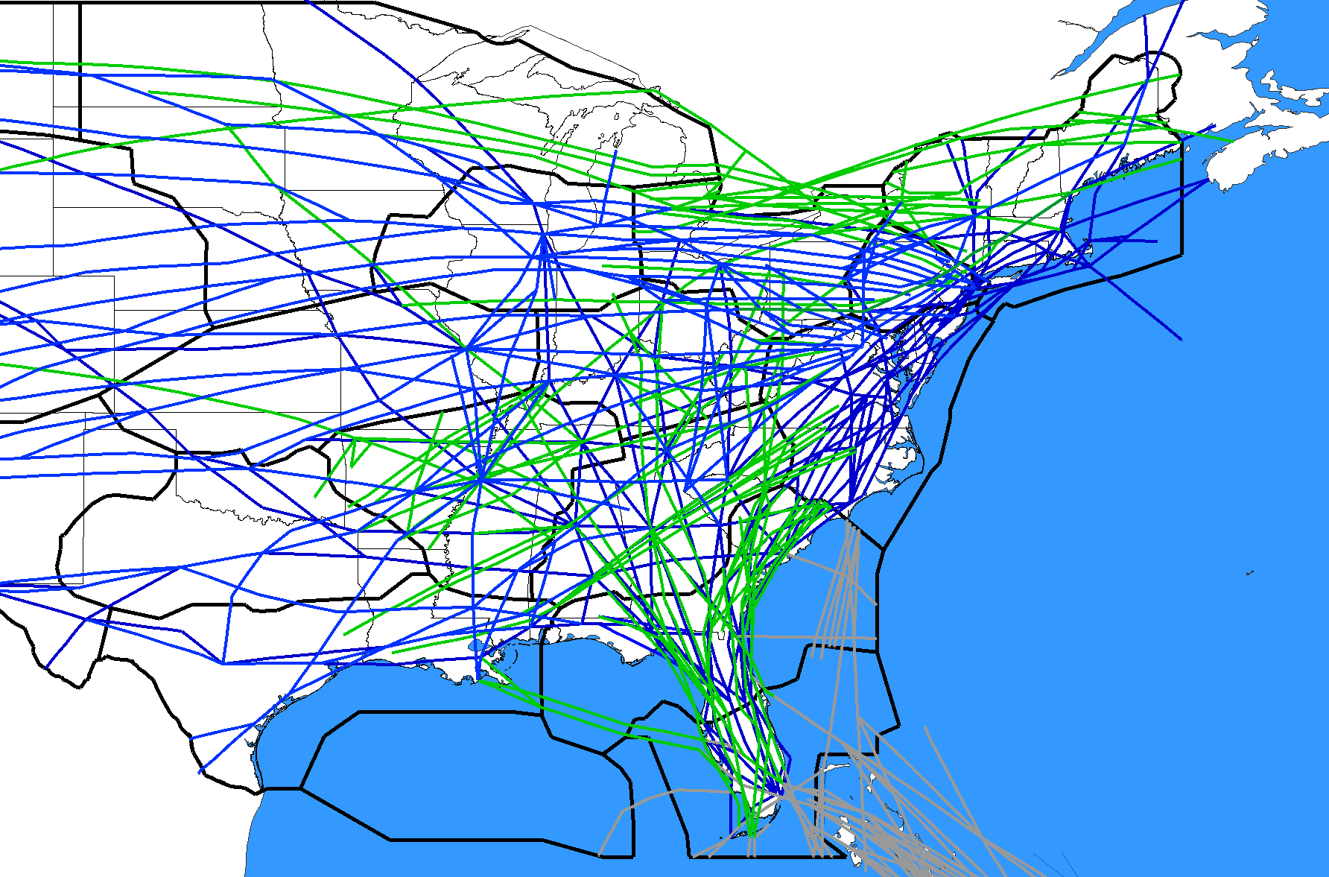
BEFORE
Not all central and western U.S. Routes are depicted
Q-Routes depicted in green
Y-Routes depicted in gray
J-Routes depicted in blue

Slide 4
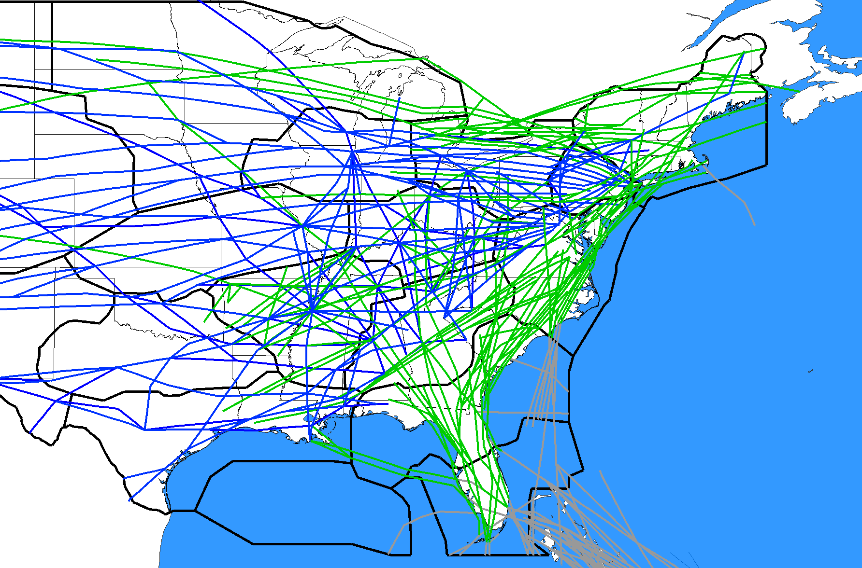
NEC ACR - FUTURE STATE 11/7/2019 11/5/2020 12/2/2021 11/3/2022 4/20/2023
Not all central and western U.S. Routes are depicted
Q-Routes depicted in green
Y-Routes depicted in gray
J-Routes depicted in blue

Slide 5
NEC ACR Summary
Implemented 142 route changes, 2019-2023 (84% of 169 total)
New Y-Routes to/from Florida and the Caribbean
161 (95%) or 169 route changes published
Implemented ZDC Ultra-High Sector 30 (OBX), 5/10/2022​
Published 20 Q-Routes: NOTAM’d NA (20) until 4/20/2023
Remainder of project to be completed in the following phases:
4/20/2023
Delete 7 Jet Routes
Implement 20 remaining Q-Routes previously published (includes Q64, Q141)
Publish/Implement 4 STARs (PHL/EWR/TEB)
6/15/2023
Amend Q101
Delete EWR DYLIN4 STAR
FUTURE STATE 4/20/2023
Q-Routes in green
Y-Routes in gray
J-Routes in blue

Slide 6
Implementation Milestones 2019-2023
10/10/2019 Published/Implemented 1 New Y-Route and 8 Waypoints
11/7/2019 Implemented ZDC Low Altitude Sector Changes
1/30/2020 Deleted/Amended 33 J-Routes/Q-Route (FL Metroplex)
1/30/2020 Deleted 5 CHS STARs
3/26/2020 Deleted/Amended 6 SIDs (BWI/IAD/DCA/HEF/ADW)
5/21/2020 Amended 2 Q-Routes: Q75, Q475
5/21/2020 Amended 1 SID (DOV)
7/16/2020 Deleted/Amended 18 J-Routes
9/10/2020 Published/Amended 8 Q-Routes
11/5/2020 Published/Deleted/Amended 9 STARs (PHL/EWR/TEB/LGA/DOV/WRI)
11/5/2020 Published/Deleted/Amended 9 SIDs/STARs/SIAPs (CHS/JZI)
11/5/2020 Deleted/Amended 10 J-Routes, 1 Q-Route
2/25/2021 Published/Deleted/Amended 20 RDU SIDs/STARs/SIAPs
10/7/2021 Published/Deleted/Amended 28 Q-Routes/Y-Routes/AR-Routes
10/7/2021 Amended 1 SID (ATL), 1 STAR (WRI)
12/2/2021 Deleted/Amended 6 Jet Routes
5/10/2022 ZDC High Altitude Sector Changes (Sector OBX-30)
9/8/2022 Published/Amended 22 Q-Routes
9/8/2022 Amended ATL PLMMR3 SID
9/8/2022 Published/Amended 5 Y-Routes
11/3/2022 Deleted/Amended 12 Jet Routes and 2 Q-Routes
2/23/2023 Published/Amended 2 Q-Routes
COVID-19
135 Routes Published, Amended, Deleted in 2020-2023

Slide 7
NEC ACR Changes 2022-2023
5/10/2022 ZDC High Altitude Sector Changes (Sector 30)
9/8/2022 (22) Q-Route Additions/Amendments
Publish (9) New Q101, Q107, Q111, Q117, Q131, Q133, Q167, Q445, Q481
Amend (10) Q22, Q60, Q85, Q87, Q97, Q99, Q109, Q113, Q135, Q409
Amend (2) Q34, Q419 (recently added, post-implementation)
Amend Q75 (recently added, post-implementation)
9/8/2022 Amend ATL PLMMR3 SID
9/8/2022 (5) Y-Route Additions/Amendments
Amend Y299, Y309, Y319, Y323
Publish Y327
9/8/2022 NOTAM NA the above Q-Routes/Y-Routes (except Q22, Q34, Q75, Q419, Y327)
11/3/2022 (12) Y-Route/AR-Route Additions/Amendments/Deletions
Amend Y291, Y307
Publish Y313
Amend (8) AR15, AR16, AR17, AR18, AR19, AR22, AR23, AR24
Delete (1) AR21
11/3/2022 Cancel Y-Route NA NOTAMs and Implement Y-Routes
Includes auto-cancellation of NA NOTAMs for Y289 and Y299 issued in 2021
11/3/2022 (14) J-Route/Q-Route Deletions/Amendments
Amend (4) J14, J24, J52, J68
Delete (8) J165, J207, J506, J561, J563, J573, J582, J585
Delete Q947
Amend Q81 (FL MP post-impl)
Completed
Completed
2/23/2023 (2) Q-Routes: Amend/implement Q437, Publish new Q141 (NOTAM NA -4/20/2023)
4/20/2023 Cancel Q-Route NA NOTAMs and Implement 20 Q-Routes
Includes NA NOTAM for Q64, Q141
4/20/2023 (7) J-Route Deletions
Delete (7) J37, J55, J79, J121, J174, J191, J209
4/20/2023 (4) STARs Amended
Amend (4) STARs: PHL (JIIMS4, PAATS4), EWR (PHLBO4), TEB (JAIKE4)
6/15/2023 (2) Q101 Amend, Delete EWR DYLIN4 STAR
Publications Slipped Due to COVID-19

Slide 8
HSD/HPD Routes
Reinforces directional nature of routes
High Altitude Single Direction to be retitled as “High Altitude Preferred Direction
ATC can clear traffic in either direction as needed
Directional arrows to be charted 4/20/2023
Directional arrows effective 4/20/2023 to be charted 6/15/2023
Arrows omitted in error on the 4/20/2023 chart date (NOTAMs issued)
Southbound Routes
AR15 BAHAA-ORL
Y313/AR22 IDOLS-HOAGG
Y291/AR19 SAGGY-MAJIK
Y289/AR17 ZILLS-DULEE
Northbound Routes
Y299 GRUBR-SEELO
AR16 PERMT-SEELO
Y309 PELCN-FLRDA
AR18 WOLFO-FLRDA
Q97 ELLDE MALET Southbound (S)
Q167 SSOXS-RIFLE Southwestbound (SW)
Q439 BLENO-DUNEE Southwestbound (SW)
Q445 SHAUP-KYSKY Northeastbound (NE)

Slide 9
Changes Effective 4/20/2023
7 J-Route Deletions (in their entirety)
Delete J37,J55,J79,J121,J174,J191,J209
Implement 20 Q-Routes (Cancel Q-Route NA NOTAMs)
New routes previously published: Q101,Q107,Q111,Q117,Q131,Q133,Q141, Q167,Q445,Q481
Routes amended/extended: Q60,Q64,Q85,Q87,Q97,Q99,Q109,Q113,Q135,Q409
4 STAR Amendments (valid transitions below)
KPHL JIIMS4: BRIGS,DASHA,ZJAAY (DELETED SWL)
KPHL PAATS4: BBDOL,GVE,HYTRA (DELETED FAK, PXT)
KEWR PHLBO4: QUART,GVE,SWANN,HYTRA (DELETED FAK, PXT)
KTEB JAIKE4: GVE,SWANN,SWNGR, ATC ASSIGNED ONLY: BOOYA,HYTRA (DELETED FAK, PXT, HPW, RIC)
Multiple FIX Cancellations
6/15/2023 1 Q-Route Amendment (6/15/2023)
Amend Q101 (add segment from TUGGR..KALDA)
6/15/2023 Delete (1) CONV STAR, KEWR DYLIN4 STAR

Slide 10
NEC ACR Fix Actions
4/20/2023
NEW: BBDOL/ZDC(PHL PAATS4), BTWNG/ZDC(TEB JAIKE4), GDZLA/ZDC(KPHL PAATS4), HVNNN/ZDC(KEWR PHLBO4), JNJEN/ZDC(TEB JAIKE4), KNUKK/ZDC(Coordination Fix), KRABY/ZDC(Coordination Fix), LOOPR/ZDC(KEWR PHLBO4), PKCHP/ZDC(KPHL JIIMS4), PRNCZ/ZDC(KPHL PAATS4), QUART/ZDC(KEWR PHLBO4), VANNC/ZJX(CHS MLTRE3), WNDYB/ZDC(PHL PAATS4), WUDRR/ZDC(PHL JIIMS4), ZMRMN/ZDC(PHL JIIMS4)
RETAIN: CLAPY/ZDC(J174/HP), CLASY/ZDC(J37), EDDYS/ZDC(J174/HP), HERIN/ZBW(J174), HUBBS/ZDC(J55), SEAER/ZBW(J79)
CANCEL: AWNUM/ZBW(J79), BLAMO/ZDC(J79/HP), GILMA/ZDC(J174), HAKOK/ZDC(J55), HASET/ZDC(J79), JADEE/ZDC(J55/HP), JMACK/ZJX(J121), JOANI/ZNY(J79), KATZN/ZDC(J79), LEESA/ZDC(J79), MONTT/ZBW(J174), MULLS/ZJX(J79/HP), OFTUR/ZBW(J174), TUBAS/ZDC(J55), WARNN/ZDC(J174), WEAVR/ZDC(J121), ZITTO/ZDC(J55)
4/20/2023 (ZTL VOR MON)
RETAIN: PIZZO/ZTL(V241)
CANCEL: GARDI/ZTL(V241), SILOS/ZTL(V20)
Future Cancellations (date TBD): Please do not file
CANCEL: BARTL/ZJX(J121), FRANZ/ZDC(J209/HP)
CANCEL: COVAN/ZBW(J563), DAVES/ZBW(J585), SCARS/ZBW(J573/HP)
CANCEL: JAMTA/ZTL(T209), NASDE/ZTL(T209), YASLU/ZTL(T209)
CANCEL: BINGS/ZBW(Q437), DWYTE/ZJX(J165), HERIN/ZBW(J174), SEAER/ZBW(J79), SLANG/ZBW(Q437)
Notes:
CIPBA DELBE EDDIE OHOLO RABOW REAVS AJGUB CFCKR CFJVL CFMJR CFNDN CFQDV COVAN CUZWA DEKOW LAMED LEEHI SCARS STUKK AWNUM CLAPY FRANZ HAKOK HASET HERIN JADEE JOANI JMACK KATZN MONTT OFTUR PELTO SEAER TUBAS WARNN WEAVR ZITTO

Slide 11
VOR MON Changes Eff 4/20/2023
KCHS Amend 2 RNAV SIDs
MLTRE3 RNAV SID (VAN transition changes to VANNC)
SWPFX3 RNAV SID
KCLT Amend 2 RNAV STARs
BANKR3 RNAV STAR
JONZE3 RNAV STAR
KTPA Delete 2 STARs
DARBS3 STAR
LZARD6 STAR
Victor Airways
Amend V5, V20, V155, V241, V321
Segment deletions, fix replacements
Slipped to 6/15/2023
Publish new KCLT JOOLS1 RNAV STAR
Delete 2 KCLT STARs
CHPTR3 STAR
UNARM6 STAR
Flight Inspection Issues – Both may be NOTAM’d GPS Required

Slide 12
Q-Route Definitions
ROUTE_ID | Overlay | Pub Date | NEW ROUTE DEFINITION
Q22 | J37 | 9/8/2022 | GUSTI OYSTY ACMES CATLN TWOUP BURGG NYBLK MASHI KIDDO OMENS BEARI UMBRE BBOBO SHTGN SYFER DANGR PYTHN BESSI JOEPO BRAND RBV LAURN LLUND BAYYS FOXWD
Q34 |  | 9/8/2022 | TXK LOOSE WASKO MATIE EDWAH MEMFS HENSY DITZL WAKOL HITMN SWAPP GHATS FOUNT TONIO KONGO NEALS SITTR ASBUR DENNY MAULS GVE BOOYA DUALY BIGRG PNGWN HULKK RBV
Q60 |  | 9/8/2022 | BURGG BYJAC EVING LOOEY JAXSN SHIRY HURTS
Q63 | Q93 | 9/8/2022 | DELETED (ZTL VOR MON Project)
Q64 |  | 10/7/2021 | CATLN FIGEY HRTWL DARRL IDDAA DADDS MARCL TYI GUILD SAWED
Q75 |  | 9/8/2022 | ENEME TEUFL TEEEM SHRIL FISHO ILBEE SLOJO GSO BROSK DRAIK GVE HAMMZ TOOBN MURPH SACRI STOEN MXE COPES BIGGY SBJ JERSY FARLE BIZEX GREKI NELIE SWALO BOS COPLY
Q81 |  | 11/3/2022 | TUNSL KARTR FIPES ZEILR PIKKR FARLU MGNTY ENDEW BITNY NICKI SNAPY BULZI IPOKE HONID
Q85 |  | 9/8/2022 | LPERD BEEGE GIPPL ROYCO IGARY PELIE BUMMA KAATT SMPRR PBCUP MOXXY CRPLR
Q87 |  | 9/8/2022 | PEAKY GOPEY GRIDS TIRCO MATLK ONEWY ZERBO DUCEN OVENP FEMON VIYAP SUSYQ TAALN JROSS RAYVO HINTZ REDFH LCAPE ALWZZ ASHEL DADDS NOWAE RIDDN GEARS HURTS
Q97 |  | 9/8/2022 | TOVAR EBAYY MALET DEBRL KENLL PRMUS WOPNR JEVED CAKET ELMSZ YURCK ELLDE YEASO PAACK KOHLS SAWED KALDA ZJAAY DLAAY BRIGS HEADI SAILN CCC NTMEG VENTE BLENO BEEKN FRIAR PQI
Q99 |  | 9/8/2022 | KPASA DOFFY CAMJO HEPAR TEEEM BLAAN BWAGS EFFAY WNGUD POLYY RAANE OGRAE PEETT SHIRY UMBRE QUART HURLE
Q101* |  | 4/20/2023 | SKARP PRANK BGBRD HYPAL TUGGR
Q107 |  | 9/8/2022 | GARIC ZORDO JAAMS ALINN HURTS
Q109 | J121 | 9/8/2022 | KNOST DEANR BRUTS EVANZ CAMJO HEPAR TEEEM RIELE PANDY RAYVO SESUE BUMMA YURCK LAANA TINKK DFENC
Q111 |  | 9/8/2022 | ZORDO LARKE RUKRR GEARS SWNGR ALXEA
Q113 |  | 9/8/2022 | RAYVO CEELY SARKY MARCL AARNN RIDDN
Q117 |  | 9/8/2022 | YLEEE CUDLE SUSSA KTEEE SAWED
Q131 |  | 9/8/2022 | ZILLS YLEEE EARZZ ODAWG KALDA ZJAAY
Q133 | J79 | 9/8/2022 | CHIEZ BENCH KOOKI PYSTN KALDA CONFR MGERK LEEAH MYRCA JFK LLUND FARLE GANDE PONCT
Q135 |  | 9/8/2022 | JROSS PELIE ELMSZ RAPZZ ZORDO CUDLE
Q141 |  | 2/23/2023 | HOUKY TAPPA HYTRA BLNTN NALES
Q167 | J55 | 9/8/2022 | ZJAAY PAJET CAANO TBONN ZIZZI YAZUU TOPRR EMJAY SPDEY RIFLE HOFFI ORCHA ALBOW GRONC NESTT BUZRD SSOXS
Q409 |  | 9/8/2022 | ENEME PUPYY ISUZO KONEY JROSS SESUE OKNEE MRPIT DEEEZ GUILD CRPLR TRPOD GNARO VILLS CYN WHITE
Q419 |  | 9/8/2022 | BROSS MYFOO NACYN BSERK HULKK RBV LAURN JFK DPK
Q437 |  | 2/23/2023 | VILLS DITCH LUIGI HNNAH LLUND
Q445 | J55 | 9/8/2022 | PAACK JAMIE CONFR RADDS WNSTN AVALO BRIGS SHAUP VALCO KYSKY
Q481 |  | 9/8/2022 | CONFR MGERK LEEAH ZIGGI DPK
Q947 |  | 11/3/2022 | Deleted
NOTE: Q101 to be amended on 6/15/2023 to add segment from TUGGR to KALDA

Slide 13
Jet Route Definitions
ROUTE_ID | Overlay | Pub Date | NEW ROUTE DEFINITION
J14 | N/A | 11/3/2022 | PNH CRUSR IRW DWINE KLUBB KOMMA LIT ARIGY CARIN XESSS YAALL VUZ
J22* | N/A | 9/8/2022 | CFDNC WEGUS LRD CRP HYNES PSX HEIGH LCH MCB MEI
J24 | N/A | 11/3/2022 | MTU CHE <break_in_route> HGO SELLS OATHE HYS SLN JUDGE MCI DRIVL WELTS STL COWES TILMN VHP BIGXX HICKI FLM HVQ TARCI TUKEY OAKLE BIGAL MOL
J31* | N/A | 9/8/2022 | LEV HRV MEI
J37 | Q22 | 4/20/2023 | DELETED
J39* | Q139 | 9/8/2022 | DELETED
J48* | N/A | 9/8/2022 | LANNA PTW BYRDD HAAGN PENSY EMI CSN MOL
J52 | N/A | 11/3/2022 | CFDDH SHUKA CASCD TWISP GEG DOXIE LKT DBS OCS FQF QUAIL HGO LAA DRAWL LBL ROLLS DANKS CRUSR MRMAC ADM TXK CISAR SUTTN SQS
J55 | Q167/445 | 4/20/2023 | DELETED
J68 | N/A | 11/3/2022 | GEP NICKL DLL BAE DABJU FNT
J69* | N/A | 9/8/2022 | DELETED
J79 | Q133 | 4/20/2023 | DELETED
J118* | N/A | 9/8/2022 | DELETED
J121 | Q109 | 4/20/2023 | DELETED
J145* | N/A | 9/8/2022 | DELETED
J165 | N/A | 11/3/2022 | DELETED
J174 | N/A | 4/20/2023 | DELETED
J186* | N/A | 9/8/2022 | DELETED
J191 | N/A | 4/20/2023 | DELETED
J207 | N/A | 11/3/2022 | DELETED
J209 | N/A | 4/20/2023 | DELETED
J506 | N/A | 11/3/2022 | DELETED
J561 | N/A | 11/3/2022 | DELETED
J563 | N/A | 11/3/2022 | DELETED
J573 | N/A | 11/3/2022 | DELETED
J582 | N/A | 11/3/2022 | DELETED
J585 | N/A | 11/3/2022 | DELETED
*Note = ZTL VOR MON Project

Slide 14
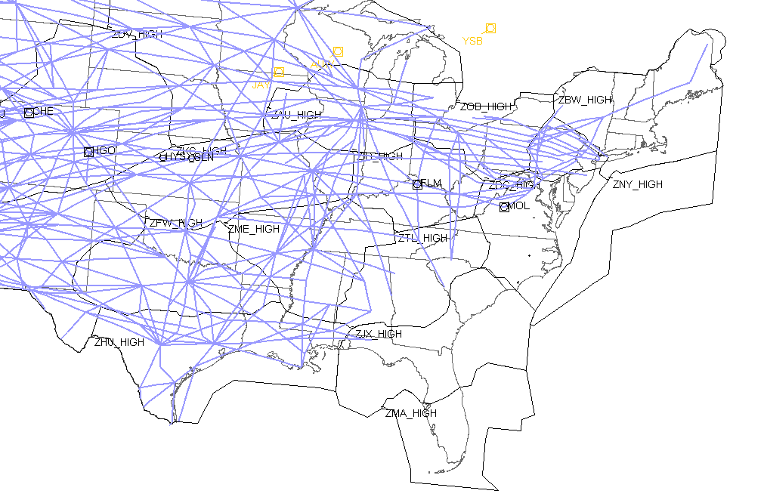
NAS Jet Routes 4/20/2023

Slide 15
Victor Airway Definitions
ROUTE_ID | Overlay | Pub Date | NEW ROUTE DEFINITION
V5* | N/A | 4/20/2023 | PZD GILLY VNA UCALA DBN HEPUT HADOC BEYLO TRAPI CORVI PENFI AHN <break_in_route> EWO JBEAM BRBON IIU ZOPOM NERVE WARSA CVG WUSPU BRNIE MOAKS JENEY PRUDE SOWAP FODAN SHIRT JOGER LIMPS GOBVE GLOOM TIYOY FABDO APE
V20* | T224 | 4/20/2023 | MFE SANCA HARGI LATEX JIMIE ASCOT SOLON POGOE CRP COPAN BETZY BOINT PSX <break_in_route> BPT WASPY LCH ARTEL CRISP MICRO ZIROR LFT LULEW BUDAM MYRIC WOVON DONBE AWDAD SIMBY VOODO RQR SNAKI SLIDD CLERY MUDDA GPT NESFE BUGLE SQWID SJI AXSIS AXEJA TENSA MVC PICKS JEFER ALOON MGM <break_in_route> BZM SANFI JOTTA INGON PROVE MAYOS LEAKS UFFIN SBV LELLI YUDUG NUTTS MELIA RIC
V155* | T410 | 4/20/2023 | SINCA BEYLO ANNAN IRQ TREAD JOKER MONET LEDAS WIDER BLOTS LOAFS CTF NOMOE LILLS SDZ OCHOC MOATS RDU WIPER BEXGO LVL MANGE MELIA FAK ROOKY NABBS COATT OGATE FALKO BRV
V241* | N/A | 4/20/2023 | SJI ZUGTI LOXLY BRATT CDUBB PENSI INBRD ITNEW BAKOS CEW GALON HACKK DARED HOUND IVGIF RRS HAVSO BAIZE EUF OMAHO WESUV RSVLT
V321* | N/A | 4/20/2023 | PZD KUTVE DUVAT LUMPP PREST RSVLT JALVO UKAVE LGC RAVOC HEFIN JAMUD HOKES GAD BOAZE ALBER OWENT RQZ HATAS VOYUD JEKBA ATWUS KUXYI SYI PECON OKENE CENOP GRILL LVT
*Note = ZTL VOR MON Project

Slide 16
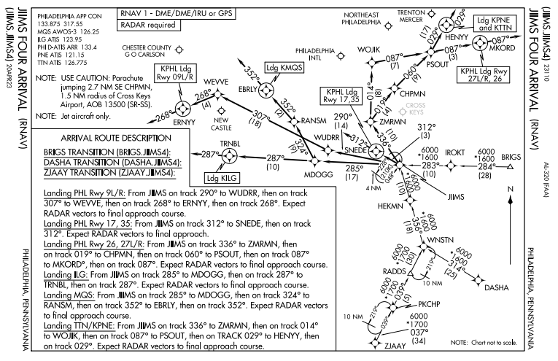
PHL JIIMS4 ARRIVAL
DELETED SWL TRANSITION

Slide 17
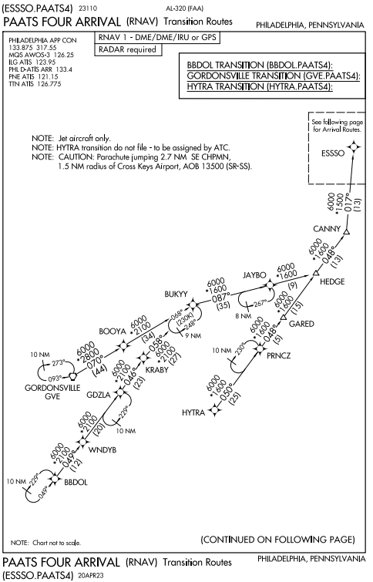
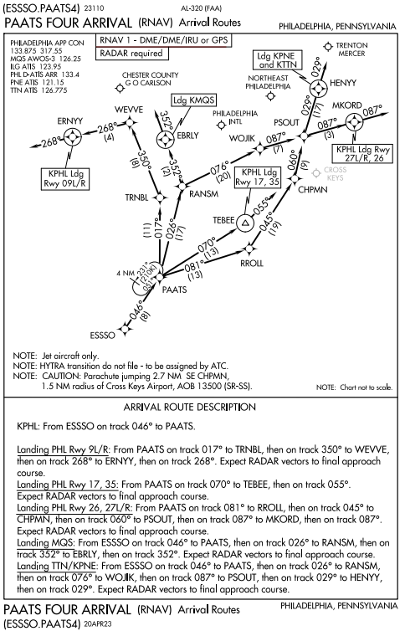
PHL PAATS4 ARRIVAL
DELETED FAK & PXT TRANSITIONS

Slide 18
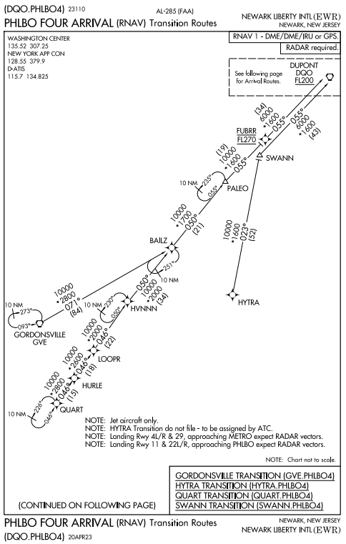
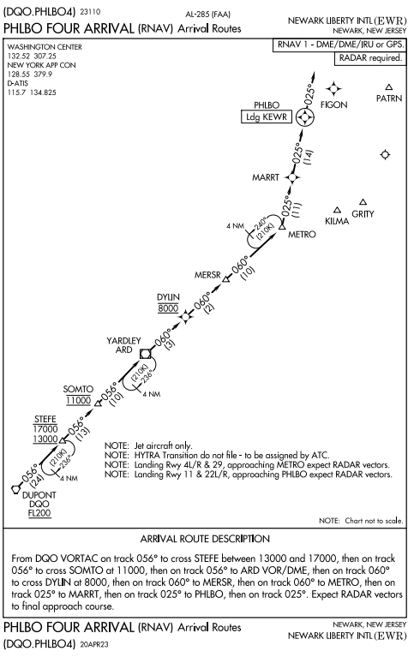
EWR PHLBO4 ARRIVAL
DELETED FAK & PXT TRANSITIONS

Slide 19
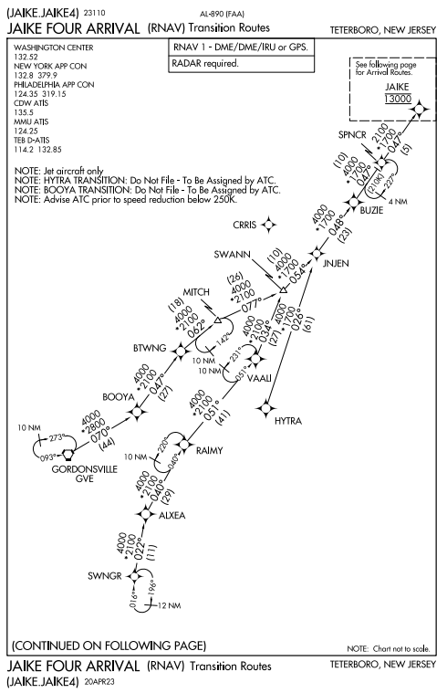
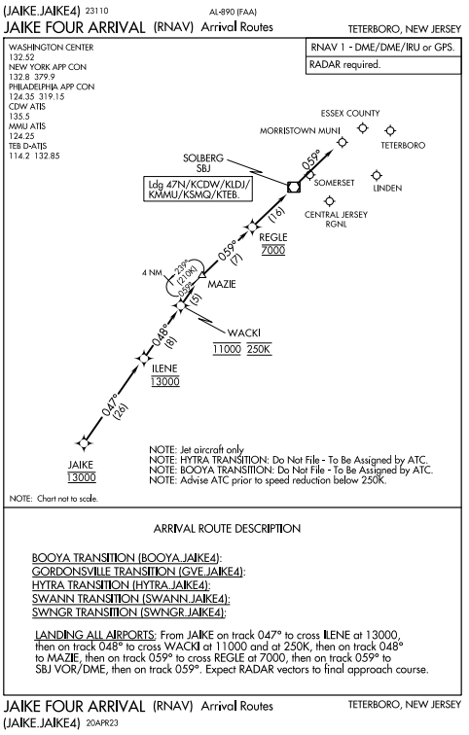
TEB JAIKE4 ARRIVAL
MEA Issue – NOTAM may be issued for MEA change to 5000 SWNGR – SWANN (no operational impact)
DELETED FAK, PXT, HPW, & RIC TRANSITIONS

Slide 20
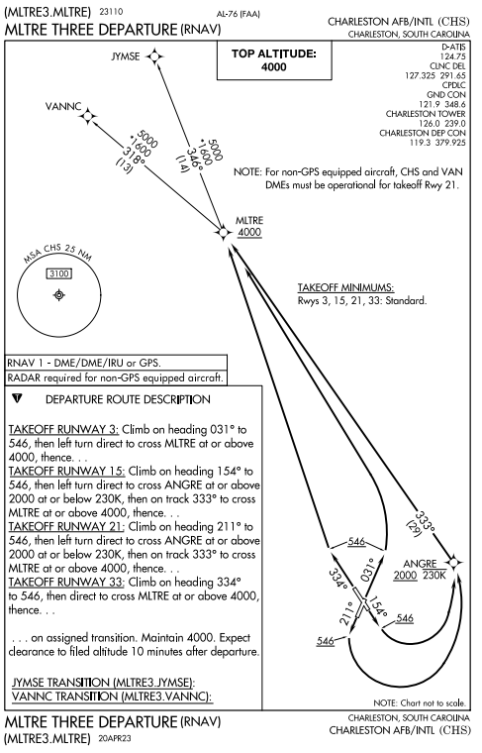
CHS MLTRE3 DEPARTURE

Slide 21
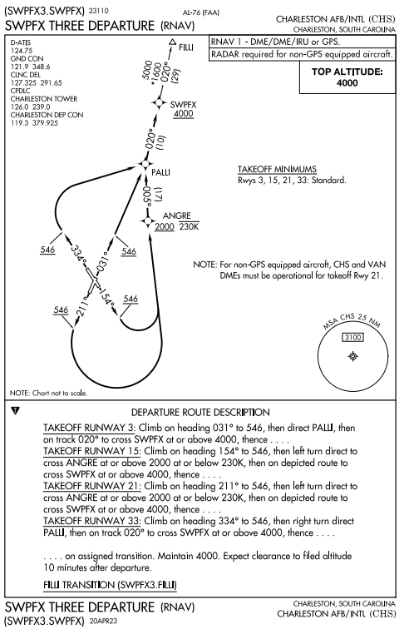
CHS SWPFX3 DEPARTURE

Slide 22
Preferred IFR Routes Effective 4/20/2023
~1200 City Pairs to be amended
Domestic routes between
ZBW, ZNY, ZDC, ZJX, ZMA, ZTL, ZHU, ZFW, ZID, ZOB
North Atlantic Routes
Landing in ZBW, ZNY, ZDC, ZJX, ZMA, ZTL, ZHU, ZFW, ZID, ZOB
The following were removed from HIGH ALTITUDE ROUTES, PLEASE DO NOT FILE
ILM (except dep KEWN), DIW, SBY, SWL
BARTL, BINGS, CEBEE, COVAN, DAVES, DWYTE, FRANZ, HERIN JAMTA, KEMPR, NASDE, SCARS, SEAER, SLANG, WETRO, YASLU
Please file Y-Routes instead of AR-Routes if GPS equipped
Route document provided 3/17 for planning purposes
National Playbook Routes & CDRs were also updated

Slide 23
Route Corrections Effective 4/20/2023
NAVCANADA/AIRAC updates for KCHS will not take place until 6/15/2023
There will be a mis-match between FAA and AIRAC for 56 days
Please utilize the following route string to KCHS eff 4/20
Q97 SAWED DFENC Q109 LAANA AMYLU AMYLU3 KCHS
Incorrect Route Published
Bad: ATL PLMMR3 BURGG Q22 RBV Q430 CREEL ORCHA JORDN2 PVD
Use: ATL PLMMR3 BURGG Q22 RBV Q430 CREEL ORCHA JORDN JORDN2 PVD

Slide 24
Route Advisories 4/20/2023 - TBD
Route Advisories will be utilized to establish to the new permanent Preferred IFR Routes
Routes will be the same as the Preferred IFR Routes
In effect for at least 7 days
After Route Advisories are cancelled, PLEASE continue to file the prescribed routes
Utilize published Preferred IFR Routes
Separate Route Advisory Possible
FL to ZDC
FL/ZTL to ZNY
FL/ZTL to ZBW
ZDC to FL
ZNY to FL
ZBW to FL

Slide 25
NEC ACR ROUTE INFO
If you have specific questions for FAA Enroute Centers (ARTCCs), please feel free to contact the following directly:
ARTCC | Name | Email
Boston Center | Terry Drew | terrence.drew@faa.gov
Center | Dennis Tennett | dtennett@natca.net
New York Center | Bill Ruby | rubymove@yahoo.com
Center | Adrienne Anthony | adrienne.d.anthony@faa.gov
Washington Center | Richard Carter | richard.c.carter@faa.gov
Center | Chris Porta | christopher.l.porta@faa.gov
Atlanta Center | Dwayne Copley | billy.d.copley@faa.gov
Center | Kevin Condon | kevin.w.condon@faa.gov
Jacksonville Center | Andrew Day | zjxoapm@gmail.com
Center | Ross Gibson | ross.gibson@faa.gov
Miami Center | Dave Petersen | dpetersen13@hotmail.com
Center | Andre Ferguson | andre.a.ferguson@faa.gov

Slide 26
Implementation TMIs 4/20/2023 - TBD
Utilized for up to 2 weeks during the implementation period
To provide controllers and aircrews the opportunity to become accustomed to the new routes and changes to the airspace while ensuring a safe operation
Intended to reduce complexity and redistribute volume across all available airspace
Specific ZDC Monitor Alert Parameters (MAP) to be reduced
TMIs being considered to reduce the need for AFPs
Miles-in-Trail possible for new Q-Routes
TMIs to be re-evaluated on a daily basis
Route Advisories to reduce volume in ZDC airspace POSSIBLE
ZBW to Florida and Florida to ZBW (both directions)
TO/FROM Florida West Coast airports file J6
TO/FROM Florida East Coast airports and MCO/ORL/ISM file J48

Slide 27
Voluntary Measures 4/20/2023 - TBD
Voluntary measures may help reduce delays
File DEEP OCEAN routes to/from Florida and the Northeast

Slide 28
How You Can Help
Share this briefing with others
Share with route planners, dispatchers, & management/staff
Provide feedback and suggestions
Help identify issues/mitigations not yet identified
Direct questions/comments to NEC ACR
Watch for additional information
Flight Plan Filers Telcon, NCF briefings, NBAA, IATA, etc.
Plan resources for route planning & programming
Updated Preferred IFR Routes to be distributed in advance (4 wks)
Be ready to utilize the new Q-Routes
File the new Q-Routes beginning on 4/20/2023

Slide 29
Q-Route NA NOTAMs (ZDC) Effective until 4/20/2023
“NOT AUTHORIZED” NOTAMs for the following will remain in effect until 4/20/2023:
Q60, !FDC 2/3301 ZDC ROUTE ZDC. Q60 JAXSN, VA TO HURTS, VA NA. 2209080907-2304200901EST
Q64 (new), !FDC 2/8570 ZDC ROUTE ZDC. Q64 TAR RIVER (TYI) VORTAC, NC TO SAWED, VA NA. 2208292045-2304200900EST
Q85, !FDC 2/3300 ZDC ROUTE ZDC ZJX. Q85 IGARY, SC TO CRPLR, VA NA. 2209080905-2304200901EST
Q87, !FDC 2/3298 ZDC ROUTE ZDC ZJX. Q87 JROSS, SC TO HURTS, VA NA. 2209080904-2304200901EST
Q97, !FDC 2/3290 ZDC ROUTE ZDC ZJX ZBW. Q97 CAKET, SC TO PRESQUE ISLE (PQI) VOR/DME, ME NA. 2209080902-2304200901EST
Q99, !FDC 2/3288 ZDC ROUTE ZDC ZJX. Q99 POLYY, NC TO HURLE, VA NA. 2209080900-2304200901EST
Q101 (new), !FDC 2/3302 ZDC ROUTE ZDC. Q101 SKARP, NC TO TUGGR, VA NA. 2209080908-2304200901EST
Q107 (new), !FDC 2/3304 ZDC ROUTE ZDC ZJX. Q107 GARIC, NC TO HURTS, VA NA. 2209080910-2304200901EST
Q109, !FDC 2/3268 ZDC ROUTE ZDC ZJX. Q109 PANDY, SC TO DFENC, NC NA. 2209080859-2304200901EST
Q111 (new), !FDC 2/3311 ZDC ROUTE ZDC. Q111 ZORDO, NC TO ALXEA, VA NA. 2209080911-2304200901EST
Q113, !FDC 2/3264 ZDC ROUTE ZDC ZJX. Q113 RAYVO, SC TO RIDDN, VA NA. 2209080857-2304200901EST
Q117 (new), !FDC 2/3312 ZDC ROUTE ZDC. Q117 YLEEE, NC TO SAWED, VA NA. 2209080912-2304200901EST
Q131 (new), !FDC 2/3313 ZDC ROUTE ZDC ZJX. Q131 ZILLS, NC TO ZJAAY, MD NA. 2209080914-2304200901EST
Q133 (new), !FDC 2/3316 ZDC ROUTE ZDC ZNY ZBW. Q133 CHIEZ, NC TO PONCT, NY NA. 2209080915-2304200901EST
Q135, !FDC 2/3262 ZDC ROUTE ZDC ZJX. Q135 JROSS, SC TO CUDLE, NC NA. 2209080855-2304200901EST
Q141 (new), !FDC 3/8677 ZDC VA..ROUTE ZDC. Q141 HOUKY, VA TO NALES, DE NA. 2302231200-2304200901EST
Q167 (new), !FDC 2/3320 ZDC ROUTE ZDC ZBW. Q167 ZJAAY, MD TO SSOXS, MA NA. 2209080917-2304200901EST
Q409, !FDC 2/3256 ZDC ROUTE ZDC ZJX. Q409 JROSS, SC TO WHITE, NJ NA. 2209080852-2304200901EST
Q445 (new), !FDC 2/3323 ZDC ROUTE ZDC ZBW. Q445 PAACK, NC TO KYSKY, NY NA. 2209080918-2304200901EST
Q481 (new), !FDC 2/3325 ZDC ROUTE ZDC ZNY ZBW. Q481 CONFR, MD TO DEER PARK (DPK) VOR/DME, NY NA. 2209080919-2304200901EST

Slide 30
Q-Route NA NOTAMs (ZNY, ZBW, ZJX) Effective until 4/20/2023
“NOT AUTHORIZED” NOTAMs for the following will remain in effect until 4/20/2023:
Q133 (new), !FDC 2/3317 ZNY ROUTE ZNY ZDC ZBW. Q133 CHIEZ, NC TO PONCT, NY NA. 2209080915-2304200901EST
Q481 (new), !FDC 2/3326 ZNY ROUTE ZNY ZDC ZBW. Q481 CONFR, MD TO DEER PARK (DPK) VOR/DME, NY NA. 2209080919-2304200901EST
Q97, !FDC 2/3295 ZBW ROUTE ZBW ZDC ZJX. Q97 CAKET, SC TO PRESQUE ISLE (PQI) VOR/DME, ME NA. 2209080902-2304200901EST
Q133 (new), !FDC 2/3318 ZBW ROUTE ZBW ZNY ZDC. Q133 CHIEZ, NC TO PONCT, NY NA. 2209080915-2304200901EST
Q167 (new), !FDC 2/3321 ZBW ROUTE ZBW ZDC. Q167 ZJAAY, MD TO SSOXS, MA NA. 2209080917-2304200901EST
Q445 (new), !FDC 2/3324 ZBW ROUTE ZBW ZDC. Q445 PAACK, NC TO KYSKY, NY NA. 2209080918-2304200901EST
Q481 (new), !FDC 2/3327 ZBW ROUTE ZBW ZNY ZDC. Q481 CONFR, MD TO DEER PARK (DPK) VOR/DME, NY NA. 2209080919-2304200901EST
Q85, !FDC 2/3299 ZJX ROUTE ZJX ZDC. Q85 IGARY, SC TO CRPLR, VA NA. 2209080905-2304200901EST
Q87, !FDC 2/3296 ZJX ROUTE ZJX ZDC. Q87 JROSS, SC TO HURTS, VA NA. 2209080904-2304200901EST
Q97, !FDC 2/3289 ZJX ROUTE ZJX ZDC ZBW. Q97 CAKET, SC TO PRESQUE ISLE (PQI) VOR/DME, ME NA. 2209080902-2304200901EST
Q99, !FDC 2/3287 ZJX ROUTE ZJX ZDC. Q99 POLYY, NC TO HURLE, VA NA. 2209080900-2304200901EST
Q107 (new), !FDC 2/3310 ZJX ROUTE ZJX ZDC. Q107 GARIC, NC TO HURTS, VA NA. 2209080910-2304200901EST
Q109, !FDC 2/3267 ZJX ROUTE ZJX ZDC. Q109 PANDY, SC TO DFENC, NC NA. 2209080859-2304200901EST
Q113, !FDC 2/3263 ZJX ROUTE ZJX ZDC. Q113 RAYVO, SC TO RIDDN, VA NA. 2209080857-2304200901EST
Q131 (new), !FDC 2/3314 ZJX ROUTE ZJX ZDC. Q131 ZILLS, NC TO ZJAAY, MD NA. 2209080914-2304200901EST
Q135, !FDC 2/3261 ZJX ROUTE ZJX ZDC. Q135 JROSS, SC TO CUDLE, NC NA. 2209080855-2304200901EST
Q409, !FDC 2/3257 ZJX ROUTE ZJX ZDC. Q409 JROSS, SC TO WHITE, NJ NA. 2209080852-2304200901EST
NOTE: The above NOTAMs are duplicates of the ZDC NOTAMs because the routes traverse multiple ARTCCs.
NOTE: Q437 was added since last distribution

