Slide 1
Pilot Briefing:
Climb Via, Descend Via, Speed Adjustments
NBAA Domestic Operations Committee
Rev: 4.00 January, 2024

Slide 2
Acknowledgments
NBAA gratefully acknowledges the assistance of the following groups in the preparation of this program:
Jeppesen, Inc.
  Jeppesen navigation data and charts furnished for this program are for training & familiarization purposes only. They are not to be used for navigation purposes
Performance-Based Aviation Rulemaking Committee (PARC) Pilot and Controller Procedures & System Integration (PCPSI) Working Group
FAA’s PBN Policy and Support Group
FAA Flight Standards - Performance Based Flight Systems Branch (AFS-470)
Nav Canada

Slide 3
New & Revised Air Traffic Procedures
Climb Via, Descend Via, & Speed Adjustments
United States: Effective April 3, 2014
ICAO: Effective November 10, 2016
Introduces the “Climb Via” clearance
Updates the “Descend Via” clearance
Revises & expands on ATC clearance phraseology supporting speed adjustments
Provides ATC with new clearance/phraseology options
Reduces frequency congestion
Reduction in hear-back/read-back errors

Slide 4
ICAO Climb Via & Descend Via
10 November 2016
Adopted to further world-wide harmonization of ATC clearance
Allows ATC and aircrew to communicate and understand detailed clearance information that would otherwise require long and potentially complex transmissions

Slide 5
Overview:
Simple, intuitive phraseology for issuing a clearance to laterally & vertically navigate a departure or an arrival
Pilots must be familiar with the application of these types of clearances:
  “Climb Via/Descend Via”
  Climb/Descend Via “Except Maintain”
  Climb/Descend “and Maintain”
  “Climb and Maintain” or “Descend and Maintain”
  Speed Phraseology
Purpose of this program is to provide this familiarization
  Definitions
  Examples of operational application
  U.S. Quick Reference Card

Slide 6
Pilots Need To Know
FAA “Climb Via” & “Descend Via”
“Climb Via”:
  An abbreviated ATC clearance that requires compliance with a procedure’s lateral path, associated speed restrictions and altitude restrictions along the cleared route or procedure until climbing to the “Top Altitude” published on the SID
“Descend Via”:
  An abbreviated ATC clearance that requires compliance with a published procedure’s lateral path and associated speed restrictions and provides a pilot-discretion descent to comply with published altitude restrictions until descending to the “Bottom Altitude” published on the STAR

Slide 7
Pilots Need To Know
FAA “Climb Via/Descend Via Except Maintain”
Execute the Climb Via clearance to an ATC assigned “Top Altitude”
Execute a Descend Via clearance to an ATC assigned “Bottom Altitude”

Slide 8
Pilots Need To Know
FAA “Climb and Maintain” or “Descend and Maintain”
Pilot is expected to vacate current altitude and commence an unrestricted climb/descent to comply with the clearance
For aircraft already climbing via a SID, or descending via a STAR, published altitude restrictions are deleted unless re-issued by ATC
Speed restrictions always remain in effect unless the controller explicitly cancels or amends the speed restrictions

Slide 9
Pilots Need To Know
FAA Speed Phraseology
“Climb Via” or “Descend Via” :
  Absent any qualifying instructions, issuance of a climb or descend via clearance cancels a previously issued ATC speed adjustment and provides pilot discretion to adjust speed while requiring compliance with upcoming restrictions
  ATC may require compliance with a previous ATC-issued speed adjustment using phraseology:
    “Proceed direct FNCHR, maintain three zero zero knots until FNCHR , then descend via the FNCHR one arrival, landing north”
  Where there are no upcoming speed restrictions, issuance of a “Proceed direct (WP name), climb/descend via ....” cancels a previously issued speed adjustment and authorizes speed at pilot's discretion as appropriate for the phase of flight, ensuring compliance with 14 CFR 91.117
“Resume Normal Speed”:
  Cancels ATC issued speed restrictions and instructs pilot to return to normal aircraft speed where no restrictions are published on the procedure/route currently being flown
  It does not delete speed restrictions on upcoming segments of flight (e.g., a STAR later in the flight)
  This does not relieve the pilot of those speed restrictions which are applicable to 14 CFR Section 91.117
“Resume Published Speed” :
  Cancels ATC issued speed restrictions; pilot is expected to comply with speeds published on the SID/STAR
“Delete Speed Restrictions” :
  Cancels ATC assigned, and
  Cancels all published speed restrictions on a charted procedure

Slide 10


Pilot/Controller Phraseology
Pilots shall respond to “Climb Via” or “Descend Via” clearances by repeating the clearance verbatim; phrases such as “on the SID” or “descending on the arrival” are not acceptable and can create additional workload with unnecessary controller queries
When changing frequencies or on initial contact advise ATC of current altitude, “Climbing/Descending Via” procedure name, and runway transitions if assigned; if issued an altitude or speed not contained on the SID/STAR, advise ATC of restrictions issued by the prior controller

Slide 11
Pilot/Controller Phraseology
Examples:
“Southwest Seven Eleven leaving two thousand climbing via the Laura Two departure.”
“Delta Fifty Eight climb via SID except cross MKALA at or above seven thousand.”
“American One Twenty proceed direct ROCKR, cross ROCKR at or above one zero thousand, climb via the BIZEE Two departure.”
“United Thirty Five cleared to Johnston Airport, Scott One departure, JONEZ transition, Q-one forty five, climb via SID except maintain flight level one eight zero.”
“JetBlue Six Zero Two leaving flight level two one zero descending via the IVANE two arrival landing south.”
“Delta One Twenty One leaving flight level one niner zero, descending via the EAGUL Five arrival runway two-six transition."

Slide 12
Pilot/Controller Initial Contact Phraseology
Proper Phraseology Conveys Intent
Do note use non-standard phraseology with a “Climb Via” or “Descend Via” clearance:
“On the SID”
“Climbing on the SID”
“On the RUUDY Five”
“Descending on the arrival”
“On the EAGUL arrival”
Use Standard Phraseology
“Leaving two thousand, eight hundred climbing via the Cowboy Six”
“Leaving flight level two, two zero, descending via the SEEVR Four...”
“Leaving two thousand, eight hundred, climbing to one four thousand”
“Leaving one seven thousand, eight hundred, descending to one zero thousand”
  Informs ATC That The Aircraft Will Comply With Published Restrictions On The SID Or STAR
  Informs ATC That The Aircraft Will Not Comply With Published Restrictions SID Or STAR

Slide 13
ICAO Climb Via SID & Descend Via STAR
Cleared Level is expectedly stated:
  “FASTAIR 345 DESCEND VIA STAR TO 3 000 FEET”
  “FASTAIR 345 CLIMB VIA SID TO FL 100”
Climb Via SID & Descend Via STAR are NOT “at pilot’s discretion”. Pilots must vacate altitude upon receipt and acknowledgment of clearance
  Exception: Canada – remains a “when ready” climb or descent clearance
Climb/Descend Unrestricted cancels both level and speed restrictions:
  “FASTAIR 345 CLIMB UNRESTRICTED TO FL 070”
  “FASTAIR 345 DESCEND UNRESTRICTED TO 4 000 FEET”
Provision for tactical cancelation of level and/or speed restrictions
  “FASTAIR 345 DESCEND VIA STAR TO 2 000 FEET CANCEL LEVEL RESTRICTION AT BATON”
  “FASTAIR 345 CLIMB VIA SID TO FL 080 CANCEL SPEED RESTRICTION AT TRUNK’’

Slide 14
ICAO Climb Via SID & Descend Via STAR
Speed control instructions remain in effect unless explicitly cancelled or amended by the controller:
  ATC-assigned speed restrictions are not canceled with a Climb Via SID or Descend Via STAR clearance as long as the speed does not contradict State rules
  Maintain last assigned speed until State rules require a speed reduction
Canada Only: Unless specifically stated by ATC, an instruction to “Resume Normal Speed” does not cancel speed restrictions that are applicable to published procedures of upcoming segments of flight
  Upcoming speed restrictions on the SID or STAR will be adhered to. However, the speed is at the pilot’s discretion until the next published speed restriction

Slide 15
ICAO Climb Via SID & Descend Via STAR
Summary of Differences:
USA | ICAO
Top/Bottom altitudes are charted DESCEND VIA EAGUL6 ARRIVAL | Always assign an altitude. DESCEND VIA STAR [TO] (altitude)
DESCEND AND MAINTAIN (altitude) = DELETE RESTRICTIONS | DESCEND UNRESTRICTED [TO] (altitude)= DELETE RESTRICTIONS ABOVE THE CLEARANCE ALTITUDE
DELETE SPEED RESTRICTION | SPEED RESTRICTION CANCELLED
DELETE ALTITUDE RESTRICTION | ALTITUDE RESTRICTION CANCELLED
DESCEND/CLIMB VIA – Cancels previously issued speed – comply with published speeds | DESCEND/CLIMB VIA – Does not cancel a previously issued speed

Slide 16
ICAO Climb Via SID & Descend Via STAR
Summary of Differences:
USA | ICAO
DESCEND VIA – pilot’s discretion descent to meet speed & altitude constraints | DESCEND VIA – pilot to begin descent immediately to comply with altitude constraints
Uses the STAR/SID name and number with descend/climb via clearances | Does not use specific STAR/SID name with descend/climb via clearances

Slide 17
Briefing Topics
Climb Via
Descend Via
Speed Adjustments
Additional Resources
ICAO
Please click on the above picture to access the program pertaining to “Climb Via”, “Descend Via” and ATC speed adjustments. Within each briefing, you will have the option to return to this menu.
Exit Program

Slide 18
DEDICATED TO THE HELPING BUSINESS ACHIEVE ITS HIGHEST GOALS

Slide 19
Briefing Topics – Climb Via (CV)
Terminology
Operational Application
Predeparture Clearance (PDC)
Briefing Card
FAA “Climb Via” Video
Return To Briefing Topic Main Menu

Slide 20
Briefing Topics – Descend Via (DV)
Terminology
Operational Application
Briefing Card
Return To Briefing Topic Main Menu

Slide 21
Briefing Topics – Additional Resources
Frequently Asked Questions
FAA PBN Resources
FAA Climb Via & Descend Via InFO
Return To Briefing Topic Main Menu

Slide 22
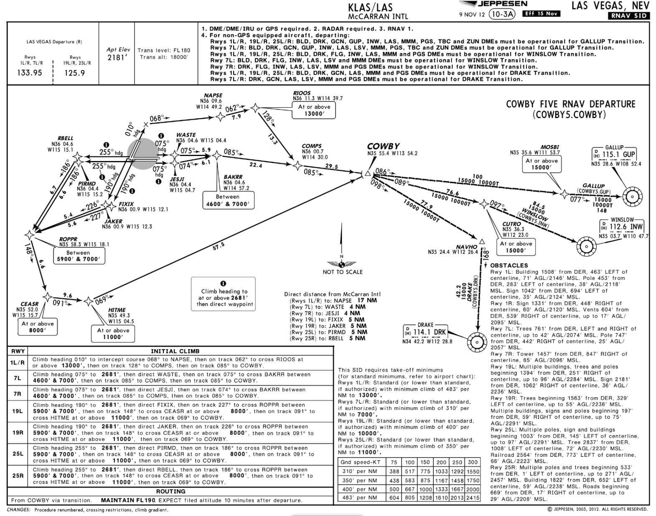
Climb Via:
Climb Via – Terminology
An abbreviated ATC clearance that requires compliance with the procedure lateral path, associated speed restrictions, and altitude restrictions along the cleared route or procedure.
©Jeppesen, Inc. Not for Navigation Purposes
<ESC Exit>

Slide 23
Climb Via (AIM 5-2-8 e 4)
Climb Via – Terminology
Authorizes Pilot To:
When used in the IFR departure clearance, in a PDC, DCL*, or when subsequently cleared after departure to a waypoint depicted on a SID, to join a procedure after departure or resume a procedure
When vertical navigation is interrupted and an altitude is assigned to maintain which is not contained on the published procedure, to climb from that previously assigned altitude at pilot’s discretion to the altitude depicted for the next waypoint
  ATC must ensure obstacle clearance until the aircraft is established on the lateral and vertical path of the SID
Once established on the depicted departure, to climb and to meet all published or assigned altitude and speed restrictions
*DCL = Departure Clearance Via Data Link FANS 1/A Aircraft/Operators
<ESC Exit>

Slide 24
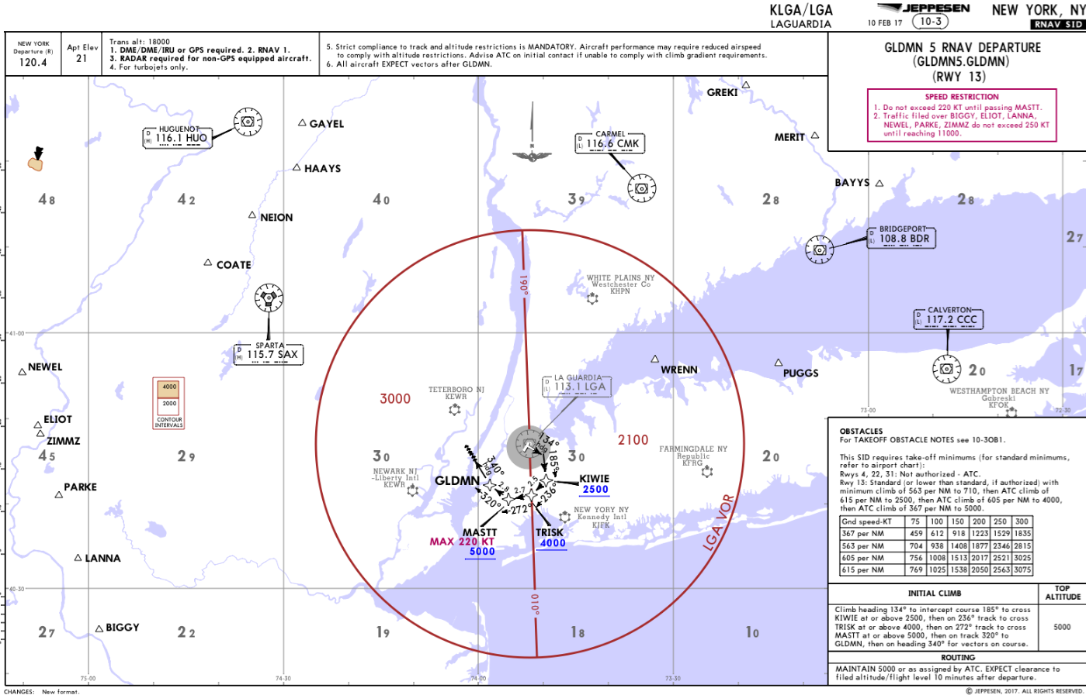
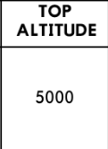
Top Altitude:
Climb Via – Terminology
In Reference To SID Published Altitude Restrictions The Charted “Maintain” Altitude Contained In The Procedure Description Or Assigned By ATC.
©Jeppesen, Inc. Not for Navigation Purposes

Slide 25
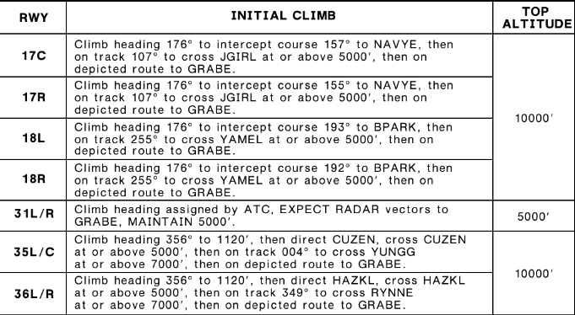
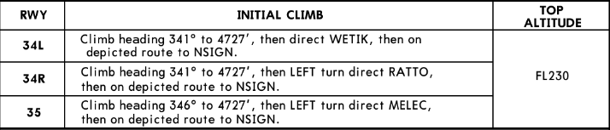
Top Altitude
Climb Via – Terminology
May be published for all runways & transitions
May be runway/transition specific
May be departure airport specific
It is not:
  The altitude filed in the IFR flight plan
  The “expect” altitude in the IFR clearance or published on the SID
<ESC Exit>

Slide 26
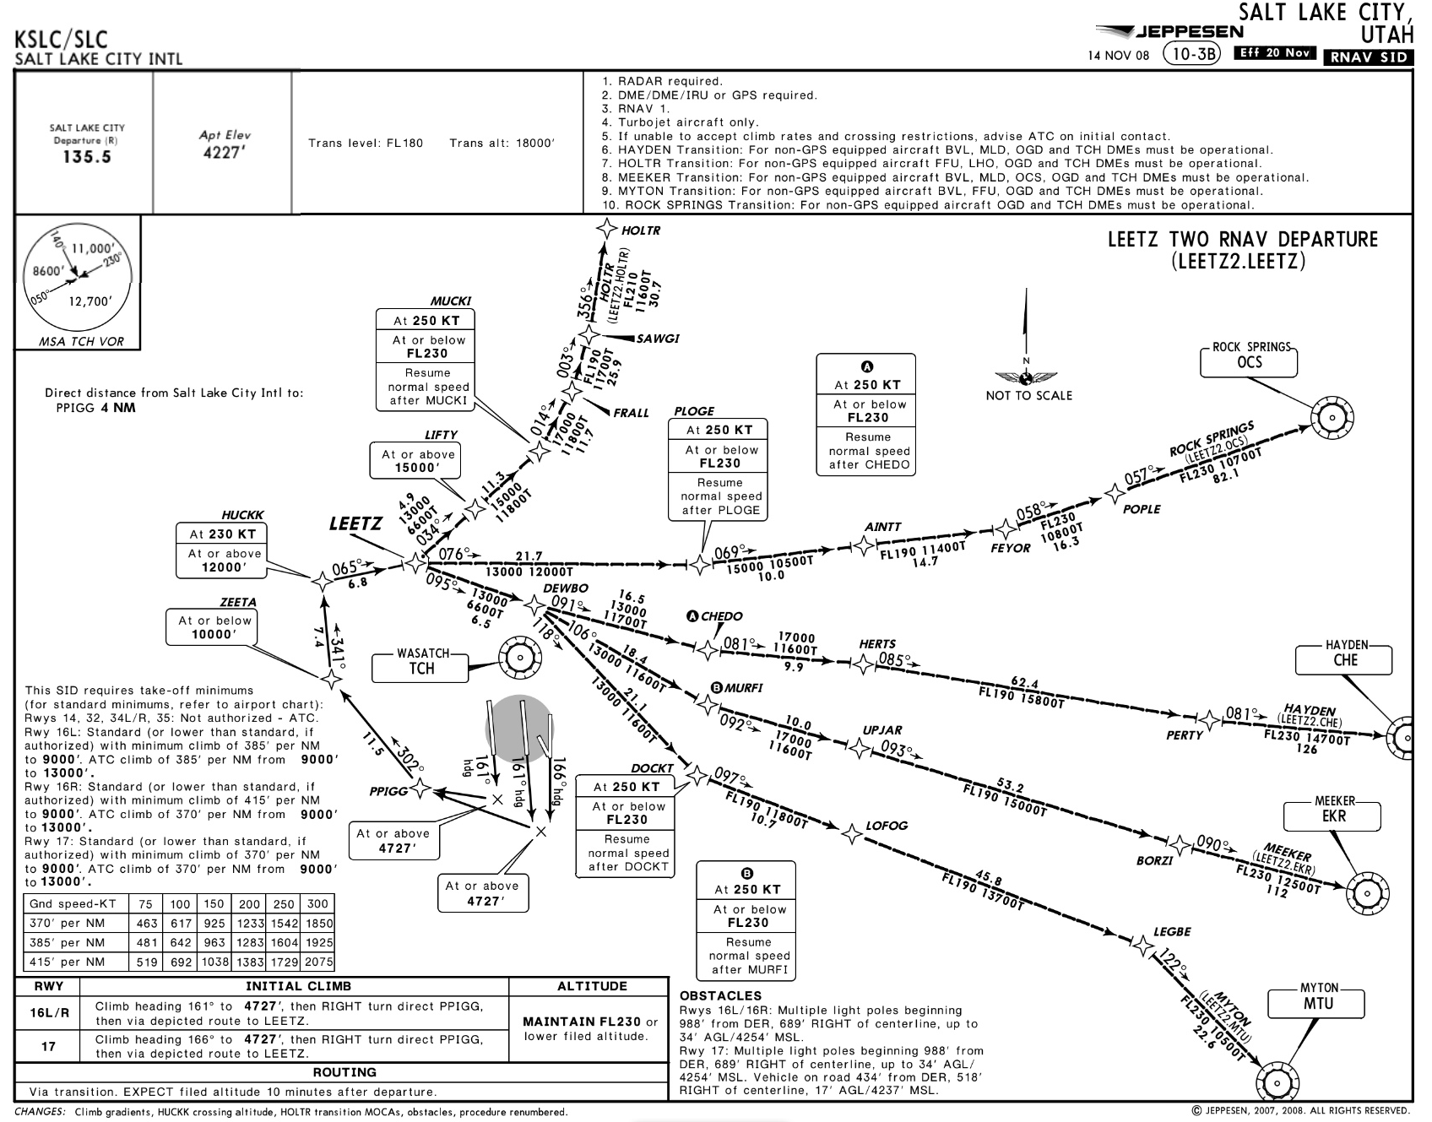
An ATC Clearance That Includes An IFR Departure Procedure
Climb Via – Operational Application
Is a clearance to fly the depicted route & assigned transition
Is a clearance requiring compliance with published speed restrictions
However, altitude assignment & vertical navigation is a separate clearance
ATC Clearance:
“Cleared LEETZ Departure”
©Jeppesen, Inc. Not for Navigation Purposes

Slide 27
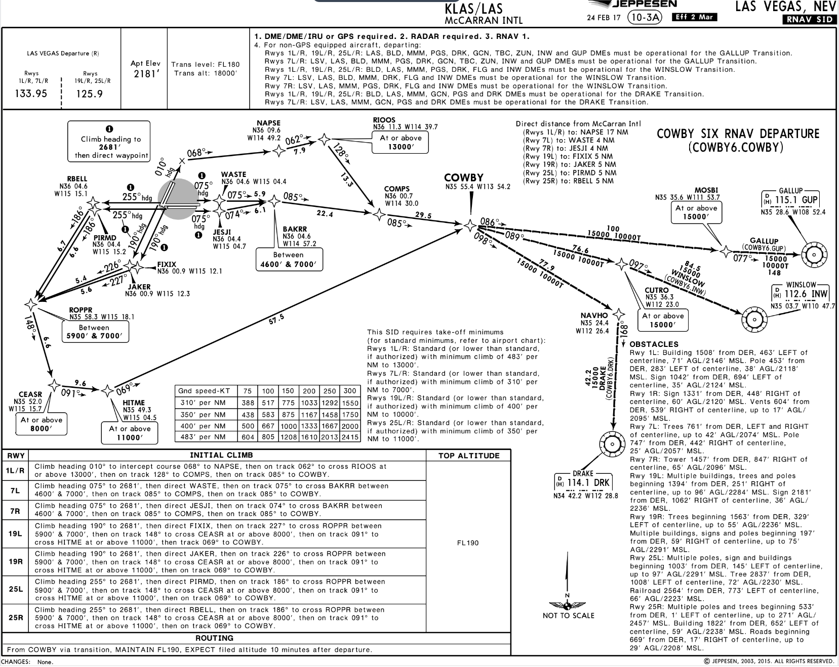
Climb Via – Operational Application
©Jeppesen, Inc. Not for Navigation Purposes
ATC Voice:
“Cleared…Cowboy Six Departure, Gallup Transition, Then As Filed. Climb Via SID…”
<ESC Exit>

Slide 28
“Climb Via SID” Clearance
Climb Via – Operational Application
After takeoff, the pilot should:
Track the lateral path of the COWBY6
Comply with published speed restrictions
Climb to meet all published altitude restrictions
Climb to the “Top Altitude” published on the SID
Published
“Top Altitude”
FL 190
GUP
MOSBI
At or Above 15000’
COWBY
HITME
At or Above 11000’
CEASR
At or Above 8000’
JAKER
ROPPR
Between 5900’ & 7000’
RW19R
At or Above 2681’
<ESC Exit>

Slide 29
Pilot/Controller Initial Contact Phraseology
Climb Via – Operational Application
“Las Vegas Departure,
Gulfstream Six Five Zero Golf Alpha, Leaving Two Thousand Eight Hundred, Climbing Via The Cowboy Six Departure”
“Gulfstream Six Five Zero Golf Alpha, Las Vegas Departure, Radar Contact”
<ESC Exit>

Slide 30

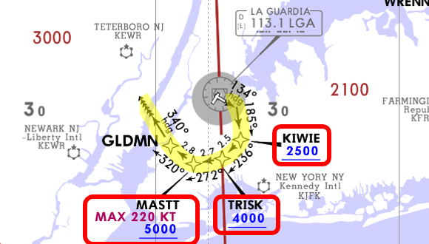
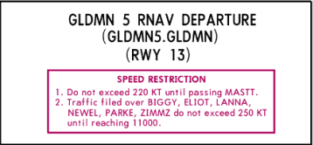
Climb Via – Operational Application
ATC Voice:
“Cleared…GLDMN Five Departure, Radar Vectors ZIMMZ, Then As Filed. Climb Via SID…”
©Jeppesen, Inc. Not for Navigation Purposes
<ESC Exit>

Slide 31
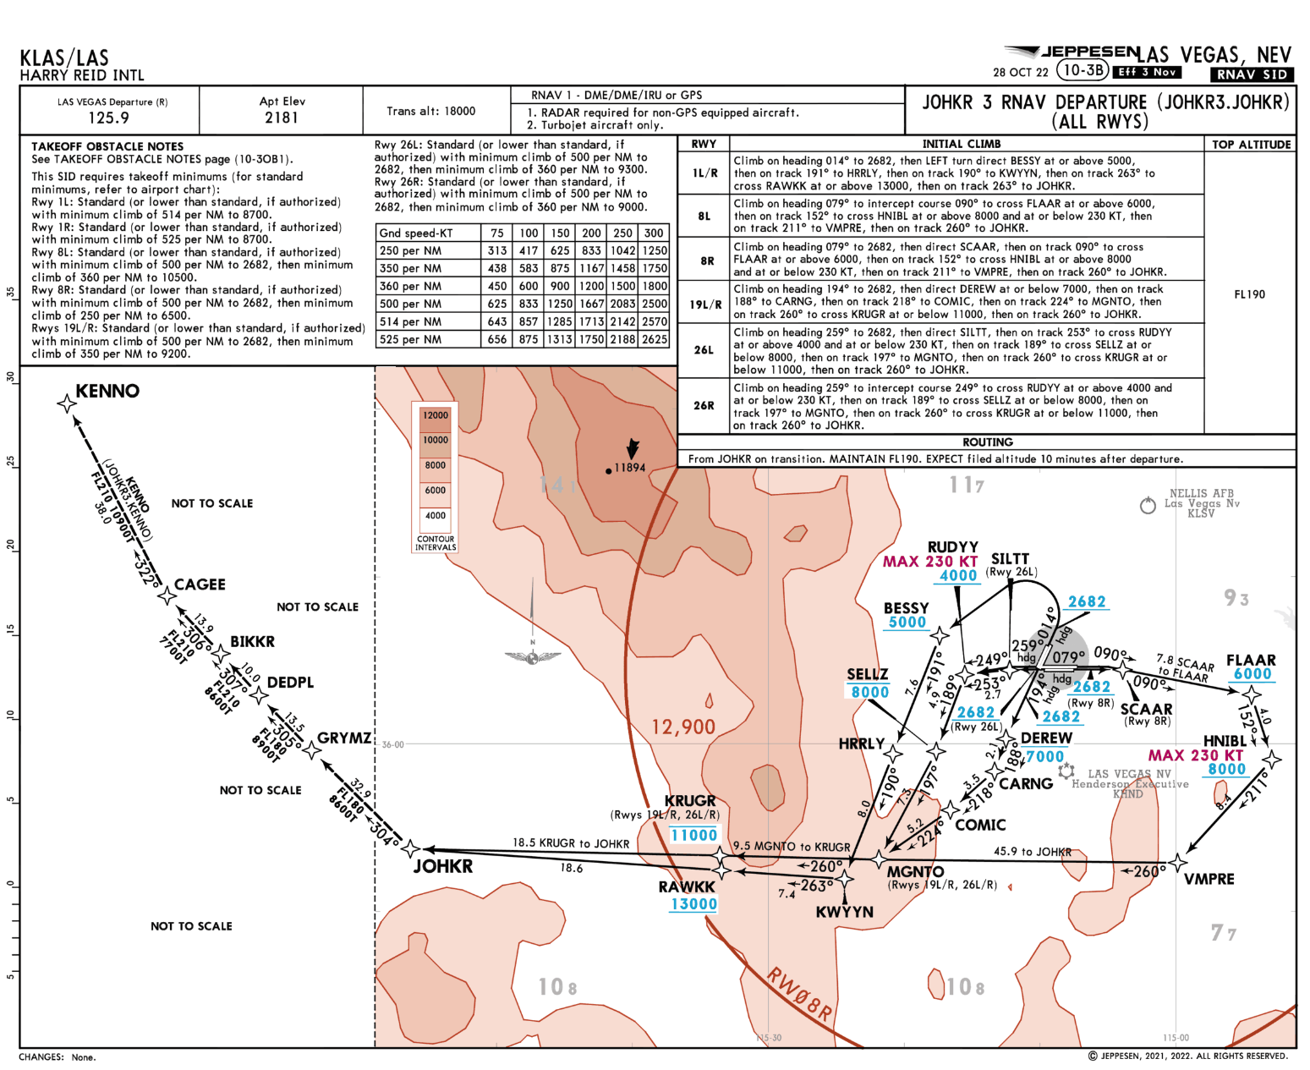
Climb Via – Operational Application
ATC Voice:
“Cleared…JOHKR 3 Departure, KENNO Transition, Then As Filed. Climb Via SID…”
Published
“Top Altitude”
©Jeppesen, Inc. Not for Navigation Purposes
<ESC Exit>

Slide 32
“Climb Via SID”
Climb Via – Operational Application
After Takeoff, The Pilot Should:
Track the lateral path of the JOHKR3.KENNO
Climb to meet all published altitude restrictions
Comply with all speed restrictions
Climb to the published “Top Altitude” (FL190)
GRYMZ
DEDPL
BIKKR
CAGEE
KENNO
JOHKR
Published
“Top Altitude”
FL 190
MGNTO
KRUGR
At or Below 11000’
SELLZ
At or Below
8000’
RUDYY
SILTT
MAX 230 KT
At or Above
4000’
RW26L
At or Above 2682’
<ESC Exit>

Slide 33
Climb Via, Except Maintain…
Climb Via – Operational Application
Used By ATC to Assign Or Amend The Top Altitude
When the “Top Altitude” is published as “Assigned by ATC”
When ATC must assign a “Top Altitude” that differs from that published on a chart
<ESC Exit>

Slide 34
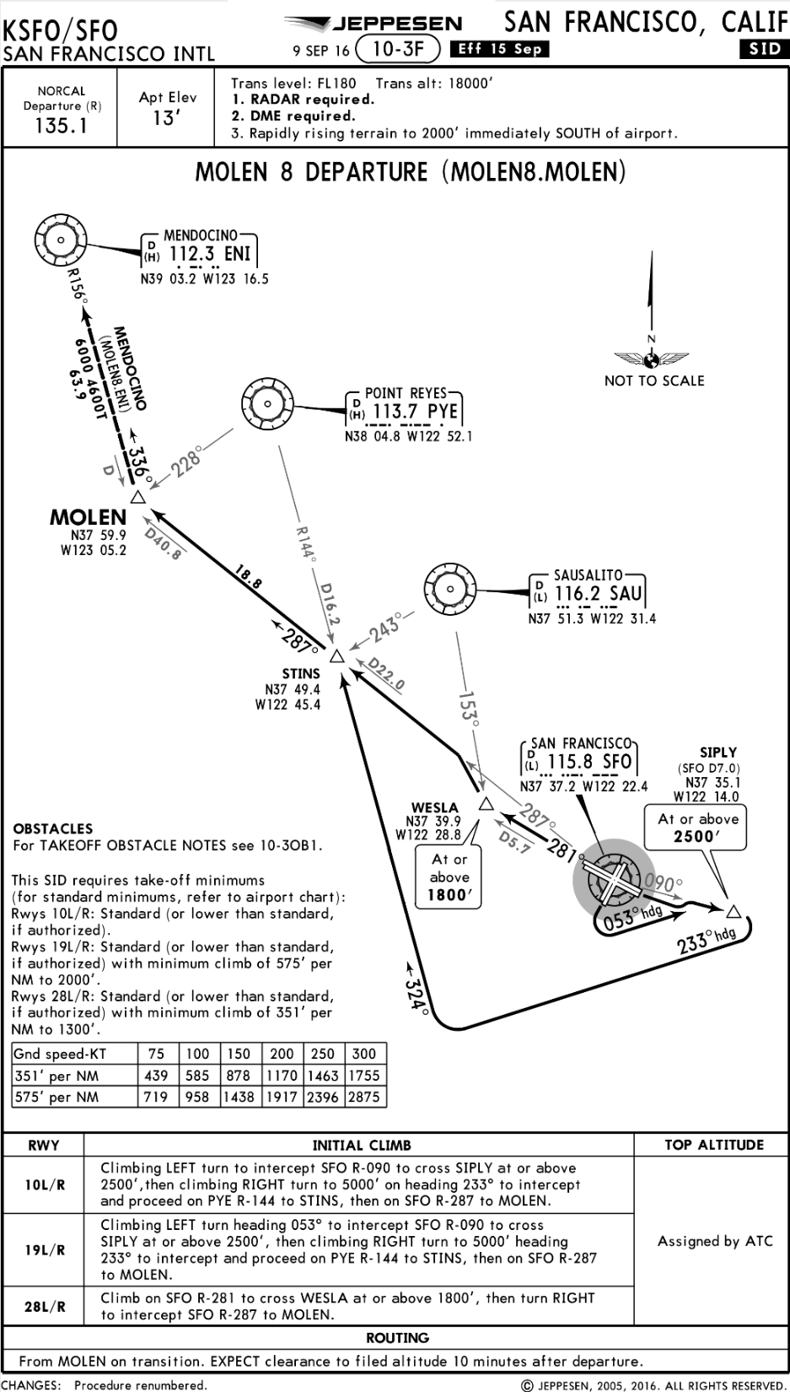
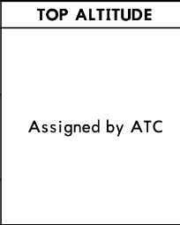
Climb Via, Except Maintain…
Climb Via – Operational Application
After Takeoff, The Pilot Should:
Track the lateral path of the MOLEN 8
Climb to meet all published altitude restrictions
Climb to the “Top Altitude” stated in the “Climb Via SID, Except Maintain” clearance
<ESC Exit>

Slide 35
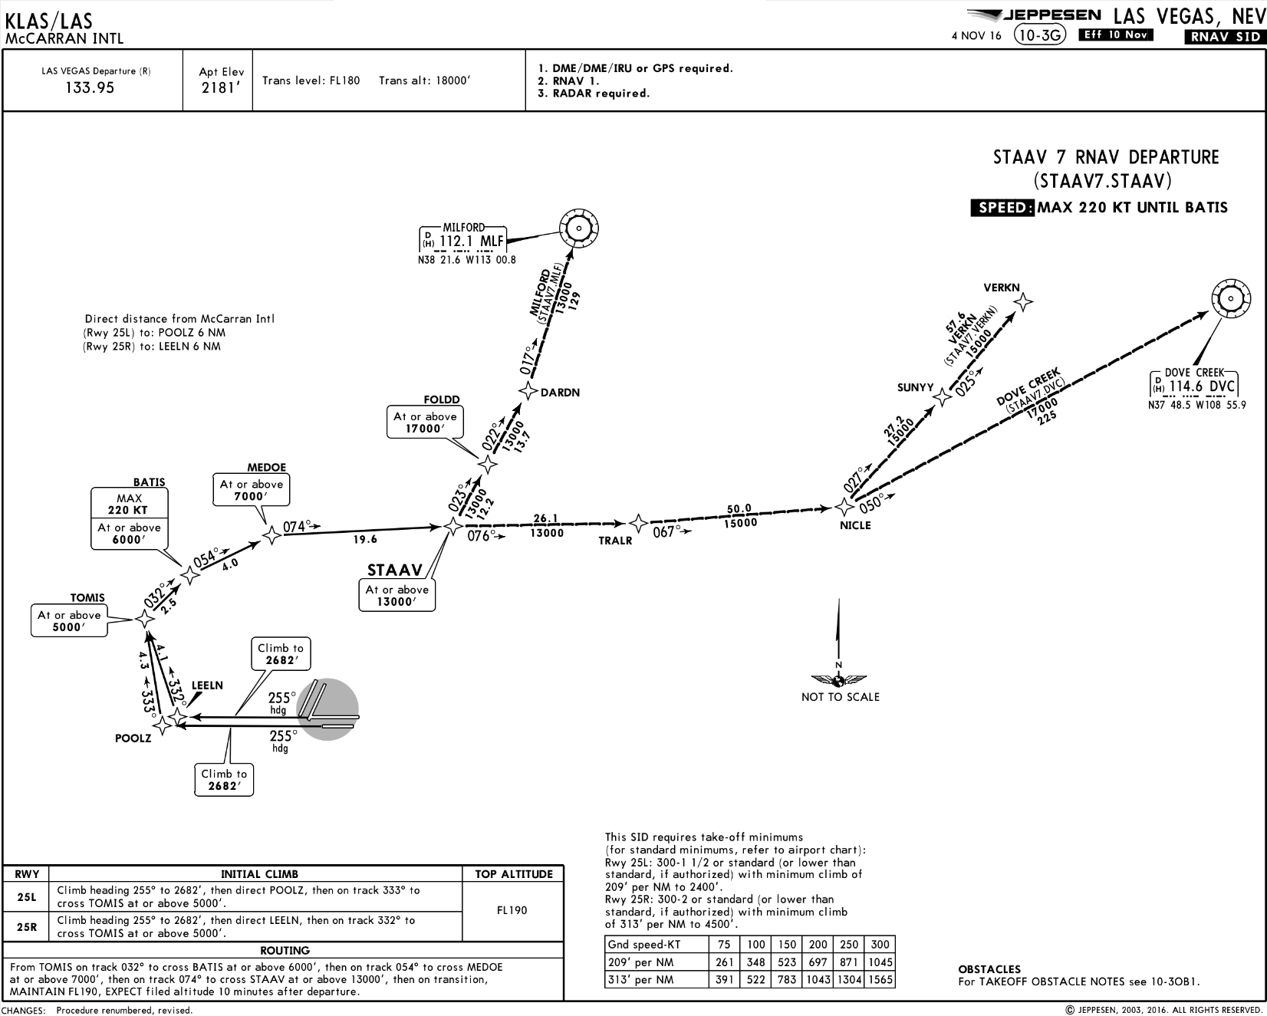
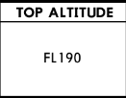
Climb Via – Operational Application
Assign A “Top Altitude” That Differs From That Published On A SID
Altitude Restriction at FOLDD Requires Further ATC Clearance
ATC Voice:
“Cleared…STAAV Seven Departure, Milford Transition, Climb Via SID, Except Maintain One-Three Thousand…”
©Jeppesen, Inc. Not for Navigation Purposes
<ESC Exit>

Slide 36
“Climb Via SID, Except Maintain…”
Climb Via – Operational Application
After Takeoff, The Pilot Should:
Track the lateral path of the STAAV7
Comply with published speed restrictions
Climb to meet all published altitude restrictions
Climb to the “Top Altitude” stated in the “Climb Via SID, Except Maintain” clearance
The altitude restriction at FOLDD requires a further ATC clearance
FOLDD
At or Above 17000’
DARDN
MLF
STAAV
ATC-Assigned
“Top Altitude”
13,000’
At or Above 13000’
MEDOE
At or Above 7000’
BATIS
MAX
220 KT
At or above 6000’
LEELN
TOMIS
At or Above 5000’
RW25R
At or Above 2680’
<ESC Exit>

Slide 37
Pilot/Controller Initial Contact Phraseology
Climb Via – Operational Application
Pilot Must Provide The “Top Altitude” On Initial Contact
When Climbing With A “Climb Via, Except Maintain” Altitude Assignment
“Las Vegas Departure, Gulfstream November One, Leaving Two Thousand Seven Hundred For One-Three Thousand,
Climbing Via The STAAV Seven Departure”
“Gulfstream November One,
Las Vegas Departure, Radar Contact”
<ESC Exit>

Slide 38
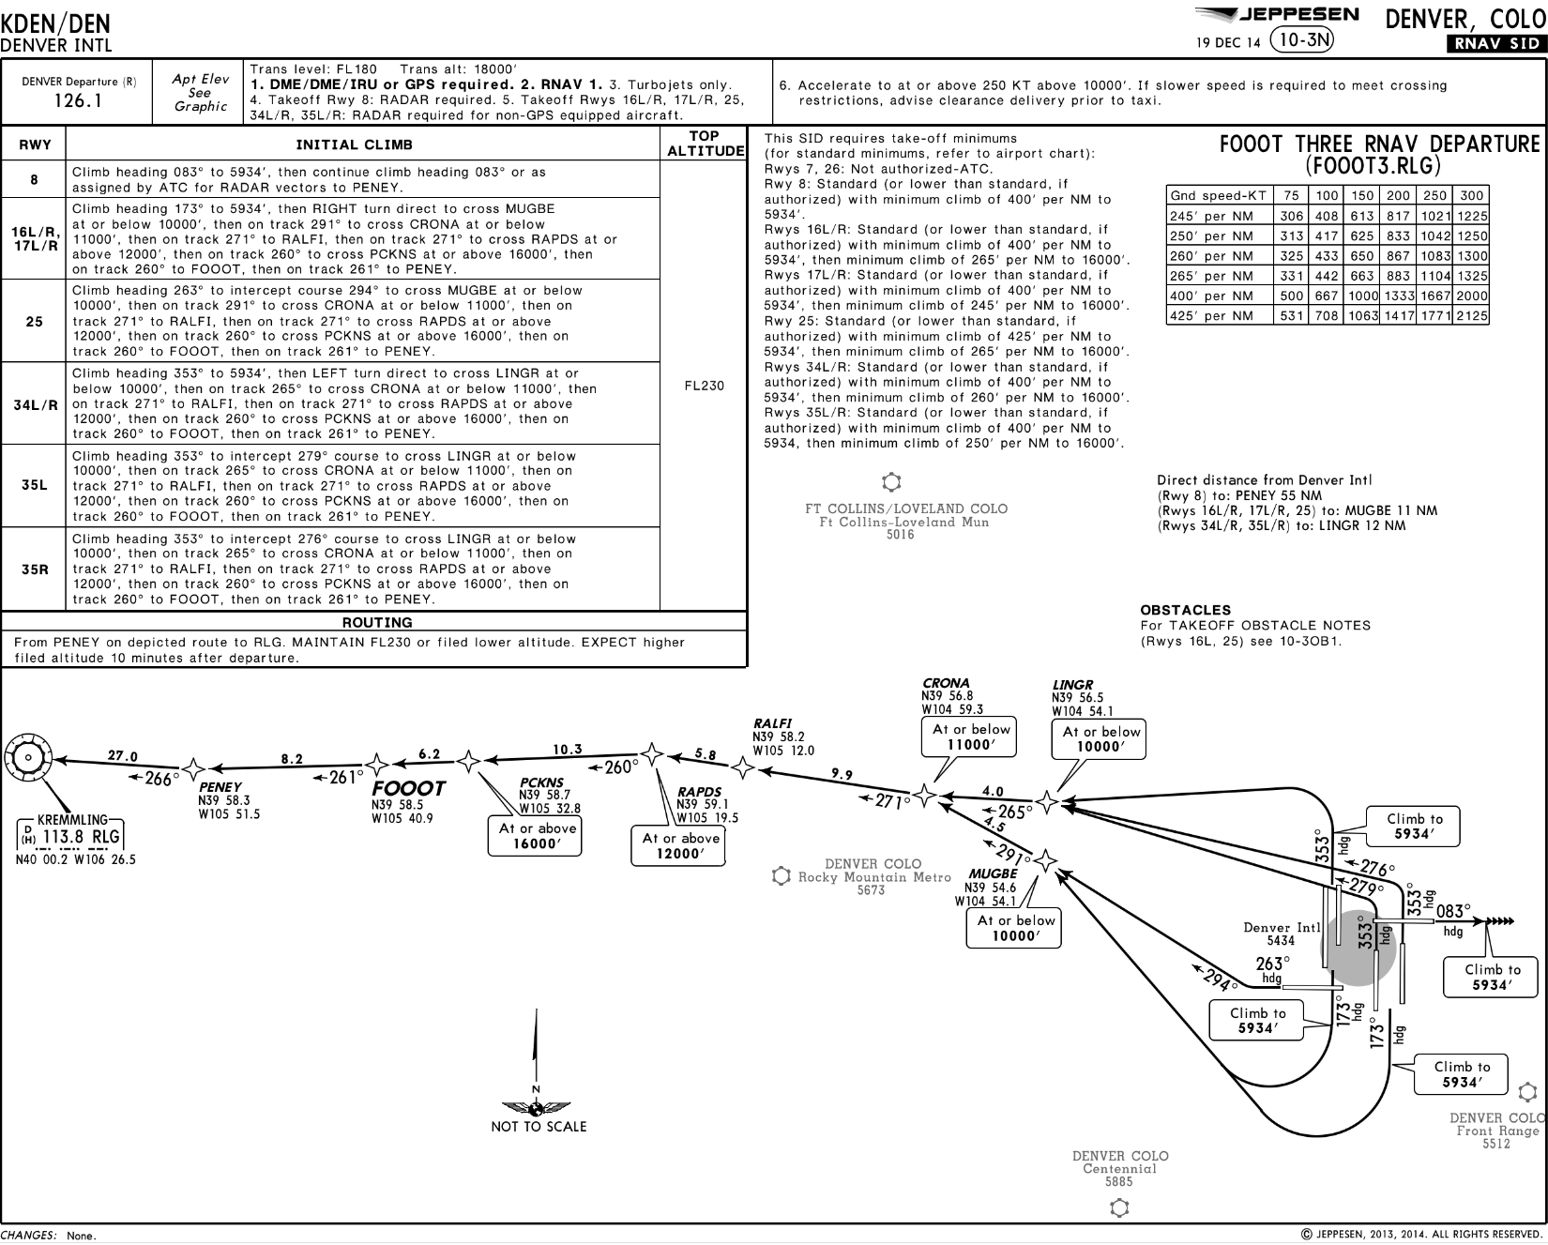
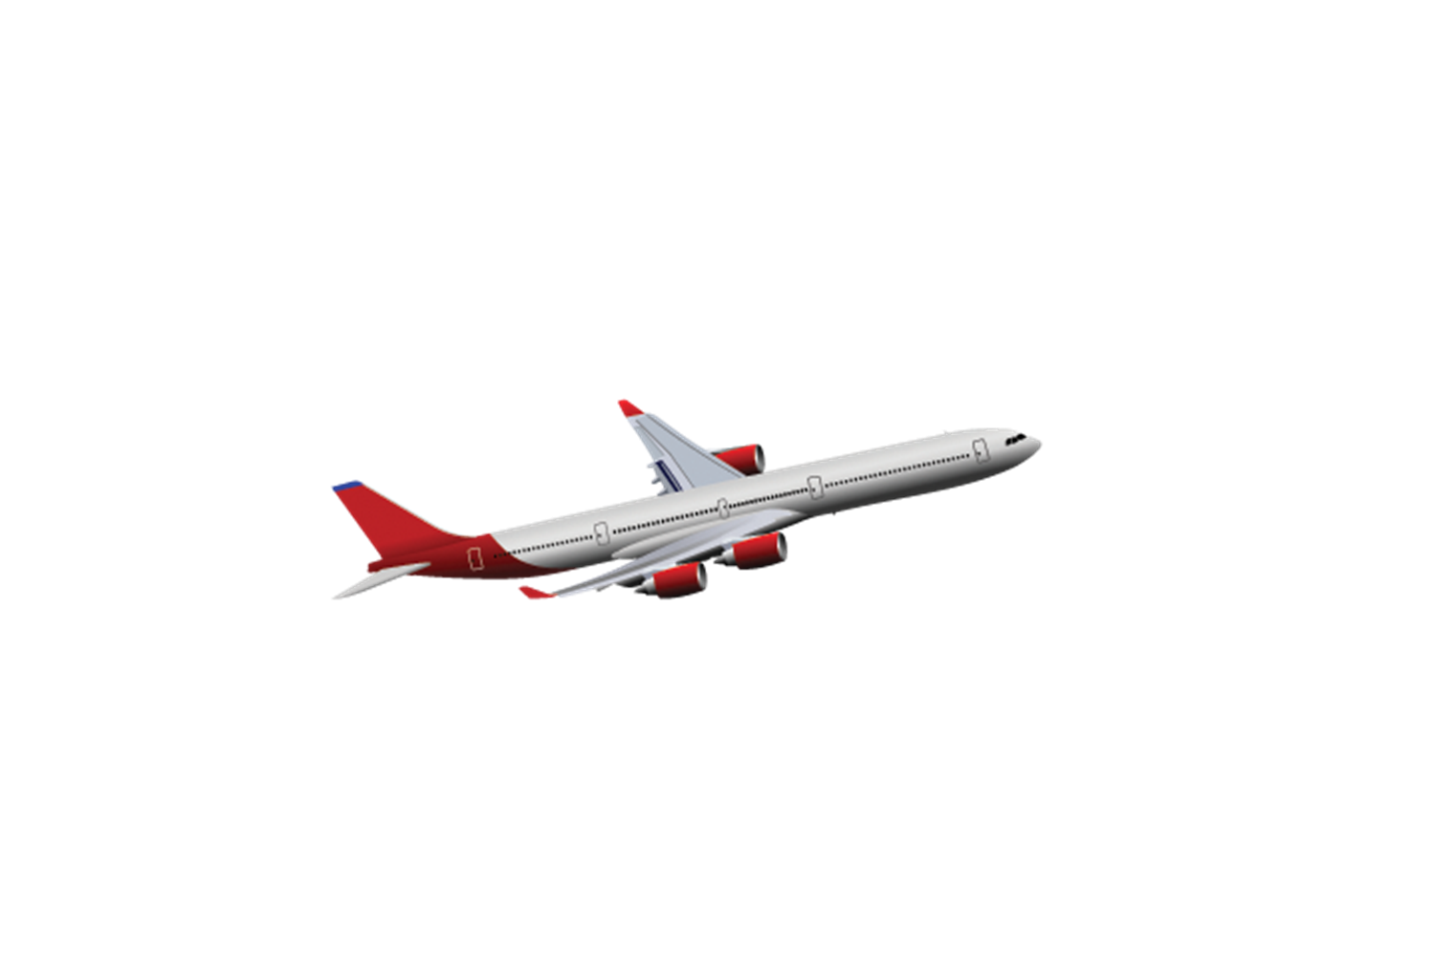
“Climb Via” – Applications After Takeoff
Climb Via – Operational Application
Initial ATC Clearance:
“Cleared FOOOT Three Departure, Maintain One Zero Thousand”
After Takeoff, ATC Issues :
“Climb Via SID”
Track the lateral path of the FOOOT SID
Comply with published speed restrictions
Comply with published altitude restrictions
Then climb to the ATC assigned “Top Altitude” (FL 230)
©Jeppesen, Inc. Not for Navigation Purposes

Slide 39
“Climb Via” – Applications After Takeoff
Climb Via – Operational Application
Initial ATC Clearance:
“Cleared FOOOT Three Departure, Climb Via SID”
Top Altitude
After Takeoff, ATC Issues :
“Climb Via SID, Except Cross RAPDS At Or Above One Four Thousand”
Track the lateral path of the FOOOT SID
Comply with published speed restrictions
Comply with published altitude restrictions
Cross RAPDS “at or above” 14,000’
Then climb to the ATC assigned “Top Altitude” (FL 230)
©Jeppesen, Inc. Not for Navigation Purposes

Slide 40
“Climb Via” – Applications After Takeoff
Climb Via – Operational Application
Initial ATC Clearance:
“Cleared FOOOT Three Departure, Climb Via SID”
After Takeoff, ATC Issues :
“Climb Via SID Except Maintain Flight Level Three Zero Zero”
Track the lateral path of the FOOOT SID
Comply with published speed restrictions
Comply with published altitude restrictions
Then climb to the new ATC assigned “Top Altitude” (FL 300)
©Jeppesen, Inc. Not for Navigation Purposes

Slide 41
ATC Intervention On A SID
Climb Via – Operational Application
ATC will issue an altitude to maintain and all appropriate altitude restrictions when a radar vector will take the aircraft off an assigned procedure that contains altitude instructions or the previously issued clearance included crossing restrictions
ATC must advise the pilot what to expect when the vector is completed
Phraseology:
  “Lear Two Three Mike X-ray, Fly Heading One Five Zero, Vectors For Spacing, Maintain One Zero Thousand, Expect To Resume The EPPKE Two Departure”
Pilots may consider the SID canceled, unless the controller adds “expect to resume [SID name] departure”, in which case pilots should be prepared to rejoin the SID at a subsequent fix or procedure leg
<ESC Exit>

Slide 42
ATC Intervention On A SID
Climb Via – Operational Application
If ATC interrupts lateral/vertical navigation while an aircraft is flying a SID, ATC must ensure obstacle clearance
When issuing a “climb via” clearance to join a procedure, ATC must ensure obstacle clearance until the aircraft is established on the lateral and vertical path of the SID
ATC will assign an altitude to cross if no altitude is depicted at a waypoint/fix, or when otherwise necessary/required, for an aircraft on a direct route to a waypoint fix where the SID will be joined or resumed
<ESC Exit>

Slide 43
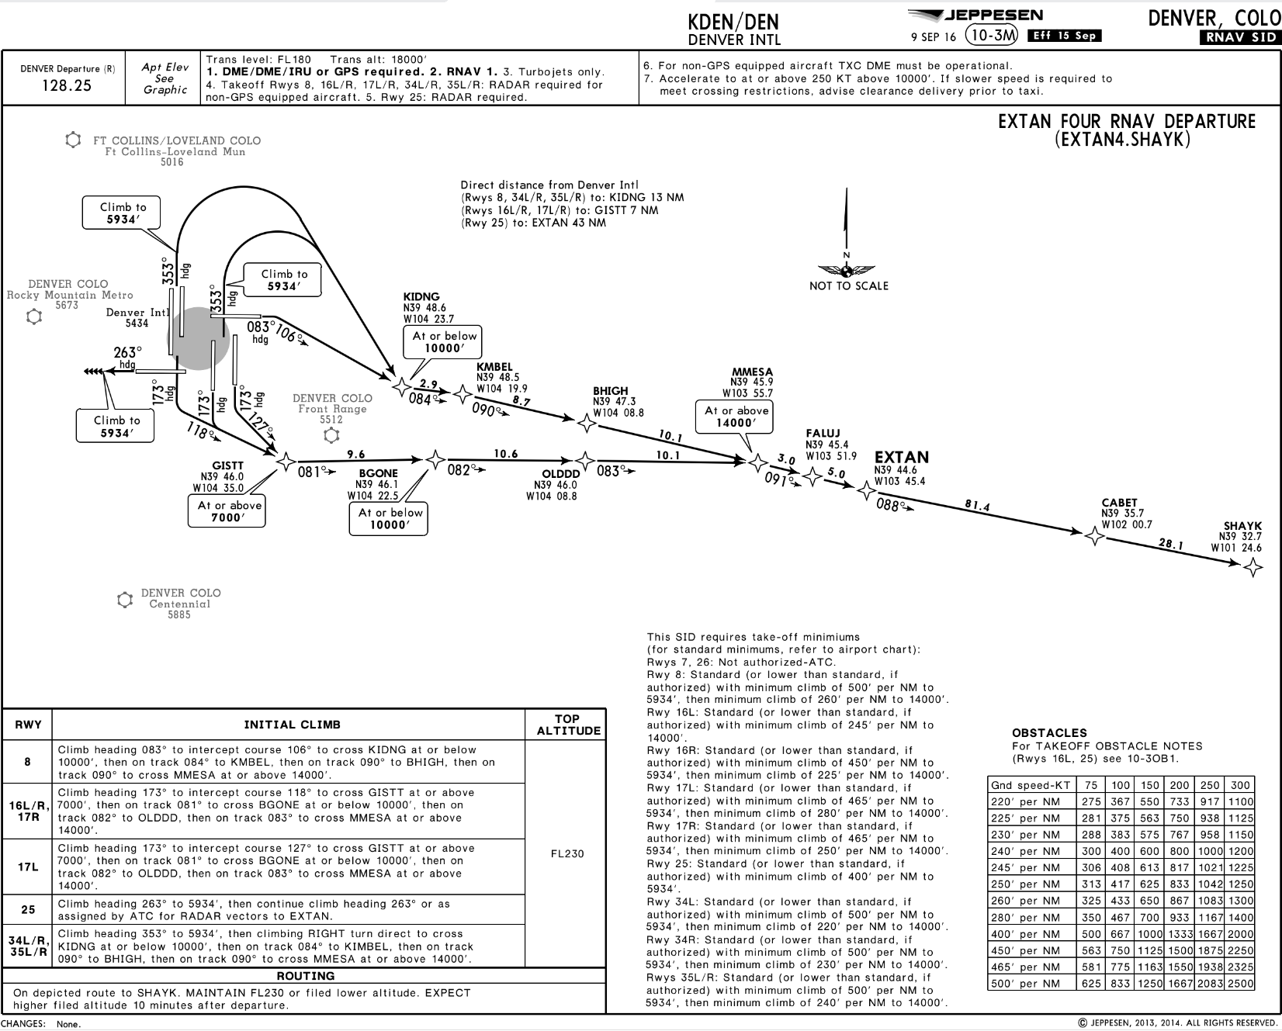

Climb Via – Operational Application
Initial ATC Clearance:
“Cleared EXTAN Three Departure, Climb Via SID”
After Passing GISTT, ATC Issues Heading Vector:
“Fly Heading One Two Zero, Vectors For Spacing,
Climb and Maintain One Four Thousand, Expect To Resume The EXTAN Departure”
Fly heading 120 degrees
Climb unrestricted to 14,000’
Expect to resume EXTAN Three
ATC Must Issue An Altitude To Maintain If They Vector The Aircraft Off Of The SID
©Jeppesen, Inc. Not for Navigation Purposes
<ESC Exit>

Slide 44
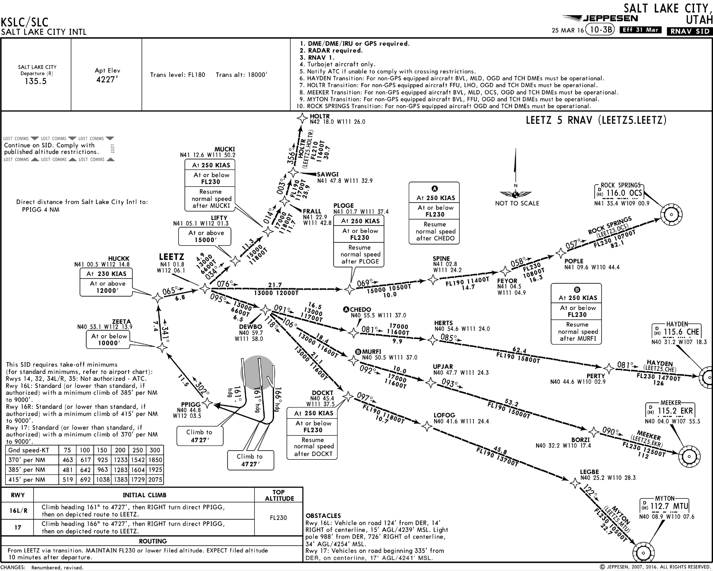
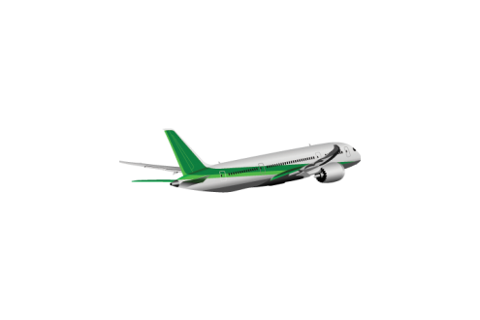
Climb Via – Operational Application
Initial ATC Clearance:
“Cleared LEETZ Five Departure Rock Springs Transition…, Climb Via SID”
After Takeoff, ATC Issues Clearance:
“Climb Via The LEETZ Five Departure, Except After LEETZ, Maintain Flight Level One Niner Zero”
Altitude Restriction at PLOGE Requires Further ATC Clearance
Track the lateral path of the LEETZ SID
Comply with published speed restrictions
Comply with published altitude restrictions until crossing LEETZ
Then climb to the ATC assigned “Top Altitude” (FL 190)
©Jeppesen, Inc. Not for Navigation Purposes
<ESC Exit>

Slide 45
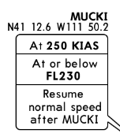
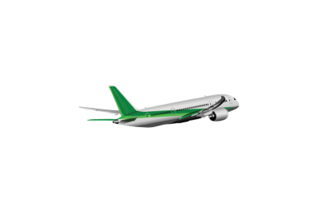
Climb Via – Operational Application
Initial ATC Clearance:
“Cleared LEETZ Five Departure HOLTR Transition…, Climb Via SID”
After Passing PPIGG, ATC Issues Clearance:
“Proceed Direct MUCKI,
Climb Via The LEETZ Five Departure”
Proceed direct to MUCKI
Then track the lateral path of the LEETZ SID
Cross MUCKI at or below FL 230
Climb to the “Top Altitude” (FL 230)
Do not exceed 250 KT until MUCKI
230 KT Speed Restriction Published At HUCKK
Is Not Applicable Unless Restated By ATC
©Jeppesen, Inc. Not for Navigation Purposes
<ESC Exit>

Slide 46
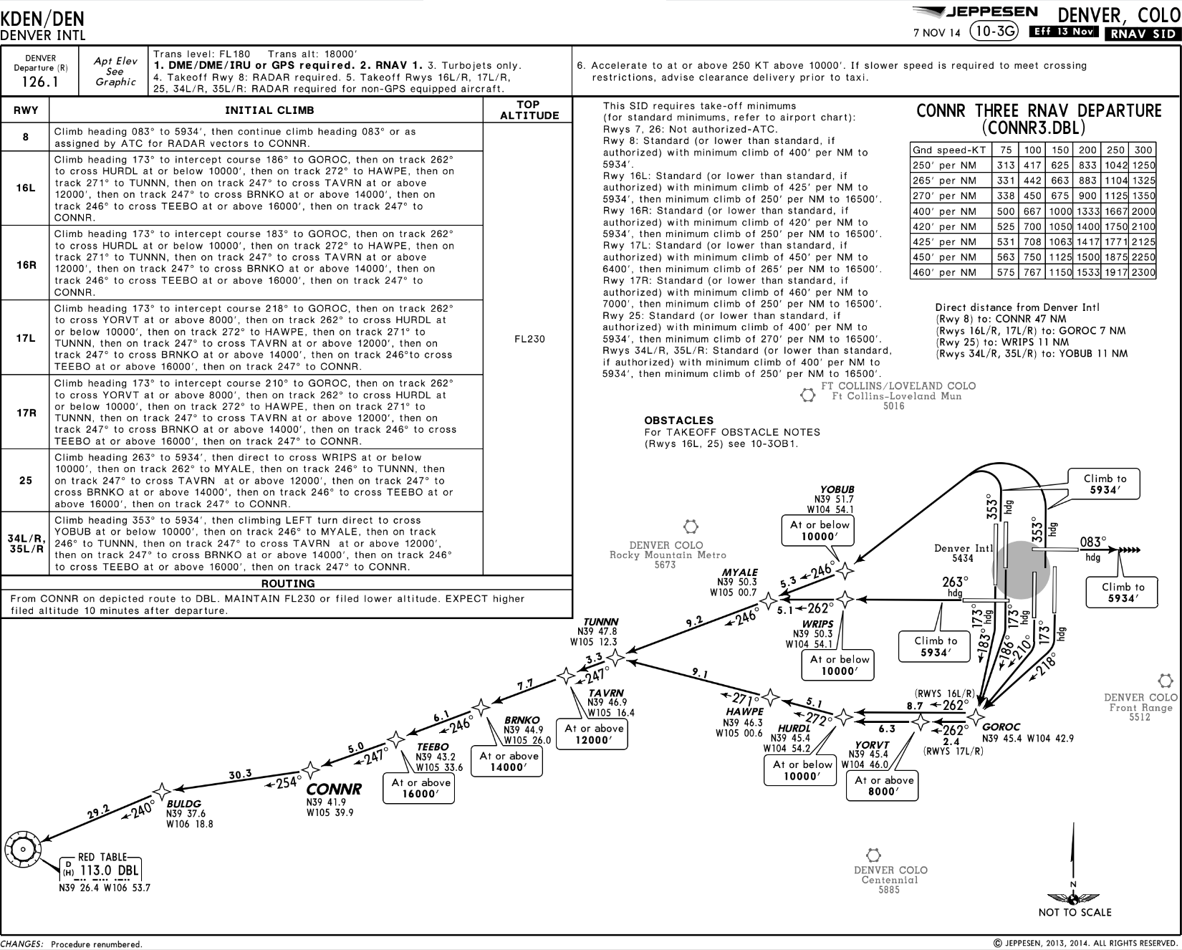


Climb Via – Operational Application
After Takeoff, ATC Issues Clearance:
“Proceed Direct TUNNN, Cross TUNNN At Or Above One-One Thousand, Then Climb Via The CONNR Three Departure”
Proceed direct to TUNNN
Then track the lateral path of the CONNR SID
Cross TUNNN at or above 11,000’
Comply with altitude & speed restrictions published after TUNNN
Climb to the published “Top Altitude” (FL 230)
©Jeppesen, Inc. Not for Navigation Purposes
<ESC Exit>

Slide 47

Weather Deviation
Established on a SID with a Climb Via Clearance
If a deviation from the lateral track of a SID is requested & approved by ATC for any reason, the climb via clearance is canceled.
  (e.g., for weather),
If ATC does not assign an altitude to maintain with approval to deviate from the SID’s lateral track, pilots should request an altitude to maintain from the controller.
Published speed restrictions on the SID, including a speed limit chart note, are canceled. ATC must re-issue any applicable speed restrictions.
  “Forth Worth Center, Gulfstream Two Three Yankee, unable climb via, request an altitude to maintain in the climb”

Slide 48
Unrestricted Climb
Climb Via – Operational Application
Phraseology: “Maintain” or “Climb & Maintain”
Initial IFR clearance:
  “Cleared To …, LOOP Six Departure, As Filed, Maintain Four Thousand”
After initial IFR clearance, but prior to or after takeoff:
  “Hawker Two Three Yankee, Climb And Maintain One-two Thousand”
Receipt of a “Maintain” or “Climb & Maintain” altitude clearance means:
  All Published Altitude Restrictions Are Canceled
  All Published Speed Restrictions Remain In Effect
<ESC Exit>

Slide 49
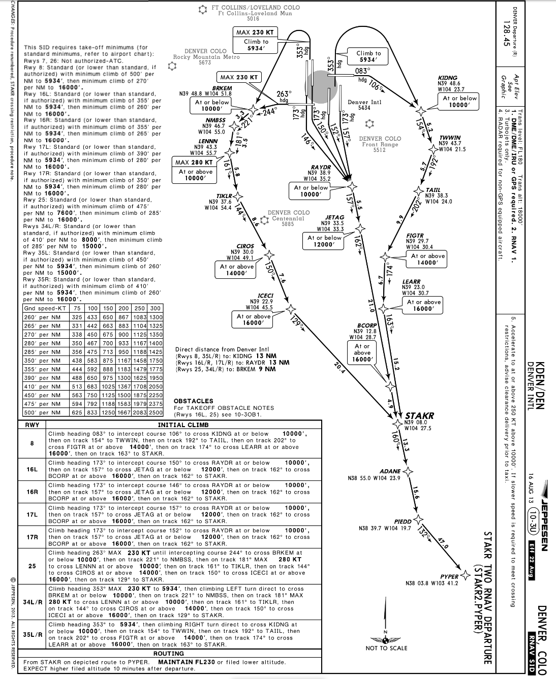

Climb Via – Operational Application
Initial IFR Clearance:
“Cleared…STAKR Two Departure, Climb Via SID…”
After Takeoff, ATC Issue Clearance:
“Climb And Maintain Flight Level Two Three Zero”
Track the lateral path of the STAKR SID
Climb and maintain FL 230
Disregard all published altitude restrictions
Comply with published speed restrictions (280 KT until LENNN)
©Jeppesen, Inc. Not for Navigation Purposes
<ESC Exit>

Slide 50
“Maintain” or “Climb & Maintain…”
Climb Via – Operational Application
The Pilot Should:
Track the lateral path of the STAKR2
Comply with all published speed restrictions
Published altitude restrictions are canceled
Climb to the assigned “Maintain” altitude
FL 230
PIEDD
PYPER
ADANE
STAKR
ICECI
At or Above 16000’
CIROS
“Climb And Maintain FL 230”
At or Above 14000’
TIKLR
LENNN
MAX
280 KT
At or Above
10000’
Comply With Published Speeds!
NMBSS
BRKEM
At or below 10000’
MAX 230 KT
Climb to 5934’
<ESC Exit>

Slide 51
Speed Restrictions Published On A SID
Climb Via – Operational Application
When cleared along a route or procedure that contains published speed restrictions, pilots must comply with those speed restrictions independent of a “Climb Via” or “Climb & Maintain” clearance
ATC anticipates pilots will begin accelerating after passing a speed restriction commensurate with normal aircraft operations, but will not exceed the next speed restriction, if any, published on the SID
If vectored off of a SID route segment where published speeds apply, the published speeds are cancelled and speed is at pilot's discretion unless ATC has assigned a speed
  This includes any speed limit or speed restriction published as a chart note on the SID, e.g., "Turbojet departures at/above 10000 maintain 280K until advised by ATC”
Absent any qualifying instructions, issuance of a “Climb Via” clearance cancels a previously issued ATC speed adjustment and provides pilot discretion to adjust speed while requiring compliance with upcoming restrictions
ATC may require compliance with previously issued speed adjustments using phraseology:
  “Proceed to (WP name), then climb via...”
  “Maintain (speed) until (WP name), then climb via...”
  “Cross (WP name) at (speed) then climb via....”
Where there are no upcoming speed restrictions, issuance of a “Proceed direct (WP name), climb via ....” cancels a previously issued speed adjustment and authorizes speed at pilot's discretion as appropriate for the phase of flight, ensuring compliance with 14 CFR 91.117
<ESC Exit>

Slide 52
Pre-Departure Clearances (PDC)
Climb Via – PDC
IFR Clearance Received Via ACARS Service
PDC “REMARKS” section will contain:
  ATC assigned departure (SID or ODP)
  “Climb Via” clearance
The “FILED FLIGHT PLAN” section may list the filed departure procedure
The ATC assigned departure may differ from that filed in the IFR flight plan
Fly the ATC-assigned departure, not the departure that was filed!
Ensure the filed departure procedure is uplinked to the FMS
Verify the correct departure procedure in the FMS
* Note: The “Route” & “Remarks” sections are generic descriptions of the elements of a typical the PDC message. They are not necessarily specific sections in the PDC as the format of these messages will vary with FOC or service provider
<ESC Exit>

Slide 53
Climb Via – PDC
PDC Nxxxx
KIAD-KICT
-ATC CLEARANCE-
CLR AS FILED
-FILED FLIGHT PLAN-
KIAD RNLDI4 OTTTO COLNS J134
FLM CASSO KICT
-REMARKS-
CLEARED RNLDI4 DEPARTURE OTTTO TRSN
CLIMB VIA SID
EXP 400 10 MIN AFT DP,DPFRQ SEE SID
SQUAWK 1367
-OTHER INFO-
REQUESTED ALT: 400
PROPOSED ETD: 1930Z
CLEARANCE ETD: Z
AIRCRAFT: xxxx/L
* END OF CLEARANCE *
ATC-Assigned Departure Procedure & “Climb Via” Clearance
Note: PDC Format Varies With AOC or Service Provider
<ESC Exit>

Slide 54
Climb Via – PDC
PDC Nxxxx
KIAD-KTEB
-ATC CLEARANCE-
WOOLY1 SWANN FUBRR JAIKE3
KTEB
THEN AS FILED
-FILED FLIGHT PLAN-
KIAD JCOBY3 SWANN./.KTEB
-REMARKS-
CLEARED WOOLY1 DEPARTURE SWANN TRSN
CLIMB VIA SID
EXP 190 10 MIN AFT DP,DPFRQ SEE SID
SQUAWK 2454
-OTHER INFO-
REQUESTED ALT: 190
PROPOSED ETD: 1805Z
CLEARANCE ETD: Z
AIRCRAFT: xxxx/L
* END OF CLEARANCE *
Filed Departure Procedure &
Uplinked Procedure To FMS
ATC-Assigned Departure Procedure & “Climb Via” Clearance
Note: PDC Format Varies With AOC or Service Provider
<ESC Exit>

Slide 55
Datalink Clearance (DCL)
Climb Via – DCL
CPDLC is used by ATC to send the IFR clearance, along with route revisions to the FMS using FANS.
A “Climb Via SID”, “Climb Via SID, Except Maintain <altitude>” or “Maintain <altitude>” element is included in the DCL message.
Route changes with DCL:
  When ATC issues a new route or revised route – use the PUSH-TO-LOAD function to load the new or revised route into the FMS.
  The SID is NEVER included in the new or revised route upload. The SID MUST be manually loaded when a new or revised route is sent by ATC.
    The revised route may be just the SID itself or the runway of departure
Verify the SID and departure runway is in the FMS after loading the new or revised route.
Fly the ATC-assigned departure, not the departure that was filed!
<ESC Exit>

Slide 56
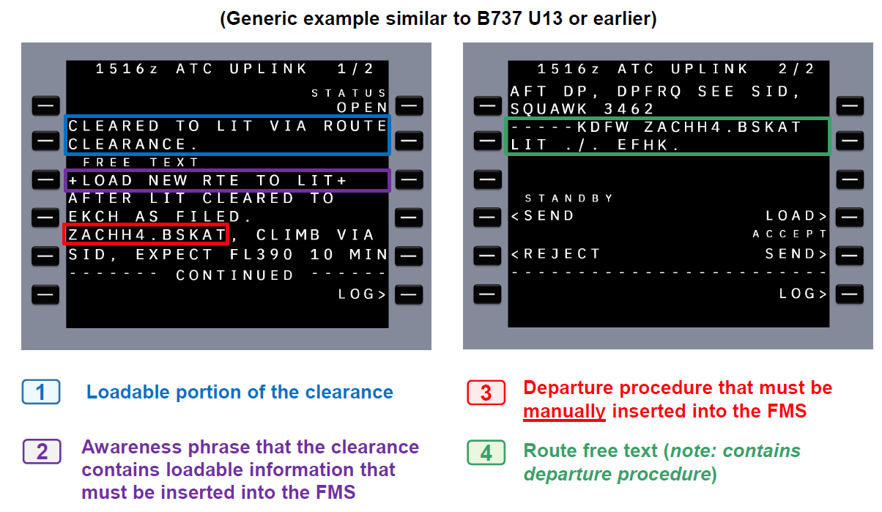
Climb Via – DCL
<ESC Exit>

Slide 57
Using DCL
Climb Via – DCL
For further information on using DCL, please see the guidance on the L3Harris or FAA websites:
L3Harris DCL Demonstration Video: https://youtu.be/W_oBhj_RN6A?si=npyTbm8B6NWs8uM5
Federal Aviation Administration (FAA) Data Communications (Data Comm) User Information | L3Harris® Fast. Forward.
Data Communication Program (DataComm) | Federal Aviation Administration (faa.gov)
<ESC Exit>

Slide 58
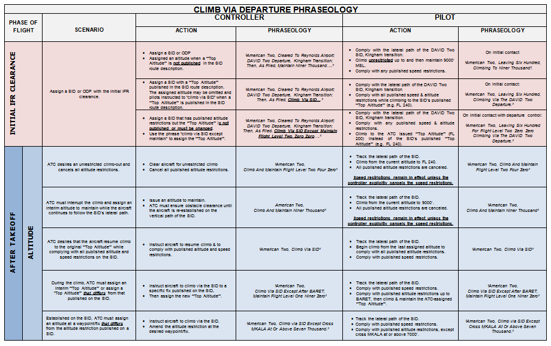
Climb Via – Briefing Card
Download the latest Version From NBAA’s Website
<ESC Exit>

Slide 59
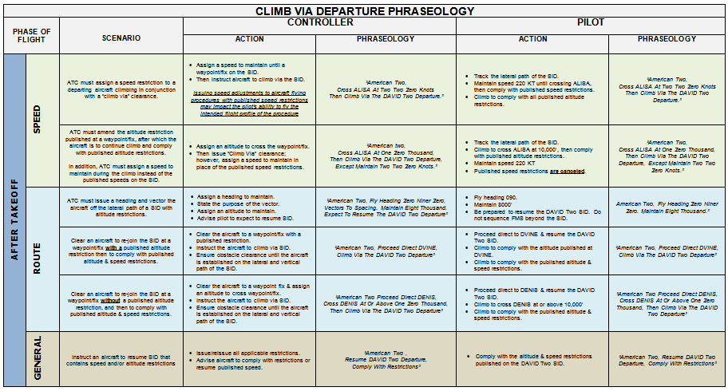
Climb Via – Briefing Card
Download the latest Version From NBAA’s Website
<ESC Exit>

Slide 60
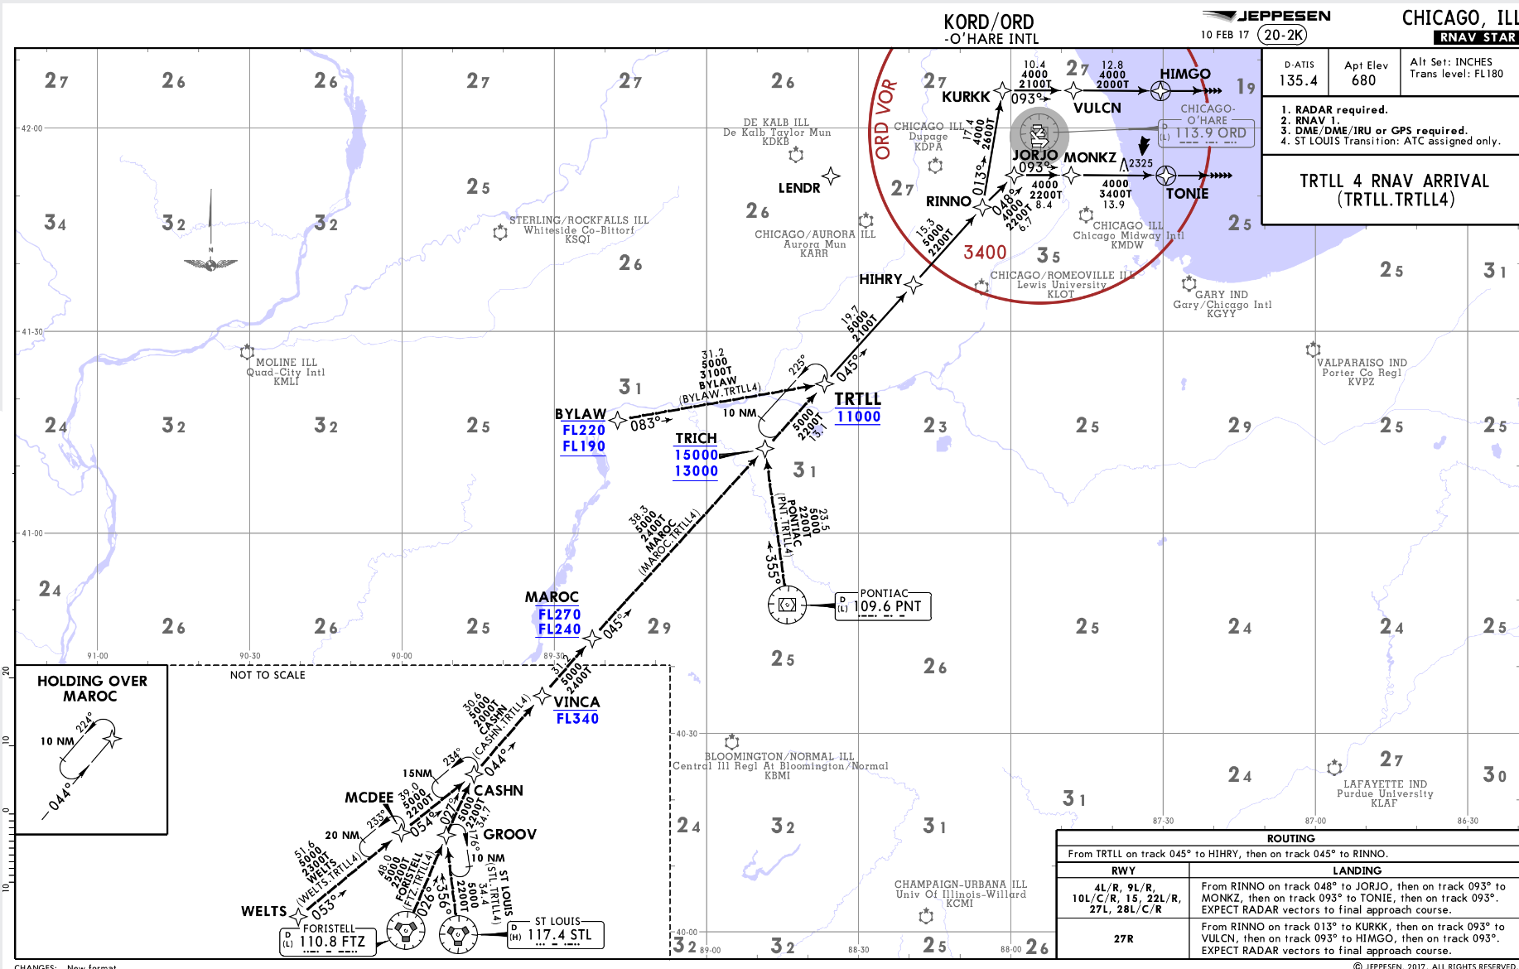
Descend Via:
Descend Via – Terminology
An abbreviated ATC clearance that requires compliance with a published procedure lateral path and associated speed restrictions and provides a pilot-discretion descent to comply with published altitude restrictions.
©Jeppesen, Inc. Not for Navigation Purposes
<ESC Exit>

Slide 61
Descend Via (AIM 5-4-1 a 2)
Descend Via – Terminology
Authorizes The Pilot To
Descend at pilot’s discretion to meet published restrictions and laterally navigate on a STAR
When cleared to a waypoint depicted on a STAR, to descend from a previously assigned altitude at pilot’s discretion to the altitude depicted at the waypoint
Once established on the depicted arrival, to descend and to meet all published or assigned altitude and/or speed restrictions
<ESC Exit>

Slide 62

Bottom Altitude:
Descend Via – Terminology
In reference to published altitude restrictions on a STAR or STAR runway transition, the lowest altitude authorized.
©Jeppesen, Inc. Not for Navigation Purposes
<ESC Exit>

Slide 63
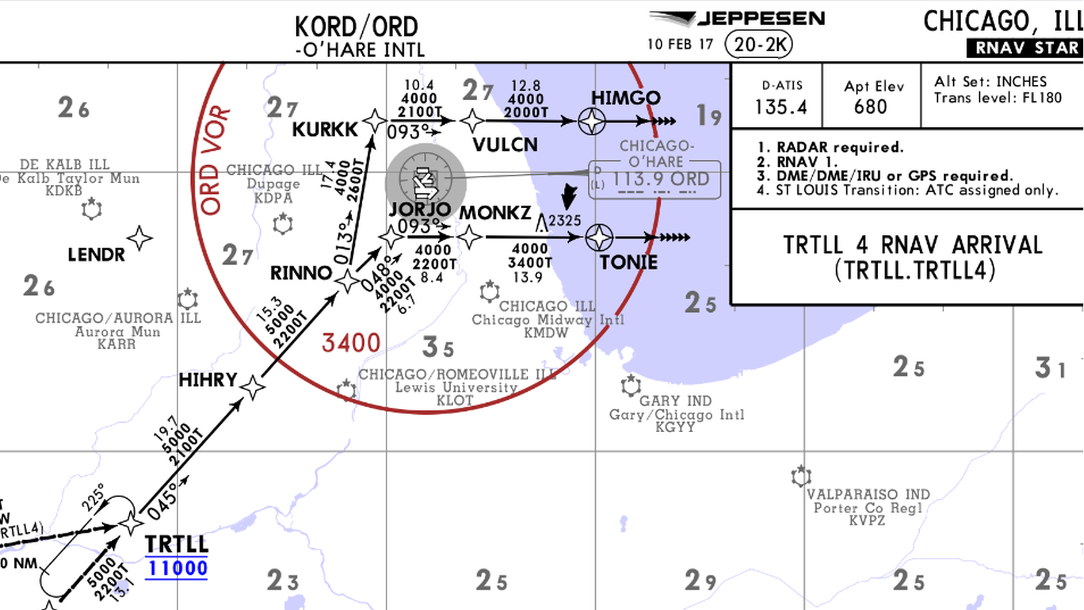
Bottom Altitude
Descend Via – Terminology
The “Bottom Altitude” Is NOT:
The Published Segment MEA
The Published Segment MOCA
The “Bottom Altitude” Is The Lowest Published Altitude Constraint
©Jeppesen, Inc. Not for Navigation Purposes
<ESC Exit>

Slide 64
Bottom Altitude
Descend Via – Terminology
In reference to published altitude restrictions on a STAR or STAR runway transition, the lowest altitude authorized.
Runway transition or landing direction may be provided by ARTCC
  An advisory note may be included on the chart:
Otherwise, landing runway must be assigned by Arrival Controller on initial contact or as soon a practical thereafter, and no later than 10 miles prior to the runway transition waypoint
Landing runway in use broadcast by the ATIS may be used to determine anticipated STAR transition for planning purposes
<ESC Exit>

Slide 65
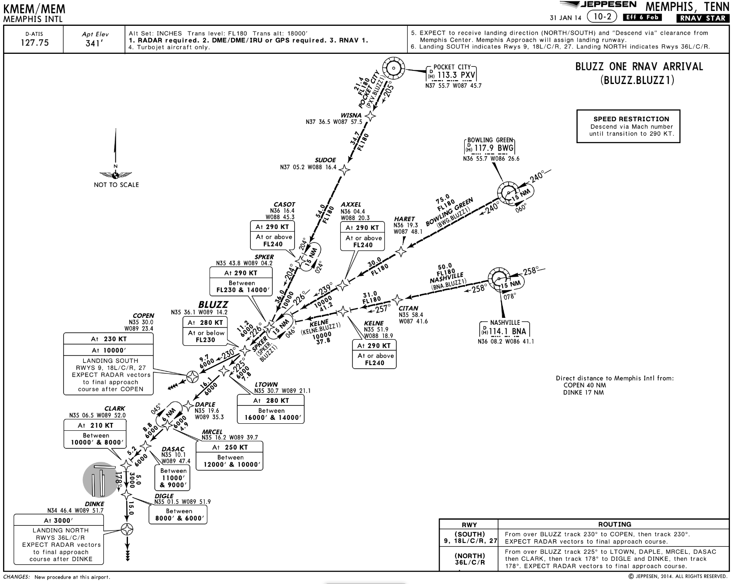
ATC Clearance That Includes A STAR:
Descend Via – Operational Application
Is a clearance to fly the depicted route & assigned transition
Is a clearance requiring compliance with published speed restrictions
A chart note used to transition from Mach to IAS applies once the aircraft is established on the published lateral path of the STAR
However, altitude assignment & vertical navigation is a separate clearance!
ATC Clearance:
“Proceed Direct Bowling Green,
Cleared BLUZZ One Arrival”
ATC Clearance:
“Proceed Direct Bowling Green, Cleared LTOWN Six Arrival”
©Jeppesen, Inc. Not for Navigation Purposes

Slide 66
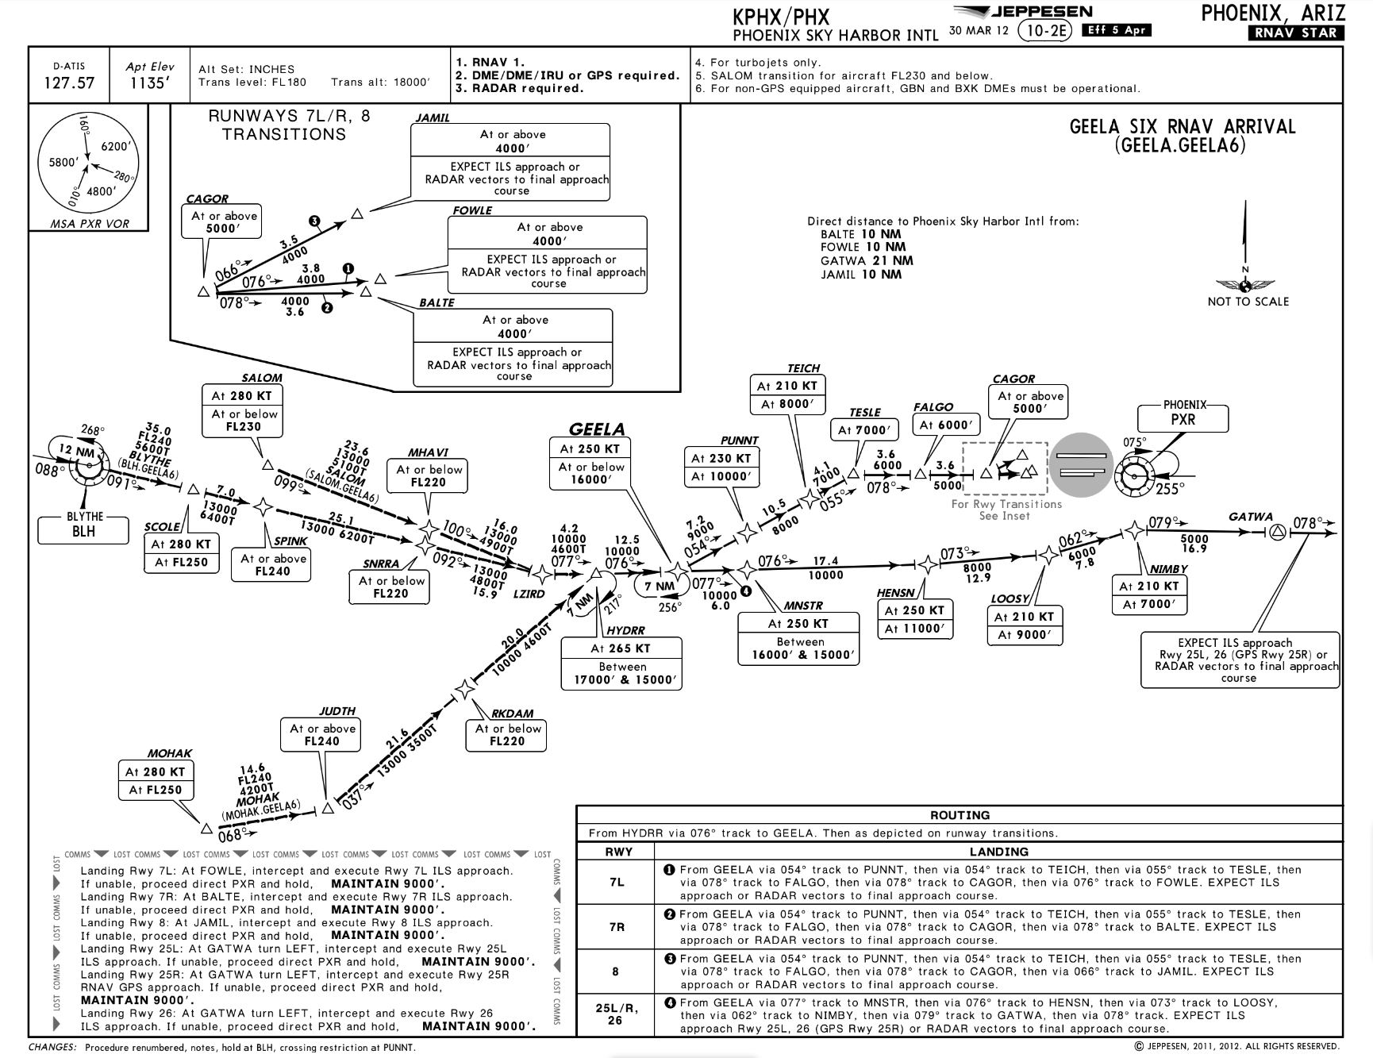
Descend Via – Operational Application
ATC Clearance:
“Learjet Four Five Lima Juliet, Descend Via the GEELA Six Arrival, Runway Two Five Left”
©Jeppesen, Inc. Not for Navigation Purposes
<ESC Exit>

Slide 67
“Descend Via” Clearance
Descend Via – Operational Application
The Pilot Should:
Track the lateral path of the GEELA6
Comply with published speed restrictions
Descend at pilot’s discretion to comply with all published altitude restrictions
Descend to the “Bottom Altitude” published on the STAR
GEELA
Published
“Bottom Altitude”
7,000’
BLH
At 250 KT
At or Below 16000’
SCOLE
HENSN
At 280 KT At FL250
SPINK
At 250 KT At 11000’
At or Above FL240
SNRRA
NIMBY
At or Above FL220
LIZRD
At 210 KT At 7000’
GATWA
MNSTR
LOOSY
HYDRR
At 250 KT
Between
16000’ & 15000’
At 265 KT Between
17000’ & 15000’
At 210 KT At 9000’
<ESC Exit>

Slide 68
Pilot/Controller Initial Contact Phraseology
Descend Via – Operational Application
“Phoenix Approach, Learjet Four Five Lima Juliet,
Leaving Flight Level Two Eight Zero,
Descending Via The GEELA Six Arrival,
Runway Two Five Left, Information Alpha”
“Learjet Four Five Lima Juliet, Phoenix Approach,
Expect I-L-S Two Five Left Approach”
<ESC Exit>

Slide 69
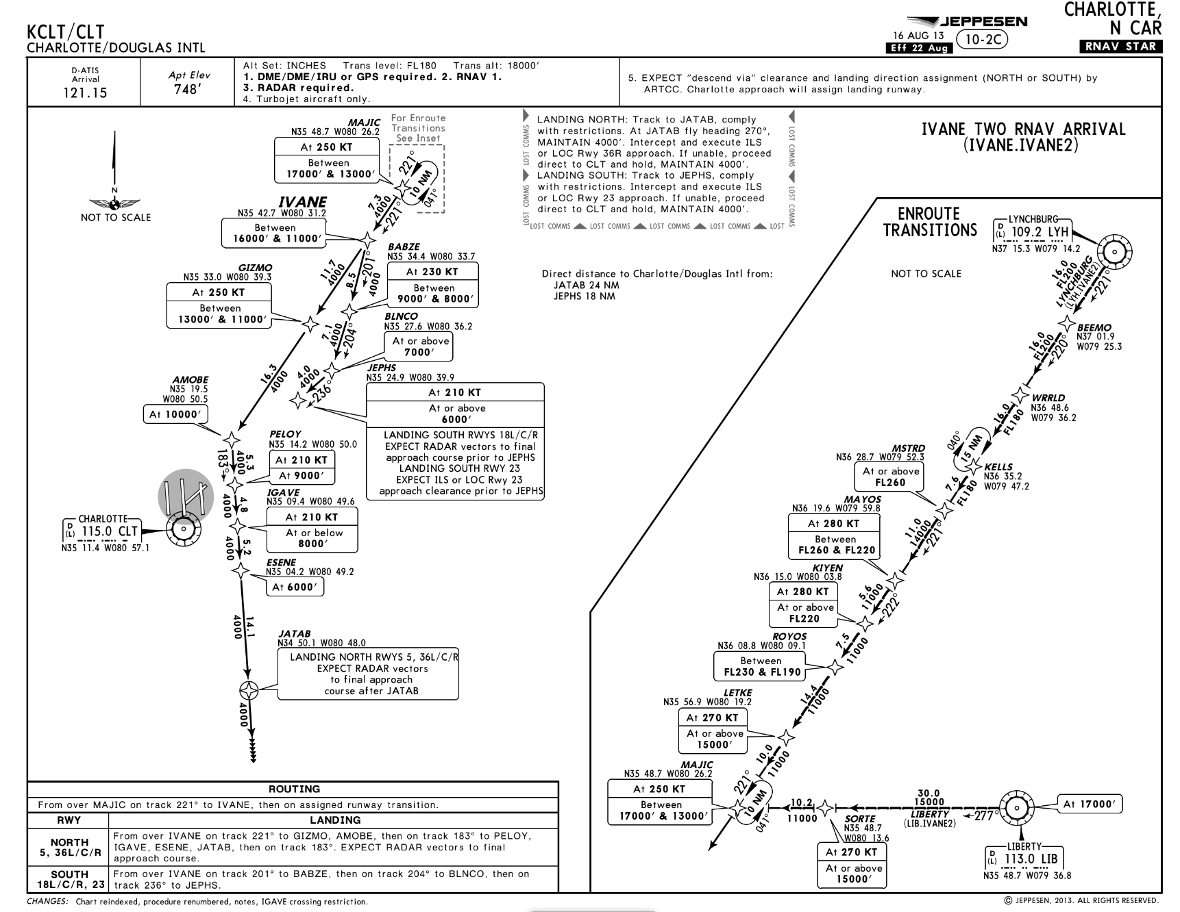

Descend Via – Operational Application
A “Descend Via” Clearance From The Center (ARTCC)
May Include The Landing Direction
ATC Clearance:
“Falcon Five Zero Delta Alpha,
Descend Via The IVANE Two Arrival, Landing North
Contact Washington Center On One Three Two Point Two Five”
“Washington Center, Falcon Five Zero Delta Alpha,
Leaving Flight Level Three Zero Zero,
Descending Via The IVANE Two Arrival, Landing North”
©Jeppesen, Inc. Not for Navigation Purposes
<ESC Exit>

Slide 70

Descend Via – Operational Application
A “Descend Via” Clearance From The Approach Controller
Will Include The Landing Runway
“Charlotte Approach , Falcon Five Zero Delta Alpha,
Leaving One Five Thousand,
Descending Via The IVANE Two Arrival, Landing North,
Information Charlie”
ATC Clearance:
“Falcon Five Zero Delta Alpha,
Descend Via the IVANE Two Arrival, Runway Three Six Center”
©Jeppesen, Inc. Not for Navigation Purposes
<ESC Exit>

Slide 71
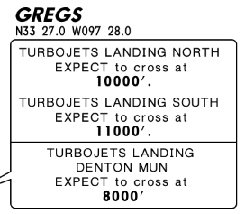
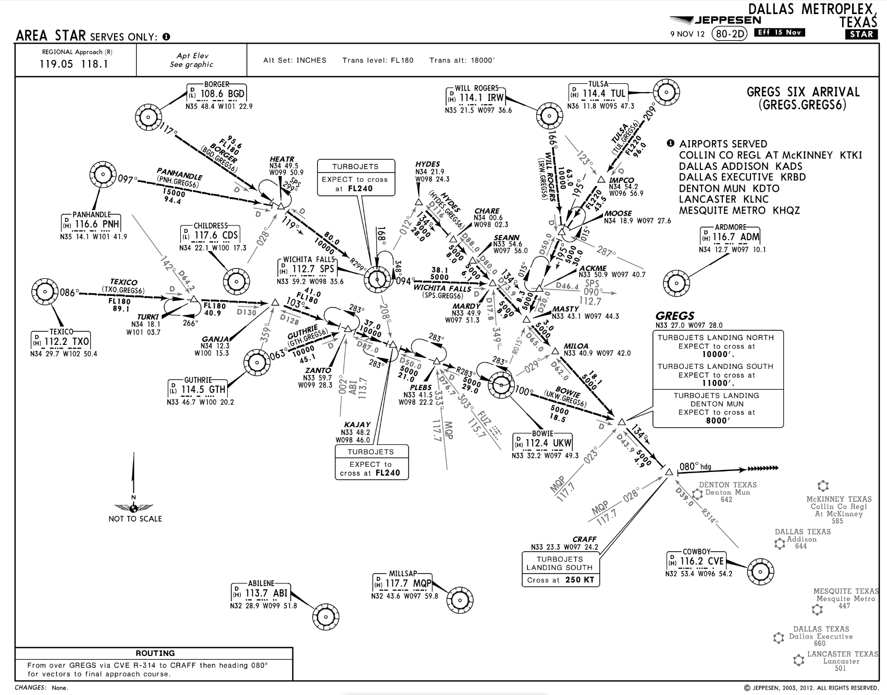

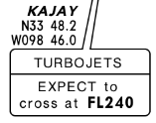
Descend Via – Operational Application
A “Descend Via” Clearance Will Not Be Used Where The STAR Contains
Only Published “Expect” Altitude And/Or Speed Restrictions
©Jeppesen, Inc. Not for Navigation Purposes
<ESC Exit>

Slide 72
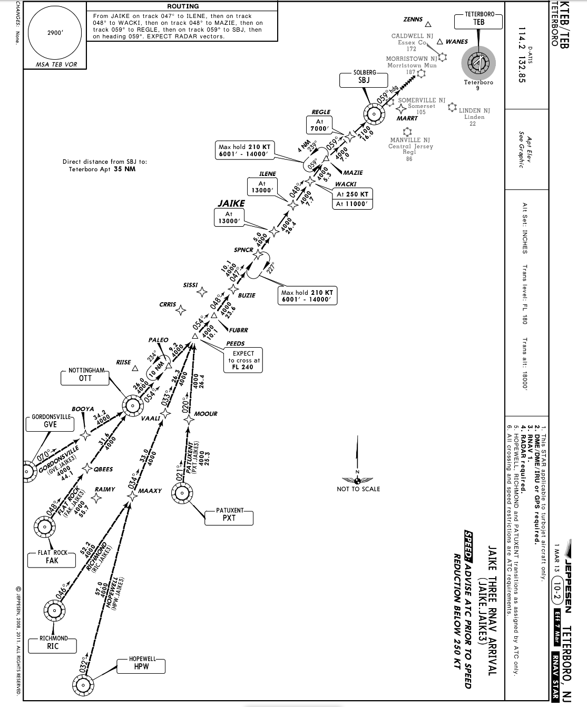





ATC Clearance:
“Gulfstream Two Three Echo,
Cross PEEDS At Flight Level Two Four Zero,
Then Descend Via The JAIKE Three Arrival”
“Descend Via” May Be Used On Procedures That Contain Both “EXPECT” And REQUIRED Altitude And Speed Restrictions Only If Altitude And/Or Speed Restrictions Or Alternate Restrictions Are Issued For The Fix/Waypoint Associated With All Expect Restrictions
“Descend Via” Clearances May Also Be Issued If An Aircraft Is Past All Fixes/Waypoints That Have Expect Restrictions
©Jeppesen, Inc. Not for Navigation Purposes
<ESC Exit>

Slide 73
STARs
Descend Via – Operational Application
ATC Clearances
Lateral/Routing Clearance:
  “Cleared TYLER One Arrival”
    No descent authorized
    Comply with published speed restrictions
    Comply with the Mach to IAS transition note once established on the published lateral path of the STAR
Lateral Route & Unrestricted Descent:
  “Cleared TYLER One Arrival, Descend At Pilot’s Discretion, Maintain One Zero Thousand”
    Initiate descent at pilot’s discretion to 10,000’
    All published altitude restrictions are canceled
    All published speed restrictions and the Mach to IAS transition note remain in effect
<ESC Exit>

Slide 74

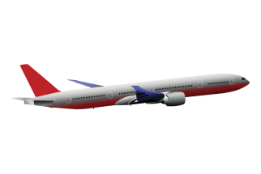
ATC Clearance:
“Proceed Direct Bowling Green, Cleared BLUZZ One Arrival, Landing North, Descend and Maintain One Zero Thousand”
Track the lateral path of the BLUZZ One STAR
Descend and maintain 10,000’
Disregard all published altitude restrictions
Transition from cruise Mach to 290 KT once over BWG VORTAC and on the lateral path of the STAR
Comply with published speed restrictions
Altitude Restrictions at DIGLE & DINKE Requires Further ATC Clearance
©Jeppesen, Inc. Not for Navigation Purposes
<ESC Exit>

Slide 75
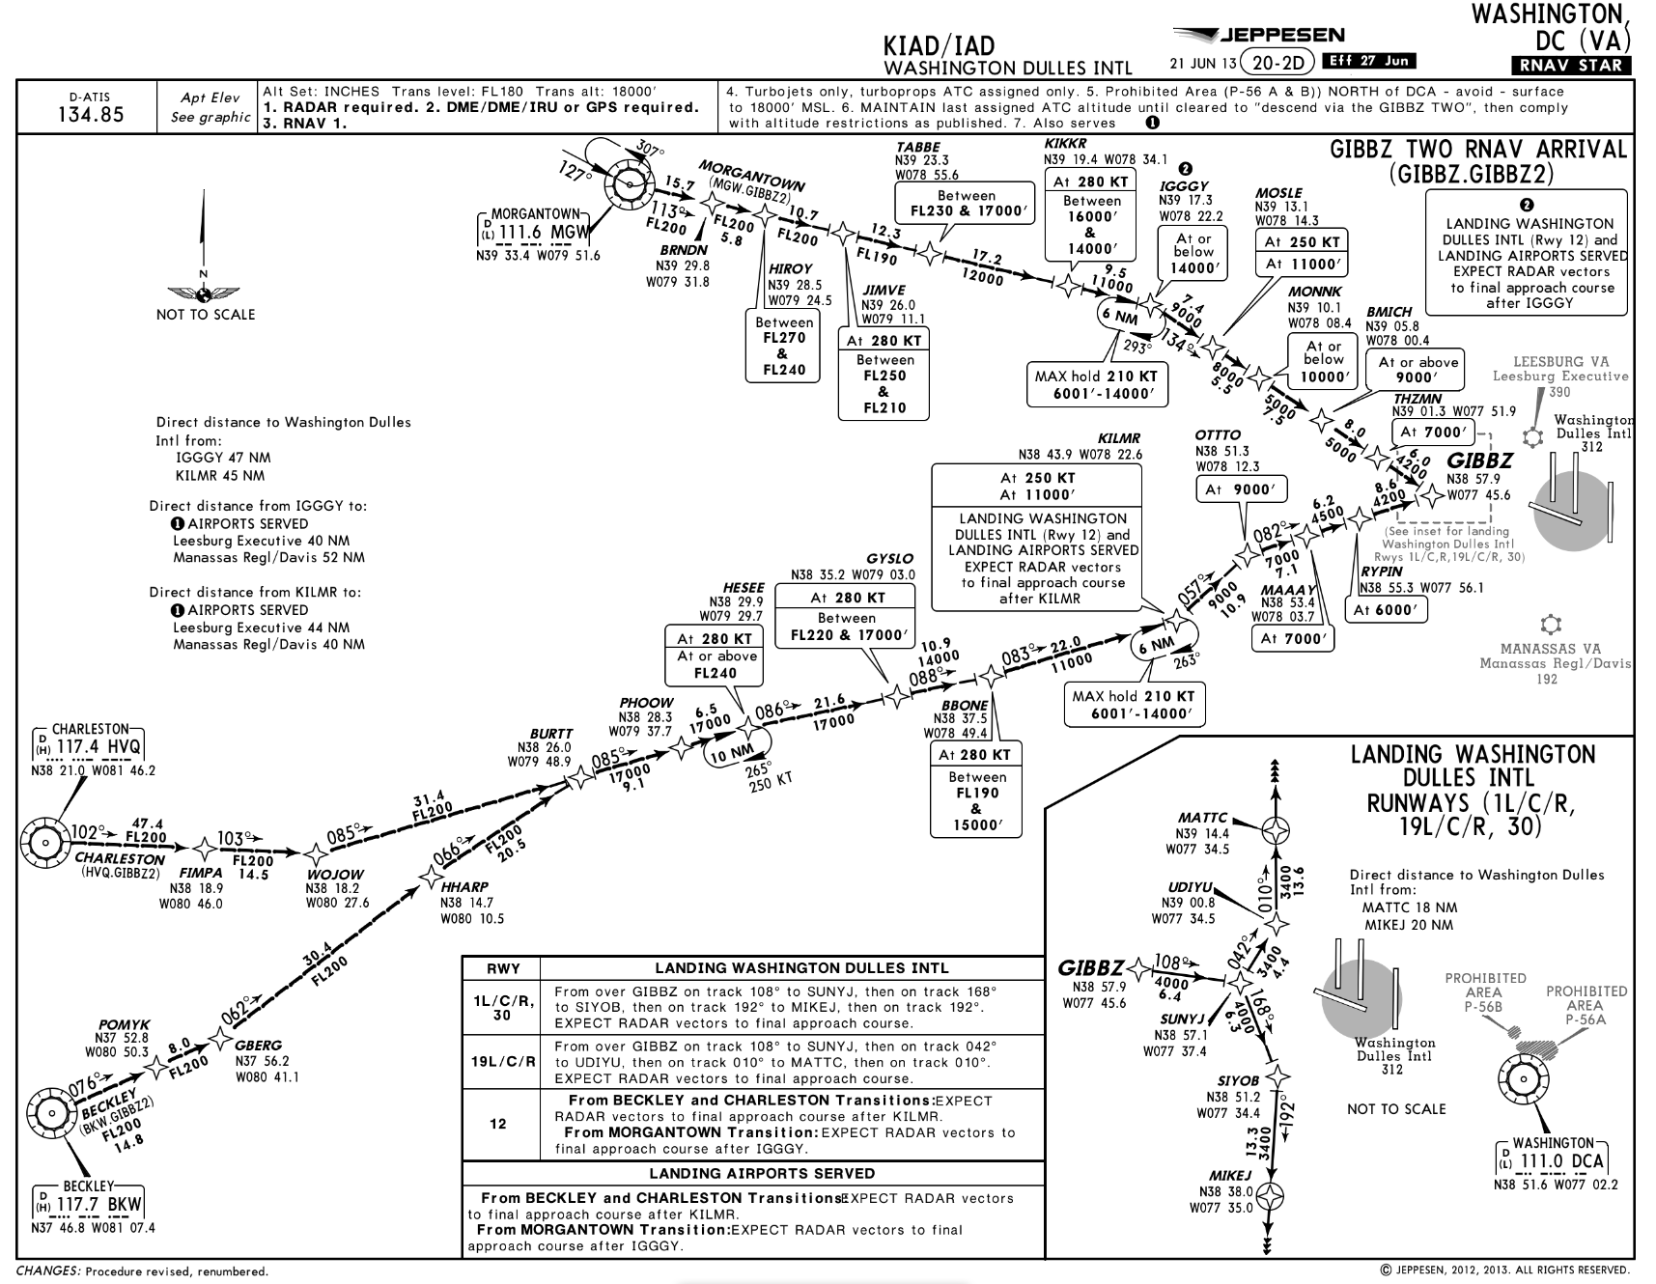
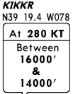
Descend Via – Operational Application
©Jeppesen, Inc. Not for Navigation Purposes
ATC May Assign “Descend Via” With An Interim Altitude Or New “Bottom Altitude”
ATC Clearance:
“Falcon 900 Delta Alpha, Descend Via The GIBBZ Two Arrival, Landing North,
Except After KIKKR Descend And Maintain One Zero Thousand”
Altitude Restrictions at BMICH & THZMN Requires Further ATC Clearance
<ESC Exit>

Slide 76
“Descend Via” With An Interim Altitude Or Revised Bottom Altitude
Descend Via – Operational Application
The Pilot Should:
Track the lateral path of the GIBBZ2, Runway 1 Center transition
Descend at pilot’s discretion to comply with published altitude restrictions until KIKKR
Then descend unrestricted and at a optimum rate to 10,000’
Comply with all published speed restrictions (e.g., 250 KT at MOSLE)
Altitude Restrictions at BMICH & THZMN Requires Further ATC Clearance
MGW
TABBE
IGGGY
Between
FL270 & FL240
At or Below 14000’
ATC Issued
“Bottom Altitude”
10,000’
BRNDN
HIROY
JIMVE
Between
FL270
&
FL240
At 280 KT
Between
FL270
&
FL240
KIKKR
MOSLE
At 280 KT Between
16000’ & 14000’
At 250 KT
At 11000’
MONNK
GIBBZ
At or Below 10000’
BMICH
THZMN
At or Above 9000’
At 7000’
<ESC Exit>

Slide 77
Pilot/Controller Initial Contact Phraseology
Descend Via – Operational Application
“Potomac Approach,
Falcon Nine Zero Zero Delta Alpha, Leaving Flight Level Two Four Zero For One Zero Thousand,
Descending Via The GIBBZ Two Arrival,
Landing North, Information Bravo”
“Falcon Nine Zero Zero Delta Alpha,
Potomac Approach,
Expect RNAV Zulu Runway One Center”
<ESC Exit>

Slide 78
ATC Intervention On A STAR
Descend Via – Operational Application
ATC will issue an altitude to maintain and all appropriate altitude restrictions when the vector will take the aircraft off an assigned procedure that contains altitude instructions or the previously issued clearance included crossing restrictions
ATC must advise the pilot what to expect when the vector is completed
Phraseology:
  “Citation Two Charlie Alpha, Fly Heading Zero Niner Zero, Vector For Spacing, Descend And Maintain Flight Level Two Niner Zero, Expect To Resume The BRBBQ One Arrival”
Air traffic will assign an altitude to cross the waypoint/fix, if no altitude is depicted at the waypoint/fix, for aircraft on a direct routing to a STAR
Air traffic must ensure obstacle clearance when issuing a “Descend Via” instruction to the pilot
The chart note used to transition from Mach to IAS is canceled
<ESC Exit>

Slide 79
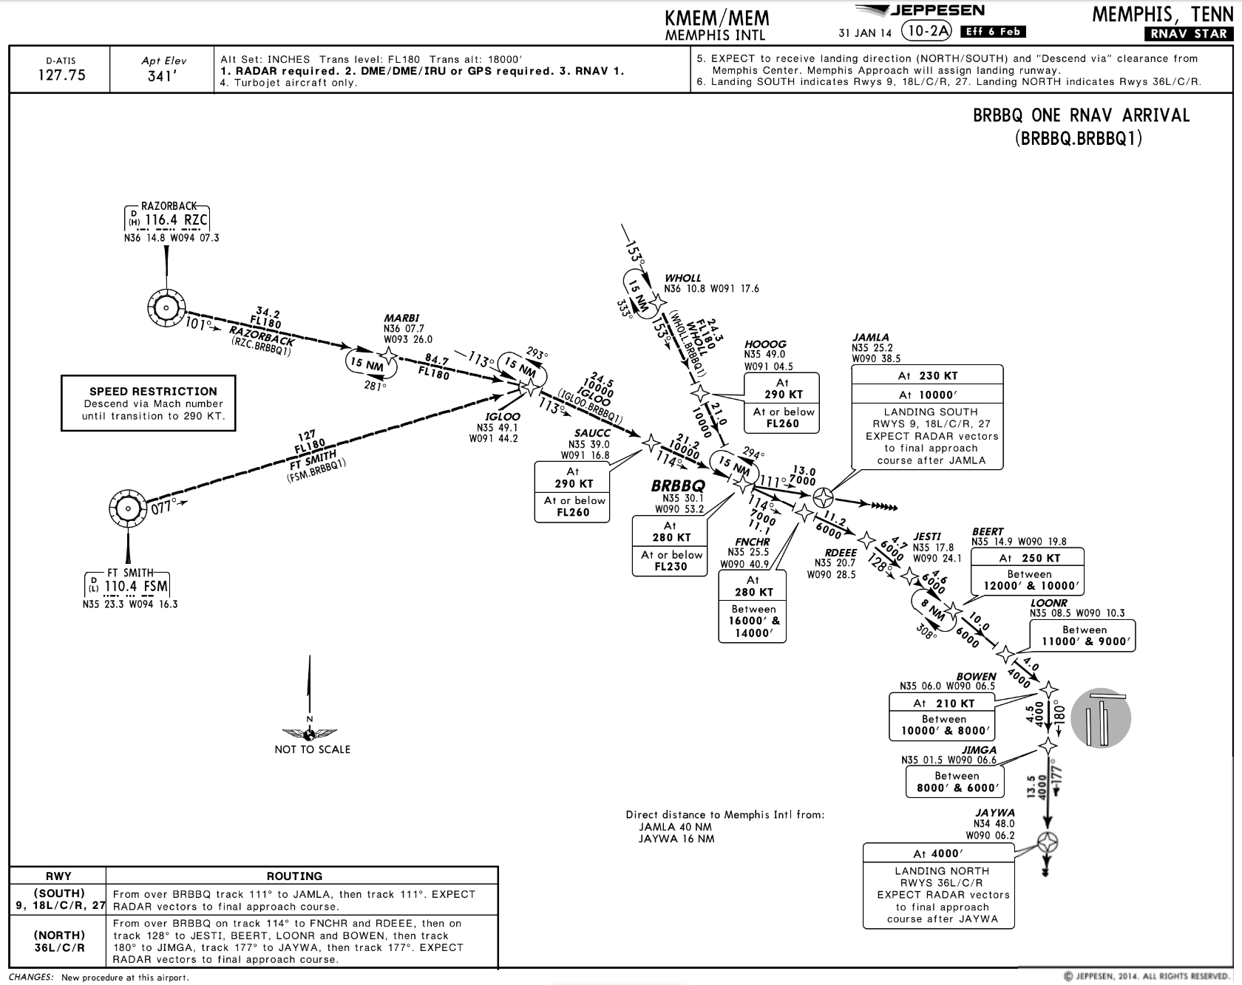



Descend Via – Operational Application
ATC Clearance:
“Fly Heading One Two Zero, Vectors For Spacing,
Descend And Maintain Flight Level Two Niner Zero,
Expect To Resume The BRBBQ One Arrival”
Fly the ATC-assigned heading (120 degrees)
Mach to IAS speed transition note is canceled
Descend & maintain FL 290
Be prepared to re-join the BRBBQ STAR
©Jeppesen, Inc. Not for Navigation Purposes
<ESC Exit>

Slide 80
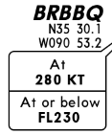
Descend Via – Operational Application
ATC Clearance:
“Proceed Direct BRBBQ,
Descend Via The BRBBQ One Arrival, Landing North”
Proceed direct to BRBBQ
The Mach to IAS speed transition note does not apply – aircraft is not established on the STAR. Cleared-to waypoint has a published speed
Cross BRBBQ at or below FL 230 and at 280 KT
Track the lateral path of the BRBBQ STAR
Comply with published speed restrictions
Comply with published altitude restrictions to the “Bottom Altitude” (4,000’)
©Jeppesen, Inc. Not for Navigation Purposes
<ESC Exit>

Slide 81

Descend Via – Operational Application
ATC Clearance:
“Proceed Direct JESTI, Cross JESTI At One Zero Thousand, Then Descend Via The BRBBQ One Arrival, Landing North”
ATC Must Assign An Altitude To Cross JESTI
Proceed direct to JESTI
The Mach to IAS speed transition note applies once established over JESTI
Cross JESTI at 10,000’
Then track the lateral path of the BRBBQ STAR
Comply with published speed restrictions after JESTI
Comply with published altitude restrictions after JESTI to the “Bottom Altitude” (4,000’)
©Jeppesen, Inc. Not for Navigation Purposes
<ESC Exit>

Slide 82

Descend Via – Operational Application
ATC Clearance:
“Proceed Direct BEERT,, Descend Via The BRBBQ One Arrival, Landing North”
©Jeppesen, Inc. Not for Navigation Purposes
Proceed direct to BEERT
The Mach to IAS speed transition note does not apply – aircraft is not established on the STAR. Cleared-to waypoint has a published speed
Cross BEERT between 12,000’ & 10,000’
Cross BEERT at 250 KT
  Reduce speed the minimum distance required prior to BEERT commensurate with normal aircraft performance
Track the lateral path of the BRBBQ STAR
Comply with published speed restrictions
Comply with published altitude restrictions to the “Bottom Altitude” (4,000’)
<ESC Exit>

Slide 83
Weather Deviation
Established on a STAR with a Descend Via Clearance
If a deviation from the lateral track of a STAR is requested & approved by ATC for any reason, the descend via clearance is canceled.
  (e.g. for weather),
If ATC does not assign an altitude to maintain with approval to deviate from the STAR’s lateral track, pilots should request an altitude to maintain from the controller.
Published speed restrictions on the STAR, including a Mach-to-IAS speed transition chart note, are canceled. ATC must re-issue any applicable speed restrictions.
  “Forth Worth Center, American 123, unable descend via, request an altitude to maintain in the descent”

Slide 84
Speed Restrictions Published On A STAR
Descend Via – Operational Application
When otherwise cleared along a route or procedure that contains published speed restrictions, the pilot must comply with those speed restrictions independent of a “Descend Via” or “Descend & Maintain” clearance
ATC anticipates pilots will begin adjusting speed the minimum distance necessary prior to a published speed restriction, commensurate with normal aircraft deceleration, to cross the waypoint/fix at the published speed
Once at the published speed, ATC expects pilots will maintain the published speed until additional adjustment is required to comply with further published or ATC assigned speed restrictions or as required to ensure compliance with 14 CFR Section 91.117
If vectored off of a STAR route segment where published speeds apply, these published speeds including the Mach-to-IAS speed transition chart note are cancelled, and speed is at pilot's discretion unless ATC has assigned a speed
Absent any qualifying instructions, issuance of a “Descend Via” clearance cancels a previously issued ATC speed adjustment and provides pilot discretion to adjust speed while requiring compliance with upcoming restrictions
ATC may require compliance with previously issued speed adjustments using phraseology:
  “Proceed to (WP name), then descend via...”,
  “Maintain (speed) until (WP name), then descend via...”
  “Cross (WP name) at (speed) then descend via....”
Where there are no upcoming speed restrictions, issuance of a “Proceed direct (WP name), descend via ....” cancels a previously issued speed adjustment and authorizes speed at pilot's discretion as appropriate for the phase of flight, ensuring compliance with 14 CFR 91.117
<ESC Exit>

Slide 85
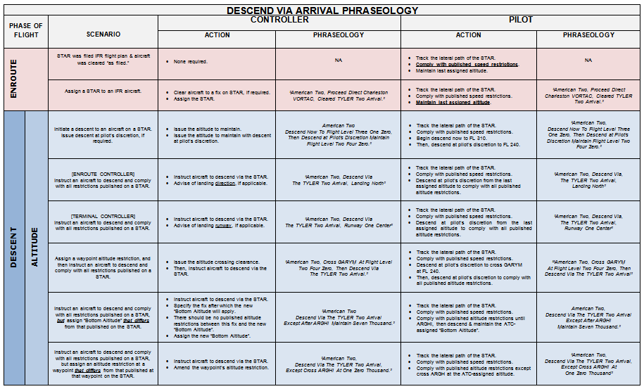
Descend Via – Briefing Card
Download the latest Version From NBAA’s Website
<ESC Exit>

Slide 86
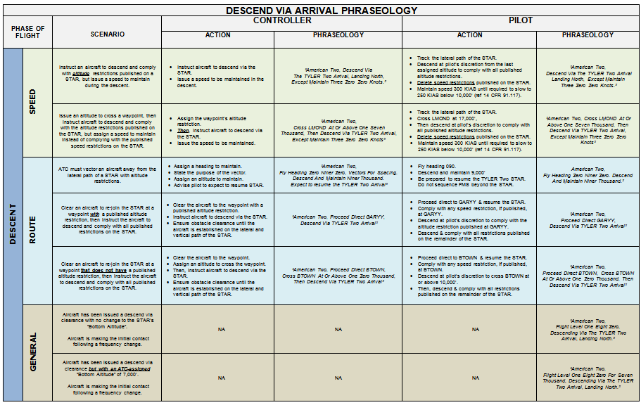
Descend Via – Briefing Card
Download the latest Version From NBAA’s Website
<ESC Exit>

Slide 87
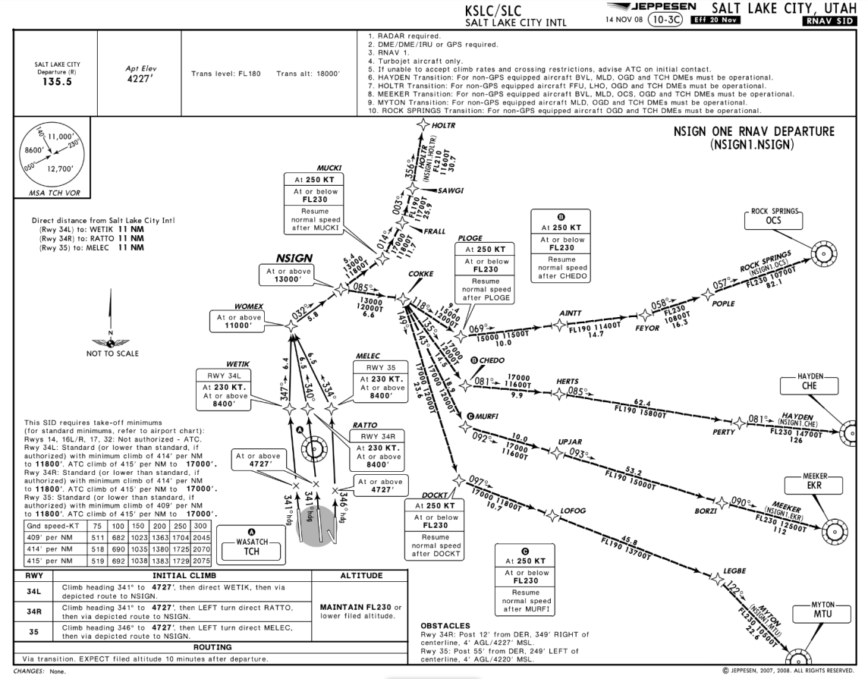
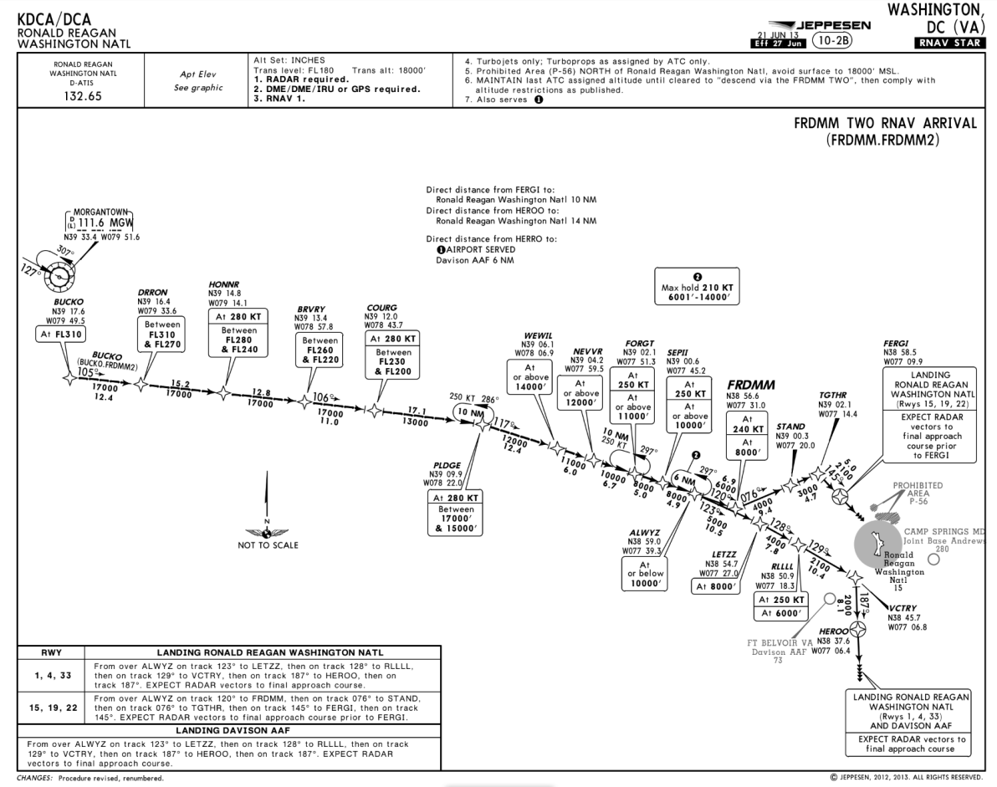
Published Speeds On SIDs & STARs
Speed Adjustments
Unless Otherwise Assigned By ATC, Pilots Must Comply With Published Speed Restrictions Independent Of Any Climb Or Descent Clearance
©Jeppesen, Inc. Not for Navigation Purposes
<ESC Exit>

Slide 88

SID & STAR Published Speed Restrictions
Speed Adjustments
Strict compliance with published speed restrictions is necessary to maintain lateral & longitudinal spacing and to prevent “compression” of the sequential aircraft flow
Where a speed reduction is required, ATC anticipates pilots will begin adjusting speed the minimum distance necessary, commensurate with normal aircraft performance, prior to a published speed restriction so as to cross the waypoint/fix at the published speed
Once at the published speed, ATC expects pilots will maintain the published speed until additional adjustment is required to comply with further published or ATC assigned speed restrictions or as required to ensure compliance with 14 CFR Section 91.117
HYDRR
At 265 KT
Between
17000’ & 15000’
GEELA
At 250 KT
At or Below 16000’
MNSTR
At 250 KT
Between
16000’ & 15000’
HENSN
At 250 KT At 11000’
NIMBY
At 210KT At 7000’
Speed
265 KT
Begin Speed Reduction At The Minimum Distance Necessary Commensurate With Normal Aircraft Performance To Cross GEELA At 250 KT.
LOOSY
At 210KT At 9000’
<ESC Exit>

Slide 89
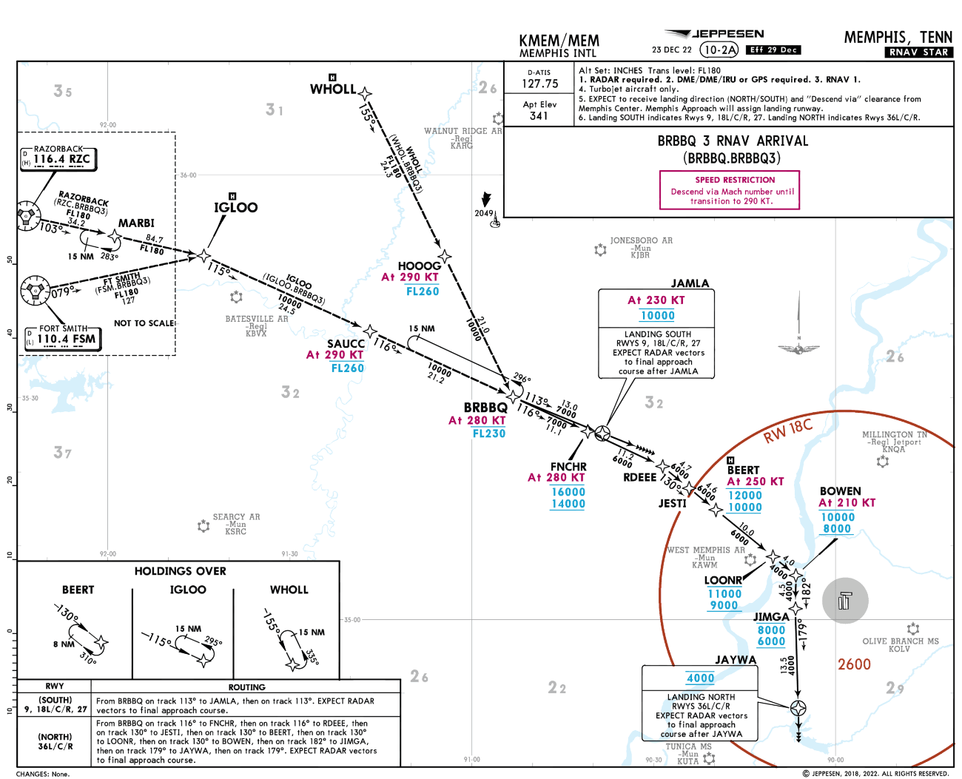
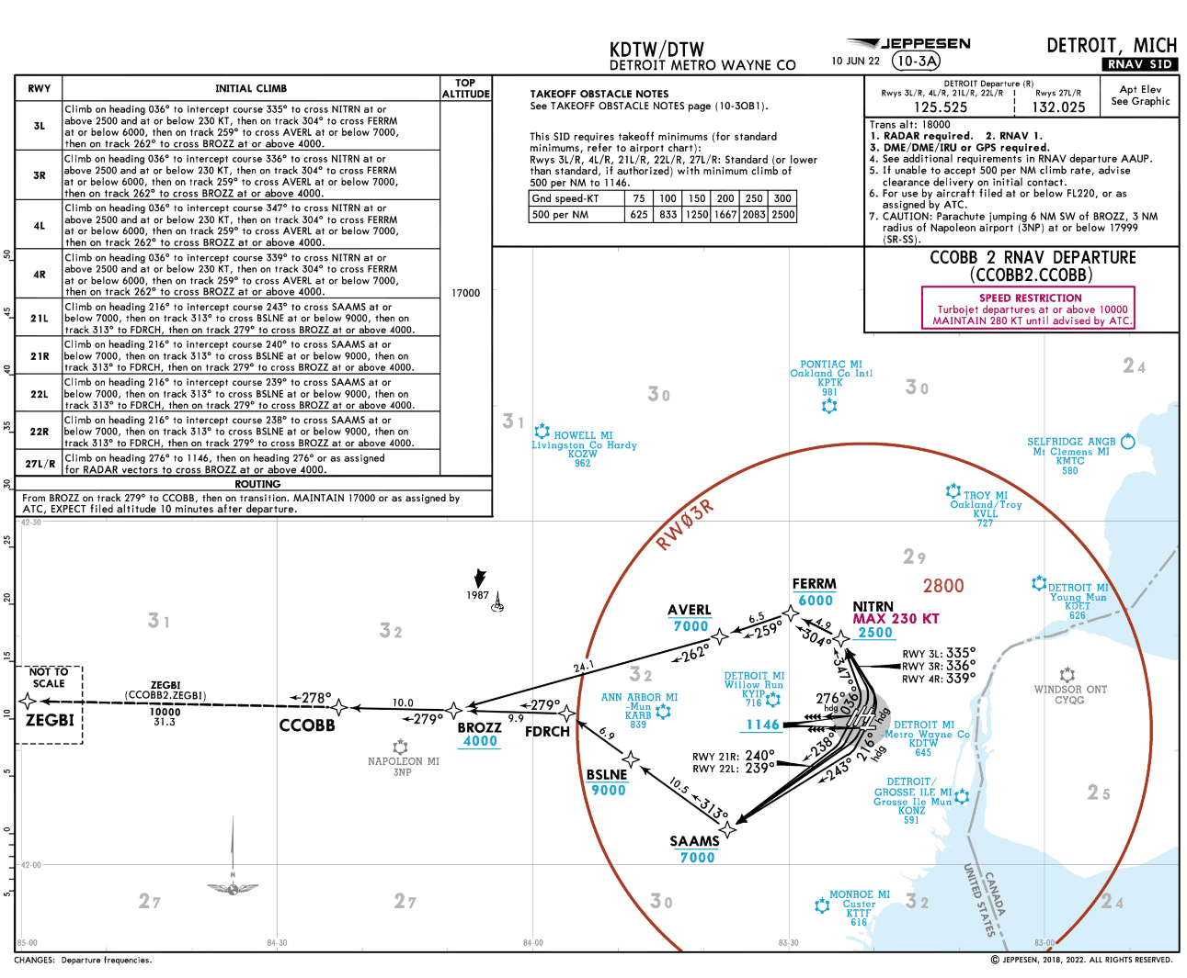

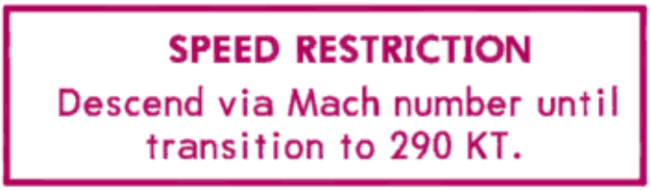
Speed Chart Notes
Speed Adjustments
Speed Restrictions chart notes on SIDs and Mach-to-IAS Speed Transition charts notes on STARs apply only while the aircraft is established on the lateral path of the SID or STAR.
If ATC vectors the aircraft off of the procedure, they must assign a speed to maintain. Otherwise, speed is at the pilot’s discretion.
89
<ESC Exit>

Slide 90
Speed Adjustments
Speed Adjustments
However, ATC may issue speed adjustments to address tactical requirements necessary for the separation & spacing of aircraft
ATC uses the phraseology “Maintain (Speed) Knots” to assign a speed to be maintained:
  “Learjet Four Five Lima Juliet, Maintain Two Five Zero Knots”
It is recommended that pilots provide the ATC-assigned speed on subsequent frequency changes
  (ref: AIM 4-4-12. Speed Adjustments)
ATC-assigned speeds remain in effect until canceled by ATC
When issuing speed adjustments to aircraft cleared on procedures with published speed restrictions, ATC will specify the point at which the issued restriction begins, ends, or changes the published restrictions using the methods described on the following slides to cancel or amend speed assignments

Slide 91
Phraseology
Speed Adjustments
“Climb Via” & “Descend Via”
Absent any qualifying instructions, issuance of a climb or descend via clearance cancels a previously issued ATC speed adjustment and provides pilot discretion to adjust speed while requiring compliance with upcoming restrictions'
ATC may require compliance with previously issued speed adjustments using phraseology such as
  “Proceed To (WP Name), Then Climb/Descend Via...”
  “Maintain (Speed) Until (WP Name), Then Climb/Descend Via...”
  “Cross (WP Name) At (Speed) Then Climb/Descend Via....”
Where there are no upcoming speed restrictions, issuance of a “Proceed Direct (WP Name), Climb/Descend Via ....” cancels a previously issued speed adjustment and authorizes speed at pilot's discretion as appropriate for the phase of flight, ensuring compliance with 14 CFR 91.117
<ESC Exit>

Slide 92



Speed Adjustments
Resume climb & comply with published altitude restrictions to the “Top Altitude” (FL 230)
The last ATC-assigned speed (230 KT) is canceled
Pilot may adjust speed at their discretion in compliance with 14 CFR 91.117, not to exceed the 250 KT speed restriction at DOCKT
©Jeppesen, Inc. Not for Navigation Purposes
ATC Clearance #2:
“Climb Via SID”
ATC Clearance #1:
“Maintain One Three Thousand And Two Three Zero Knots”
<ESC Exit>

Slide 93
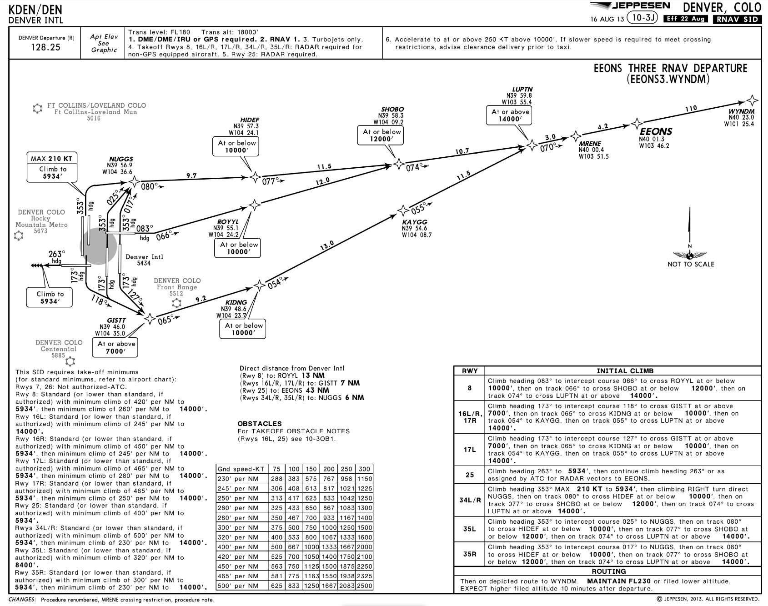
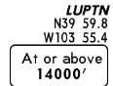
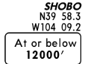

Speed Adjustments
ATC Clearance #2:
“Proceed Direct SHOBO,
Climb Via The EEONS Three Departure”
ATC Clearance #1:
“Fly Heading Three Five Zero, Vectors For Spacing,
Do Not Exceed Two Five Zero Knots,
Expect To Resume The EEONS Three Departure”
Proceed direct to SHOBO & resume EEONS SID
The last ATC-assigned speed (250 KT) is canceled
Pilot may adjust speed at their discretion in compliance with 14 CFR 91.117
Continue climb & comply with published altitude restrictions to the “Top Altitude” (FL 230)

Slide 94

Speed Adjustments
ATC Clearance #2:
“Proceed Direct LENNN,
Climb Via The STAKR Two Departure”
ATC Clearance #1:
“Fly Heading Two Seven Zero, Vectors for Spacing,
Maintain Two Five Zero Knots,
Expect To Resume The STAKR Two Departure”
The last ATC-assigned speed (250 KT) is canceled
Pilot may adjust speed at their discretion in compliance with 14 CFR 91.117
Comply with the 280 KT speed restriction at LENNN
Proceed direct to LENNN & track the lateral path of the STAKR SID
Comply with published altitude & speed restrictions
Climb to the published “Top Altitude” (FL 230)
©Jeppesen, Inc. Not for Navigation Purposes
<ESC Exit>

Slide 95

Speed Adjustments
ATC Clearance #1:
“Maintain Mach 0.75 In The Descent”
ATC Clearance #2:
“Descend Via The BRBBQ One Arrival, Landing North”
The last ATC-assigned speed (0.75M) is canceled
Pilot may adjust their Mach speed at their discretion
Pilot must comply with the charted speed note and transition to 290 KT
Cross SAUCC at 290 KT
Comply with published altitude restrictions to “Bottom Altitude” (4,000’)
Comply with published speed restrictions
Recommended That Pilots Not Make Excessive Speed Variations
Until The Transition Speed Without Advising ATC
©Jeppesen, Inc. Not for Navigation Purposes
<ESC Exit>

Slide 96

Speed Adjustments
©Jeppesen, Inc. Not for Navigation Purposes
ATC Clearance #1:
“Maintain Mach 0.75 In The Descent”
ATC Clearance #2:
“Maintain Three One Zero Knots Until SAUCC,
Cross SAUCC at Flight Level 260,
Then Descend Via The BRBBQ One Arrival, Landing North”
Mach-to-IAS speed transition note is canceled
The 290 KT speed restriction at SAUCC is canceled
Maintain ATC-assigned speed (310 KT) until SAUCC, and then comply with the published speed restrictions beginning at BRBBQ
Cross SAUCC at Flight Level 260, and then comply with published altitude restrictions to “Bottom Altitude” (4,000’)
<ESC Exit>

Slide 97
Speed Adjustments
ATC Clearance #2:
“Maintain Three One Zero Knots Until SAUCC,
Cross SAUCC at Flight Level 260,
Then Descend Via The BRBBQ One Arrival, Landing North”
ATC-Assigned Speed
310 KT Until SAUCC
Speed Restriction at SAUCC is Canceled
Cross SAUCC at FL 260, Then Descend Via the BRBBQ One STAR
SAUCC
At
290 KT
At or below
FL260
MARBI
BRBBQ
At
280 KT
At or below
FL230
FNCHR
IGLOO
At
280 KT
Between
16000’ &
14000’
Begin Speed Reduction At The Minimum Distance Necessary Commensurate With Normal Aircraft Performance To Comply With The Next Published Speed Restriction (BRBBQ At 280 KT)
<ESC Exit>

Slide 98
Speed Adjustments
ATC Clearance #1:
“Maintain Three One Zero Knots”
ATC Clearance #2:
“Cross SAUCC At Two Niner Zero Knots,
Then Descend Via The BRBBQ One Arrival, Landing North”
Maintain ATC-assigned speed (310 KT)
Cross SAUCC at 290 KT, Then…
Comply with published altitude restrictions to “Bottom Altitude” (4,000’)
Comply with published speed restrictions
©Jeppesen, Inc. Not for Navigation Purposes
<ESC Exit>

Slide 99


Speed Adjustments
ATC Clearance:
“Fly Heading Two Seven Zero, Vectors For Weather Over QUENY,
Descend And Maintain One Zero Thousand,
Expect To Resume The EAGUL Five Arrival”
250 KT speed restriction is canceled
Speed is at the pilot’s discretion
Maintain ATC-assigned altitude (10,000’)
Expect to resume EAGUL Five

Slide 100

Speed Adjustments
©Jeppesen, Inc. Not for Navigation Purposes
ATC Clearance:
“Descend Via The EAGUL Five Arrival, Except Maintain Three Zero Zero Knots”
Comply with published altitude restrictions to the “Bottom Altitude” (7,000’)
Maintain 300 KT – Published speed restrictions are canceled
When necessary, reduce to 250 KT below 10,000’ MSL (14 CFR 91.117)
Then maintain 250 KT until advised by ATC

Slide 101

Phraseology
Speed Adjustments
“Resume Normal Speed”
Used to terminate ATC assigned speed adjustments on segments where no published speed restrictions apply
It does not delete speed restrictions on upcoming segments of flight and does not relieve the pilot of those speed restrictions which are applicable to 14 CFR Section 91.117
ATC Clearance:
“Maintain Two Three Zero Knots Until PEVEE, Then Resume Normal Speed”
Maintain 230 KT until PEVEE
Resume normal speed passing PEVEE
Do not exceed 250 KT until above 10,000’
©Jeppesen, Inc. Not for Navigation Purposes
<ESC Exit>

Slide 102
Phraseology
Speed Adjustments
“Resume Published Speed”
Used by ATC to terminate a speed adjustment where speed restrictions are published on a charted procedure
ATC Clearance #1:
“Descend Via The GEELA Six Arrival,
Except Maintain Three One Zero Knots or Greater”
ATC Clearance #2:
“After HYDRR, Resume Published Speeds”
©Jeppesen, Inc. Not for Navigation Purposes

Slide 103

Complying With Speed Restrictions
Speed Adjustments
When instructed to “resume published speed,” ATC anticipates pilots will begin adjusting speed the minimum distance necessary prior to a published speed restriction so as to cross the waypoint/fix at the published speed
Once at the published speed, ATC expects pilots will maintain the published speed until additional adjustment is required to comply with further published or ATC assigned speed restrictions or as required to ensure compliance with 14 CFR Section 91.117
HYDRR
ATC Clearance:
“After HYDRR, Resume Published Speeds”
At 265 KT
Between
17000’ & 15000’
GEELA
MNSTR
At 250 KT
At or Below 16000’
At 250 KT
Between
16000’ & 15000’
HENSN
ATC-Assigned Speed
310 KT or Greater
At 250 KT At 11000’
NIMBY
At 210KT At 7000’
Begin Speed Reduction At The Minimum Distance Necessary Commensurate With Normal Aircraft Performance To Cross GEELA At 250 KT
LOOSY
At 210KT At 9000’
<ESC Exit>

Slide 104
Phraseology
Speed Adjustments
“Delete Speed Restrictions”
ATC will advise the pilot to “Delete Speed Restrictions” when either ATC assigned or published speed restrictions on a charted procedure are no longer required
When deleting published restrictions, ATC must ensure obstacle clearance until aircraft are established on a route where no published restrictions apply
This does not relieve the pilot of those speed restrictions which are applicable to 14 CFR Section 91.117
<ESC Exit>

Slide 105



Speed Adjustments
Initial IFR Clearance:
“Cleared…STAAV Four Departure, Dove Creek Transition, Climb Via SID…”
Delete all speed restrictions on STAAV SID
Do not exceed 250 KT until above 10,000’ (14 CFR 91.117)
Comply with all published altitude restrictions
Climb to the published “Top Altitude” (FL 190)
When Deleting Published Restrictions, ATC Must Ensure Obstacle Clearance Until The Aircraft Is Established On A Route Where No Published Restrictions Apply
After Takeoff - ATC Clearance:
“Delete Speed Restrictions”
<ESC Exit>

Slide 106
ICAO
ICAO & Canada
Previous Standard
Procedures for Air Navigation Services (PANS) – Air Traffic Management (ATM) Document 4444 is the ICAO Standard & Recommended Practices (SARP) for air traffic control
Until recently, PANS-ATM 4444 required compliance with published altitude and speed restrictions on SIDs and STARs when the aircraft was cleared to climb or descend on the departure or arrival:
  SIDs:
  When a departing aircraft on a SID is cleared to climb to a level higher than the initially cleared level or the level(s) specified in a SID, the aircraft shall follow the published vertical profile of a SID, unless such restrictions are explicitly cancelled by ATC
  STARs:
  When an arriving aircraft on a STAR is cleared to descend to a level lower than the level or the level(s) specified in a STAR, the aircraft shall follow the published vertical profile of a STAR, unless such restrictions are explicitly cancelled by ATC. Published minimum levels based on terrain clearance shall always be applied.
<ESC Exit>

Slide 107
ICAO Climb Via SID & Descend Via STAR
ICAO & Canada
Effective 10 November 2016 Revision To PANS-ATM 4444
SID/STAR phraseology allows ATC and aircrew to communicate and understand detailed clearance information that would otherwise require long and potentially complex transmissions.
Over time, these benefits have been eroded through the development of non-harmonized practices and different meanings being attached to certain elements of SID/STAR phraseology.
Consequently, there may be a mismatch between ATC and aircrew expectations when SID/STAR phraseology is used, and what certain terms may mean. This presents a safety risk that requires a renewed effort to adopt harmonized SID/STAR phraseology
<ESC Exit>

Slide 108


ICAO Core Phraseology
ICAO & Canada
Effective 10 November 2016
<ESC Exit>

Slide 109


ICAO Core Phraseology
ICAO & Canada
Effective 10 November 2016
<ESC Exit>

Slide 110
What Has Not Changed
ICAO & Canada
Use of CANCEL SPEED RESTRICTION applies only to the speed restrictions associated with the SID or STAR procedure. It does not cancel other speed restrictions such as the speed limits detailed at ICAO Annex 11 Chapter 2 and Appendix 4
The requirement for a QNH altimeter setting to be included in the descent clearance when first cleared to an altitude below the transition level, except when it is known that the aircraft has already received the information (PANS-ATM 4.10.4.5 refers), does not change.
The terrain clearance responsibilities prescribed in ICAO Doc 4444 (PANS-ATM) 8.6.5.2 do not change
And finally, while pilots and ATS providers are expected to comply with the revised phraseology, in unusual or unforeseen circumstances it may not be possible to apply the phraseology as intended. Should this happen, pilots and ATS personnel are still expected to use plain language, which must be as clear and concise as possible.
<ESC Exit>

Slide 111
ICAO Climb Via SID & Descend Via STAR
ICAO & Canada
The Purposes Of This Change
Provide core phraseology that positively reinforces that the lateral, vertical and speed requirements embedded in a SID or STAR will continue to apply, unless explicitly cancelled or amended by the controller;
Provide supplementary phraseology that enables any level and/or speed restrictions as local circumstances, practice or procedures permit;
Harmonize through appropriate phraseology the means by which aircraft must be cleared where variations to the lateral profile are required, such as where waypoints along the procedure are bypassed.
<ESC Exit>

Slide 112

Global State Of Implementation
Global adoption
Several States have already implemented
Additional States will follow in 2017
Click For ICAO Climb Via/Descend Via Webpage

Slide 113
ICAO Climb Via SID & Descend Via STAR
ICAO & Canada
Pilots Take Note…
The use of a SID designator in a clearance without a cleared level does not authorize the aircraft to climb on the SID vertical profile
The use of a STAR designator in a clearance without a cleared level does not authorize the aircraft to descend on the STAR vertical profile
Pilots must receive a “Climb Via SID” or “Descend Via STAR” clearance to climb/descend on the SID/STAR vertical profile
<ESC Exit>

Slide 114

Pilot Readback
ICAO & Canada
“Climb Via SID” or “Descend Via STAR”
Controllers must get a readback if specifying “Climb Via SID” or “Descend Via STAR.”
Readback of “Via STAR” or “Via SID” may result in a different flight path than a “Descend To” or “Climb To” clearance
<ESC Exit>

Slide 115
ICAO Climb Via SID & Descend Via STAR
Briefing Topics
ICAO Climb Via SID
ICAO Descend Via STAR
Additional Information & Differences
Briefings topics provide scenarios and significant differences between FAA, ICAO, and Canada Climb Via/Descend Via clearances
Please click on the above picture to access the program pertaining to “Climb Via SID”, “Descend Via STAR”, or Additional Information. Within each briefing, you will have the option to return to this menu.
Exit Program

Slide 116

Return To Briefing Topic Main Menu

Slide 117

ICAO Climb Via SID
ICAO & Canada
“Clearances to aircraft on a SID with remaining published level and/or speed restrictions shall indicate if such restrictions are to be followed or are cancelled.”
The Use Of A SID Designator Without A Cleared Level Does Not Authorize The Aircraft To Climb On The SID Vertical Profile
<ESC Exit>

Slide 118


ICAO Climb Via SID
ICAO & Canada
Initial IFR Clearance – On Ground
Standard clearances for departing aircraft shall contain the following items:
Aircraft identification;
Clearance limit, normally destination aerodrome;
Designator of the assigned SID, if applicable;
Cleared level;
Allocated SSR code;
Any other necessary instructions or information not contained in the SID description, (e.g. instructions relating to change of frequency)
<ESC Exit>

Slide 119
ICAO Climb Via SID
ICAO & Canada
SID With Altitude Restrictions
SID Without Altitude Restrictions
Initial ATC Clearance:
“FASTAIR 345 CLEARED TO XXX, (SID NAME) DEPARTURE FLIGHT PLANNED ROUTE, CLIMB VIA SID [TO] (ALTITUDE),DEPART RUNWAY TWO-SEVEN, SQUAWK (CODE), WHEN AIRBORNE CONTACT DEPARTURE ON 128.17”
Initial ATC Clearance:
“FASTAIR 345 CLEARED TO XXX, (SID NAME) DEPARTURE FLIGHT PLANNED ROUTE CLIMB [TO] (ALTITUDE), DEPART RUNWAY TWO-SEVEN, SQUAWK (CODE), WHEN AIRBORNE CONTACT DEPARTURE ON 128.17”
<ESC Exit>

Slide 120
FAA – ICAO Differences
ICAO & Canada
FAA
ICAO
Altitude is not issued if “Top Altitude” is published on the SID and pilot is expected to climb to the published “Top Altitude”
  “Climb Via CONNR Three departure”
ATC will issue an altitude with the Climb Via clearance only when necessary to issue a different “Top Altitude”
  “Climb Via CONNR Three departure except maintain one zero thousand”
Cleared “level” is always included with a Climb Via clearance
“Top Altitude” concept is not used
“VIA” will no longer be used to describe the lateral route clearance
  FASTAIR 1234, cleared to the Heathrow airport via…
  Avoid confusion with “Climb Via SID” clearance
<ESC Exit>

Slide 121

ICAO Climb Via SID
ICAO & Canada
Airborne - Climb On A SID With Charted Restrictions
CLIMB VIA SID TO (level):
Climb to the cleared level and comply with published level restrictions
Follow the lateral profile of the SID
Comply with published speed restrictions or ATC-issued speed control instructions as applicable
<ESC Exit>

Slide 122

ICAO & Canada
<ESC Exit>

Slide 123
FAA – ICAO Differences
ICAO & Canada
FAA
ICAO
Altitude is not issued if “Top Altitude” is published on the SID and pilot is expected to climb to the published “Top Altitude”
  “Climb Via CONNR Three departure”
ATC will issue an altitude with the Climb Via clearance only when necessary to issue a different “Top Altitude”
  “Climb Via CONNR Three departure except maintain one zero thousand”
Cleared “level” is always included with a Climb Via clearance
“Top Altitude” concept is not used
<ESC Exit>

Slide 124
ICAO Climb Via SID
ICAO & Canada
Tactical Cancellation Of A Speed Restriction
CLIMB VIA SID TO (level), CANCEL SPEED RESTRICTION(S) AT (point(s)):
Climb to the cleared level and comply with published level restrictions
Follow the lateral profile of the SID
Published speed restrictions are cancelled at the specified point(s).
<ESC Exit>

Slide 125

ICAO & Canada
<ESC Exit>

Slide 126
FAA – ICAO Differences
ICAO & Canada
FAA
ICAO
Uses “Climb Via, Except” to delete a published speed restriction at a fix.
  Climb via LEETZ Five departure, except delete speed restriction at HUCKK”
Cleared “level” is always included with a Climb Via clearance
ICAO uses “CANCEL” vs. “DELETE”
ICAO uses “AT (point)” to designate the fix where the speed restriction is canceled
<ESC Exit>

Slide 127
ICAO Climb Via SID
ICAO & Canada
Tactical Cancellation Of A Level Restriction
CLIMB VIA SID TO (level), CANCEL LEVEL RESTRICTION(S) AT (point(s)):
Climb to the cleared level, published level restriction(s) at the specified point(s) are cancelled
Follow the lateral profile of the SID
Comply with published speed restrictions or ATC-issued speed control instructions as applicable
<ESC Exit>

Slide 128

ICAO & Canada
<ESC Exit>

Slide 129
FAA – ICAO Differences
ICAO & Canada
FAA
ICAO
Uses “Climb Via, Except” to delete a published altitude restriction at a fix.
  Climb via LEETZ Five departure, except delete altitude restriction at ZEETA”
Cleared “level” is always included with a Climb Via clearance
ICAO uses “CANCEL” vs. “DELETE”
ICAO uses “AT (point)” to designate the fix where the level restriction is canceled
<ESC Exit>

Slide 130
ICAO Climb Via SID
ICAO & Canada
Cancellation of all restrictions below the cleared level
CLIMB UNRESTRICTED TO (level) or
CLIMB TO (level), CANCEL LEVEL AND SPEED RESTRICTION(S):
Climb to the cleared level, published level restrictions are cancelled
Follow the lateral profile of the SID
Published speed restrictions and ATC-issued speed control instructions are cancelled
<ESC Exit>

Slide 131


ICAO & Canada
<ESC Exit>

Slide 132
FAA – ICAO Differences
ICAO & Canada
FAA
ICAO
“Climb And Maintain” clearance, pilot is expected to vacate current altitude and commence an unrestricted climb to comply with the clearance. For aircraft already climbing via a SID, published altitude restrictions are deleted unless reissued by ATC. Pilots must comply with published speed restrictions
“Delete Speed Restrictions” cancels ATC assigned or published speed restrictions
FAA equivalent clearance: “Climb and maintain six thousand, delete speed restrictions”
Two separate options for phraseology:
  CLIMB UNRESTRICTED TO (level) or
  CLIMB TO (level), CANCEL LEVEL AND SPEED RESTRICTION(S)
Cancels both published level and published/ATC-assigned speed restrictions
Cleared “level” is always included with a Climb Via clearance
<ESC Exit>

Slide 133
ICAO Climb Via SID
ICAO & Canada
Climb To <Level>
When no charted restrictions exist, or when there are no other remaining published restrictions, nor remaining level or speed restrictions on the SID, the phrase “CLIMB TO (Level)” or should be used
<ESC Exit>

Slide 134
ICAO Climb Via SID
ICAO & Canada
Proceeding direct to a point on SID
When a departing aircraft is cleared to proceed direct to a published waypoint on the SID, the speed and level restrictions associated with the bypassed waypoints are cancelled. All remaining published speed and level restrictions shall remain applicable.
<ESC Exit>

Slide 135

ICAO & Canada
<ESC Exit>

Slide 136
FAA – ICAO Differences
ICAO & Canada
FAA
ICAO
If the fix has a published altitude restriction:
  “Proceed direct DVINE, climb via the Suzan Two departure.”
  Comply with published restriction at DIVNE
If the fix does not have a published altitude restriction, ATC will assign an altitude to cross the fix:
  “Proceed direct ROCKR, cross ROCKR at or above one-zero thousand, climb via the BIZEE Two departure.”
“Top Altitude” is not stated unless changed by ATC:
  “Proceed direct ROCKR, cross ROCKR at or above one-zero thousand, climb via the BIZEE Two departure, except maintain flight level two three zero”
Uses “Climb Via SID”. Will not include procedure by name
Cleared “level” is always included with a Climb Via clearance
<ESC Exit>

Slide 137
ICAO Climb Via SID
ICAO & Canada
Vector flight off a SID
When a departing aircraft is vectored or cleared to proceed to a point that is not on the SID, all the published speed and level restrictions of the SID are cancelled and the controller shall:
Reiterate the cleared level
Provide speed and level restrictions as necessary
Notify the pilot if it is expected that the aircraft will be instructed to subsequently rejoin the SID
<ESC Exit>

Slide 138

ICAO & Canada
<ESC Exit>

Slide 139
FAA – ICAO Differences
ICAO & Canada
FAA
ICAO
Phraseology:
  “Lear four five lima juliet, fly heading zero-two-zero, maintain one two thousand, expect to resume the LEETZ Four departure”
  “Lear four five lima juliet, deviations left of course approved , maintain one two thousand, expect to resume the LEETZ Four departure at LEETZ”
ICAO phraseology “EXPECT TO REJOIN SID”
Omits the SID procedure name
<ESC Exit>

Slide 140
ICAO Climb Via SID
ICAO & Canada
SID Rejoin Instructions
ATC instructions to an aircraft to rejoin a SID shall include:
The designator of the SID to be rejoined unless advance notification of rejoin has been provided
The cleared level
The position at which it is expected to rejoin the SID
<ESC Exit>

Slide 141

ICAO & Canada
<ESC Exit>

Slide 142


ICAO & Canada
<ESC Exit>

Slide 143

ICAO & Canada
<ESC Exit>

Slide 144

ICAO & Canada
<ESC Exit>

Slide 145
FAA – ICAO Differences
ICAO & Canada
FAA
ICAO
FAA does not use “Rejoin” or “Resume” phraseology in conjunction with a “Climb Via…” clearance.
“Climb Via” is a clearance to rejoin the SID’s lateral path.
An altitude will not be issued unless it is necessary to change the “Top Altitude”:
  “Proceed direct ROCKR, cross ROCKR at or above one-zero thousand, climb via the BIZEE Two departure, except maintain flight level two three zero”
Both “Rejoin SID” & Climb Via SID” used in the clearance
If aircraft was not told to expect to rejoin SID, name of the procedure will be included in the clearance:
  “Proceed Direct PIMOK, Rejoin KODAP 1A Departure, Climb Via SID To FL 120”
If aircraft was told to expect to rejoin, procedure name is excluded:
  “Proceed Direct PIMOK Rejoin SID, Climb Via SID To FL 120”
A level will always be issued with the ”Climb Via SID” clearance
<ESC Exit>

Slide 146

ICAO Descend Via STAR
ICAO & Canada
“Clearances to aircraft on a STAR with remaining published level and/or speed restrictions shall indicate if such restrictions are to be followed or are cancelled. The following phraseologies shall be used with the following meaning.”
<ESC Exit>

Slide 147
ICAO Descend Via STAR
ICAO & Canada
Descent Via A STAR With Charted Restrictions
DESCEND VIA STAR TO (level):
Descend to the cleared level and comply with published level restrictions
Follow the lateral profile of the STAR
Comply with published speed restrictions or ATC-issued speed control instructions as applicable
“Descend Via STAR To (Level)” Is NOT A Pilot’s Discretion Descent. Pilots Must Commence Descent Upon Receipt of Clearance.
<ESC Exit>

Slide 148

ICAO & Canada
<ESC Exit>

Slide 149
FAA – ICAO Differences
ICAO & Canada
FAA
ICAO
“Descend Via” authorizes the pilot to descend at pilot’s discretion to meet published restrictions and laterally navigate on a STAR
“Descend Via” includes the name of the arrival
“Bottom Altitude” is not provided in the “Descend Via” clearance unless ATC assigns a new “Bottom Altitude”
Cleared level is always assigned in the “Descend Via STAR” clearance
Procedure name is not included in the clearance
“Descend Via STAR” is not a pilot’s discretion descent clearance. Pilot’s must begin descent and vacate previously assigned altitude upon acknowledgment of the clearance
  EXCEPTION CANADA – Canada is harmonizing with FAA’s application of “Descend Via STAR”
<ESC Exit>

Slide 150
ICAO Descend Via STAR
ICAO & Canada
Descent Via A STAR With Charted Restrictions
WHEN READY DESCEND VIA STAR TO (level):
Descend to the cleared level and comply with published level restrictions
Follow the lateral profile of the STAR
Comply with published speed restrictions or ATC-issued speed control instructions as applicable
The Addition of “When Ready” To The Descend Via STAR Clearance Authorizes A Descent At Pilot’s Discretion
<ESC Exit>

Slide 151


ICAO & Canada
<ESC Exit>

Slide 152
ICAO Descend Via STAR
ICAO & Canada
Tactical Cancellation Of A Speed Restriction
DESCEND VIA STAR TO (level), CANCEL SPEED RESTRICTION(S) AT (point(s)):
Descend to the cleared level and comply with published level restrictions
Follow the lateral profile of the STAR
Published speed restrictions are cancelled at the specified point(s)
<ESC Exit>

Slide 153

ICAO & Canada
<ESC Exit>

Slide 154
FAA – ICAO Differences
ICAO & Canada
FAA
ICAO
FAA uses “Delete Speed Restriction at <waypoint>” to deleted a speed restriction at a single waypoint
When either ATC assigned speed adjustments or published speed restrictions are no longer required, ATC will state “Delete Speed Restrictions”, which deletes all published & ATC-assigned speed restrictions
Uses “Cancel” instead of “Delete”
<ESC Exit>

Slide 155
ICAO Descend Via STAR
ICAO & Canada
Tactical Cancellation Of A Level Restriction
DESCEND VIA STAR TO (level), CANCEL LEVEL RESTRICTION(S) AT (point(s)):
Descend to the cleared level, published level restriction(s) at the specified point(s) are cancelled;
Follow the lateral profile of the STAR; and
Comply with published speed restrictions or ATC-issued speed control instructions as applicable
<ESC Exit>

Slide 156

ICAO & Canada
<ESC Exit>

Slide 157
FAA – ICAO Differences
ICAO & Canada
FAA
ICAO
FAA uses “Delete Altitude Restriction at <waypoint>”
ATC will restate “Descend Via” and then use “except” or “except maintain” phraseology to modify published restrictions or assign a new bottom altitude
If altitude restrictions are no longer applicable, the controller issues an amended clearance as follows “Descend and maintain one four thousand”
Uses “Cancel” instead of “Delete”
<ESC Exit>

Slide 158
ICAO Descend Via STAR
ICAO & Canada
Cancellation Of All Restrictions Above The Cleared Level
DESCEND UNRESTRICTED TO (level) or DESCEND TO (level), CANCEL LEVEL AND SPEED RESTRICTION(S):
Descend to the cleared level, published level restrictions are cancelled
Follow the lateral profile of the STAR
Published speed restrictions and ATC-issued speed control instructions are cancelled
<ESC Exit>

Slide 159

ICAO & Canada
<ESC Exit>

Slide 160
FAA – ICAO Differences
ICAO & Canada
FAA
ICAO
“Descend And Maintain” clearance, pilot is expected to vacate current altitude and commence an unrestricted descent to comply with the clearance. For aircraft already descending via a STAR, published altitude restrictions are deleted unless reissued by ATC. Pilots must comply with published speed restrictions
“Delete Speed Restrictions” cancels ATC assigned or published speed restrictions
FAA equivalent clearance: “Descend and maintain six thousand, delete speed restrictions”
Two separate options for phraseology:
  DESCEND UNRESTRICTED TO (level) or
  DESCEND TO (level), CANCEL LEVEL AND SPEED RESTRICTION(S)
Clearance cancels both published altitude restrictions and published/ATC-assigned speed restrictions
<ESC Exit>

Slide 161
ICAO Descend Via STAR
ICAO & Canada
Descend To <Level>
When no charted restrictions exist, or when there are no other remaining published restrictions, nor remaining level or speed restrictions on the STAR, the phrase or “DESCEND TO (Level)” should be used
<ESC Exit>

Slide 162
ICAO Descend Via STAR
ICAO & Canada
Proceeding Direct To A Point On STAR
When an arriving aircraft is cleared to proceed direct to a published waypoint on the STAR, the speed and level restrictions associated with the bypassed waypoints are cancelled. All remaining published speed and level restrictions shall remain applicable
<ESC Exit>

Slide 163

ICAO & Canada
<ESC Exit>

Slide 164
FAA – ICAO Differences
ICAO & Canada
FAA
ICAO
FAA uses the STAR arrival name
An altitude is not included in the “Descend Via” clearance unless the “Bottom Altitude” is changed by ATC
An altitude will be assigned to cross the fix that the aircraft is cleared direct to if no altitude restriction is published at the fix:
  “Proceed direct Denis, cross Denis at or above flight level two zero zero, then descend via the MMELL One arrival.”
Cleared level is always assigned in the “Descend Via STAR” clearance
<ESC Exit>

Slide 165
ICAO Descend Via STAR
ICAO & Canada
Vector Flight Off A STAR
When an arriving aircraft is vectored or cleared to proceed to a point that is not on the STAR, all the published speed and level restrictions of the STAR are cancelled and the controller shall:
Reiterate the cleared level
Provide speed and level restrictions as necessary
Notify the pilot if it is expected that the aircraft will be instructed to subsequently rejoin the STAR
<ESC Exit>

Slide 166

ICAO & Canada
<ESC Exit>

Slide 167
FAA – ICAO Differences
ICAO & Canada
FAA
ICAO
FAA states the procedure by name:
  “Gulfstream one echo mike, fly heading one eight zero, descend and maintain one two thousand, expect to resume the DYAMD Three arrival”
  “Gulfstream one echo mike, deviations left of course approved, descend and maintain one two thousand, expect to resume the DYAMD Three arrival”
ICAO phraseology “EXPECT TO REJOIN STAR”
STAR <Name> is not used
<ESC Exit>

Slide 168
ICAO Descend Via STAR
ICAO & Canada
STAR Rejoin Instruction
ATC instructions to an aircraft to rejoin a STAR shall include:
The designator of the STAR to be rejoined, unless advance notification of rejoin has been provided
The cleared level on rejoining the STAR
The position at which it is expected to rejoin the STAR.
<ESC Exit>

Slide 169

ICAO & Canada
<ESC Exit>

Slide 170


ICAO & Canada
<ESC Exit>

Slide 171

ICAO & Canada
<ESC Exit>

Slide 172


ICAO & Canada
<ESC Exit>

Slide 173
FAA – ICAO Differences
ICAO & Canada
FAA
ICAO
FAA does not use “Rejoin” or “Resume” phraseology in conjunction with a “Descend Via” clearance.
A “Descend Via” authorizes the aircraft to rejoin the STAR’s lateral path.
An altitude will not be issued unless it is necessary to change the “Bottom Altitude”:
  “Proceed direct DENIS, cross DENIS at or above flight level two zero zero, then descend via the MMELL One arrival”
Both “Rejoin STAR” & Descend Via STAR” used in the clearance
If aircraft was not told to expect to rejoin STAR, name of the procedure will be included in the clearance:
  “FASTAIR 345 proceed direct FRANC rejoin DELTA 1b arrival descend via STAR to 2 000 feet”
If aircraft was told to expect to rejoin, procedure name is excluded:
  “FASTAIR 345 proceed direct FRANC rejoin STAR descend via star to 2 000 feet”
A level will always be issued with the ”Descend Via STAR” clearance
<ESC Exit>

Slide 174
ICAO
Use of “Via” Phraseology
To avoid potential confusion, “Via” will only be used in conjunction with a “Climb Via SID” or “Descend Via STAR” clearance
The word “Via” will not be used in any other context for airborne clearance
The word VIA will no longer be used in conjunction with the route. For example, controllers will no longer say:
“Cleared To The London Heathrow Airport Via …”
The word “VIA” will still appear in Controller-Pilot Data Link Communications (CPDLC) messages, however, it is not use it in Direct Controller Pilot Communication (DCPC).

Slide 175
FAA vs. ICAO
ICAO & Canada
ATC-Assigned Speeds – Significant Difference
ICAO:
  ICAO PANS-ATM 4.6.1.2 Speed control instructions shall remain in effect unless explicitly cancelled or amended by the controller.
  “Climb Via SID” or “Descend Via STAR” does not cancel a previously issued ATC-assigned speed restriction:
FAA:
  “Climb Via SID” or “Descend Via <name> arrival” deletes any previously issued ATC-assigned speed restriction. Published speeds now apply
<ESC Exit>

Slide 176
FAA vs. Canada
ICAO & Canada
ATC-Assigned Speeds
Canada Examples:
  A controller applies a speed reduction to 230K. or less, and then subsequently clears an arrival “VIA STAR.” If the first speed restriction on the STAR is 250K at a fix, the 230K ATC speed restriction still applies.
Or…
  A controller applies a speed restriction to maintain 300K, and then subsequently clears an arrival “VIA STAR.” If the first speed restriction on the STAR is 250K at a fix, the 300K ATC speed restriction still applies until CARs supersedes this speed assignment.
In Canada, pilots should inform ATC when they start to reduce speed to conform to the Canadian Aviation Regulations (CARs)
<ESC Exit>

Slide 177
FAA vs. Canada Only
ICAO & Canada
“Resume Normal Speed”
Canada:
  To cancel an ATC-assigned speed restriction, ATC will inform the pilot to “Resume Normal Speed”.
  This will ensure that upcoming speed restrictions on the SID/STAR will be adhered to. When applicable, normal speed implies “published” speeds.
  SID/STAR published speeds apply after “Resume Normal Speed”
FAA:
  Cancels ATC issued speed restrictions and instructs pilot to return to normal aircraft speed where no restrictions are published. This does not relieve the pilot of those speed restrictions which are applicable to 14 CFR Section 91.117.
<ESC Exit>

Slide 178
FAA vs. ICAO
ICAO & Canada
Additional Differences
Initial Contact Phraseology
ICAO:
  Pilots must provide the phrase “Climb Via SID” or “Descend Via STAR” and the cleared level on initial contact
FAA:
  Pilots must only provide the cleared altitude/flight level when any ATC-assigned restrictions are not published on the procedure
  If ATC does not assign an altitude with a “Climb Via” or “Descend Via” clearance, the assigned level is not used on initial contact
<ESC Exit>

Slide 179
ICAO vs. FAA
ICAO & Canada
Additional Differences
ICAO:
  Climb Via SID and Descend Via STAR are not “when ready” or “at pilot’s discretion” instructions
  Pilots must vacate previously assigned altitudes and climb/descend to meet the next published restriction
FAA
  Climb Via and Descend Via are “pilot’s discretion” clearances
  Pilots may begin climb/descend at their discretion
<ESC Exit>

Slide 180

Off Published Routes
ICAO & Canada
PANS-ATM 4444
<ESC Exit>

Slide 181
DEDICATED TO THE HELPING BUSINESS ACHIEVE ITS HIGHEST GOALS

